Slide 1


Manual on Uniform Traffic Control Devices for Streets and Highways
An Overview of Changes in the 11th Edition
As published in the December 2023
Notice of Final Rule
Prepared by the
Federal Highway Administration’s
Office of Operations
Traffic Control Devices Program
Notes:
Welcome to the Manual on Uniform Traffic Control Devices for Streets and Highways—the MUTCD 11th Edition.
This series provides an overview of the significant changes in the MUTCD and was prepared by the FHWA’s Office of Operations Traffic Control Devices team. Each module address the changes in a specific area of the MUTCD.
Additional modules on the MUTCD 11th Edition are available at the MUTCD Web Site at http://mutcd.fhwa.dot.gov/. The series includes the following modules:
Part 1
Part 2:
Chapter 2A
Chapter 2B
Chapter 2C
Chapter 2D
Chapter 2E
Chapter 2F
Chapter 2G
Chapters 2H and 2I
Chapters 2J and 2K
Chapter 2L
Chapters 2M and 2N
Part 3
Part 4
Part 5
Part 6
Part 7
Part 8
Part 9

Slide 2
Disclaimers
Except for the statutes and regulations cited, the contents of this presentation do not have the force and effect of law and are not meant to bind the States or the public in any way. This presentation is intended only to provide information regarding existing requirements under the law or agency policies.
The Federal Highway Administration (FHWA) is the source of all images in this presentation unless otherwise indicated.
Notes:
(Disclaimer) Except for the statutes and regulations cited, the contents of this presentation do not have the force and effect of law and are not meant to bind the States or the public in any way. This presentation is intended only to provide information regarding existing requirements under the law or agency policies.
FHWA is the source of all images in this presentation unless otherwise indicated.

Slide 3
Introduction and Background
Manual on
Uniform Traffic Control Devices
for Streets and Highways
Introduction
and Background
the MUTCD 11th Edition
As published in the December 2023
Notice of Final Rule
Notes:
The remainder of this presentation will focus on the significant changes to the MUTCD.

Slide 4
Development of the 11th Edition of the
Manual on Uniform Traffic Control Devices for Streets and Highways (MUTCD)
Published Notice of Proposed Amendments in the
Federal Register December 14, 2020
Comment period and public docket closed May 14, 2021
Received more than 17,000 submissions to docket containing over 100,000 individual comments
Published Final Rule in the Federal Register December 19, 2023
Final Rule became effective January 18, 2024
Notes:
Three years elapsed between the publication of the Notice of Proposed Amendments soliciting public comment, and the Final Rule issuing the 11th Edition of the MUTCD. One of the primary factors that affected the duration of this rulemaking was the volume of comments submitted to the public docket – more than one hundred thousand. Every comment was analyzed, and a determination made as to how to resolve the comment. In addition to public comment, a new law was enacted during the rulemaking that affected the MUTCD. Thus, FHWA needed to ensure that any additional considerations were adequately addressed.
The Final Rule was published in the Federal Register on December 19, 2023, and became effective 30 days later on January 18, 2024.

Slide 5
Key Themes of the MUTCD 11th Edition
Safety for all road users, including protection of vulnerable road users
Improved mobility for pedestrians with disabilities
Addition of successful new technologies and applications
Readiness for connected and automated vehicles
Increased flexibility for jurisdictions
Improved organization of content
Notes:
Broadly speaking, there are 6 themes that are prevalent in the changes adopted in the 11th Edition of the MUTCD.
These themes are:
protection of vulnerable road users;
improved mobility for pedestrians with disabilities;
addition of successful new technology and applications;
readiness for connected and automated vehicles;
increased flexibility for jurisdictions; and
improved organization of content.

Slide 6
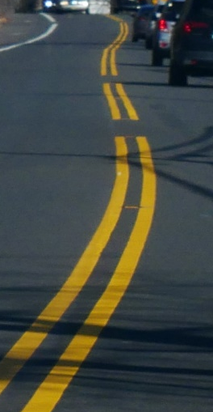
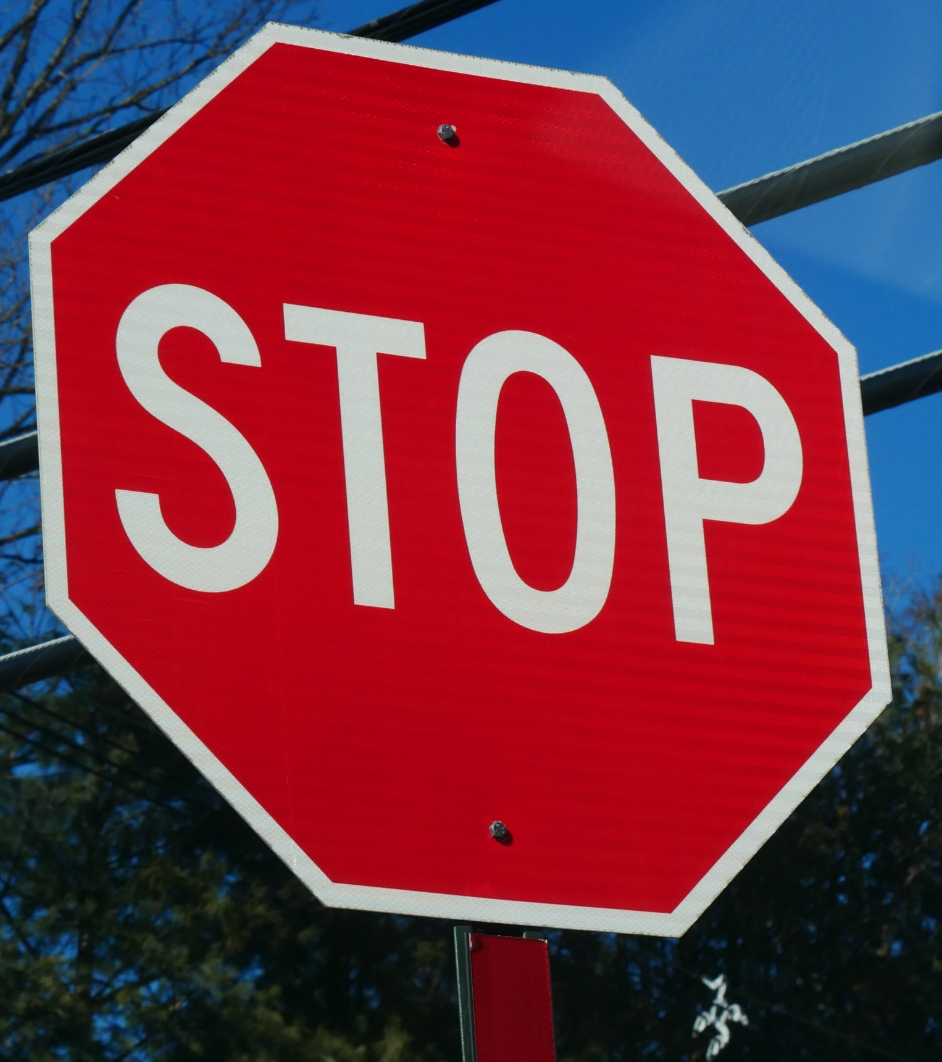
General Principles of the MUTCD
It is a human-centered standard:
  Traffic control devices are designed to communicate with the road user—safely, efficiently
  Devices and applications are designed to accommodate behaviors, expectancies, and response capabilities
Ultimately, the MUTCD is about the road user as defined in 23 U.S.C.148(a)(8) which includes: motorists, passengers, public transportation operators and users, truck drivers, bicyclists, motorcyclists, and pedestrians, including a person with disabilities.
Notes:
While the content of the MUTCD has changed over time to reflect evolving societal factors, the core foundation of the MUTCD has remained consistent. The MUTCD is a human-centered standard and is informed by what is called human-factors research. Traffic control devices must communicate effectively with all road users in an efficient and safe manner, meaning they must convey the needed traffic control message in a concise and readily understandable fashion, in such as to require minimal distraction from the road user in what is a complex and dynamic environment.
Research has shown that vehicle operator distraction from the roadway in front of them for as little as 2 seconds can more than double the risk of a crash. We also know that though innovative traffic operation strategies and technologies are rapidly advancing, human capability in modern times to recognize, comprehend, and respond to information has remained consistent. Human cognitive and response capability is essentially the same as it was back in 1935 when the first MUTCD was published.

Slide 7
General Principles of Traffic Control Devices
What makes for an effective traffic control device?¹
  Fulfills a need
  Conveys a clear, simple meaning
  Commands attention
  Commands respect from road users
  Provides adequate time for response
¹ MUTCD 11th Edition §1D.01.
Notes:
And, finally, what are the basic principles of the devices and applications adopted in the MUTCD?
Fulfill a need—is the installation of the device justified by traffic operational and safety considerations.
Convey a clear and simple meaning—can road users understand the message, easily and without hesitation or extended deliberation.
Command attention—is the device conspicuous enough to be detected, but without being unduly distracting from other devices and roadway and traffic conditions.
Command respect—is the device or application designed to be taken seriously so that it is not disregarded or simply ignored. This includes the message itself.
Provide adequate time for response—can a road user to process the message and respond accordingly, typically in a matter of seconds, while managing all the other navigational tasks including looking for other road users, whether in motor vehicles, bicycles, or as pedestrians, and in many cases while operating a vehicle.
These principles are articulated right up front in Part 1 of the MUTCD.
In any traffic control device decision, it’s important to revisit these principles as a first step in your process, then at the last step as a final check to ensure that, after considering all relevant factors of the condition you’re addressing, your decision still adheres to these principles. These principles are what guide our decisions, particularly in those situations which the MUTCD provides for a high degree of professional judgment which is prevalent throughout the MUTCD and in professional practice.

Slide 8
Overview of Changes in Part 1
Manual on
Uniform Traffic Control Devices
1
for Streets and Highways
An Overview of Changes in Part 1
As published in the December 2023
Notice of Final Rule
Notes:
The remainder of this presentation will focus on the significant changes to Part 1 of the MUTCD.

Slide 9
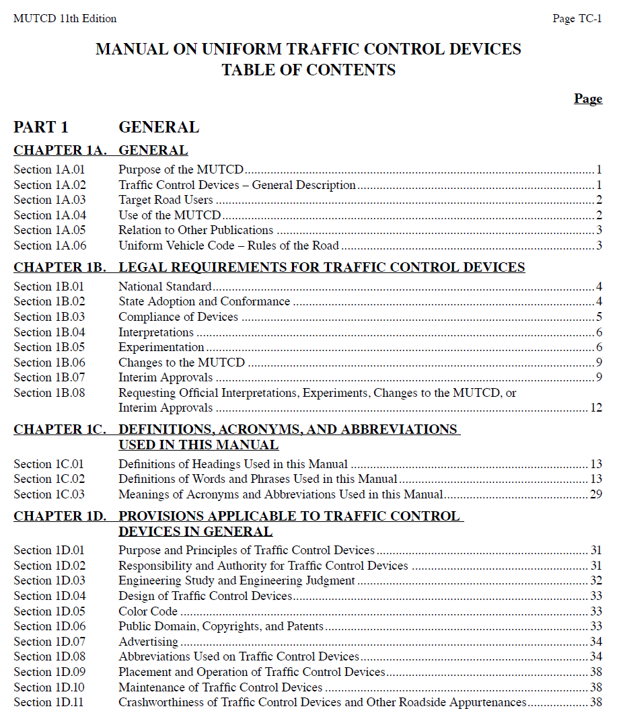
General
Deleted 2009 MUTCD Introduction
Relocated most of that material into Part 1
Reorganized into four new chapters
Eliminated duplicate material
Made editorial improvements
Adjusted mandate levels
Notes:
Most of the content from the Introduction of the previous edition of the MUTCD—the 10th or 2009 Edition—has been incorporated into an expanded and restructured Part 1. The content is reorganized into four new chapters, to create a more logical flow of information and to make it easier for users to find the information they need. The four new Chapters cover general information; legal requirements for traffic control devices; definitions, acronyms, and abbreviations; and provisions applicable to traffic control devices in general.
Throughout Part 1, provisions that are redundant or similar, either in Part 1 or elsewhere in the MUTCD, are deleted or edited as appropriate. Statements that could be confusing or misunderstood are clarified. This editing is also done throughout the entire MUTCD.
In some cases, the level of mandate—Standard, Guidance, Option, or Support—is changed to be consistent with related provisions in other Parts of the MUTCD. Some of these changes provide additional flexibility for jurisdictions. Others strengthen provisions to improve safety and ensure uniformity.

Slide 10
Section 1A.01 Purpose of the MUTCD
New statement of the MUTCD’s purpose
Four specific objectives:
  Safety and mobility for all users
  Efficiency through uniformity
  National consistency
  Provision of basic principles
Importance of uniformity for safety
Notes:
The purpose of the MUTCD is stated in a new Section. This new content is added because a clear statement of the MUTCD’s purpose is critical in defining what content is appropriate for the MUTCD and how those provisions are intended to be used.
The purpose of the MUTCD is to establish uniform national criteria for the use of traffic control devices that meet the needs of road users on all streets, highways, pedestrian and bicycle facilities, and site roadways open to public travel.
This purpose is achieved through the following objectives:
Promote safety and mobility for all users of the road network;
Promote efficiency through creating national uniformity in the meaning and appearance of traffic control devices;
Promote national consistency in the use, installation, and operation of traffic control devices; and
Provide basic principles for professionals to use in making decisions regarding the use, installation, operation, maintenance, and removal of traffic control devices.
This Section also establishes that uniformity of traffic control devices simplifies the task of the road user because it aids in recognition and understanding, thereby reducing reaction time and improving safety.

Slide 11
Section 1A.03 Target Road Users
Traffic control devices can target operators of motor vehicles and vulnerable road users (bicyclists and pedestrians, including individuals with disabilities)
  The term vulnerable user is defined in 23 U.S.C. 148(a)(15)
Protection of vulnerable road users is a priority
Notes:
A new Section describes how traffic control devices can be targeted to all types of road users.
It also affirms that protection of vulnerable road users is a priority in this MUTCD.

Slide 12
Section 1A.04 Use of the MUTCD
Establishes minimum qualifications for those responsible for making traffic control device decisions
Clarifies that decisions shall be made by an engineer or individual under supervision of engineer who has appropriate experience and expertise
Stipulates that decisions shall be made using engineering judgment or study as determined by the MUTCD provision being applied
Recommends individuals should consider the impacts of their traffic control devices decisions
Notes:
A new Section regarding the use of the MUTCD has been included, informed in part by the 20-Year Vision and Strategic Plan for the MUTCD.
A new Standard provision establishes minimum qualifications for those responsible for making traffic control device decisions, to ensure that individuals possess specialized training and experience to make such important decisions that affect the safe mobility of the traveling public. This new content clarifies that traffic control device decisions shall be made by an engineer, or an individual under the supervision of an engineer, who has the appropriate levels of experience and expertise to make the traffic control device decision. Such decisions are to be based on an engineering study or engineering judgment, as determined by the MUTCD provision being applied in the decision. Comparable changes have also been made in new Section 1D.03, “Engineering Study and Engineering Judgment.”
A new Guidance provision recommends that traffic control device decisions should be made with consideration of the impacts of the decision on safety, operational efficiency, and mobility of all road users at that location. In addition, this provision recommends consideration of agency resources, enforcement, and any education aspects of traffic control devices.

Slide 13
Section 1A.05 Relation to Other Publications
Deleted list of reference publications
Retained the two FHWA publications incorporated into the MUTCD by reference:
  Standard Highway Signs publication
  Color Specifications for Retroreflective Sign and Pavement Marking Materials (23 Code of Federal Regulations Part 655)
Notes:
In Section 1A.05, the extensive list of referenced publications that was in the 2009 MUTCD is deleted because it was not an exhaustive list and it is not known whether all the publications listed contained information that is consistent with the MUTCD’s provisions.
Two FHWA publications have been retained as they are more than simple references, but rather are incorporated into the MUTCD by reference -- Standard Highway Signs and “Color Specifications for Retroreflective Sign and Pavement Marking Materials,” which is an appendix to Subpart F of Part 655 of Title 23 of the Code of Federal Regulations.

Slide 14
Section 1B.01 National Standard
Revised Standard indicating the types of facilities to which the MUTCD shall apply and not apply
Notes:
In Section 1B.01, the Standard indicating the types of facilities to which the MUTCD shall apply and shall not apply is revised to be consistent with the Code of Federal Regulations (23 CFR 655.603(a)). The revised Standard is structured in a way to make it easier for users of the MUTCD to understand where it applies and where it does not apply. This improved information is particularly important for smaller agencies and individual owners of site roadways open to public travel.

Slide 15
Section 1B.02 State Adoption and Conformance
FHWA considers any policies, directives, specifications, standard drawings, or other supplemental documents an agency issues that change or modify Standard, Guidance, or Option provisions in the MUTCD as supplements to the MUTCD
FHWA must approve these supplements as being in substantial conformance with the national MUTCD
Notes:
A new Standard provision clarifies the fact that, in addition to officially titled State MUTCDs or MUTCD Supplements, any policies, directives, specifications, standard drawings, or other supplemental documents issued by an agency that change or modify Standard, Guidance, or Option provisions of the national MUTCD are a form of supplement to the MUTCD. As supplements, such items must receive approval from FHWA as being in substantial conformance with the national MUTCD. Review and approval of these documents would focus solely on MUTCD substantial conformance unless review was otherwise necessary for reasons unrelated to the MUTCD.

Slide 16
Compliance Dates (1 of 7)
Specific dates when provisions are required to be implemented:
  Six compliance dates (including one retained from 2009 MUTCD, Revision 3)
All other existing TCDs can be brought into compliance with the new MUTCD provisions as part of reconstruction or replacement, without a specified time limit (systematic upgrading provision) or at the end of a device’s “useful life”
Compliance dates are summarized in Table 1B-1
Notes:
Although there are many changes in the 11th Edition, agencies are not required to update all their existing traffic control devices immediately after the new edition is adopted. Rather, agencies generally will update any existing devices that no longer comply as part of a systematic upgrading process or when an individual device is at the end of its useful life.
The only exception is for the six provisions that have been identified for specific devices or applications that must be implemented by a compliance date specified in the MUTCD. The provisions that have compliance dates associated with them are summarized in Table 1B-1.

Slide 17
Compliance Dates (2 of 7)
Table 1B-1. Target Compliance Dates Established by the FHWA
MUTCD Section(s) | Subject Area | Specific Provision | Compliance Date
2B.64 | Weight Limit Signs | Paragraph 14 - requirement for additional Weight Limit sign with the advisory distance or directional legend in advance of applicable section of highway or structure | 5 years from the effective date of this edition of the MUTCD
2C.25 | Low Clearance Signs (W12-2) | Paragraph 1 - Required posting of the Low Clearance Advance (W12-2) sign in advance of the structure | 5 years from the effective date of this edition of the MUTCD
2C.25 | Low Clearance Signs (W12-2a, W12-2b) | Paragraph 8 - Recommended posting of Low Clearance Overhead (W12-2a or 12-2b) signs on an arch or other structure under which the clearance varies greatly | 5 years from the effective date of this edition of the MUTCD
3A.05 | Maintaining Minimum Retroreflectivity | Implementation and continued use of a method that is designed to maintain retroreflectivity of longitudinal pavement markings (see Paragraph 1 of Section 3A.05) | September 6, 2026
8B.16 | High-Profile Grade Crossings | Paragraphs 3 and 7 - Recommended installation of Low Ground Clearance and/or Vehicle Exclusion signs and detour signs for vehicles with low ground clearances that might hang up on high-profile grade crossings at locations with a known history | 5 years from the effective date of this edition of the MUTCD
8D.09 through 8D.12 | Highway Traffic Signals at or Near Grade Crossings | Assessment and determination of appropriate treatment to achieve compliance (preemption, movement prohibition, pre-signals, queue cutter signals) | 10 years from the effective date of this edition of the MUTCD
Notes:
Table 1B-1 lists the specific provisions, the relevant Sections of the MUTCD where the provisions can be found, and the compliance date for implementation expressed as a time period from when the 11th Edition became effective, which was January 18, 2024.
Provisions with compliance dates adopted in previous editions of the MUTCD are not listed in the 11th Edition since their compliance dates have passed.
A brief look at each of the provisions that has a compliance date follows.

Slide 18
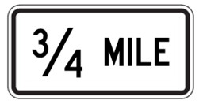

Compliance Dates (3 of 7)
Weight Limit sign with distance or directional legend at advance location:
  5-year compliance date (January 18, 2029)
R12-1
R12-5
Distance Plaque (Example)
Directional Plaque (Example)
Notes:
Section 2B.54 requires that an additional Weight Limit sign, with a distance or directional legend, be located in advance of the applicable section of highway or structure so that prohibited vehicles can detour or turn around prior to the limit zone.
A 5-year compliance date for installing the additional signs was established based on the critical nature of the infrastructure being protected.

Slide 19
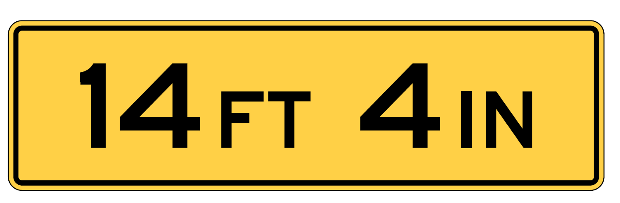
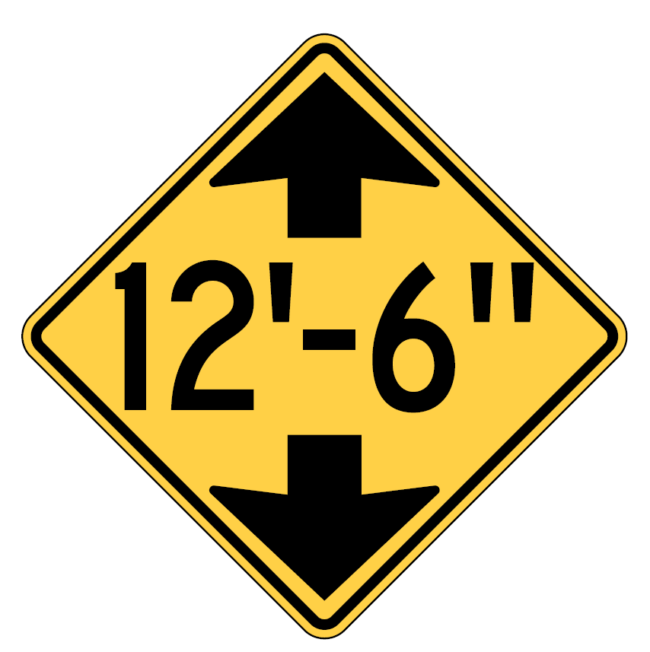
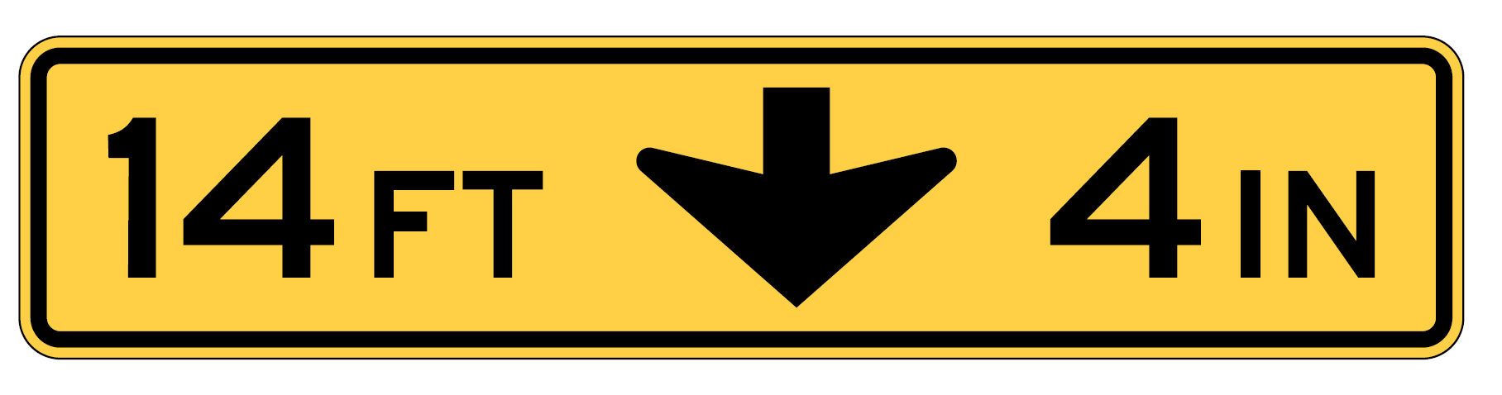
Compliance Dates (4 of 7)
Low Clearance advance (W12-2) sign and Low Clearance overhead (W12-2a or W12-2b) sign:
  5-year compliance date (January 18, 2029)
W12-2a
W12-2
W12-2b
Notes:
Section 2C.25 requires the Low Clearance Advance sign (W12-2) be used to warn road users of vertical clearances less than 14 feet 6 inches, or vertical clearances less than 12 inches above the statutory maximum vehicle height, whichever is greater.
The Section also recommends that for an arch or other structure under which the clearance varies greatly, two or more Low Clearance Overhead signs (W12-2a or W12-2b) should be installed on the structure itself to indicate the portions of the roadway over which the low clearance applies. This provision was based on a recommendation from the National Transportation Safety Board to provide signing indicating the proper lane of travel for over height vehicles traveling under an arched structure.
A 5-year compliance date was established for both provisions based on the critical nature of the infrastructure.

Slide 20

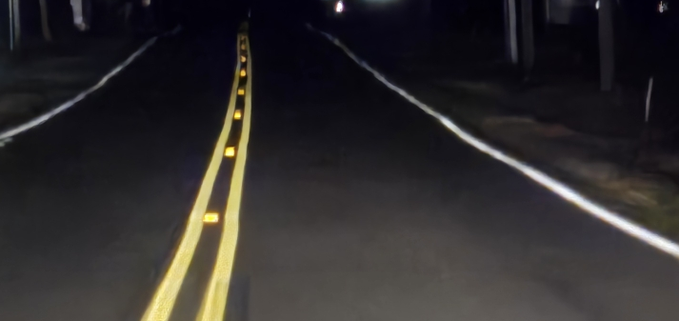
Compliance Dates (5 of 7)
Implement method for maintaining minimum retroreflectivity of longitudinal pavement markings:
  September 6, 2026, compliance date
  (established by MUTCD 10th Edition, Rev. 3)
Notes:
In a previous and separate rulemaking, a standard for the minimum level of retroreflectivity that must be maintained for pavement markings is established along with a compliance date which became Revision 3 to the 2009 edition of the MUTCD. The provisions from that completed rulemaking have been incorporated into Section 3A.05 of the 11th Edition.
The compliance date of September 6, 2026, was established by the previous rulemaking. This compliance date applies only to the implementation and continued use of a method that is designed to maintain retroreflectivity of longitudinal pavement markings.

Slide 21

Compliance Dates (6 of 7)
Low ground clearance symbol (W10-5), vehicle exclusion and detour signs, or both:
  5-year compliance date
  (January 18, 2029)
W10-5
W10-14P
W10-5P
W10-14aP
Notes:
Section 8B.16 recommends the installation of Low Ground Clearance and/or Vehicle Exclusion and detour signs for vehicles with low ground clearances that might become immobilized or hung up on high-profile grade crossings due to their undercarriages being too low to clear the roadway profile at the track crossing. This change was made based on an NTSB recommendation, to provide guidance to agencies to help identify and address high-profile crossings, especially those that are known from past experience to be subject to specific vehicle type hang-ups.
The 5-year compliance date for this provision applies to known potential vehicle hang-up locations that are currently identified by agencies through their grade crossing inventory. The intent is that agencies review all known potential hang-up locations and decide if the existing W10-5 sign is sufficient, or if there should be specific vehicle exclusion and/or detour signs.
The 5-year date also includes the installation of additional signs (if needed).

Slide 22
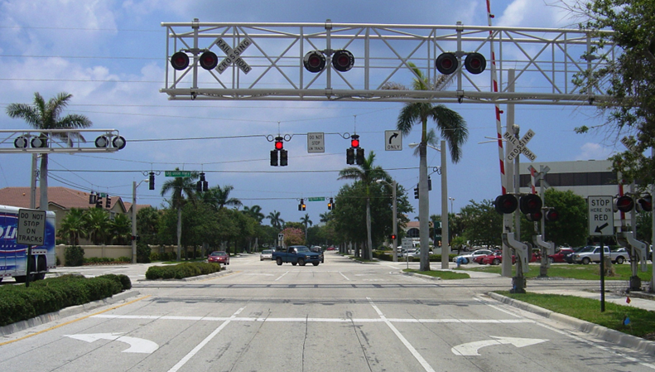
Compliance Dates (7 of 7)
Highway traffic signals at or near grade crossings:
  Recommends assessment and determination of appropriate treatment to achieve compliance with MUTCD provisions on preemption, movement prohibition, pre-signals, and queue cutter signals
  10-year compliance date
  (January 18, 2034)
Notes:
This compliance date was established due to the critical safety issues when traffic control signals and pedestrian hybrid beacons are located at or near highway-rail and highway-light rail transit grade crossings. It is important that assessments be made of such crossings to determine what treatments are needed at each location to achieve compliance with the various MUTCD requirements in Sections 8D.09 through 8D.12 regarding preemption, movement prohibition, pre-signals, and queue cutter signals.
A 10-year compliance date has been established for agencies to make these assessments. The date does not apply to the implementation of needed treatments. Agencies will be granted flexibility to determine the schedule for installation of improvements based on availability of funding and other safety priorities through the systematic replacement and upgrade of traffic control devices as currently prescribed in the MUTCD for other traffic control devices.

Slide 23
Section 1B.05 Experimentation
Clarifies and streamlines process
Retains the requirement for official approval to experiment with a traffic control device that does not comply with the MUTCD
Includes provisions for multijurisdictional experiments and for expanding an approved experiment to include additional sites under another jurisdiction
Notes:
Experimentation is the process by which new traffic control device concepts or applications can be evaluated for effectiveness.
The provisions on experimentation have been relocated into a separate Section, new Section 1B.05. The content on experimentation has been greatly expanded and revised to clarify and streamline the process used by agencies to request and receive approval to experiment with a novel traffic control device or application.
The MUTCD continues to require road owners or operators to obtain FHWA’s approval prior to experimenting with a traffic control device or application that does not comply with the MUTCD. FHWA’s review and approval are necessary to minimize any safety risk from experimental devices, help ensure that experimental evaluation plans contain adequate measures to determine effectiveness, and provide national documentation of results that can be used to inform the MUTCD in future rulemaking or other action.
A new Support provision clarifies that FHWA will consider an experimentation request with a novel device or application across multiple jurisdictions when the experiment has a common hypothesis, evaluation plan, and evaluation team. FHWA has, in fact, approved experiments that involve sites in multiple jurisdictions. However, the MUTCD was not explicit that an experiment is not required to be contained within a single jurisdiction.
Similarly, a request to add experimental sites to an experimentation approved for another jurisdiction will be considered when submitted jointly by all the authorities for operation of the roads or streets on which the experiment is then to take place. Likewise, FHWA has granted approval to jurisdictions to incorporate experimental sites into an ongoing experiment that was approved for a different jurisdiction.

Slide 24
Section 1C.01 Definitions of Headings Used in
This Manual
Revised the definition of Standard to clarify that in limited
location-specific cases, the results of a documented engineering study might indicate a deviation from one or more requirements of a Standard provision to be appropriate
Notes:
Chapter 1C contains the definitions of headings, words, and phrases used in the MUTCD.
New Section 1C.01 covers the definitions of the headings used throughout the MUTCD: Standard, Guidance, Option, and Support.
The definition of “Standard” has been revised to clarify that, in limited location-specific cases, the results of a documented engineering study might indicate a deviation from one or more requirements of a Standard provision to be appropriate. This revision is based on an Official Ruling from the 2009 MUTCD.

Slide 25
Section 1C.02 Definitions of Words and Phrases
Used in This Manual
Revised existing definitions
Deleted existing definitions
Added new definitions
“Nested” several topic-related definitions
Notes:
In new Section 1C.02, many definitions of words and phrases are added, deleted, or revised. The additions generally are for new terms used in the 11th Edition, while deletions generally are for terms no longer used. Revisions are for improved clarity, consistency, and accuracy.
In some cases, definitions of related terms have been “nested” under the definition of the broad term. In the 2009 MUTCD, nesting was used for speed-related terms, with “Speed” being the broad term and other speed terms such as “Design Speed,” “85th-Percentile Speed,” and “Pace” listed as sub-definitions under Speed. This concept is expanded in the 11th Edition to the broad terms of Beacon, Bicycle Lane, Highway Traffic Signal, Hybrid Beacon, and Toll Collection, with the sub-definitions of each listed under the broad term rather than as separate definitions. This concept makes it easier to identify the interrelationships between the broad term and the definitions of the various types or categories of that broad term.

Slide 26
Section 1D.01 Purpose and Principles of Traffic
Control Devices
Traffic control devices used on site roadways open to public travel shall have the same shape, color, and meaning as those the MUTCD requires, unless exceptions are provided in the MUTCD
Notes:
In new Section 1D.01, a Standard provision has been added for clarification purposes, requiring that traffic control devices used on site roadways open to public travel have the same shape, color, and meaning as those required by the MUTCD, unless exceptions are provided in the MUTCD.

Slide 27
Section 1D.06 Public Domain, Copyrights, and Patents
Clarifies that the meaning, appearance, operation, and application of traffic control devices, including those proposed for experimentation, shall not be protected by a patent, trademark, or copyright
Clarifies that method of assembly, method of manufacture, and component parts can be protected
Notes:
A new Section 1D.06 clarifies the previous provisions for public domain, copyrights, and patents with respect to traffic control devices. The provisions clarify that the meaning, appearance, operation, and application of traffic control devices as a road user experiences them shall not be protected by a patent, trademark, or copyright.
However, other aspects of a traffic control device, such as a manufacturer’s method of assembly, method of manufacture, and the component parts of a traffic control device can be, and often are protected.
This limitation on patents and protections is due to the adverse impact a protected traffic control device has on the very uniformity of display the MUTCD is intended to promote.

Slide 28
Section 1D.09 Placement and Operation of
Traffic Control Devices
All necessary traffic control devices shall be in place before any new highway, site roadway open to public travel, detour, or temporary route is opened to public travel
Notes:
In new Section 1D.09, Guidance is changed to Standard that before any new highway, site roadway open to public travel, detour, or temporary route is opened to public travel, all necessary traffic control devices shall be in place. This revision is made for consistency with other regulations and because it is important that all necessary traffic control devices be in place before new roads, detours, or temporary routes are opened to public travel.

Slide 29
Section 1D.11 Crashworthiness of Traffic Control Devices and Other Roadside Appurtenances
Certain traffic control devices and their supports, related appurtenances, or both shall be crashworthy, in accordance with various sections of this Manual per the definition of this term in Section 1C.02 of the MUTCD.
Notes:
New Section 1D.11 retains the previous requirements for crashworthiness. Crashworthiness of a device or appurtenance is defined specifically in Section 1C.02.

Slide 30

FHWA’s National
Traffic Control Devices Program
for more information:
mutcd.fhwa.dot.gov
e–Subscribe Service
Official Rulings Database
Standard Highway Signs
Frequently Asked Questions
MUTCD News Feed
Notes:
This concludes this module. Additional modules on the MUTCD 11th Edition are available at the MUTCD Web Site at http://mutcd.fhwa.dot.gov/.
Almost anything related to the MUTCD that you need is at the official MUTCD Web site.
If you haven’t yet signed up for our e-Subscribe service, please take a moment to do so. We’ll send out a bulletin whenever new information is available so you can keep up-to-date. As subscribers, you’ll also hear about future Webinar and other opportunities first.

