Slide 1


Manual on Uniform Traffic Control Devices for Streets and Highways
An Overview of Changes in the 11th Edition
As published in the December 2023
Notice of Final Rule
Prepared by the
Federal Highway Administration’s
Office of Operations
Traffic Control Devices Program
Notes:
Welcome to the Manual on Uniform Traffic Control Devices for Streets and Highways—the MUTCD 11th Edition.
This series provides an overview of the significant changes in the MUTCD and was prepared by the FHWA’s Office of Operations Traffic Control Devices team. Each module address the changes in a specific area of the MUTCD.
Additional modules on the MUTCD 11th Edition are available at the MUTCD Web Site at http://mutcd.fhwa.dot.gov/. The series includes the following modules:
Part 1
Part 2:
Chapter 2A
Chapter 2B
Chapter 2C
Chapter 2D
Chapter 2E
Chapter 2F
Chapter 2G
Chapters 2H and 2I
Chapters 2J and 2K
Chapter 2L
Chapters 2M and 2N
Part 3
Part 4
Part 5
Part 6
Part 7
Part 8
Part 9

Slide 2
Disclaimers
Except for the statutes and regulations cited, the contents of this presentation do not have the force and effect of law and are not meant to bind the States or the public in any way. This presentation is intended only to provide information regarding existing requirements under the law or agency policies.
The Federal Highway Administration (FHWA) is the source of all images in this presentation unless otherwise indicated.
Notes:
(Disclaimer) Except for the statutes and regulations cited, the contents of this presentation do not have the force and effect of law and are not meant to bind the States or the public in any way. This presentation is intended only to provide information regarding existing requirements under the law or agency policies.
FHWA is the source of all images in this presentation unless otherwise indicated.

Slide 3
Overview of Changes in Chapter 2A
Manual on
Uniform Traffic Control Devices
2A
for Streets and Highways
An Overview of Changes in Chapter 2A
As published in the December 2023
Notice of Final Rule
Notes:
The remainder of this presentation will focus on the significant changes to Chapter 2A of the MUTCD.

Slide 4
Section 2A.01 Function and Purpose of Signs
Adds Guidance:
  Permanent signs should not be used on a frequent basis to confirm rules of the road or statutes
  Temporary signs should be used when necessary to advise of new regulations as part of an educational campaign
Notes:
New Guidance is added stating that Permanent signs should not be used on a frequent basis to confirm rules of the road or statutes. If engineering judgment determines a need for a permanent sign to distinguish between differing requirements of similar statutes in different jurisdictions, then a sign should be located in the vicinity of the jurisdictional boundary, and should be located away from warning, directional, and higher-priority regulatory signs, so as not to contribute to sign clutter.
Agencies should use temporary signs when determined necessary to advise of new regulations or as part of an educational campaign. These temporary signs or messages should be used sparingly and only at strategic locations. The use of signs should be considered only as a supporting element of a larger educational campaign rather than as the primary source of notification.

Slide 5
Section 2A.04 Design of Signs
Revises Standard to prohibit modification of symbol proportion
Revises Standard to clarify:
  Word legend shall not replace a standard symbol
  Alternative sign design shall not replace a standardized design when a standard sign is provided
Expands Standard to prohibit display of telephone numbers, hashtags, and scanning graphics on the faces of signs
Adds Option to allow date of fabrication, sign designation, sign size, and/or manufacturer name to be displayed on sign face in accordance with revised Standard
Notes:
The Standard is revised to clarify that the modification of symbol proportion is prohibited. This change is made because symbol designs are standardized for recognition based on the specific proportions of the symbol.
Clarification is added that a word legend shall not replace a standard symbol. Similarly, an alternative sign design is prohibited when a standard sign is provided in the MUTCD or the Standard Highway Signs publication. This change is for clarification purposes and does not represent a change to requirements and is consistent with the 2009 MUTCD, which discontinued a number of alternate standard signs with word legends for which the primary standard sign included a symbol legend.
A Standard is expanded prohibiting the display of telephone numbers, hashtags, and scanning graphics in addition to the already prohibited internet and email addresses, URLs, and domain names. Scanning graphics is a new term. These are graphics designed for scanning by machine, and include bar codes, quick response (QR) codes or other matrix bar-code formats, or similar graphics.
An Option is added to allow the date of fabrication, sign designation, sign size, and/or manufacturer name to be displayed on the sign face using the provisions in the new Standard regarding placement, color, and size.

Slide 6
Section 2A.05 Shapes
Table 2A-1. Use of Sign Shapes
Shape | Signs
Octagon* | Stop (R1-1)**
Equilateral Triangle (downward-pointing)* | Yield (R1-2)**
Circle* | Grade Crossing Advance Warning (W10-1)**
Pennant (Isosceles Triangle with longer axis horizontal, pointed right)* | No Passing Zone (W14-3)**
Pentagon (upward-pointing)* | School (S1-1) (squared bottom corners)** County Route (M1-6) (tapered lower sides)**
Crossbuck (two rectangles in a perpendicular “X” configuration)* | Grade Crossing (R15-1)**
Diamond | Warning Series
Rectangle (including square) | Regulatory Series Guide Series*** Warning Series
Trapezoid* | Recreational and Cultural Interest Area Guide Series (isosceles or right-angled) National Forest Route Sign (M1-1) (isosceles)**
Revises and relocates Guidance: Sign shapes should not be obscured by a sign mounted
on back of assembly
Adds Guidance on installing standard sign when lateral space
is limited:
    Adds Options for vertical rectangle and overhead horizontal rectangle shapes due to lateral constraints
Adds Standard: Modifications to sign shape are prohibited
* This shape shall be limited exclusively to the sign(s) indicated.
** This sign shall be exclusively the shape shown.
*** Guide series includes general service, specific service, tourist-oriented directional, general information, recreational and cultural interest area, and emergency management signs.
Note: Signs with standardized designs shall not be modified to accommodate a different shape except as provided in this Manual.
Notes:
Guidance is relocated and revised about signs with exclusive shapes not being obscured when mounted on the back of another sign. Shapes that are exclusive to a particular sign (such as an octagon for STOP, a pennant for NO PASSING ZONE, or a circle for Railroad Advance) should not be obscured by another sign mounted on the back of the same assembly.
Guidance is added on methods of installing a standard sign when lateral space is limited.
An Option is added to use a vertically-oriented rectangle instead of a horizontally-oriented rectangle due to lateral constraints. An Option is also added to use a horizontally-oriented rectangle for a standard warning sign when mounting overhead due to lateral constraints.
A Standard is added prohibiting modifications to sign shapes, such as cutting off the left and right points of a diamond-shaped sign.

Slide 7
Sections 2A.06 Color and 2A.07 Dimensions
Adds Standard prohibiting color gradients (except on business identification sign panels)
Adds Standard prohibiting increases in sign size above the maximum allowable sign size:
  Exception: supplemental plaques to maintain relative proportion
Notes:
A Standard is added prohibiting color gradients, such as smooth or defined color transitions, except when used on business identification sign panels. Colors shall be consistent across the face of a sign or a sign panel.
A Standard is added that prohibits increasing sign sizes above the maximum allowable sign size. Guidance allows an exception to this standard when supplemental plaques are installed with larger sized signs. In that specific case, a corresponding increase in the size of the plaque and its legend should be made to maintain proportions.

Slide 8
Section 2A.08 Word Messages
Adds Standard: Word messages shall be aligned horizontally across a sign, reading left to right
Adds Option: Secondary language may be displayed on signs intended for viewing only by pedestrians and occupants of parked vehicles
Adds Standard: Distances shall be displayed using fractions of a mile (rather than decimals)
Notes:
A Standard is added stating that all word messages shall be aligned horizontally across a sign, reading left to right (except as otherwise provided in the MUTCD). This change allows an exception for signs that require a vertically oriented message, such as Reference Location signs and the Depth Gauge sign. It also explicitly prohibits the use of words on retroreflective sign post strips that are used for enhanced conspicuity.
An Option is added allowing secondary language, in addition to English, to be displayed on signs intended for viewing only by pedestrians and occupants of parked vehicles.
A Standard is added stating that distances shall be displayed on signs using fractions of mile rather than decimals (except as otherwise provided in the MUTCD).

Slide 9
Section 2A.09 Symbols
Changes Guidance to Option to allow mirror images of symbols
Revises Option to clarify that research studies are allowable for new symbol designs in compliance with official experimentation provisions
Revises Guidance to clarify that educational plaque should be used based on engineering judgment
Removes Option to use recreational and cultural interest area guide sign symbols on streets or highways outside of a recreational and cultural interest area
Notes:
A Guidance is changed to an Option to allow the use of mirror images of symbols when the reverse orientation might better convey to road users a direction of movement.
An Option is revised for clarification. State and/or local highway agencies may conduct research studies to determine road user comprehension, sign conspicuity, and sign legibility in compliance with the provisions for official experimentation, per Section 1B.05, when a new symbol design is under consideration.
Guidance is revised to clarify that an educational plaque should accompany new standard warning or regulatory symbol signs where engineering judgment determines that the plaque will improve road user comprehension during the transition from a word message to symbol signs.
The prior Option to use recreational and cultural interest area guide sign symbols on streets or highways outside of a recreational and cultural interest area is removed. Word messages are allowable and intended to be used outside of recreational and cultural interest areas, while recreational and cultural interest area symbols are intended for use inside recreational and cultural interest areas. There may have been confusion regarding use of recreational and cultural interest area symbols in the previous Manual; however, the language in the 11th Edition is intended to clarify the intended use of recreational and cultural interest area symbols and ensure consistency throughout the Manual.

Slide 10
Section 2A.10 Sign Borders
Revises Standard to clarify that signs shall have the same border and legend color to outline distinctive shape and for ease of recognition
Revises Guidance to clarify that on unusually large signs, border width should be 2.5 to 3 inches
Notes:
A Standard is revised for clarification. Signs shall have a border of the same color as the legend in order to outline their distinctive shape and thereby give them easy recognition and a finished appearance.
Guidance is added for unusually large signs with oversized letter heights, route shields, or other legend elements, the border should be 2.5 inches wide and should not exceed 3 inches in width.

Slide 11
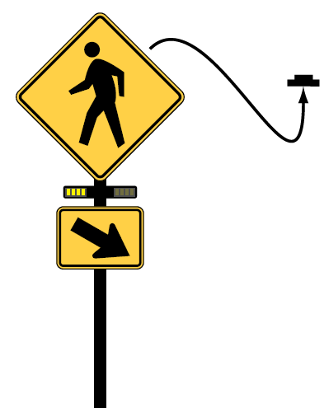


Section 2A.11 Enhanced Conspicuity for Standard
Signs (1 of 2)
Revises Options to:
  Prohibit a warning beacon from supplementing “DO NOT ENTER” and “WRONG WAY” signs
  Allow a rectangular
  rapid-flashing beacon to supplement pedestrian, school,
  or trail warning sign
Revises Guidance for “NEW” plaque to remain in place no more than 12 months
A – W16-15P plaque above a regulatory or warning sign if the regulation or condition is new
F – Supplemental beacon
Notes:
An Option is revised to prohibit DO NOT ENTER and WRONG WAY signs from being supplemented by a Warning Beacon. However, a Stop Beacon may be added to STOP, DO NOT ENTER and WRONG WAY signs to increase conspicuity. The use of Speed Limit Beacons to improve conspicuity of Speed Limit signs is retained.
A rectangular rapid-flashing beacon may be added to a Pedestrian, School, or Trail warning sign at an uncontrolled, marked crosswalk.
Guidance is revised to state that if a NEW plaque is used, it should remain in place for a period of time determined by engineering judgment, but no more than 12 months.

Slide 12
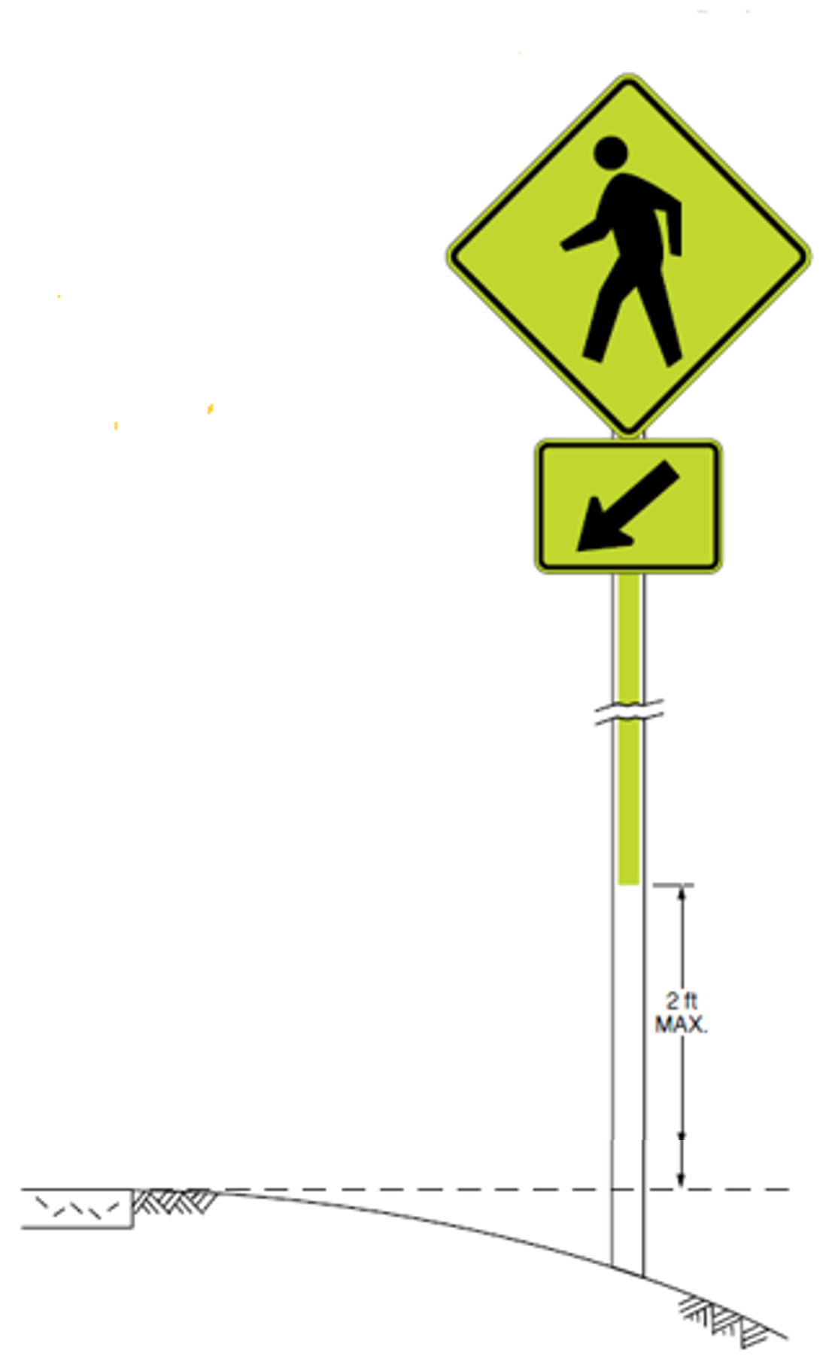
Section 2A.11 Enhance Conspicuity for Standard
Signs (2 of 2)
E – Vertical retroreflective strip on sign support
Removes redundant Standard, as definition of plaque prohibits use of “NEW” plaque alone
Revises Standard to clarify that no legend or other information shall be added to sign support on
retroreflective strip
Adds Standard to clarify that duplicate signs in same assembly are prohibited
No legends or other information on strip

Slide 13
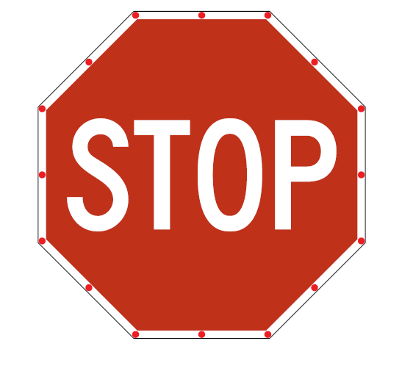
Section 2A.12 Light-Emitting Diodes (LEDs) Used for Conspicuity Enhancement of Standard Signs
Adds Support, Options, and Standards:
  Adds Standard to prohibit LEDs protruding outside sign border or legend
  Adds Standard to allow fluorescent yellow-green LEDs with school, bicycle, or pedestrian warning signs
  Adds Standard to clarify that actuation of “STOP” or “YIELD” sign LEDs is prohibited
G – LEDs in border
Notes:
A new section (2A.12) is added and includes relocated and revised text regarding light-emitting diode (LED) units. The new section applies to the use of illuminated elements that supplement a sign legend to enhance the conspicuity of the sign. These are not considered changeable message signs since the legend of the sign is always displayed even when the LED units are not illuminated.
Standards are added to cover the color, placement, flashing rate, and other specifications for LED units.
A Standard is added to prohibit LEDs from protruding outside the sign border or legend.
A Standard is added to allow fluorescent yellow-green as an LED color with school area, bicycle or pedestrian warning signs.
A Standard is added to clarify that when used in STOP or YIELD signs, flashing LED units shall operate continuously. Actuation of the LED units shall not be allowed.

Slide 14
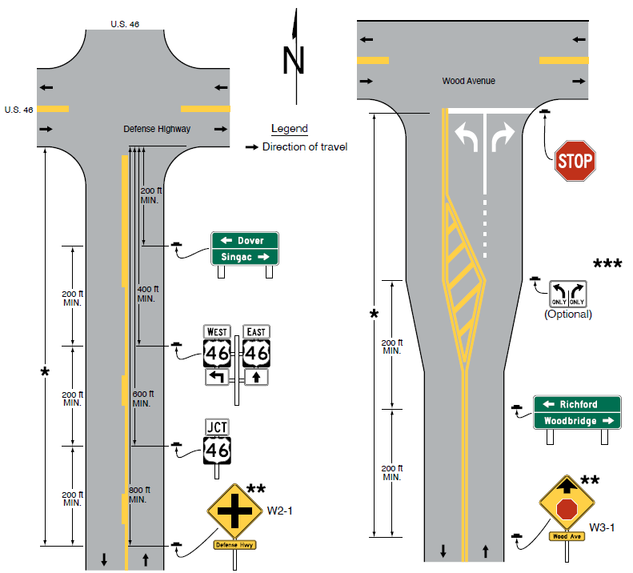
Section 2A.13 Standardization of Location
Figure 2A-4. Relative Locations of Regulatory, Warning, and
Guide Signs on an Intersection Approach (Sheet 1 of 4)
A – Single-lane approach
B – Multi-lane approach
Adds Figure 2A-4
Changes Standard to Guidance for use of speed as a factor for sign placement
Adds Guidance: Sign for left lane should be located on left-hand side of roadway (with exceptions)
Adds Guidance: Guide sign may vary in precedence over other signs
Note: See Chapter 2D for information on guide signs
and Part 3 for information on pavement markings
∗ See Table 2C-3 for the recommended minimum distance
∗∗ See Section 2C.41 for the application of the W2-1 sign
and Section 2C.35 for the application of the W3-1 sign
∗∗∗ See Section 2B.27 for the application of Intersection
Lane Control signs
Notes:
A new Figure 2A-4 with four sheets is added in Section 2A.13 to illustrate the relative locations of Regulatory, Warning, and Guide Signs on an urban signalized intersection approach to help clarify typical signing at these complex situations for practitioners.
A Standard is changed to Guidance on the use of speed as a factor in determining sign location. This provides agencies with more flexibility to use the factors they determine, through engineering judgment or study, to be most appropriate.
Guidance is added for clarification where certain signs indicate an action by a road user in the left lane or at the left-hand side of a one-way road. An example of this situation is the placement of a LEFT LANE ENDS sign on the left-hand side of the roadway. In the case of a divided road, the sign should be located in the median if adequate width is available.
Guidance is added to clarify priority where space is limited for sign installation. Priority according to type of sign will depend on the specific situation and conditions of the site at which the signs are to be installed. Guide signs should be relocated when conflicting with regulatory and warning information. However, at a decision point, the guide sign should take precedence.

Slide 15
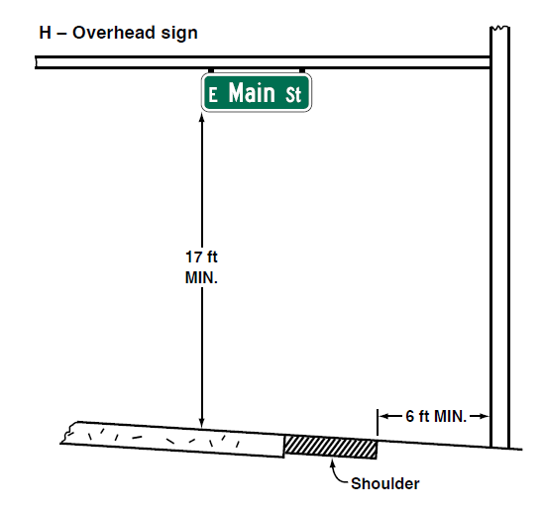
Section 2A.15 Mounting Height
Relocates Standard: Signs post-mounted on a
median barrier overhanging any portion of the
traveled way shall be mounted with a vertical
clearance that complies with that of overhead
signs (17-foot minimum)
Adds Guidance recommending signs not
be mounted out of road user’s normal field
of vision, especially in urban settings
H – Overhead Sign
Notes:
A Standard is relocated from Chapter 2G and more appropriately placed in this Section that requires signs post-mounted on a median barrier that overhang any portion of the traveled way to be mounted with a vertical clearance that complies with that of overhead signs, which is a 17-foot minimum.
New Guidance is added recommending that signs not be mounted at such a height as to be out of the road user’s normal field of vision, especially in urban settings where signs are often mounted on traffic signal or light poles.

Slide 16
Section 2A.18 Posts and Mountings
Adds Standard:
  Equipment for powering electronic components of a sign shall not compromise the crashworthy performance of the sign installation
  Equipment shall not obscure the shape of the sign
Notes:
A new Standard is added that states that if mounted to the sign support, equipment for powering electronic components of a sign, including solar panels, shall be mounted so as not to compromise the crashworthy performance of the sign installation. Such equipment shall be mounted so as not to obscure the shape of the sign.

Slide 17
Section 2A.20 Excessive Use of Signs
Revises Guidance for clarification on excessive sign use
Adds Guidance: Signs and other traffic control devices should be installed and maintained from a systematic standpoint rather than individually
Notes:
Clarification is added to the Guidance statement that signs should be used and located judiciously, minimizing their proliferation in order to maintain their effectiveness; that signs should be used conservatively; and that sign clutter be avoided. Signs and directional guide signs for primary routes and destinations should be used frequently at strategic locations because their use promotes efficient operations by keeping road users informed of their location.
A new Guidance statement is added recommending that signs and other traffic control devices be installed and maintained from a systematic standpoint rather than individually. When a new sign is installed, the existing signs in the vicinity should be considered for replacement, relocation, or removal as a result of the new sign that is installed. Existing systems of signs should be reviewed periodically for evidence of sign clutter and adjustments should be made accordingly.

Slide 18
Section 2A.21 Retroreflection and Illumination
Section 2A.22 Maintaining Minimum Retroreflectivity
Adds Standard: Opaque or non-retroreflective material shall be used for black legend or background
Revises Guidance to clarify methods described in Maintaining Traffic Sign Retroreflectivity or a method developed based on an engineering study, should be used to maintain sign retroreflectivity at or above the minimum levels in Table 2A-5
Removes Option: Signs with blue or brown backgrounds are no longer excluded from retroreflectivity maintenance requirements
Notes:
In Section 2A.21, a new Standard is added that where the color black is specified for the legend or background of a sign, an opaque and non-retroreflective material shall be used. Under headlamp illumination, retroreflective black appears as white, which creates a conflict with the 2009 requirement for signs to appear similar under daytime and nighttime conditions. The 11th Edition resolves this conflict.
In Section 2A.22, a Guidance statement is revised to state that one or more of the methods described in “Maintaining Traffic Sign Retroreflectivity,” by the FHWA or a method developed based on an engineering study should be used to maintain sign retroreflectivity at or above the minimum levels in Table 2A-5. Signs that are identified through the agency’s method as being below the minimum levels should be replaced. The list of specific methods that was in the 2009 MUTCD was removed in the 11th Edition.
In addition, Signs with blue or brown backgrounds are removed from the list of signs that may be excluded from the retroreflectivity maintenance provisions. All signs communicate critical information to road users during nighttime, low light, and adverse weather conditions where retroreflectivity is essential for safety, including on park and recreational roads.

Slide 19
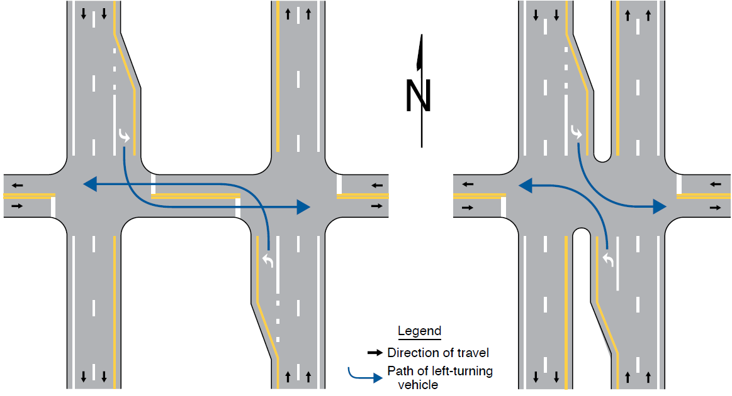
Section 2A.23 Median Opening Treatments for
Divided Highways
Revises Guidance: Divided highway crossings should
be signed as separate intersections when both
these conditions are met:
  Paths of opposing left turns from the divided highway cross each other
  Adequate storage exists in interior approaches for design vehicles expected to cross divided highway
Adds Figure 2A-5
Figure 2A-5. Intersection Configuration at a Divided Highway Crossing
A – Separate intersections
(paths of opposing left-turning vehicles cross)
B – Single intersection
(paths of opposing left-turning
vehicles do not cross)
Notes:
Guidance is revised to included recommendations for signing a divided highway crossing as separate intersections when both of the following conditions are met: 1) The paths of opposing left turns from a divided highway cross each other and 2) there is adequate storage in the interior approaches for the design vehicles expected to cross the divided highway.
A new Figure 2A-5 is added to illustrate these criteria. These changes provide additional details for road user safety, based on the results of recently completed research on this topic.

Slide 20

FHWA’s National
Traffic Control Devices Program
for more information:
mutcd.fhwa.dot.gov
e–Subscribe Service
Official Rulings Database
Standard Highway Signs
Frequently Asked Questions
MUTCD News Feed
Notes:
This concludes this module. Additional modules on the MUTCD 11th Edition are available at the MUTCD Web Site at http://mutcd.fhwa.dot.gov/.
Almost anything related to the MUTCD that you need is at the official MUTCD Web site.
If you haven’t yet signed up for our e-Subscribe service, please take a moment to do so. We’ll send out a bulletin whenever new information is available so you can keep up-to-date. As subscribers, you’ll also hear about future Webinar and other opportunities first.

