Slide 1


Manual on Uniform Traffic Control Devices for Streets and Highways
An Overview of Changes in the 11th Edition
As published in the December 2023
Notice of Final Rule
Prepared by the
Federal Highway Administration’s
Office of Operations
Traffic Control Devices Program
Notes:
Welcome to the Manual on Uniform Traffic Control Devices for Streets and Highways—the MUTCD 11th Edition.
This series provides an overview of the significant changes in the MUTCD and was prepared by the FHWA’s Office of Operations Traffic Control Devices team. Each module address the changes in a specific area of the MUTCD.
Additional modules on the MUTCD 11th Edition are available at the MUTCD Web Site at http://mutcd.fhwa.dot.gov/. The series includes the following modules:
Part 1
Part 2:
Chapter 2A
Chapter 2B
Chapter 2C
Chapter 2D
Chapter 2E
Chapter 2F
Chapter 2G
Chapters 2H and 2I
Chapters 2J and 2K
Chapter 2L
Chapters 2M and 2N
Part 3
Part 4
Part 5
Part 6
Part 7
Part 8
Part 9

Slide 2
Disclaimers
Except for the statutes and regulations cited, the contents of this presentation do not have the force and effect of law and are not meant to bind the States or the public in any way. This presentation is intended only to provide information regarding existing requirements under the law or agency policies.
The Federal Highway Administration (FHWA) is the source of all images in this presentation unless otherwise indicated.
Notes:
(Disclaimer) Except for the statutes and regulations cited, the contents of this presentation do not have the force and effect of law and are not meant to bind the States or the public in any way. This presentation is intended only to provide information regarding existing requirements under the law or agency policies.
FHWA is the source of all images in this presentation unless otherwise indicated.

Slide 3
Overview of Changes in Chapter 2B
Manual on
Uniform Traffic Control Devices
2B
for Streets and Highways
An Overview of Changes in Chapter 2B
As published in the December 2023
Notice of Final Rule
Notes:
The remainder of this presentation will focus on the significant changes to Chapter 2B of the MUTCD.

Slide 4
General
Reorganizes Chapter 2B into 13 sub-chapters:
  Groupings of the 76 Sections by topic area
  Index at start of Chapter
Notes:
Chapter 2B has been significantly reorganized to group similar subjects together, making it easier to see interrelationships between topics.
The 76 sections of Chapter 2B are now grouped into 13 sub-chapters, with an index at the start of the chapter.
This presentation will discuss the significant changes within the sections in Chapter 2B.

Slide 5

Section 2B.02 Design of Regulatory Signs (1 of 2)
Light-emitting diode (LED) signs with part-time prohibitory message:
  Previous Guidance now Standard
  Red prohibition symbol (circle and diagonal) shall approximate that of the static sign as closely as possible
  Symbol of the action to be prohibited shall be white on a black background
Notes:
In Section 2B.02, a previous Guidance statement about LED signs has been changed to a Standard.
Specifically, the Standard applies to a part-time prohibitory message, such as a No Right Turn symbol that’s displayed only during a certain period of the day or only during a certain portion of a traffic signal cycle.
It requires the red circle and diagonal symbol to approximate that of the standard static sign and the action (such as the right turn arrow symbol) to be white on an opaque black background.

Slide 6
Section 2B.02 Design of Regulatory Signs (2 of 2)
Adds Standard for regulatory signs incorporated within border of a larger full-matrix changeable message sign (CMS) and displayed entirely with LEDs:
  Must be displayed in the same size, shape, colors, and legend as the standard regulatory sign
Notes:
Also, a new Standard was added to address the increasingly common use of large full-matrix changeable message signs (CMS) and the need to display an image of a regulatory sign (such as a variable Speed Limit sign) within the border of a larger full-matrix CMS.
The Standard requires that the regulatory sign be shown on the CMS in the same size, shape, colors, and legend as the standard static regulatory sign.

Slide 7
Section 2B.03 Size of Regulatory Signs
Removes 36-inch size requirement for STOP signs on side roads intersecting a multi-lane road with speed limit of 45 mph or higher
Adds Guidance on minimum size of all regulatory signs facing traffic on exit and entrance ramps:
  At major interchanges connecting an expressway or freeway with another expressway or freeway—use Table 2B-1 column for the mainline roadway classification
  At all other interchange classifications—use Table 2B-1 Conventional Road Single Lane and Multi-Lane columns
Notes:
In Section 2B.03, Table 2B-1 continues to require that a Stop sign on a multi-lane approach must be 36” size. For side roads that are not multi-lane, the former requirement has been eliminated that a 36-inch size Stop sign must be used on all side roads intersecting a multi-lane road with a speed limit of 45 mph or higher, even if the side road is not multi-lane.
Also, new Guidance statement has been added about the minimum size of all regulatory signs that face traffic on entrance and exit ramps:
- At major interchanges that connect an expressway or freeway with another expressway or freeways, the Table 2B-1 column for the mainline roadway classification (expressway or freeway) should be used.
- At all other interchange classifications, the Table 2B-1 columns for Conventional Roads (Single-Lane or Multi-Lane) should be used.

Slide 8
New Subchapter on Signing for Right-of-Way at Intersections
Organized into separate Sections:
  General Considerations
  Determining the Minor Road for Unsignalized Intersections
  Right-of-Way Intersection Control Considerations
  Separate sections for each type of control:
    No Intersection Control
    Yield Control
    Minor Road Stop Control
    All-Way Stop Control
Notes:
One of the new sub-chapters in Chapter 2B deals with “Signing of Right-of-Way at Intersections.” The sections in this sub-chapter are organized in a logical way, including separate sections for each type of control, from least restrictive to most restrictive, with recommended warrants for each type.
The new or revised warrants are all based on NCHRP research Project 03–109, published as NCHRP Web Only Document 213 “Potential MUTCD Criteria for Selecting the Type of Control for Unsignalized Intersections.”
The following slides discuss the significant changes in several of the sections in this sub-chapter.

Slide 9
Section 2B.06 General Considerations
STOP or YIELD signs shall not be used for speed control (changed from Guidance to Standard)
Adds guidance that the type of traffic control at an intersection should be the least restrictive that provides appropriate level of safety and efficiency for all road users
Two new factors that should be considered when selecting a type of intersection control:
  Driver yielding behavior regarding all modes of conflicting traffic, including bikes and pedestrians (peds)
  Grade crossing near intersection
Notes:
In Section 2B.06, there are 3 significant changes regarding intersection right-of-way.
The former Guidance about not using Stop or Yield signs for speed control has been changed to a Standard prohibiting this practice.
New Guidance has been added that recommends using the type of traffic control be the least restrictive type that provides appropriate level of safety and efficiency for all road users.
And the list of factors that should be considered when selecting a type of intersection control has been supplemented with 2 additional factors – driver yielding behavior regarding all modes of conflicting traffic and presence of a grade crossing near the intersection.

Slide 10
Section 2B.07 Determining the Minor Road for Unsignalized Intersections
Adds Guidance on criteria for selection of the minor road to be controlled by YIELD or STOP signs
Notes:
In Section 2B.07, new Guidance has been added to recommend 5 criteria for selecting which road at an intersection should be designated the minor road to be controlled by Stop or Yield signs, based on the NCHRP research cited previously. The criteria are stated as “the roadway that:
- intersects a designated through or numbered highway,
- has the lower functional classification,
- has the lower traffic volume,
- has the lower speed limit, and/or
- intersects with a roadway that has a higher priority for one or more modes of travel.”
In Section 2B.08, a list of alternatives to consider before converting to a more restrictive form of right-of-way control at an unsignalized intersection has been relocated from Part 4 (Highway Traffic Signals) and changed from an Option (may be considered) to Guidance (should be considered). Also, some additional alternatives have been added to the list to make it more complete.
-

Slide 11
Section 2B.08 Right-of-Way Intersection Control Considerations
List of alternatives to consider before converting to a more restrictive form of right-of-way control at an unsignalized intersection—relocated from Part 4 and changed from Option to Guidance, with some additional alternatives added

Slide 12
Section 2B.09 No Intersection Control
Decision not to use intersection control should be based on engineering judgment
List of factors that may be considered
Notes:
Now, we’ll look at the types of intersection control, starting with the least restrictive type – no control.
A decision not to use any right-of-way control at an intersection should be based on engineering judgment. Typically, no control might be appropriate for some intersections of very minor residential streets or for some very low volume rural road intersections.
This section also has a list of 7 factors (conditions at the intersection) that may be considered in using engineering judgment to make a decision in favor of no control. The conditions include such things as adequate sight distance, single-lane approaches, low volumes, and other conditions that might make no control suitable.

Slide 13
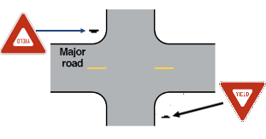
Section 2B.10 Yield Control
Adds Guidance and updated Options for the conditions that should be considered for yield control
Adds Guidance at an intersection of two roadways having approximately equal characteristics, YIELD signs should be installed on the approach that conflicts the most with school walking routes or ped or bike crossing activity
Notes:
In Section 2B.10, Yield Control (the next least restrictive type of control) is discussed.
The section includes 2 new Guidance statements. The first is a list of 6 conditions that all must exist at the intersection, as determined by engineering judgment, to warrant this type of control. The conditions include such things as sight distance, volumes, crash history, geometry, and roadway classification -- based on the NCHRP research.
The second new Guidance statement is a recommendation that applies to when yield control is to be installed at an intersection of two roadways having approximately equal volumes, speeds, and other characteristics. In this case , the Yield signs should be installed on the approach(es) that conflict the most with school walking routes, pedestrian crossing activity, or bike crossing activity.
Additionally, the Optional conditions for when Yield signs may be installed have been updated and expanded.

Slide 14
Section 2B.11 Minor Road Stop Control
Revises Guidance on selection of this control:
  Minimum vehicular volume criterion deleted
  Crash criteria revised to separately address three-leg and four-leg intersections
Notes:
Section 2B.11 deals with perhaps the most common type of control – Stop signs on the minor road.
Guidance about use of this type of control has been revised based on the NCHRP research. The former minimum vehicular volume criterion of 6,000 vehicles per day has been eliminated, and the crash criteria have been revised to separately address 3-leg and 4-leg intersections.

Slide 15

Sections 2B.12 through 2B.17 All-Way Stop Control
Adds Guidance—engineering study should include an analysis of pertinent factors, including those contained in five specific new warrants:
  Describes in detail in Sections 2B.13 through 2B.17
Adds Standard—satisfaction of one or more of the five warrants shall not in itself require installation of all-way stop control
Notes:
All-Way Stop control is covered in 6 sections – 2B.12 through 2B.17.
Section 2B.12 discusses All-Way Stop control in general. It includes new Guidance about the engineering study used as a basis for selecting this type of control, stating that the study should include an analysis of pertinent factors, including those contained in 5 specific new warrants that are each detailed separately in Sections 2B.13 through 2B.17. The all-way stop control warrants, all based on the NCHRP research, are:
Crash Experience (2B.13)
Sight Distance (2B.14)
Transition to Signal Control or Transition to Yield Control at a Circular Intersection (2B.15)
8-Hour Volume (Vehicles, Pedestrians, Bicycles) (2B.16)
Other Factors (2B.17)
Section 2B.12 also includes a new Standard – satisfaction of one or more of the 5 warrants shall not in itself require the installation of all-way stop control. In other words, even if a warrant is met, there may be conditions at the intersection that engineering judgment determines as making all-way stop control inadvisable.

Slide 16
Section 2B.18 STOP Sign or YIELD Sign Placement
Adds supplemental plaques for optional use below YIELD sign at entry to multi-lane roundabout:
Notes:
Section 2B.18 includes 2 new plaques that may be used below a Yield sign at an entry to a multi-lane roundabout. These plaques can address situations that occur when drivers at a multi-lane roundabout are not anticipating the vehicle in the inside lane to maneuver to exit the roundabout.

Slide 17
Section 2B.19 Yield Here to and Stop Here for Pedestrians Signs (R1-5 Series)
Revises Standard to clarify that R1-5 series signs shall be used only where a crosswalk crosses an uncontrolled multi-lane approach
Adds two additional signs for use at trail crossings
Changes previous Option to use STATE LAW plaque with R1-5 series signs to a Standard prohibiting such use
R1-5d
R1-5e
Notes:
In Section 2B.19, a revised Standard about Yield Here To/Stop Here For Pedestrians (R1-5 series) signs states that these signs shall be used only where a crosswalk crosses an uncontrolled multi-lane approach, because this is where there is a multiple threat scenario that can block other drivers’ and pedestrians’ views of one another.
Also, new R1-5d and R1-5e signs have been added for use at trail crossings across an uncontrolled multi-lane approach. The new signs feature both a bicycle symbol and a pedestrian symbol, because both modes of travel typically use a trail.
The STATE LAW plaque, which was previously allowed to be used with the R1-5 series signs, is now prohibited for this use. This change was made because the R1-5 series signs apply to the specific location for yielding or stopping in advance of a specific crosswalk that is occupied, rather than to the general requirement to yield or stop at occupied crosswalks that is typically specified by State law.

Slide 18
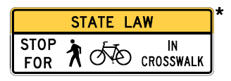
Section 2B.20 In-Street and Overhead Ped and Trail Crossing Signs (R1-6 and R1-9 Series) (1 of 2)
Adds two in-street signs and two overhead signs for use at trail crossings
W11-15
R1-9d
W16-7P
R1-6d
R1-6e
R1-9e
* The legend STATE LAW is optional. A fluorescent yellow-green
background color may be used instead of yellow for this sign.
Notes:
Section 2B.20 covers the In-Street and Overhead Yield To/Stop For Pedestrians signs. It includes new varieties of both types for use at trail crossings, containing both the pedestrian symbol and the bicycle symbol.
These signs shall be used only as a supplement to a Trail Crossing (W11-15) warning sign.

Slide 19
Section 2B.20 In-Street and Overhead Ped and Trail Crossing Signs (R1-6 and R1-9 Series) (2 of 2)
Standard requiring the R1-6 or R1-9 series signs be used as a supplement to a Pedestrian Crossing (W11–2) or Trail Crossing (W11–15) warning sign
Revises Standard to clarify allowable placement including when determined more than one sign or additional placement on edge line might be beneficial
Adds Support referencing Part 3 for the use of channelizing devices
Notes:
A former Option has been changed to a Standard to require, rather than just allow, that if an R1-6 or R1-9 series sign is used, it shall be as a supplement to a Pedestrian Crossing or Trail Crossing warning sign with a diagonal downward-pointing arrow plaque that is post-mounted at the crosswalk location. It is important that if a jurisdiction is using an In-Street sign as a reminder that they are also using the basic warning signs at the crossing, for the safety of pedestrians.
Also in Section 2B.20, the Standard about where the in-street signs shall be placed has been revised to clarify that more than one sign or additional placement on the edge line might be beneficial.
Further, a new Support paragraph is added in the final rule referencing new provisions in Section 3I.02 that clarify the flexibilities available for the use of channelizing devices at mid-block pedestrian crossings in conjunction with In-Street Pedestrian Crossing (R1‑6 Series) Signs. This Support will provide agencies further information on existing treatments that can provide additional emphasis for the pedestrian crossing and provide a channelizing and potentially calming effect on vehicle traffic.

Slide 20
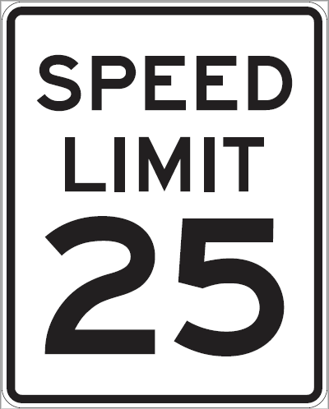
Section 2B.21 Speed Limit Signs (R2-1) (1 of 3)
The MUTCD provisions apply to non-statutory speed limits only​
Emphasizes role of site context (new Standard), roadway type and function; 85th-percentile speed is not deciding factor
Adds Support on applying the provisions to set appropriate speed limits on facilities where vehicles and vulnerable users mix
Clarifies that many factors can influence the speed limit
as determined in the engineering study
Notes:
Section 2B.21 addresses Speed Limit signs, but one of the most significant changes deals with the provisions in this section on the setting of speed limits (determination of what speed limit is to be posted). Many comments on this topic were submitted by the public in response to the Notice of Proposed Amendments.
Significant changes have been made in this section based on consideration of the public comments, most notably regarding where the 85th percentile speed should and should not be the primary consideration for setting the speed limit. The type of roadway and the context in which that section of roadway exists are a new focus of this topic.
The following slides present details on the most significant changes.

Slide 21
Section 2B.21 Speed Limit Signs (R2-1) (2 of 3)
Speed distribution in the engineering study: changed from requirement to recommendation
Standard added that roadway context shall be considered
Includes both 85th-percentile and 50th-percentile (median) speeds in the recommended factors
Includes range of recommended factors that influence the speed limit as determined in the engineering study:
  Pedestrian and bicyclist activity, crash history, land use, intersection spacing, driveway density, roadway geometry, roadside conditions, roadway functional classification, traffic volume, and observed speeds
Notes:
[Just read the text on the slide]
Addition of the 50th percentile speed as a factor to consider because a speed limit set lower than the 50th percentile speed has been shown to result in excessive rates of violation of the speed limit.

Slide 22
Section 2B.21 Speed Limit Signs (R2-1) (3 of 3)
Clarifies that speed distribution has a role in engineering study, but the 85th-percentile speed is not the deciding or heaviest weighted factor over other factors or context​
The 85th-percentile speed as a data point can be an indicator that other modifications or speed management strategies might be needed to achieve compliance​
Posting the speed limit within 5 mph of the 85th-percentile speed is a recommendation, not a requirement, and does not apply to “all roadways:”
  Only recommended for certain roadway types and conditions (freeways, expressways, and rural highways outside urbanized locations or conditions)​
Notes:
It is important to note that other factors in the engineering study might have greater influence or importance than speed distribution when setting posted speed limit, depending on the site conditions of the specific location
Sometimes measures other than traffic control devices can be advisable to help achieve desired operating speeds, especially when the 85th percentile speed is considerably higher than the posted speed limit or when speed studies have shown consistent increases in operating speeds over time. Such measures include geometric changes, additional enforcement, or other speed reduction countermeasures.
The 85th percentile speed remains the primary basis for setting a speed limit on freeways, expressways , and rural highways outside of urban areas or urbanized conditions. This is where the presence of vulnerable road users is unlikely.

Slide 23
Section 2B.26 Movement Prohibition Signs
Adds supplemental legends illustrated in Figure 2B-4:
R3-1b
R3-1c
R3-1d
R3-1e
R3-1f
OR
R3-1g
R3-1h
Notes:
In Section 2B.26, new Options have been added for movement prohibition signs that only apply to certain vehicle classes, that exempt certain vehicle classes, or that are limited to certain time periods. New signs for these purposes, using a supplementary legend rather than a supplementary plaque, are now illustrated in Figure 2B-4.

Slide 24
Section 2B.28 Mandatory Movement Lane Control Signs
Adds optional signs for use at the start of an added turn lane in median
R3-19
R3-19a
R3-19b
Notes:
In Section 2B.28, a new Option has been added for use of post-mounted R19 series signs at the start of an added left turn lane, u-turn lane, or left-and-u-turn lane in the median of a divided highway. These signs can also be used if the added median turn lane is separated from the adjacent through lane by a channelizing or divisional island.

Slide 25
Section 2B.29 Optional Movement Lane Control Signs (R3-6 Series)
Adds two variations of R3-6 signs illustrated in Figure 2B-4
R3-6
R3-6a
R3-6b
Notes:
In Section 2B.29, two new varieties of the R3-6 thru-and-left optional movement lane control sign have been added. These new signs are for lanes restricted to two different turn movements rather than thru-and-left.

Slide 26
Section 2B.30 Advance Intersection Lane Control Signs (R3-8 Series)
Adds R3-8 signs for when bike lane is located between two
general-purpose lanes
R3-8 series signs shall not be mounted at far side of intersection or overhead
R3-8xa
R3-8xb
R3-8xc
Notes:
In Section 2B.30, a new Option has been added that where there is a bicycle lane located between two general-purpose lanes on the approach to an intersection, the basic design of the R3-8 series of advance intersection lane control signs may be modified to show the bike lane with white legend on a black background. Three varieties of this new type of R3-8 signs are illustrated in Figure 2B-4.
Also, a new Standard has been added to prohibit the far-side mounting of R3-8 signs, because it can be confusing to road users, who might misinterpret it as applying to a downstream intersection. It is also prohibited to mount R3-8 signs overhead, as R3-5 and R3-6 signs are intended for overhead mounting above each individual lane to which they apply.

Slide 27
Sections 2B.31 and 2B.38
Adds R3-33a vertical rectangle sign for when roadside width will not accommodate horizontal rectangle R3-33
R4-16 sign only appropriate when there are two lanes in
one direction, not more than two lanes
R3-33
R3-33a
R4-16
Notes:
In Section 2B.31, a new vertical rectangle version of the horizontal rectangle R3-33 RIGHT LANE MUST EXIT sign has been added for optional use when the roadside width is too narrow to accommodate the horizontal rectangle sign.
In Section 2B.38, the Option and Guidance statements regarding the use of the R4-16 KEEP RIGHT EXCEPT TO PASS sign have been revised to clarify that this sign is only to be used when there are 2 lanes in one direction, and not when there are more than 2. The SLOWER TRAFFIC KEEP RIGHT (R4-3) or TRUCKS USE RIGHT LANE (R4-5) signs are intended for use where there are more than 2 lanes in one direction.

Slide 28
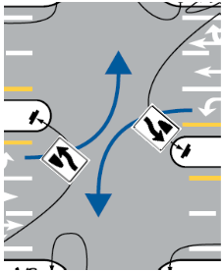
Section 2B.39 Keep Right and Keep Left Signs
Keep Right signs at median or median opening shall be placed as close as practical to approach end, visible to the divided highway and angled toward the crossroad approach
Recommend word message instead of symbol where approach end channelizes traffic away from approach direction
OR
R4-7b
R4-20
Notes:
In Section 2B.39, a new Standard prescribes where Keep Right signs shall be placed at the start of a median or at a median opening, based on recent NCHRP research.
Also, new Guidance recommends that where the approach end of a median or channelizing island channelizes all approaching traffic away from the approach direction (such as shown in the illustration), the word message R4-7b Keep Right sign or R4-20 ALL TRAFFIC sign should be used, to emphasize the degree of curvature away from the approach direction.

Slide 29
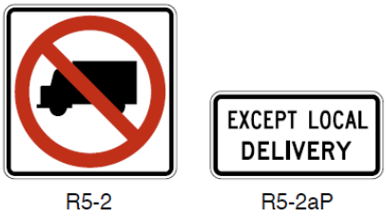
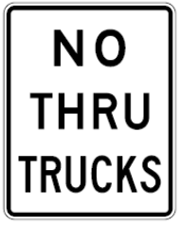
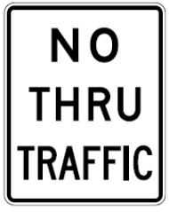
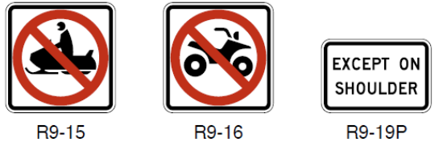
Section 2B.45 Selective Exclusion Signs and Plaques
Word message NO TRUCKS sign alternative eliminated
Adds two new plaques
Adds four new exclusion signs and plaques
R5-2
R5-2aP
R9-15
R9-16
R9-19P
R5-2b
R5-12
Notes:
In Section 2B.45, the former option to use a word message NO TRUCKS sign has been eliminated, as the symbol is well understood and there is no need for the word message.
However, because there is no symbol to adequately convey the message No Thru Trucks or No Thru Traffic, these 2 new word message signs have been added.
Also, new symbolic signs for No Snowmobiles and No ATVs have been added, as well as two new supplemental plaques associated with Selective Exclusion signs.

Slide 30
Section 2B.46 DO NOT ENTER Sign (R5-1)
Standard on where DO NOT ENTER sign shall be used expanded and made more specific, such as where a two-way roadway becomes a one-way roadway approaching from the opposite direction
EXCEPT BICYCLES plaque may be used with
DO NOT ENTER sign when counter-flow bikes
are allowed
Notes:
In Section 2B.46, a Standard has been expanded to specify additional conditions and situations where a Do Not Enter sign shall be used, such as where a 2-way roadway becomes a one-way roadway that approaches from the opposite direction. An example of this condition is shown in Figure 2B-18.

Slide 31
Section 2B.48 Wrong-Way Traffic Control at Interchange Ramps (1 of 2)
Adds Option for mounting DO NOT ENTER and WRONG WAY signs on the same support facing wrong-way traffic at the intersection of the crossroad and the exit ramp
  In this case, the mounting height to the bottom of the Wrong Way sign may be a minimum of 3 ft
R5-1a
Notes:
In Section 2B.48, a number of new Options have been added to give more flexibility to use and locate signs that would better address occurrence of wrong-way entries onto freeways and expressways from the crossroad at interchanges. The changes are based on recent NCHRP research.
The new option allowing Do Not Enter and Wrong Way signs to be mounted on the same post and at a lower mounting height, facing potentially wrong-way drivers at the intersection of the crossroad and the exit ramp, provides an optional supplement that is intended for a potentially disoriented driver whose vision might be focused at a lower height.
The next slide shows this type of mounting.

Slide 32
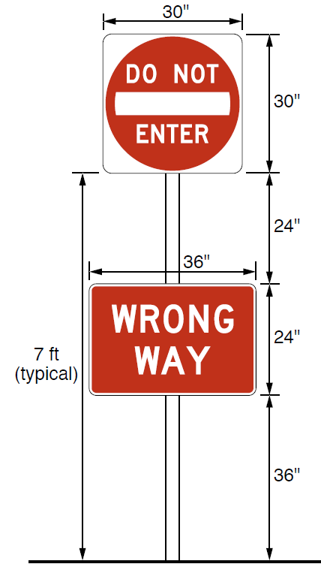
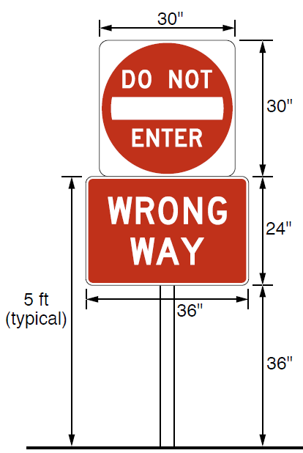
Section 2B.48 Wrong-Way Traffic Control at Interchange Ramps (2 of 2)
Notes:
This slide shows part of Figure 2B-17 which illustrates how Do Not Enter and Wrong Way signs can be mounted on the same post, with the Wrong Way sign at a lower mounting height, facing potentially wrong-way drivers at the intersection of the crossroad and the exit ramp. Shown here are arrangements with a 30-inch Do Not Enter sign. The assembly on the left would be for when the Do Not Enter is supposed to be mounted at 7 feet above grade. The assembly on the right is for when a 5 feet mounting height is specified for the Do Not Enter sign.
Figure 2B-17 also shows examples of mountings with larger size signs.

Slide 33

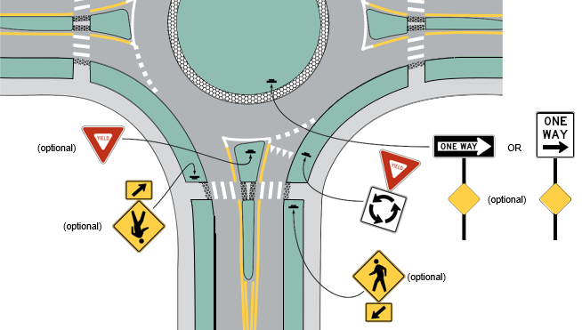
Roundabout Directional Arrow Signs Eliminated
Notes:
The Roundabout Directional Arrow signs that were in the 2009 MUTCD for use on the central island of a roundabout have been eliminated. This is because those signs look very much like a chevron alignment sign, which is a warning sign, and because the signs have become prone to misuse.
To address the condition for which Roundabout Directional Arrow signs were intended, Section 2B.49 now provides for the optional use of regulatory ONE WAY signs on the central island to direct traffic counter-clockwise around the roundabout.

Slide 34
Section 2B.53 Design of Parking, Standing, and Stopping Signs
Adds Mobile Parking Payment plaque
Adds Electric Vehicle Parking and Charging signs
R7-111
R7-111a
R7-112
R7-112a
R7-112b
R7-113aP
R7-113
R7-113bP
R7-114
R7-114a
R7-114b
Notes:
In Section 2B.52, two classifications of parking regulatory signs are established – prohibitive and permissive – with descriptions of what types of parking regulations generally fall into each category. And Figure 2B-25 has been reconfigured to group together the prohibitive signs, permissive signs, and combination signs.
In Section 2B.53, a new optional Mobile Parking Payment plaque has been added for use where payments can be made electronically, such as by phone call or via a mobile phone app.
Also, a series of new parking signs, both prohibitive and permissive, have been added for Electric Vehicle Parking and Charging signs and plaques for parking spaces reserved for electric vehicles only and for spaces reserved for electric vehicle charging only.

Slide 35

Section 2B.58 Traffic Signal Pedestrian and Bicyclist Actuation Signs
Changes R10-25 sign design
R10-25
R10-25
Notes:
In Section 2B.58, the legend and design of the R10-25 sign has been changed. This sign is used where a pushbutton is provided to activate warning lights such as flashing yellow warning beacons that supplement a pedestrian crossing sign. The new design features the additional legend “Wait for gap in traffic” to discourage pedestrians from starting to cross immediately without making sure traffic has come to a stop.

Slide 36
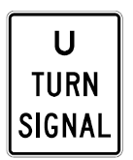
Section 2B.59 Traffic Signal Signs and Plaques
R10-12a
R10-12b
R10-10b
R10-14b
R10-23a
R10-16
R10-30
Notes:
In Section 2B.59, several new traffic signal regulatory signs have been added, as shown in the top row of signs on this slide. Use of these signs is optional.
The R10-12a sign may be installed adjacent to a signal face to reinforce the meaning of a flashing yellow left turn arrow signal indication in that face.
The R10-12b sign may be installed adjacent to a left turn signal face, but only where the conflicting bicycle movement would be unexpected by motor vehicle drivers.
The R10-10a sign is a variety of the R10-10 LEFT (RIGHT) TURN SIGNAL sign, for optional use adjacent to a signal face that exclusively controls a u-turn movement.
And the R10-14b sign may be installed for extra emphasis at an Emergency Vehicle Hybrid Beacon.
The R10-23a sign is only used with a Pedestrian Hybrid Beacon. The text in
Section 2B.59 has a known error that includes the word “steady” in the legend of the sign, which is incorrect. The sign legend is shown correctly on this slide and in Figure 2B-28.
The bottom two signs on this slide are used where conflicts exist between a u-turn movement on one approach and a right turn movement on another approach.
The R10-16 sign is not new, but its use has been changed from optional to Guidance. It is used where a u-turn is allowed on an approach with a protected left turn movement and drivers on the conflicting approach to the left are displayed a protected green right turn arrow indication. The sign clarifies which of the two drivers must yield to the other, specifically the u-turner must yield to right turns from the approach on their left.
The R10-30 sign reinforces that vehicles making a right turn on red after stop movement must yield to the u-turn vehicles from the street onto which they are making a right-turn-on-red movement. This new sign is for optional use.

Slide 37
Section 2B.60 No Turn on Red Signs
Revises Standard on which sign to use:
  R10-11a sign with circular red symbol when approach is controlled by both circular red and red left arrow signal indications
  Word message-only signs (R10-11 or R10-11b) if there is no red arrow for the approach
Adds Standard on location of sign
R10-11b
R10-11
R10-11a
Notes:
In Section 2B.60, a Standard has been revised to define which of the 3 No Turn on Red signs is to be used for which condition when a turn on red is to be prohibited.
The sign with the symbolic red ball (R10-11a) is to be used when the approach is controlled by both circular red and red left arrow signal indications, to clarify that a red left arrow does not allow a left turn. [Note that there is a known error in the text, which inadvertently left out the word “left” between “red” and “arrow”.]
If there is no red left arrow on the approach, then the word message only versions (R10-11 and R10-11b) are to be used.
Also, a new Standard has been added that requires a second, near-side, sign if the primary No Turn on Red sign is the standard size, is located on the far side of the intersection, and is more than 120 feet from the stop line. This is to assure adequate legibility of the prohibition.

Slide 38
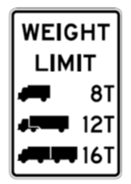
Section 2B.64 Weight Limit Signs (1 of 2)
Requires sign if section of highway or structure has a vehicle weight restriction:
  National Bridge Inspection Standards and National Tunnel Inspection Standards require load posting
Standardizes symbols
Adds sign and plaque
for emergency-vehicle
weight limits
R12-5
R12-6
R12-7
R12-7aP
Notes:
In Section 2B.64, a new Standard has been added to require that a weight limit sign be used to indicate a section of highway or structure that has a vehicle weight restriction. The NPA proposed Guidance was elevated to a Standard because the National Bridge Inspection Standards (23CFR650c) and National Tunnel Inspection Standards (23CFR 650E) require load posting. In concert with this change, the Option in paragraph 2 of the 2009 MUTCD is deleted, as the new Standard requires using one of the available weight limits signs.
Also, a new Standard prescribes that the symbols used to indicate the different vehicle configurations (single-unit, single-trailer or multi-trailer) shall be used regardless of individual shapes of trucks or number of axles, and that other symbols or modifications of the 3 standard symbols shall not be used.
A new R12-6 sign has been added for to allow for a more comprehensive posting of gross weight based on axle configurations and vehicle types.
And a new R12-7 sign and R12-7aP plaque have been added for posting of weight limits that apply only to emergency vehicles.

Slide 39
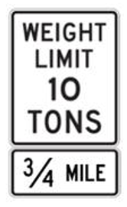
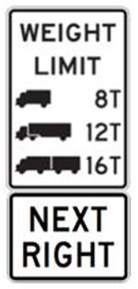
Section 2B.64 Weight Limit Signs (2 of 2)
Adds Standard: requires advance Weight Limit sign with advisory distance or directional legend
Compliance date = 5 years
Notes:
Section 2B.64 also now requires, rather than recommends, that an Advance Weight Limit sign, with an advisory distance or directional legend, shall also be used and shall be located in advance of the applicable section of highway or structure so that prohibited vehicles can detour or turn around prior to the limit zone.
This advance sign is to be in addition to the weight limit sign posted at the structure or start of the restricted section of highway.
A 5-year compliance date has been established for implementing this requirement, due to the critical nature of the infrastructure.

Slide 40
Section 2B.69 Photo Enforced Signs and Plaques
Adds sign for Traffic Signal Photo Enforced:
  Not for use if red-light cameras are not present on any approach to the location
  Must be on separate support from Signal Ahead warning sign
R10-18a
Notes:
In Section 2B.69, a new optional Traffic Signal Photo Enforced (R10–18a) sign has been added. This sign may be installed in advance of or at a signalized location where red-light cameras are present on any approach to the signalized location. It shall not be used for any location where there are no red-light cameras present on any approach. The sign must not be combined on the same support as a Signal Ahead warning sign.

Slide 41
Sections 2B.70, 2B.71, and 2B.72
Adds three new signs
Sign legends may be modified based on State law
R16-3
R16-4
R16-15
Notes:
In Sections 2B.70 through 2B.72, three new signs have been added. The Move Over or Reduce Speed sign and the No Hand-Held Phone Use by Driver sign reflect the need for standardized signs for these two types of regulations, which are commonly in place in many states.
The new Minor Crashes Move Vehicles from Travel Lanes sign is a new design of the former Fender Bender sign. The black on yellow header panel now states STATE LAW rather than FENDER BENDER.
For all 3 of these signs, an Option statement indicates that the word legend of the sign may be modified if the specific requirements of the state law vary from the standard legend.

Slide 42

FHWA’s National
Traffic Control Devices Program
for more information:
mutcd.fhwa.dot.gov
e–Subscribe Service
Official Rulings Database
Standard Highway Signs
Frequently Asked Questions
MUTCD News Feed
Notes:
This concludes this module. Additional modules on the MUTCD 11th Edition are available at the MUTCD Web Site at http://mutcd.fhwa.dot.gov/.
Almost anything related to the MUTCD that you need is at the official MUTCD Web site.
If you haven’t yet signed up for our e-Subscribe service, please take a moment to do so. We’ll send out a bulletin whenever new information is available so you can keep up-to-date. As subscribers, you’ll also hear about future Webinar and other opportunities first.

