Slide 1


Manual on Uniform Traffic Control Devices for Streets and Highways
An Overview of Changes in the 11th Edition
As published in the December 2023
Notice of Final Rule
Prepared by the
Federal Highway Administration’s
Office of Operations
Traffic Control Devices Program
Notes:
Welcome to the Manual on Uniform Traffic Control Devices for Streets and Highways—the MUTCD 11th Edition.
This series provides an overview of the significant changes in the MUTCD and was prepared by the FHWA’s Office of Operations Traffic Control Devices team. Each module address the changes in a specific area of the MUTCD.
Additional modules on the MUTCD 11th Edition are available at the MUTCD Web Site at http://mutcd.fhwa.dot.gov/. The series includes the following modules:
Part 1
Part 2:
Chapter 2A
Chapter 2B
Chapter 2C
Chapter 2D
Chapter 2E
Chapter 2F
Chapter 2G
Chapters 2H and 2I
Chapters 2J and 2K
Chapter 2L
Chapters 2M and 2N
Part 3
Part 4
Part 5
Part 6
Part 7
Part 8
Part 9

Slide 2
Disclaimers
Except for the statutes and regulations cited, the contents of this presentation do not have the force and effect of law and are not meant to bind the States or the public in any way. This presentation is intended only to provide information regarding existing requirements under the law or agency policies.
The Federal Highway Administration (FHWA) is the source of all images in this presentation unless otherwise indicated.
Notes:
(Disclaimer) Except for the statutes and regulations cited, the contents of this presentation do not have the force and effect of law and are not meant to bind the States or the public in any way. This presentation is intended only to provide information regarding existing requirements under the law or agency policies.
FHWA is the source of all images in this presentation unless otherwise indicated.

Slide 3
Overview of Changes in Chapter 2C
Manual on
Uniform Traffic Control Devices
2C
for Streets and Highways
An Overview of Changes in Chapter 2C
As published in the December 2023
Notice of Final Rule
Notes:
The remainder of this presentation will focus on the significant changes to Chapter 2C of the MUTCD.

Slide 4
General
Reorganizes Chapter 2C into 10 sub-chapters:
  Groupings of the 73 sections by topic area
  Index at start of Chapter
Notes:
Chapter 2C has been significantly reorganized to group similar subjects together, making it easier to see interrelationships between topics.
The 73 sections of Chapter 2C are now grouped into 10 sub-chapters, with an index at the start of the chapter.
This presentation will discuss the significant changes within the sections in Chapter 2C.

Slide 5
Section 2C.03 Size of Warning Signs and Plaques
Adds Guidance on minimum size of all warning signs facing traffic on exit and entrance ramps:
  Major interchanges connecting Expressway or Freeway to another Expressway or Freeway—use Table 2C-1 column for the mainline
  At other interchange classifications—specifies minimum size 36″ × 36″
Notes:
In Section 2C.03, new Guidance has been added about the minimum size of all warning signs that face traffic on entrance and exit ramps:
- At major interchanges that connect an expressway or freeway with another expressway or freeways, the Table 2C-1 column for the mainline roadway classification (expressway or freeway) should be used.
- At all other interchange classifications, the minimum size should be 36” x 36”.

Slide 6
Section 2C.04 Placement of Warning Signs
Table 2C-3—Revises Advance Placement Distances in Condition B
Deceleration to 0 mph aligns with American Association of State Highway and Transportation Officials (AASHTO) stopping sight distance minimum design guidelines
Table 2C-3. Guidelines for Advance Placement of Warning Signs
Notes:
Table 2C-3 Guidelines for Advance Placement of Warning Signs has been revised. This is the table that the Section 2C.04 text says should be applied with engineering judgment to provide adequate perception response time (PRT) for the condition being warned of, depending on speed.
The revisions in Table 2C-3 affect the Condition B “deceleration to 0 mph” column, which are the advance placement distances for warning signs regarding a potential stop condition. Typically, that would be signs such as Stop Ahead, Yield Ahead, Signal Ahead, and Intersection Warning signs.
The distances listed in that “0 mph” column have been revised to match those found in the AASHTO Green Book (2018) Table 3-1, Stopping Sight Distance, based on a PRT of 2.5 seconds, and a deceleration rate of 11.2 ft/sec².
These new values are larger than those in the 2009 MUTCD Table, thus placing Advance Traffic Control signs further in advance of the intersection. This provides greater advance notice of the critical intersection stop condition, a factor of safety for legibility distance, and more space on the intersection approach for lane control and guide signing.

Slide 7
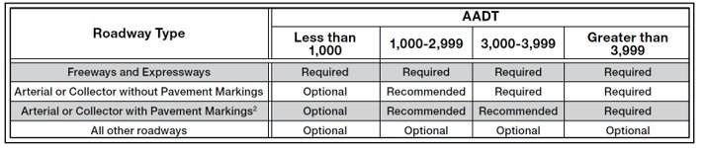
Section 2C.06 Device Selection for Changes in Horizontal Alignment (1 of 2)
Revises Table 2C-4 to include two charts
Chart A determines need first
Table 2C-4. Application of Traffic Control Devices for Changes in Horizontal Alignment
A - Determination of the Need for Devices for Changes in Horizontal Alignment¹
¹ If devices are determined to be needed, the selection of the device(s) is based on Chart B below.
² An arterial or collector is considered to have pavement markings when either a center line, edge lines, or both are present.
Notes:
In Section 2C.06, a new revised Table 2C-4, Application of Traffic Control Devices for Changes in Horizontal Alignment, makes the process more understandable for first determining need for a device to warn of a change in horizontal alignment and then selecting which device to use.
The need (required, recommended, or optional) is determined based on roadway type and AADT volume. See Chart A.
This table also ties in with Section 2C.59 on Advisory Speed Plaques and Table 2C-6, which details the use of Advisory Speed Plaques (required, recommended, and optional) based on the same speed differential I just mentioned as used in Table 2C-4. More on this later in this presentation when we get to Section 2C.59.

Slide 8
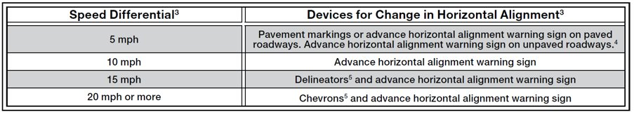
Section 2C.06 Device Selection for Changes in Horizontal Alignment (2 of 2)
Chart B is for the selection of the device
Table 2C-4. Application of Traffic Control Devices for Changes in Horizontal Alignment
B - Selection of Devices for Changes in Horizontal Alignment
Notes:
Then the type(s) of devices to select in Chart B are based on the speed differential between the horizontal curve’s advisory speed and the roadway’s speed on the approach to the curve (posted speed, statutory speed limit, or 85th percentile speed.)
This table also ties in with Section 2C.59 on Advisory Speed Plaques and Table 2C-6, which details the use of Advisory Speed Plaques (required, recommended, and optional) based on the same speed differential I just mentioned as used in Table 2C-4. More on this later in this presentation when we get to Section 2C.59.

Slide 9
Section 2C.07 Horizontal Alignment Signs
Changes 30-mph-or-less advisory speed criterion for use of Turn (W1-1) sign instead of Curve (W1-2) sign from Standard to Guidance
Eliminates Combination Horizontal Alignment /Advisory Speed (W1-1a,
W1-2a) signs
W1-1
W1-2
W1-1a
W1-2a
Notes:
In the 2009 and prior MUTCDs, a Standard specified that, if the advisory speed of a horizontal curve is 30 mph or less, a Turn sign (W1-1) shall be used instead of a Curve sign (W1-2). That Standard has now been changed to Guidance. This will allow engineering judgment to be used when the curve is not severe enough to make the Turn sign appropriate, such as on lower speed roadways where the geometric conditions are better portrayed by the use of the Curve sign.
Also, the former Combination Horizontal Alignment/Advisory Speed signs (W1-1a and W1-2a) have been eliminated. This is because, for changes in horizontal alignment, it is misleading to have an advance warning sign placed at the point of the hazard and because the sign was being used incorrectly by some agencies in place of a standard advance W1-1 or W1-2 sign with an Advisory Speed Plaque, rather than its intended use as a supplement. Instead, Section 2C.59 now provides a Confirming Advisory Speed plaque for this purpose.

Slide 10
Section 2C.08 Chevron Alignment Sign (W1-8)
Light-emitting diodes (LEDs) within Chevron Alignment sign to enhance conspicuity:
  Adds Option for use
  Adds Standard that LEDS used shall be yellow and shall outline the chevron symbol
Chevrons shall not to be used in the central island of a circular intersection
W1-8
Notes:
In Section 2C.08, new provisions have been added to allow the use of yellow LEDs outlining the chevron symbol in Chevron Alignment signs, to enhance conspicuity of the signs.
Also in Section 2C.08, a new Standard has been added to prohibit the use of Chevron Alignment signs in the central island of a circular intersection. The reason is for consistency with a similar prohibition for Large Arrow signs in Section 2C.10. Both the Large Arrow and Chevron signs are used for curves, turns, and changes of alignment and they are not appropriate for direction of traffic entering a roundabout or neighborhood traffic circle where that traffic must yield to traffic in the circulatory roadway.

Slide 11
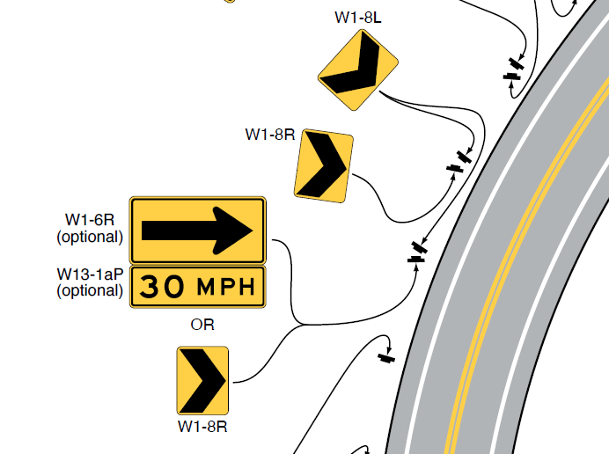
Section 2C.10 One-Direction Large Arrow Sign
(W1-6) (1 of 2)
One-Direction Large Arrow sign may be used either as a supplement to or alternative to Chevron Alignment signs or delineators for horizontal curves
Notes:
Section 2C.10 has been revised to allow use of the One-Direction Large Arrow sign either as a supplement to or alternative to Chevron Alignment signs or delineators to delineate a change in horizontal alignment. This is the result of a recent research study.
Figure 2C-2 has been revised and expanded to include 2 sheets, one for a curve and one for a turn. A portion of Sheet 1, showing a curve, is shown here, illustrating the use of a Large Arrow sign to either supplement or substitute for a Chevron.

Slide 12
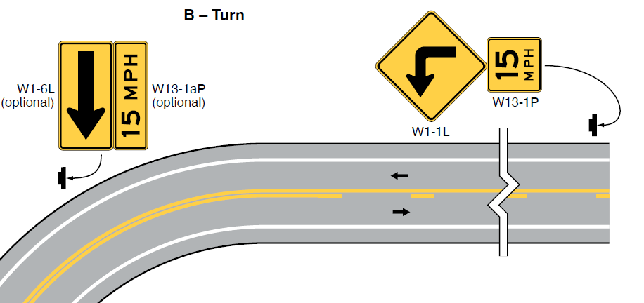
Section 2C.10 One-Direction Large Arrow Sign
(W1-6) (2 of 2)
Notes:
Here is a portion of the second sheet of Figure 2C-2, showing an example of a turn and the use of Large Arrow signs with Confirming Advisory Speed Plaques (which will be discussed later in this presentation).

Slide 13
Section 2C.11 Truck Rollover Sign (W1-13)
If used, the Truck Rollover warning sign (with required Advisory Speed plaque, W13-1P) should be located downstream from the horizontal alignment warning sign in advance of the curve
W1-13
Notes:
There is new Guidance in Section 2C.11 regarding the recommended location of a Truck Rollover warning sign (and the supplemental Advisory Speed Plaque that is required to accompany it). The Guidance calls for the sign to be located downstream from the horizontal alignment warning sign that’s located in advance of the curve (the message of which is aimed at all drivers, not just trucks).

Slide 14
Section 2C.12 Advisory Exit and Ramp Speed Signs (W13-2 and W13-3) (1 of 3)
Adds new Standards, Guidance, and Options to clarify use:
  W13-2 (Advisory Exit Speed) for exit from a freeway or expressway
  W13-3 (Advisory Ramp Speed) for conventional road ramp to another roadway or roadside facility
  Use depends on speed differential between mainline speed limit and advisory speed
W13-2
W13-3
Notes:
In Section 2C.12, new text has been added to clarify where Advisory Exit Speed and Advisory Ramp Speed signs are to be used:
If an advisory speed is to be posted in advance of an exit from a freeway or expressway, the Advisory Exit Speed sign is to be used.
If an advisory speed is to be posted in advance of a conventional road ramp to another roadway or roadside facility, the Advisory Ramp Speed sign is to be used.
Installation of one of these 2 signs, as appropriate, is:
- Required when the difference between the mainline roadway speed limit and the exit or ramp advisory speed in the vicinity of the departure is 20 mph or greater.
- Recommended when the difference is 15 mph.
- Optional when the difference is 10 mph or less.

Slide 15
Section 2C.12 Combination Horizontal Alignment/ Advisory Exit and Ramp Speed Signs (2 of 3)
New:
W13-6
W13-7
W13-8
W13-9
W13-10
W13-11
(Not new)
W13-12
W13-13
Notes:
Section 2C.12 also addresses Combination Horizontal Alignment/Exit or Ramp Advisory Speed signs.
6 new signs in this category have been added to depict various geometries. The W13-6 and W13-7 signs with a 270-degree loop curve are not new. The new signs are the W13-8 and 13-9 signs with a 180-degree horseshoe curve arrow, the W13-10 and W13-11 signs with a 90-degree turn arrow, and the W13-12 and W13-13 signs with the truck rollover symbol and arrow.
A new Standard has also been added that requires the roadway geometries depicted on these standardized sign designs to be the only geometries shown. That means the arrow designs on these signs shall not be modified. The reason is to help ensure that these Combination signs are used only for conditions at exit ramps that are atypical or unexpected. This limitation is intended to minimize overuse of the Combination signs, which could result in a reduction of their effectiveness.

Slide 16
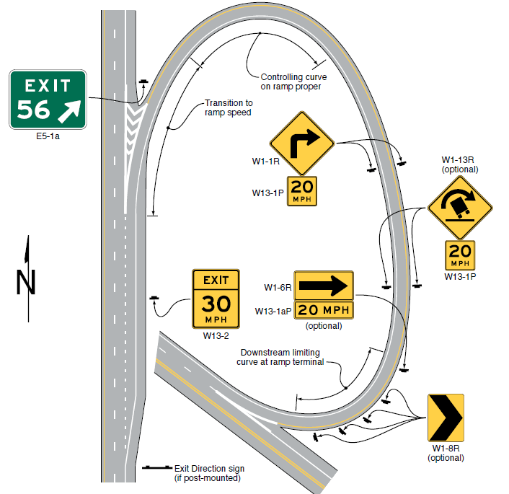
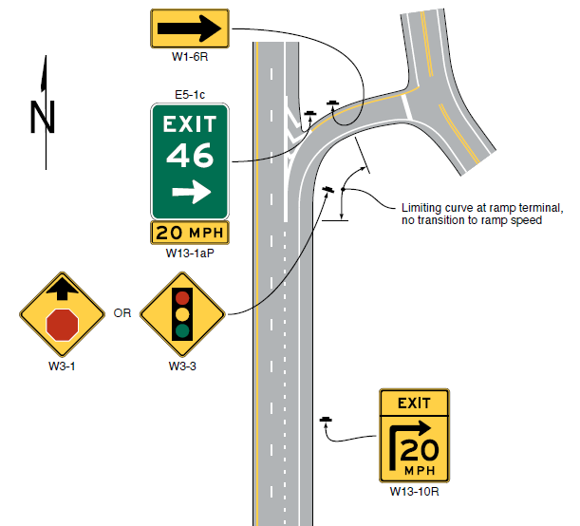
Section 2C.12 New Figures (3 of 3)
B – Loop ramp with downstream limiting curvature
E – Short ramp length with limiting curve near ramp terminal
Notes:
Also, a new Figure 2C-3 with 5 sheets has been added to depict 5 different ramp geometries and the advisory speed and horizontal alignment signs used with each. Shown here are portions of 2 of those 5 sheets, to give you examples.
The 5 drawings illustrate:
a loop ramp with constant controlling curvature along the ramp proper.
a loop ramp with downstream limiting curvature (shown on the left drawing on this slide)
a directional ramp (such as a freeway-to-freeway flyover connection)
a diagonal ramp (such as at a diamond interchange)
a short ramp length with limiting curve near ramp terminal (shown on the right drawing on this slide).

Slide 17
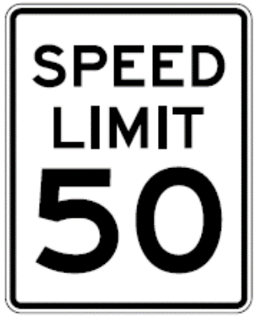
Section 2C.13 Vehicle Speed Feedback Sign and Plaque
W13-20 sign is an independent installation in relation to a horizontal alignment warning sign advisory speed
W13-20aP plaque is mounted below Speed Limit
sign in relation to a posted speed limit
Vehicle Speed Feedback sign and plaque
shall not flash, strobe, change color, or
use animation
Changeable display shall be blank when
no vehicles approaching
R2-1
W13-20
W13-20aP
Notes:
Section 2C.13 adds text and a figure about the Vehicle Speed Feedback sign and plaque, which display the speed of an approaching vehicle to provide warning to drivers of their speed in relation to either a speed limit or horizontal alignment warning advisory speed sign.
When feedback is provided in relation to a horizontal curve advisory speed, the W13-20 sign is to be an independent installation located near the point of curvature of the horizontal curve.
When vehicle speed feedback is provided in relation to a posted speed limit, the W13-20aP plaque is to be mounted below the Speed Limit sign.
The Vehicle Speed Feedback sign and plaque shall not flash, strobe, change color, or use other animated elements integrated into the changeable legend display.
When no vehicles are approaching, the changeable display shall not display a legend.

Slide 18
Sections 2C.18 and 2C.19 Narrow and One Lane Bridge and Underpass Warning Signs
Adds signs for NARROW UNDERPASS, ONE LANE BRIDGE, and ONE LANE UNDERPASS
Adds Option for STOP or YIELD signs and pavement markings at one-lane structures with restricted horizontal clearance
W5-2
W5-2a
W5-3
W5-3a
(Not new)
Notes:
In Section 2C.18, a new Narrow Underpass warning sign has been added to complement the Narrow Bridge warning sign that has been in the MUTCD for many years.
In Section 2C.19, two new signs are added to warn of one-lane structures – bridges and underpasses.
Also, a new Option has been added to allow Stop or Yield signs and pavement markings to be used at one-lane bridges or underpasses with restricted roadway horizontal clearance.

Slide 19
Section 2C.24 DEAD END, NO OUTLET, and ROAD ENDS Signs
Adds optional ROAD (STREET) ENDS XX FT signs to use on approach to end of a conventional road or street where the terminus is not apparent
Not to be used in place of DEAD END or NO OUTLET sign at entrance to such a road or street
W8-26
W8-26a
Notes:
Two new signs have been added in Section 2C.24, for optional use on the approach to the end of a conventional road or street where the terminus is not apparent. The new signs are the W8-26 ROAD ENDS XX FT and the W8-26a STREET ENDS XX FT.
A new Standard states that these signs shall not be used in place of a Dead End or No Outlet sign at the entrance to such a road or street.

Slide 20
Section 2C.25 Low Clearance Signs
Adds Standards and Guidance on Low Clearance Advance (W12-2) sign and Low Clearance Overhead (W12-2a or W12-2b) signs—Compliance Date = 5 years
W12-2a
W12-2
W12-2b
Notes:
Section 2C.25 has been modified, based on an NTSB recommendation, to require a Low Clearance sign (W12-2, now redesignated as the Low Clearance Advance sign) be used to warn road users in advance of a vertical clearance less than 14 feet 6 inches, or less than 12 inches above the statutory maximum vehicle height, whichever is greater. [Note that all States have statutory maximum vehicle heights of 13 feet 6 inches or greater, thus making the 12 inches above the statutory maximum vehicle height the prevailing criterion.]
New Guidance also states that the W12-2 sign with a supplemental distance plaque should also be placed at the nearest intersecting road or wide point in the road at which a vehicle can detour or turn around.
Also, new Guidance has been added that, for an arch or other structure under which the clearance varies greatly, two or more Low Clearance Overhead signs should be installed on the structure itself to indicate the portions of the roadway over which the low clearance applies. This was also based on recommendations from NTSB H-14-11 to provide signing indicating the proper lane of travel for over-height vehicles traveling under an arched structure.
If used, the Low Clearance Overhead (W12-2b) sign shall be placed over a lane or shoulder to indicate the portion of the structure with low clearance if the posted clearance doesn’t apply to the entire structure.
Based on the critical nature of the infrastructure that these signs help to protect from damage by over-height vehicles, a compliance date of 5 years has been established for both the Standard (required posting of the low clearance in advance of the structure) and the Guidance (recommended posting of variable low clearances on an arched structure.

Slide 21
Section 2C.35 Advance Traffic Control Signs
Adds Option allowing yellow LEDs within the sign border for conspicuity enhancement, as an alternative to a flashing yellow Warning Beacon
W3-1
W3-2
W3-3
Notes:
In Section 2C.35, an Option has been added to allow the use of yellow LEDs in the border of an Advance Traffic Control sign for enhanced conspicuity, as an alternative to a flashing yellow Warning Beacon supplementing the sign.

Slide 22
Section 2C.42 Actuated Advance Intersection Signs
Adds W2-10 sign for optional use on an
uncontrolled through road approach to a
stop-controlled side road or crossroad intersection
Adds W2-11 sign for optional use on a side
road stop-controlled approach to an
uncontrolled through road
Must be supplemented with flashing yellow
Warning Beacon activated by detection of
vehicle on conflicting approach
W2-10
W2-11
Notes:
In Section 2C.42, two new “WHEN FLASHING” signs have been added for optional use in advance of intersection conflict areas, which typically involve restricted sight distance and difficult gap selection at Stop-controlled intersections. These new signs are based on information from a Pooled Fund Study.
The TRAFFIC ENTERING WHEN FLASHING (W2-10) may be used on the uncontrolled through roadway approach to a side road or cross road stop-controlled intersection to warn of entering traffic from the side road or cross road.
The TRAFFIC APPROACHING WHEN FLASHING (W2-11) sign may be used on the side road stop-controlled approach to warn of traffic approaching on the uncontrolled through road.
Also, a new Standard states that these signs must be supplemented with a flashing yellow Warning Beacon that activates when a vehicle on a conflicting approach is detected.
LEDs in the border shall not be used with these signs or any other sign or plaque that includes the WHEN FLASHING legend, such as the W3-8 Ramp Metered When Flashing sign.
A part-time Warning Beacon indicating that a condition is in effect (as described in Part 4 of the MUTCD) differs from LEDs used within a sign as a conspicuity enhancement. While a warning beacon can be used for conspicuity, that is not its only function (and is not its function in this case). The WHEN FLASHING message requires a warning beacon for this purpose. This is consistent with Section 4S.03.

Slide 23
Section 2C.45 Merge Signs and Plaques
Section 2C.46 Added Lane Signs
Adds figures to illustrate use and placement:
  Facing traffic on major roadway (W4-1 and W4-3) or on entering roadway (W4-5 and W4-6)
W4-1
W4-5
W4-3
W4-6
Notes:
In Sections 2C.45 and 2C.46, a new Figure 2C-12 has been added to clearly illustrate the use and recommended placement of the Merge signs and Added Lane signs shown here. (See next slide.)

Slide 24
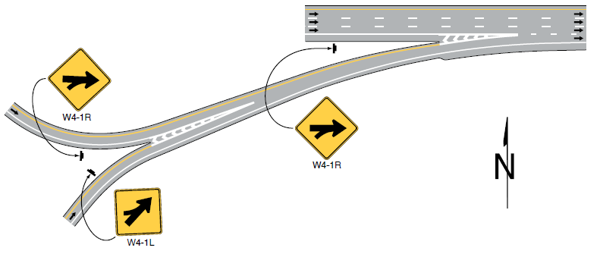
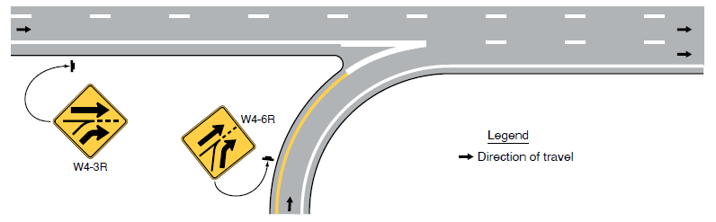
Figure 2C-12 Examples of Merge and Added Lane Placement for Entering and Converging Roadways
A – Example for converging and entering roadways
B – Example for an added lane
Notes:
Here are portions of 2 of the 3 illustrations contained in new Figure 2C-12.
The top drawing shows an example of use of Merge signs on converging and merging roadways. The two ramps merge together and have the appropriate Merge symbols installed on each of the two ramps, correctly located on the side of each ramp roadway where the merge will be encountered. After the ramps merge, the combined ramp roadway merges with the major highway.
The bottom drawing shows a ramp roadway converging with a major highway as an added lane. The appropriate Added Lane symbols are shown for the entering ramp and for the major highway, each correctly located on the side of the roadway where the convergence will be encountered. [Note that this drawing depicts a ramp entering at a large angle. One other drawing in Figure 2C-12 depicts a ramp entering at a flat angle, with the exact same signs and sign locations.]

Slide 25
Section 2C.47 Lane Ends Signs (W4-2 and W9-1)
Eliminates W9-2 sign
W4-2 sign at Table 2C-3 Advance Placement Distance from start of taper
W9-1 with Distance Plaque optional, upstream from W4-2
W9-1
W9-2
W16-2P
series
W4-2
Notes:
In Section 2C.47, the W9-2 sign has been deleted because it is a word message for which a well-established symbol already exists.
Also, Guidance on placement of Lane Ends signs has been revised:
The W4-2 symbol sign location is recommended to be at the “advance placement distance” specified by Table 2C-3 from the start of the taper.
The W9-1 Right Lane Ends sign is for optional supplemental advance warning and placed upstream of the W4-2 sign. If used, the W9-1 sign is recommended to be supplemented with a Distance plaque.
A revised Standard also clarifies that these signs shall not be used in Dropped Lane situations. For those conditions, on conventional roads at intersections, regulatory signs are required to inform road users that a thru lane is becoming a mandatory turn lane.

Slide 26
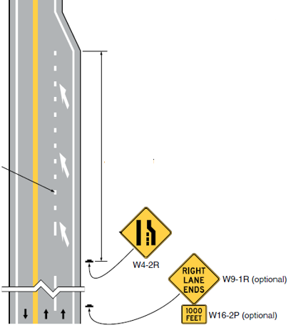
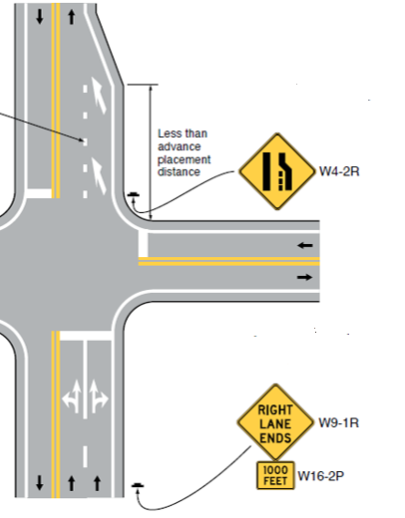
Figure 2C-13 Example Sequences for Lane Ends Signs
See Table 2C-3 to determine the advance placement distance
Note: See Section 3B.12
for lane-reduction
pavement markings
See Table 2C-3 to determine the
advance placement distance
Note: See Section 3B.12
for lane-reduction
pavement markings

Slide 27
Section 2C.48 Lanes Merge Signs (W9-4 and W4-8)
Adds signs for merge of two lanes to one in same direction with merging maneuver required for each lane:
  Not for use where one lane merges into the other
W9-4
W16-2P
series
W4-8
Notes:
Section 2C.48 provides 2 new signs and Guidance and Option text regarding their use to warn of a merge of two lanes to one in the same direction of travel with a merging maneuver required for each lane. This type of merge is for a geometric condition where both approach lanes merge into a single lane, not where one lane merges into the other.
The W4-8 Single Lane Transition sign should be placed at the Table 2C-3 Advance Placement Distance from the start of the taper.
The W9-4 Lanes Merge sign is for optional use in advance of the W4-8 sign to provide additional warning that both lanes form a single lane and that a merging maneuver is needed for the traffic in each lane.

Slide 28
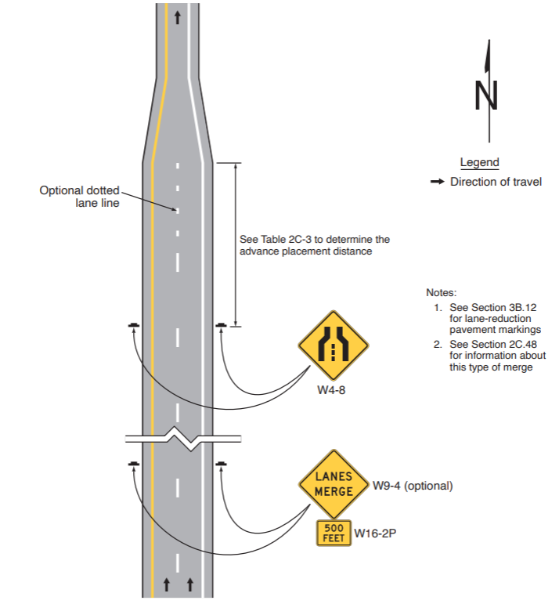
Figure 2C-13 Example Sequence for Lanes Merge Signs
Notes:
See Section 3B.12 for lane-reduction pavement markings
See Section 2C.48 for information about this type of merge
Notes:
This slide shows the last drawing in Figure 2C-13, which illustrates an example sequence of signs for the Lanes Merge condition just discussed.

Slide 29
Section 2C.54 Vehicular Traffic Warning Signs
Section 2C.55 Non-Vehicular Traffic Warning Signs
Shall not be used on an approach controlled by a STOP or YEILD sign, except under either of the following circumstances:
  Yield-controlled approach to circular intersection where crosswalk is at least 20 feet in advance of yield point
  Approach to yield-controlled channelized right turn lane at signalized or stop-controlled intersection where crosswalk is at least 20 ft in advance of yield point
Notes:
Sections 2C.54 and 2C.55 cover Vehicular Traffic Warning signs and Non-Vehicular Traffic Warning signs, respectfully. The significant change from the 2009 MUTCD in these sections is the addition of a Standard paragraph and two Option paragraphs in each of the two sections.
The new Standard in each section states that these signs shall not be used on an approach to an intersection controlled by Stop or Yield signs, for consistency with similar provisions for the School Crossing warning sign in Part 7, as these provisions apply to all crossing signs with intersections controlled by Stop or Yield signs.
The 2 new Options in each section provide exceptions to the prohibition, allowing use of the signs on:
- A Yield-controlled approach to a circular intersection where the crosswalk is at least 20 feet in advance of the yield point; or
- An approach to a Yield-controlled channelized right turn lane at a signalized or Stop-controlled intersection where the crosswalk is at least 20 feet in advance of the yield point.
The language seems to be primarily addressed to Non-Vehicular traffic such as pedestrians at a crosswalk. The reason for this language was also added to Section 2C.54 regarding Vehicular Traffic Warning signs is that the signs in that category might be installed at crosswalks for golf carts, pedestrians, bicyclists, or other shared-use path users.

Slide 30
Other New Warning Signs
W23-2a
W26-1
W3-5b
W4-7
W6-5
W6-5a
Notes:
A variety of other new warning signs have been added, as shown here:
The W23-2a New Signal Operation Ahead sign (see Section 2C.38) is for optional use on the approach to a signalized intersection to provide advance warning of a change in the phasing of the traffic signal.
The W26-1 Watch for Stopped Traffic sign (see Section 2C.39) is for optional use to warn road users of the possibility of vehicles stopping abruptly in the travel lane due to recurring congested conditions.
The W3-5b Variable Speed Zone Ahead sign (see Section 2C.40) is recommended to be used to inform road users in advance of a zone where the speed limit is varied by time of day or as conditions change.
The W4-7 Heavy Merge From Right (Left) sign (see Section 2C.49) is for optional use to supplement a W4-1 Merge sign at multilane approaches to congested areas to inform road users that it is desirable for through traffic to move out of a lane that will be occupied by a high volume of entering traffic.
The W6-5 and W6-5a Two-Way Traffic on a 3-Lane Roadway symbol signs (see Section 2C.52) are for optional use along three-lane roadways with two lanes in one direction and one in the opposing direction.

Slide 31
Section 2C.59 Advisory Speed Plaque (W13-1p) and Confirmation Advisory Speed Plaque (W13-1aP) (1 of 2)
W13-1P
W13-1aP
Table 2C-6. Use of Advisory Speed Plaque for Horizontal Alignment Changes
Speed Differential | Use of Advisory Speed Plaque (W13-1P)¹
5 mph | Optional
10 mph | Recommended
15 mph or more | Required
¹ See Section 2C.59
Notes:
In the reorganized Chapter 2C, the next-to-last sub-chapter is titled “Supplemental Warning Plaques.” It does not deal with all plaques; rather, it deals only with Supplemental Warning Plaques, which may be displayed with a warning or regulatory sign when engineering judgment indicates that road users require additional warning information beyond that contained in the main message of the warning or regulatory sign.
One new supplemental warning plaque, the W13-1aP “Confirmation Advisory Speed Plaque” has been added in Section 2C.59, which also deals with the regular W13-1P Advisory Speed Plaque.
The Confirmation Advisory Speed Plaque is a horizontal rectangle rather than a square. It is designed to be mounted under a One-Direction Large Arrow sign or an Exit Gore E5-1 series sign, to supplement, near the beginning of the alignment change, an advisory speed that is posted at the advance location in an Advance Warning sign assembly.
It may supplement a One-Direction Large Arrow (W1-6) sign on the outside of a turn or curve in line with and at approximately a right angle to approaching traffic.
It may also supplement an Exit Gore sign, placed at the gore of an exit ramp that departs from the mainline roadway at a sharp angle, to reinforce a low advisory exit speed for the curve onto the ramp.
Also in Section 2C.59, a new Table 2C-6 has been added to clarify the use (optional, recommended, or required) of any Advisory Speed Plaque or Confirmation Advisory Speed Plaque, based on the speed differential. The speed differential is the difference between the advisory speed for the horizontal curve and the posted speed limit, statutory speed limit, or the 85th percentile speed on the approach to the curve.

Slide 32
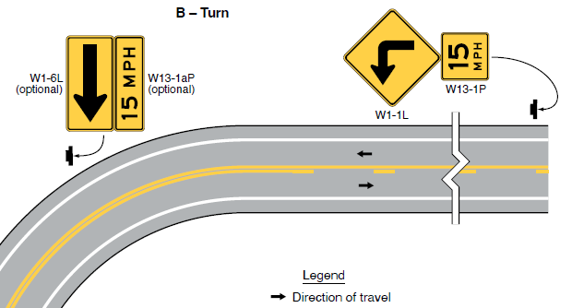
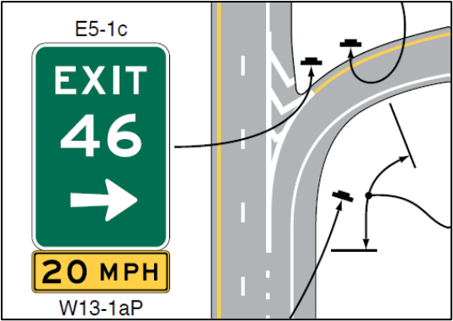
Section 2C.59 Advisory Speed Plaque and Confirmation Advisory Speed Plaque (2 of 2)
Portion of Figure 2C-2, Drawing B
Portion of Figure 2C-3, Drawing E
Notes:
Here are portions of figures in the MUTCD that illustrate use of the Confirmation Advisory Speed Plaque to supplement a Large Arrow sign and an Exit Gore sign.

Slide 33
Other New Supplemental Warning Plaques
W16-7P
W16-7aP
W16-1P
W16-1aP
W16-20P
(Existing Plaque)
W16-1P
Notes:
A variety of other new supplemental warning signs have been added, as shown here:
The W16-7aP plaque with two diagonal downward pointing arrows (see Section 2C.63) is a special variety of the long-established W16-7P single diagonal downward pointing arrow used in certain warning sign assemblies to indicate the specific location of a crossing point. The new plaque may be used with a single crossing sign located on a narrow median separating two roadways with traffic in the same direction where the crossing traverses both roadways.
The W16-1P IN ROAD and W16-1aP IN STREET plaques (see Section 2C.67) may be used to supplement a Vehicular Warning or Non-Vehicular Warning sign in situations where there is a need to warn drivers to watch for other slower forms of transportation traveling along the highway, such as bicycles, pedestrians, golf carts, horse-drawn vehicles, or farm machinery.
The W16-20P Except Bicycles plaque (see Section 2C.68) may be mounted below a warning sign to notify bicyclists that the conditions depicted by the warning sign are not applicable to bicycles, such as a No Outlet or Dead End warning sign for a roadway which terminates as a dead end or cul-de-sac but serves as a continuous route for bicycle travel through the use of connecting paths or a barrier opening.
Also, the former Share the Road supplemental plaque has been eliminated. Research has shown that the ‘‘share the road’’ message when applied to bicyclists does not adequately communicate the responsibilities of either user group on the roadway. Road users are unclear whether ‘‘share the road’’ means that drivers should give space when passing or that bicyclists should pull to the side to allow drivers to pass. The new IN ROAD/IN STREET plaques are intended to replace the SHARE THE ROAD.

Slide 34

FHWA’s National
Traffic Control Devices Program
for more information:
mutcd.fhwa.dot.gov
e–Subscribe Service
Official Rulings Database
Standard Highway Signs
Frequently Asked Questions
MUTCD News Feed
Notes:
This concludes this module. Additional modules on the MUTCD 11th Edition are available at the MUTCD Web Site at http://mutcd.fhwa.dot.gov/.
Almost anything related to the MUTCD that you need is at the official MUTCD Web site.
If you haven’t yet signed up for our e-Subscribe service, please take a moment to do so. We’ll send out a bulletin whenever new information is available so you can keep up-to-date. As subscribers, you’ll also hear about future Webinar and other opportunities first.

