Slide 1


Manual on Uniform Traffic Control Devices for Streets and Highways
An Overview of Changes in the 11th Edition
As published in the December 2023
Notice of Final Rule
Prepared by the
Federal Highway Administration’s
Office of Operations
Traffic Control Devices Program
Notes:
Welcome to the Manual on Uniform Traffic Control Devices for Streets and Highways—the MUTCD 11th Edition.
This series provides an overview of the significant changes in the MUTCD and was prepared by the FHWA’s Office of Operations Traffic Control Devices team. Each module address the changes in a specific area of the MUTCD.
Additional modules on the MUTCD 11th Edition are available at the MUTCD Web Site at http://mutcd.fhwa.dot.gov/. The series includes the following modules:
Part 1
Part 2:
Chapter 2A
Chapter 2B
Chapter 2C
Chapter 2D
Chapter 2E
Chapter 2F
Chapter 2G
Chapters 2H and 2I
Chapters 2J and 2K
Chapter 2L
Chapters 2M and 2N
Part 3
Part 4
Part 5
Part 6
Part 7
Part 8
Part 9

Slide 2
Disclaimers
Except for the statutes and regulations cited, the contents of this presentation do not have the force and effect of law and are not meant to bind the States or the public in any way. This presentation is intended only to provide information regarding existing requirements under the law or agency policies.
The Federal Highway Administration (FHWA) is the source of all images in this presentation unless otherwise indicated.
Notes:
(Disclaimer) Except for the statutes and regulations cited, the contents of this presentation do not have the force and effect of law and are not meant to bind the States or the public in any way. This presentation is intended only to provide information regarding existing requirements under the law or agency policies.
FHWA is the source of all images in this presentation unless otherwise indicated.

Slide 3
Overview of Changes in Chapter 2D
Manual on
Uniform Traffic Control Devices
2D
for Streets and Highways
An Overview of Changes in Chapter 2D
As published in the December 2023
Notice of Final Rule
Notes:
The remainder of this presentation will focus on the significant changes to Chapter 2D of the MUTCD.

Slide 4
Chapter 2D Organization
New subchapter headings to organize sections:
  General Design
  Route Signs and Auxiliary Plaques
  Sign Assemblies
  Destination and Distance Signs
  Street Name and Parking Signs
  Freeway Interchange Approach Signs
  Weigh Station, Crossover, Truck and Passing Lane, and Emergency and Slow Vehicle Turn-Out Signs
  Other Guide Signs
  Signing at Airports
Notes:
Chapter 2D is reorganized to improve usability of the MUTCD. The following subchapter headings organize sections into related groupings: General Design; Route Signs and Auxiliary Plaques; Sign Assemblies; Destination and Distance Signs; Street Name and Parking Signs; Freeway Interchange Approach Signs; Weigh Station Installation, Crossover, Truck and Passing Lane, and Emergency and Slow Vehicle Passing Lane Signs; Other Guide Signs; and Signing at Airports.

Slide 5

Section 2D.01 Scope of Conventional Road Guide Sign Standards and Application
Primary or control destinations displayed on guide signs should be:
  Meaningful to road users in navigation and orientation
  Identifiable on official maps
Not generally used on low-volume rural roads,
except as needed to guide road users back to
major roadways
Notes:
New Guidance recommends that the primary or control destinations displayed on guide signs be meaningful to road users in navigation and orientation, and that such destinations be identifiable on official maps.
New Support indicates that guide signs, other than Street Name signs, are not generally used on low-volume rural roads, except as needed to guide road users back to major roadways.

Slide 6
Section 2D.05 Size of Lettering
Except as otherwise provided in the Manual, principal legend on overhead guide signs shall be:
  At least 6 inches in height for upper-case letters
  At least 4.5 inches in nominal loop height for lower-case letters
Notes:
A new Standard requires that the principal legend on overhead guide signs shall be at least 6 inches in height for all upper-case letters, or a combination of 6 inches in height for upper-case letters and 4.5 inches in nominal loop height for lower-case letters, unless otherwise provided in the Manual.
Table 2D-2 is added and contains recommended minimum letter and numeral heights for conventional road guide signs according to speed and mounting type of either post-mounted or overhead-mounted.

Slide 7
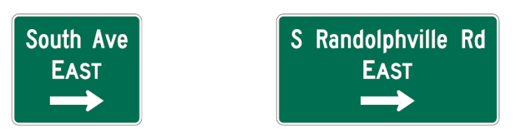
Section 2D.07 Abbreviations (1 of 2)
New Section added regarding commonly recognized abbreviations for certain words (relocated from Chapter 2E.17 of 2009 Edition)
Figure added
Figure 2D-2. Examples of Uses of Abbreviations on Guide Signs
A – Cardinal directions and orientations
“South” is the street name and shall not be abbreviated.
“East” is the cardinal direction of travel and shall not be abbreviated.
“Avenue” is the street name descriptor with a recognizable abbreviation and should be abbreviated.
“South” is a pre-directional designation and may be abbreviated.
“East” is the cardinal direction of travel and shall not be abbreviated.
“Road” is the street name descriptor with a recognizable abbreviation and should be abbreviated.
Notes:
A new Section is added regarding commonly recognized abbreviations for certain words, using material relocated from Chapter 2E.17 of the 2009 Edition of the MUTCD.
A new figure and two new tables are added with examples and recommended abbreviations for certain words, or recommended street name descriptors not acceptable for abbreviation.

Slide 8
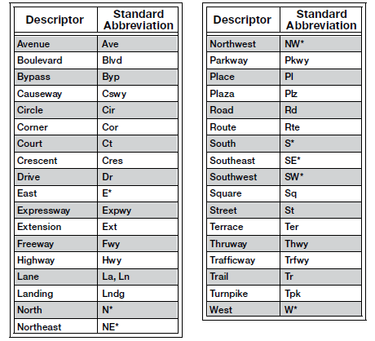
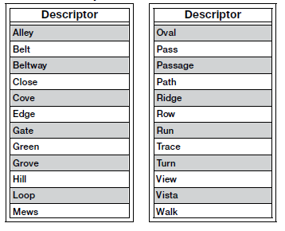
Section 2D.07 Abbreviations (2 of 2)
Adds two Tables
Table 2D-3. Acceptable Abbreviations for Street Name Descriptors
Table 2D-4. Street Name Descriptors
Not Acceptable for Abbreviation
* For pre-directional or post-directional designations or cardinal orientations, such as E Main St or 3rd St SW
Notes:
A new Section is added regarding commonly recognized abbreviations for certain words, using material relocated from Chapter 2E.17 of the 2009 Edition of the MUTCD.
A new figure and two new tables are added with examples and recommended abbreviations for certain words, or recommended street name descriptors not acceptable for abbreviation.

Slide 9



Section 2D.08 Arrows
“Curved-stem arrows” designation is revised to be “Type E directional arrows”
Type E directional arrow may be used to represent left-turn movements around a circulatory island
Type C advance turn directional arrow shall have a shaft bent at either a 90-degree angle or an oblique angle
Type E
Type C
Type D
Notes:
The designation “curved-stem arrows” is revised to be “Type E directional arrows,” which are used exclusively for circular intersections.
The Type E directional arrow may be used on guide signs on approaches to circular intersections to represent the intended driver paths to destinations involving left-turn movements around the circulatory island.
A new Standard requires that if a Type C advance turn directional arrow is used, it shall display a right or left arrow, the shaft of which is bent at a 90-degree or oblique angle.

Slide 10
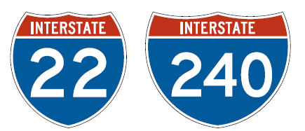
Section 2D.09 Numbered Highway Systems
Adds exception to route system order preference to accommodate driver expectancy and provide more effective direction
Interstate route numbering shall be approved by the FHWA
Interstate Route Sign
M1-1
Notes:
A new Option allows the modification of the prioritization of route systems when a different prioritization would better accommodate the expectancy of the road user and provide more effective direction, such as for separate decision points for routes that are encountered in a particular order.
A new Standard provision reflects the existing requirement that Interstate route numbering be approved by FHWA, consistent with 23 CFR 470.115(a).

Slide 11
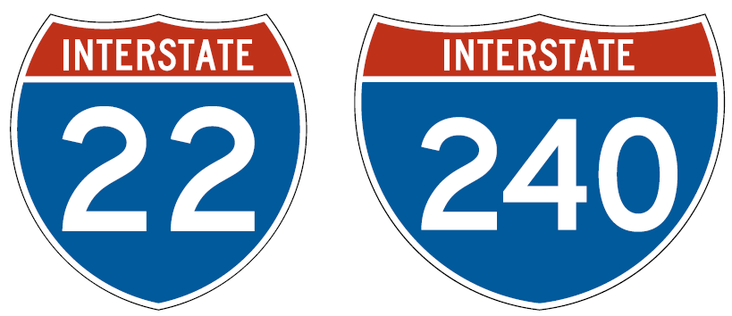
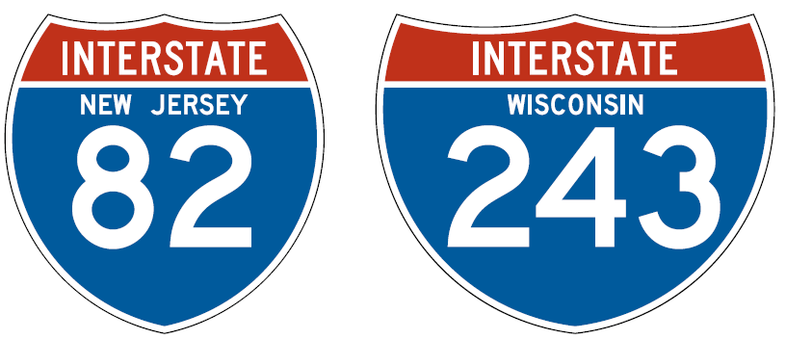
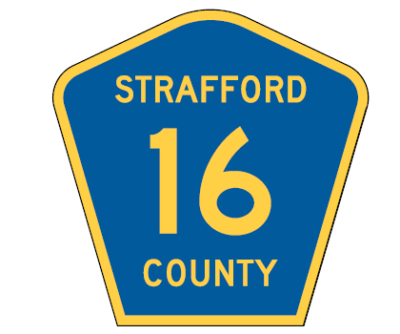
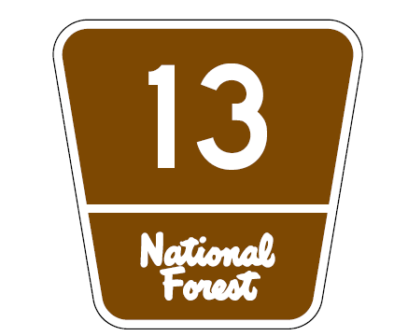
Section 2D.11 Design of Route Signs
Sign legends must comply with the “Standard Highway Signs” publication
Minimum size of 24 x 24 inches for County Route signs
May use M1-1a signs in place of M1-1 signs in Route Sign assemblies only
White rectangle background option removed
State Route sign legends shall conform to Standard Alphabets contained in “Standard Highway Signs”
Interstate Route Sign
M1-1
Interstate Route Sign
M1-1a
County Route Sign
M1-6
Forest Route Sign
M1-7
Notes:
A Standard is revised to clarify that the requirement is for sign legends to comply with the “Standard Highway Signs” publication.
It also clarifies that the minimum size for County Route signs is 24 x 24 inches, in order to maintain consistency with the minimum sizes for other Route signs.
An Option is revised to allow that when the Interstate Route sign is used in a Route Sign assembly, the M1-1a sign, containing the State name in white upper-case letters on a blue background as detailed in the “Standard Highway Signs” publication, may be used in place of the M1-1 sign. The use of the M1-1a sign shall be limited to Route Sign assemblies and does not extend to other types of signs.
The design of the Off-Interstate Business Route and County Route signs includes a wider border to address contrast on a green guide sign, and therefore, the previous Option to include a white square or rectangle behind the route shield on a green guide sign is removed.
A Standard is revised to reiterate the underlying requirement in Chapter 2A that the legend on State Route signs shall conform to the Standard Alphabets contained in the “Standard Highway Signs” publication.
A Standard is revised to clarify that the design of park and forest Route signs apply to non-National Forest routes, and that the design of the National Forest Route sign shall be as detailed in the “Standard Highway Signs” publication.

Slide 12
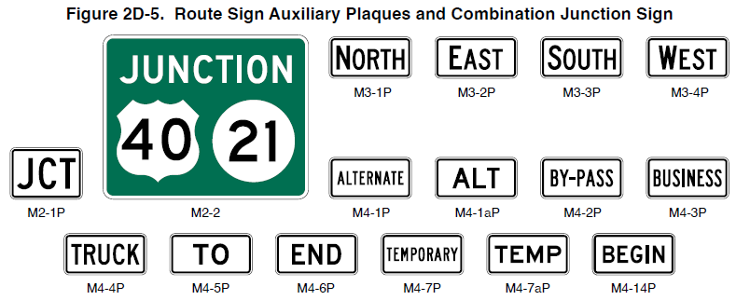
Section 2D.12 Design of Route Sign Auxiliary Plaques
Changes Guidance to Standard:
  If a route sign and its auxiliary plaques are combined to form a single guide sign, the background color of the sign shall be green
Figure 2D-5. Route Sign Auxiliary Plaques and Combination Junction Sign
M3-1P
M3-2P
M3-3P
M3-4P
M4-1P
M4-1aP
M2-1P
M2-2
M4-7P
M4-7aP
M4-2P
M4-3P
M4-4P
M4-5P
M4-6P
M4-14P
Notes:
A previous recommendation is now a requirement regarding the color and design of a combination route sign with auxiliary plaques into a single guide sign. Consistent with sign color requirements for guide signs, if a route sign and its auxiliary plaques are combined to form a single guide sign, the background color of the sign shall be green, and the design shall comply with the basic principles for the design of guide signs.

Slide 13
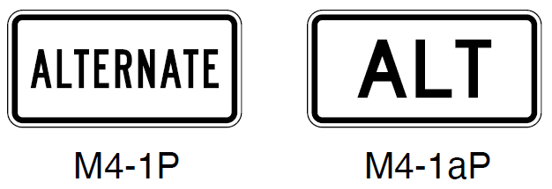
Section 2D.17 ALTERNATE Auxiliary Plaques
(M4-1P and M4-1aP)
M4-1P series plaques shall not be used to sign alternative routing not officially incorporated into the numbered highway system, such as alternative routings for incident management or emergency detours
M4-1P
M4-1aP
Notes:
A Standard is revised to prohibit the use of the M4-1P series plaques to sign an alternative routing that is not officially designated and incorporated into the numbered highway system, such as alternative routings for incident management or emergency detours. A new Section, 2D.59, which we will discuss later includes provisions for Emergency Routing signs and plaques.

Slide 14
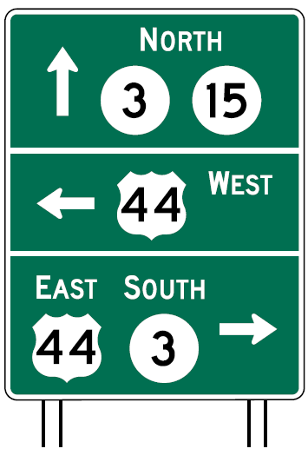
Section 2D.29 Route Sign Assemblies
Recommends that when more than four route signs are needed in a single Advance Route Turn or Directional assembly, the route signs should be mounted in a guide sign
Allows Route Sign assemblies to be omitted for routes that are part of an agency’s internal numbering system and are not publicly mapped or intended for navigational purposes by the general public
Notes:
A new Guidance provision recommends that when more than four route signs would be needed in a single Advance Route Turn or Directional assembly, the route signs should instead be mounted in a guide sign to minimize the need for repetition of the same information on multiple Cardinal Direction and Directional Arrow auxiliary plaques. This reduces informational load on the road user.
A new Option provision allows Route Sign assemblies to be omitted for routes that are part of an agency’s internal numbering system, such as for maintenance or other purposes, and are not publicly mapped or intended to be used for navigational purposes by the general public. Similarly, numbered routes that are not maintained during certain times of year, such as not being plowed during winter months, may be omitted from Route Sign assemblies. This allows agencies greater flexibility.

Slide 15


Section 2D.34 Trailblazer Assembly
Clarifies when a Cardinal Direction auxiliary plaque may be used in a Trailblazer assembly
Notes:
The optional use of a Cardinal Direction auxiliary plaque in a Trailblazer assembly is clarified to only apply where the direction leading to the route provides access only to one direction of travel for that route.

Slide 16
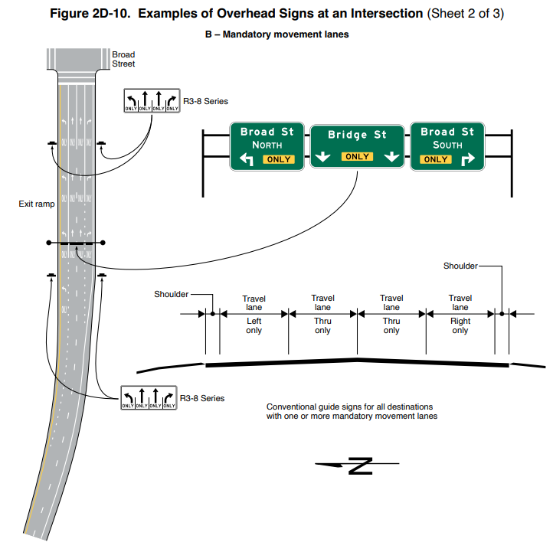
Section 2D.36 Destination Signs (D1 Series)
Overhead destination guide signs on multi-lane conventional roadways with complex or unusual roadway alignments help drivers
Overhead signs may be used to provide the following:
  Lane assignments when using the
  Arrow-per-Lane sign design configuration
  Destination information
Figure 2D-10. Examples of Overhead Signs at an Intersection (Sheet 2 of 3)
B – Mandatory movement lanes
Notes:
New Support is added which states that overhead destination guide signs are sometimes helpful on multi-lane conventional roadways with complex or unusual roadway alignments or geometrics at intersecting highways to provide positive direction to destinations and to assign lanes to be used for destinations.
A new Option is added allowing overhead Destination signs to be used to provide lane assignment and destination information for some or all of the lanes on the approach to a multi-lane intersection. Destination information may include cardinal directions, route numbers, street names, and/or place names. Overhead signs using the Arrow-per-Lane sign design configuration may be used to provide lane assignments for some or all lane destinations at the approach to a multi-lane intersection.

Slide 17
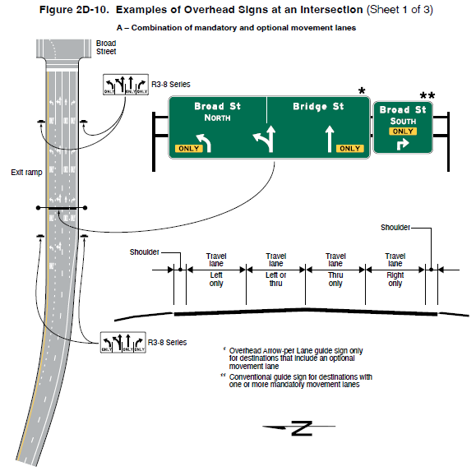
Section 2D.37 Overhead Arrow-per-Lane Destination Guide Signs
Can be used to provide lane assignments where the designated lane is not a mandatory movement lane
Must show arrow above each mandatory turn lane
Must show bifurcated arrow above option lane
Figure 2D-10. Examples of Overhead Signs at an Intersection (Sheet 1 of 3)
A – Combination of mandatory and optional movement lanes
* Overhead Arrow-per Lane guide sign only
for destinations that include an optional
movement lane
** Conventional guide sign for destinations with
one or more mandatory movement lanes
Notes:
New Section 2D.37 Overhead Arrow-Per-Lane Destination Guide Signs is added with provisions for the use of these signs on multi-lane conventional roadway intersections.
Overhead Arrow-Per-Lane destination guide signs can be used to provide lane assignments where the designated lane is not a mandatory movement lane. These signs for conventional roads shall only be used for multi-lane approaches to intersections that have an option lane. An arrow must be shown above each mandatory turn lane and a bifurcated arrow must be shown above the option lane. Standards provide other requirements for arrow placement and sizing, and guidance recommends additional criteria for the design of overhead arrow-per-lane guide signs on conventional roadways.

Slide 18



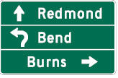
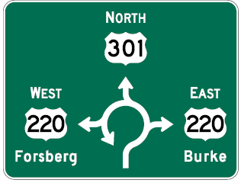
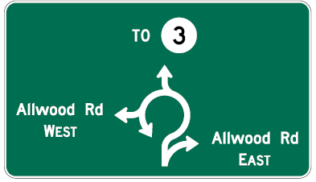
Section 2D.39 Destination Signs at Circular Intersections (1 of 2)
May use Overhead Arrow-per-Lane Destination signs with curved-stem arrows on multi-lane approaches to circular intersections with an option lane
Figure 2D-11. Destination Signs for Circular Intersections
D1-1d
D1-2d
D1-1e
D1-3d
D1-5
D1-5a
Notes:
A Support statement is revised to help ensure that the basic principles of limiting the amount of legend and aligning the arrows with each destination are applied. This is to aid road users in understanding the sign and navigating through the area.
A new Option is added to allow the use of Overhead Arrow-per-Lane Destination signs with curved-stem arrows on multi-lane approaches to circular intersections with an option lane.

Slide 19
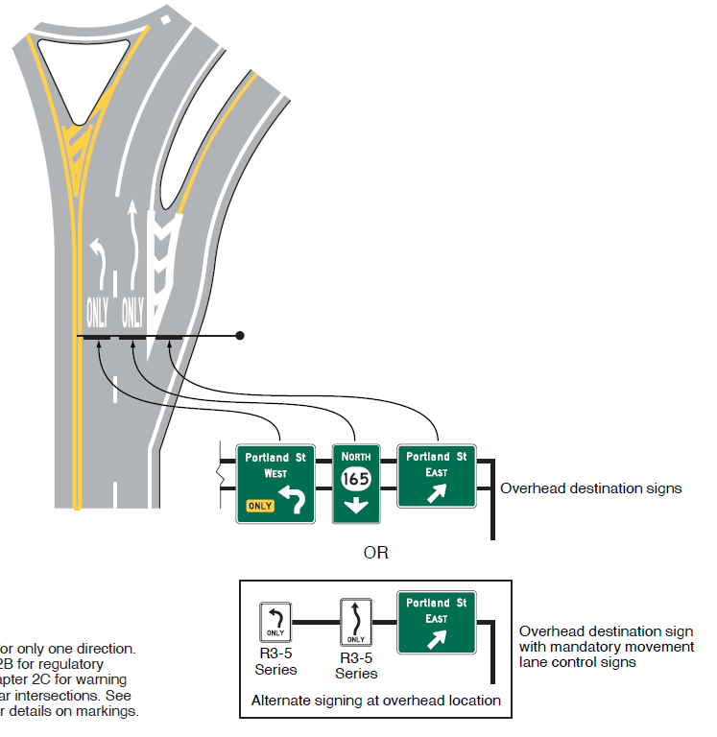
Section 2D.39 Destination Signs at Circular Intersections (2 of 2)
Limit the amount of legend and align the arrows with each destination
Notes:
A Support statement is revised to help ensure that the basic principles of limiting the amount of legend and aligning the arrows with each destination are applied. This is to aid road users in understanding the sign and navigating through the area.
A new Option is added to allow the use of Overhead Arrow-per-Lane Destination signs with curved-stem arrows on multi-lane approaches to circular intersections with an option lane.

Slide 20
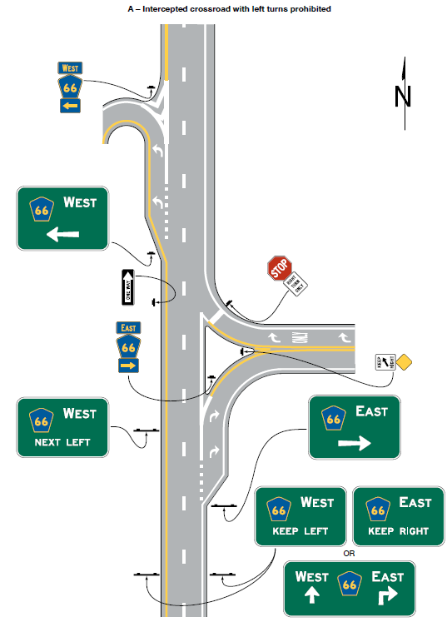
Section 2D.41 Destination Signs at Intersections with Indirect Turning Movements
Adds Section with examples of signing for locations with displaced left turn and intercepted crossroad intersections
A – Intercepted crossroad with left turns prohibited
Notes:
A new Section 2D.41 is added that contains Guidance and Support statements to provide agencies with examples of signing for locations with displaced left turn and intercepted crossroad intersections, which are newer intersection designs and becoming more common in practice and provide for consistency.
A system of guide signs along with associated lane marking should be used to direct traffic through intersection with indirect turning movements.

Slide 21
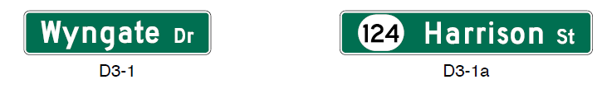
Section 2D.45 Street Name Signs (D3-1 and D3-1a)
Design Guidance:
  Use of minimum letter heights (Table 2D-6)
  Use of conventional abbreviations
  Omitting pictographs on Street Name signs with directional arrows
  Omitting borders on post-mounted Street Name signs
Legend on both front and back sides of the sign
Should not be used at intersections of freeway or expressway exit ramps with crossroads
Memorials or dedication names
D3-1
D3-1a
Notes:
In Section 2D.45, there are a number of changes related to or clarifying the design of Street Name signs. Some of the more significant changes include:
A new Guidance provision recommends using the minimum letter heights included in Table 2D-6 on Street Name signs.
An Option is changed to Guidance regarding the use of conventional abbreviations on the Street Name sign to provide consistency with guide signs.
New Guidance recommends that pictographs not be used on street name signs that contain directional arrows.
New Guidance is added regarding omitting the border from a post-mounted Street Name sign.
Guidance is added recommending that Street Name signs display their legend on both the front and back sides of the sign to facilitate navigation for pedestrians.
A new Guidance provision recommends Street Name signs should not be used at intersections of freeway exit ramps with crossroads, to help minimize the potential for wrong-way movements onto the freeway ramp.
A new Guidance provision recommends that a second Street Name sign should not be used to display the memorial or dedication name of the street.

Slide 22
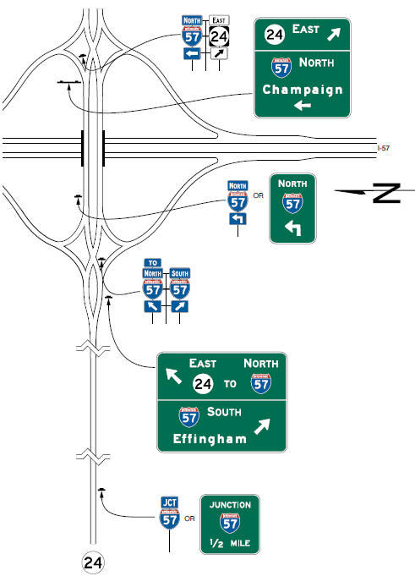
Section 2D.49 Signing on Conventional Roads on Approaches to Interchanges (1 of 2)
Adds example figure for a transposed-alignment crossroad at a diamond interchange
(Figure 2D-21)
Notes:
Two new figures are added to Section 2D.49 that shows examples of guide signing for diamond interchange scenarios.

Slide 23
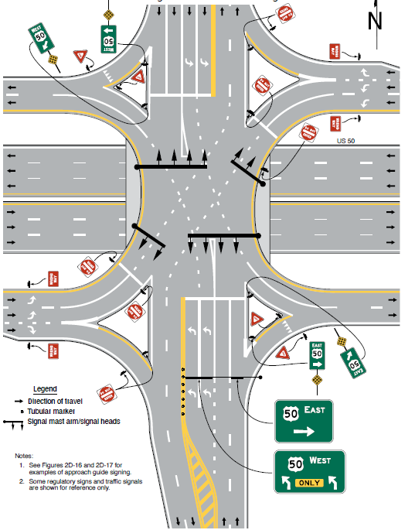
Section 2D.49 Signing on Conventional Roads on Approaches to Interchanges (2 of 2)
Adds example figure for a
single-point urban intersection at a diamond interchange
(Figure 2D-22)
Notes:
1. See Figures 2D-16 and 2D-17 for
examples of approach guide signing.
2. Some regulatory signs and traffic signals
are shown for reference only.
Notes:
Two new figures are added to Section 2D.49 that shows examples of guide signing for diamond interchange scenarios.

Slide 24
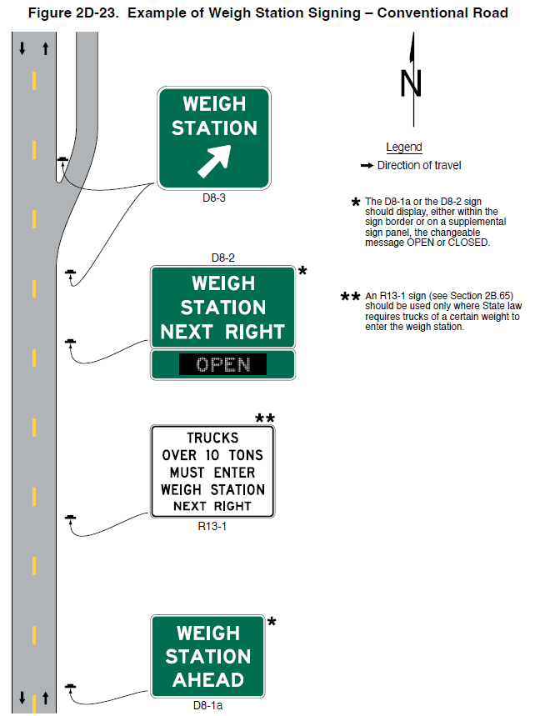
Section 2D.51 Weigh Station Signing (D8 Series)
Figure 2D-23. Example of Weigh Station Signing – Conventional Road
Adds Support definition of weigh station
Revises sign sequence Standard
Recommends Exit Gore sign
Adds Option to use COMMERCIAL VEHICLE INSPECTION legend
* The D8-1a or the D8-2 sign should display, either within the sign border or on a supplemental sign panel, the changeable message OPEN or CLOSED.
** An R13-1 sign (see Section 2B.65) should be used only where State law requires trucks of a certain weight to enter the weigh station.
Notes:
A new Support provision defines the areas where certain vehicles might be directed to stop to be weighed and/or inspected and that such an area can be a permanent roadside area, or a temporary mobile facility deployed along the roadway.
A Standard is revised to indicate the appropriate sequence of signs for Weigh Station signing on a conventional highway and to revise the sign terminology to match the typical sequence of other types of guide signs. The resulting sign sequence includes Weight Station Advance, Weigh Station Advance Direction, and Weigh Station Entrance Direction Signs.
A new Guidance provision recommends a Gore sign with the same basic legend as the Weigh Station Entrance Direction sign be used to emphasize the entrance to the weigh station.
A new Option allows the use of the alternate legend COMMERCIAL VEHICLE INSPECTION for the D8 series Weigh Station signs where only commercial vehicle inspections are conducted in the inspection area. This maintains consistency with the type of activity being conducted at the station.
A new Standard requires that when the WEIGH STATION legend of the D8 series signs is replaced with the COMMERCIAL VEHICLE INSPECTION legend, the WEIGH STATION legend of the R13–1 sign shall be replaced with the alternate legend COMMERCIAL VEHICLE INSPECTION area. This maintains consistency in sign legends.

Slide 25
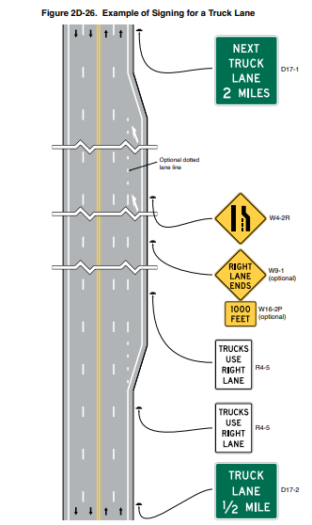
Section 2D.53 Truck and Passing Lane Signs
(D17-1 through D17-4)
Figure 2D-26. Example of Signing for a Truck Lane
Adds examples of signing for a truck lane and passing lane
Revises Guidance to improve uniformity in signing
Notes:
See Chapter 2B for regulatory signs
See Chapter 2C for warning signs
See Chapter 3B for pavement markings
Notes:
In Section 2D.53 Truck and Passing Lane signs, new example figures, Figures 2D-26 and 2D-27 illustrate examples of signing for a truck lane and passing lane respectively.
Guidance is also revised to clarify that if a series of truck lanes is provided along a highway, the Next Truck Lane sign should be installed after each truck lane segment. If an extra lane has been provided to the left-hand side of the travel lane for passing slower moving vehicles in the travel lane, an Advance Passing Lane Advance sign should be installed in advance of the lane. If a series of passing lanes are provided along a highway, a Next Passing Lane sign should be installed after each passing lane segment.
This clarifies that a passing lane is added to the left of the travel lane while a truck lane is added to the right of the travel lane.

Slide 26
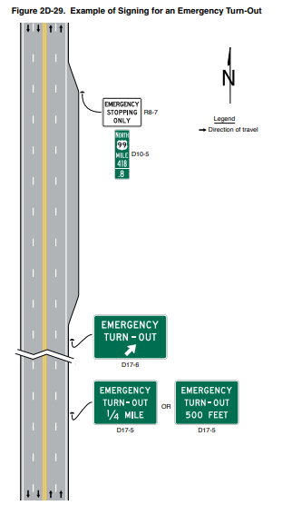
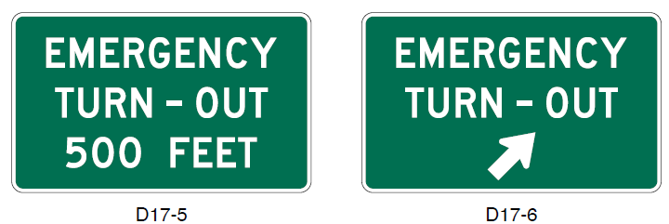
Section 2D.54 Emergency and Slow Vehicle
Turn-Out Signs
Figure 2D-29. Example of Signing of an Emergency Turn-Out
Emergency Turn-Out sign recommendations
Advance Emergency Turn-Out
D17-5
D17-6
Notes:
In Section 2D.54 Emergency and Slow Vehicle Turn-Out Signs, a new figure shows an example of signing for an emergency turn-out.
A new Guidance provision recommends that if an emergency turn-out area has been provided where a shoulder is not available for emergency stopping or where there is part-time shoulder use by traffic (as discussed in Section 2G.23), Emergency Turn-Out signs should be installed. The Advance Emergency Turn-Out Advance sign should be installed between ¼ mile and 500 feet in advance of the turn-out area. The Emergency Turn-Out Directional sign should be installed near the beginning of the turn-out.

Slide 27
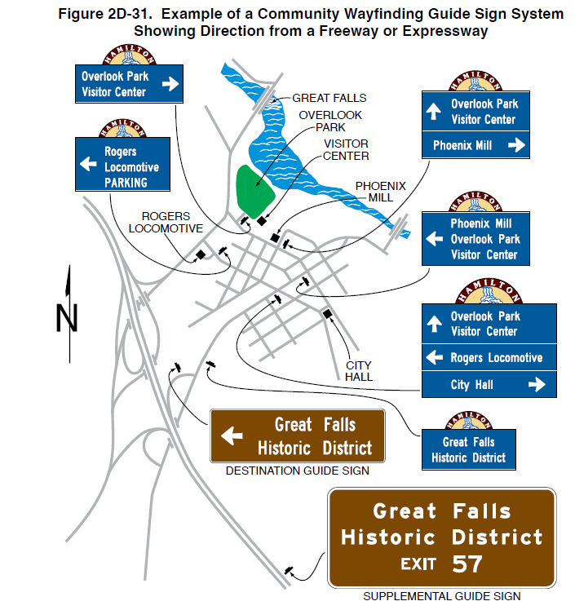
Section 2D.55 Community Wayfinding Signs
System of wayfinding guide signs
Shall be rectangular in shape
Standard Alphabets
If used, alternative lettering shall be conventional in form
Figure 2D-31. Example of a Community Wayfinding Guide Sign System Showing Direction from a Freeway or Expressway
Notes:
A new Guidance provision recommends that when a system of community wayfinding guide signs is being considered, the system of existing guide signs should be evaluated for applicability and general compliance with the provisions of the MUTCD to ensure road user directional guidance is adequately addressed.
A Guidance provision is changed to a Standard, requiring that community wayfinding guide signs be rectangular in shape.
A new Guidance provision recommends letters, numerals, and other characters should be composed of the Standard Alphabets as detailed in the “Standard Highway Signs” publication.
A new Standard requires that if a lettering style other than the Standard Alphabets is used, the alternative lettering style shall be conventional in form. The letters, numerals, and other characters shall not be italic, oblique, script, highly decorative, or of other unusual forms which by their nature would not maintain adequate legibility under driving conditions.

Slide 28
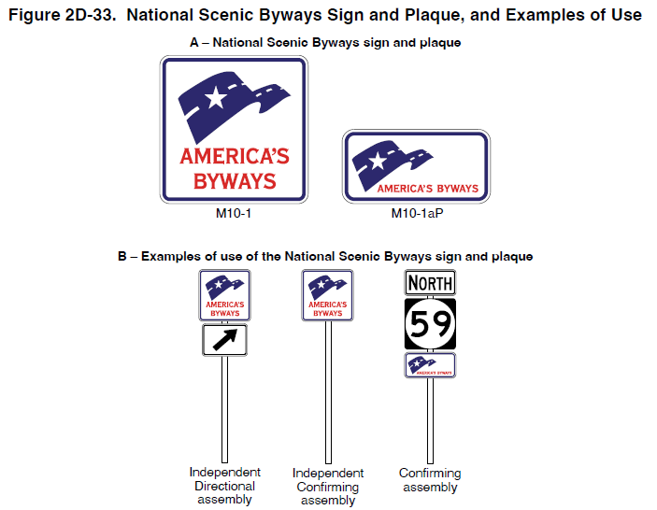
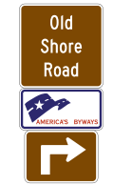
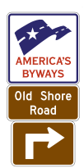
Section 2D.57 National Scenic Byways Sign and Plaque (M10-1 and M10-1aP)
Guidance on byway signing
M10-1 sign and M10-1aP plaque shall not be installed on a guide sign
Figure 2D-33. National Scenic Byways Sign and Plaque, and Examples of Use
A - National Scenic Byways sign and plaque
M10-1
M10-1aP
B- Examples of use of the National Scenic Byways sign and plaque
State Scenic Byway
that is also designated as a National Scenic Byway
National Scenic
Byway system
Independent Directional assembly
Independent Confirming assembly
Confirming assembly
Notes:
New Guidance recommends that where the byway is identified only by the National Scenic Byways sign, the Directional assembly should consist of the M10-1 sign and an M5 series or M6 series auxiliary plaque when indication of a turn is necessary to remain on the byway route. Where the name of the byway is to be displayed on identification signs or plaques along the byway route, the name should be displayed in a Directional or Confirming assembly as follows:
A. On a Byway Identification plaque mounted below the M10-1 sign; or
B. On a Byway Identification sign with the M10-1aP plaque mounted below the sign.
In either case, the size of the National Scenic Byways sign, plaque, Byway Identification sign, and Byway Identification plaque should be consistent with that specified for Route signs for the roadway classification. The byway Directional or Confirming assemblies should be located separately from any Route Sign assemblies or Destination guide signs.
A new Standard clarifies that the M10-1 sign or the M10-1aP plaque shall not be installed as sign panels on a guide sign or as part of a guide sign assembly.

Slide 29
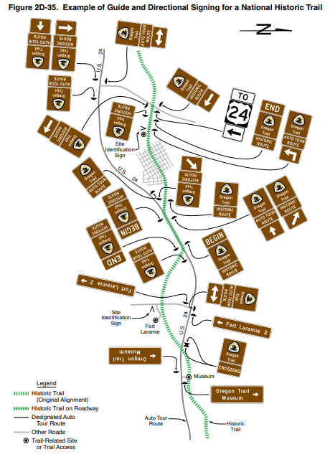
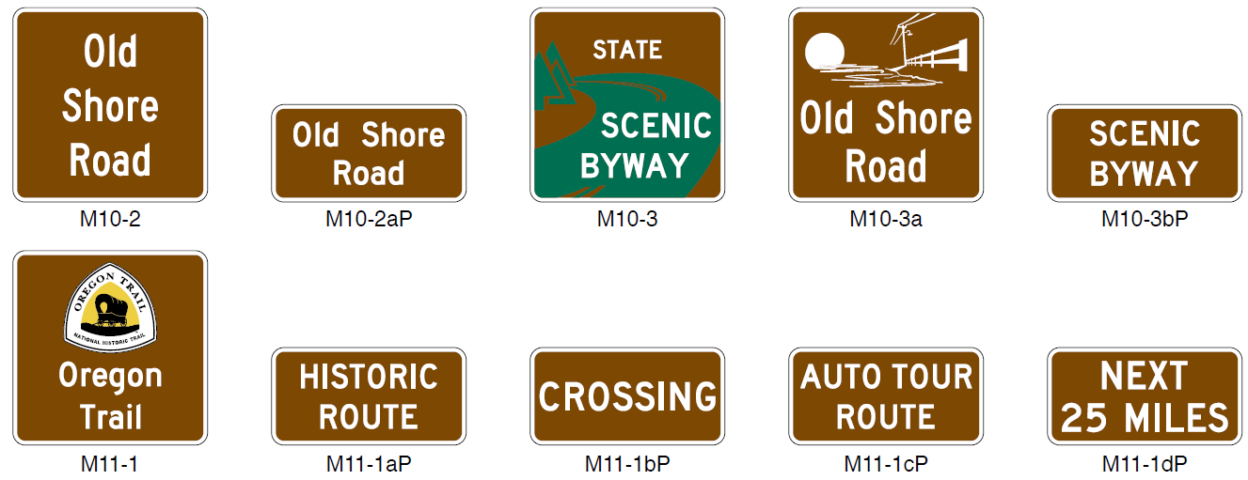
Section 2D.58 State-Designated Scenic Byway, Historic Trail, and Auto Tour Route Signs
Figure 2D-35. Example of Guide and Directional Signing for a National Historic Trail
Adds section
Addresses inconsistencies
M10-2
M10-2aP
M10-3
M10-3a
M10-3bP
M11-1
M11-1aP
M11-1bP
M11-1cP
M11-1dP
Notes:
This new Section includes relocated provisions from Chapter 2H, and addresses inconsistencies in how state-designated scenic byways, historic trails, and auto tour routes are signed. Option provisions are included to correspond to the sign designations provided in Figure 2D-34.
The signing recommendations and standards are similar in concept to National Scenic Byways. Scenic byway, historic trail, and auto tour route sign designs shall not have a similar design to or resemble a highway route sign, to avoid confusion with officially numbered roues on a highway system that are marked by the official route sign.
Although the signs have standard designations, the provisions include flexibility with regard to the design of State Scenic Byway signs. Agencies choosing to develop site specific simple graphics on scenic byway signs would evaluate the design for effectiveness as a traffic control device, avoiding complex graphics, significant number of colors, non-standard lettering styles, and advertising.

Slide 30
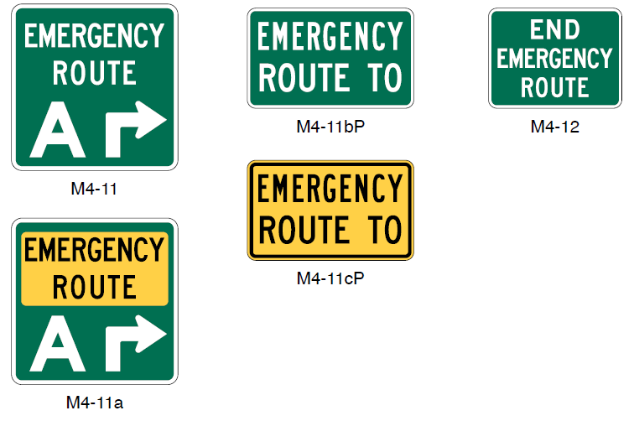
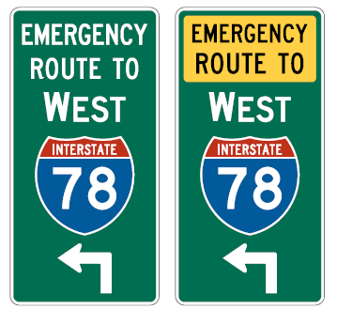
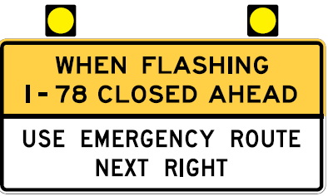
Section 2D.59 Emergency Routing Signs and Plaques (M4-11 and M4-12 Series)
Permanently signing emergency routes for corridor management
M4-11bP
M4-12
M4-11
Examples of guide signs for rerouting
M4-11cP
M4-11a
Examples of advance signs for rerouting
Notes:
New Section 2D.59 contains provisions for emergency route signs for the purposes of corridor management along routes that have recurring incidents and have reasonable rerouting paths available. These signs are intended to be permanently installed to provide instant rerouting guidance to road users when traffic congestion or backups first begin even before emergency responders could provide temporary traffic control for rerouting traffic.
The provisions are based on Official Ruling No. 6(09)-42(I).
Signs are required to have a white legend and border on a green background. Optionally, for additional emphasis the legend EMERGENCY ROUTE or EMERGENCY ROUTE TO may be displayed in a yellow panel with black letters. Orange or pink shall not be used for permanently-installed signs or plaques.
New Figure 2D-37 includes the standard signs and examples of guide signs and advance signs for rerouting, and new Figure 2D-38 illustrates an example of the use of permanently-installed emergency routing signs.

Slide 31
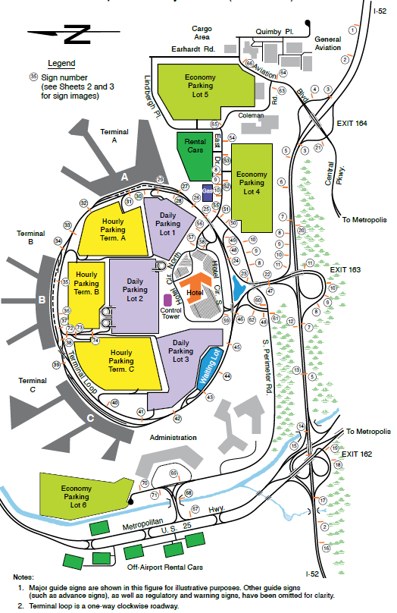
Section 2D.60 Signing at Airports
Guidance based on Airport Cooperative Research Program Report 52
Recommends potential measures to provide road users adequate time to comprehend and respond to signs at airports
Adds Figure 2D-39, providing an example of major guide signing on the approaches to and within an airport facility roadway network
Notes:
1. Major guide signs are shown in this figure for illustrative purposes. Other guide signs
(such as advance signs), as well as regulatory and warning signs, have been omitted for clarity.
2. Terminal loop is a one-way clockwise roadway.
Notes:
New Section 2D.60 contains provisions for Signing at Airports. The support and guidance provisions are based on a study by the Transportation Research Board’s Airport Cooperative Research Program. The study is documented in Report 52, “Wayfinding and Signing Guidelines for Airport Terminal and Landside,” and contains additional information on the application of traffic control devices to the unique geometrics and roadway environment that are typical of airports.
New Guidance recommends potential measures to provide road users with adequate time to comprehend and respond to signs at airports. These include:
Taking measures to reduce the speeds of vehicles on the roadway,
considering increasing the letter and numeral heights on signs to provide greater viewing distances and decision times, and
spreading airline information on separate signs that appear in sequence to limit the number of airlines displayed on a single sign at a single location.
Changeable message signs should not be used to rotate the display of airlines to an approaching road user.
Figure 2D-39 is added to provide an example of major guide signing on the approaches to and within an airport facility roadway network.

Slide 32

FHWA’s National
Traffic Control Devices Program
for more information:
mutcd.fhwa.dot.gov
e–Subscribe Service
Official Rulings Database
Standard Highway Signs
Frequently Asked Questions
MUTCD News Feed
Notes:
This concludes this module. Additional modules on the MUTCD 11th Edition are available at the MUTCD Web Site at http://mutcd.fhwa.dot.gov/.
Almost anything related to the MUTCD that you need is at the official MUTCD Web site.
If you haven’t yet signed up for our e-Subscribe service, please take a moment to do so. We’ll send out a bulletin whenever new information is available so you can keep up-to-date. As subscribers, you’ll also hear about future Webinar and other opportunities first.

