Slide 1


Manual on Uniform Traffic Control Devices for Streets and Highways
An Overview of Changes in the 11th Edition
As published in the December 2023
Notice of Final Rule
Prepared by the
Federal Highway Administration’s
Office of Operations
Traffic Control Devices Program
Notes:
Welcome to the Manual on Uniform Traffic Control Devices for Streets and Highways—the MUTCD 11th Edition.
This series provides an overview of the significant changes in the MUTCD and was prepared by the FHWA’s Office of Operations Traffic Control Devices team. Each module address the changes in a specific area of the MUTCD.
Additional modules on the MUTCD 11th Edition are available at the MUTCD Web Site at http://mutcd.fhwa.dot.gov/. The series includes the following modules:
Part 1
Part 2:
Chapter 2A
Chapter 2B
Chapter 2C
Chapter 2D
Chapter 2E
Chapter 2F
Chapter 2G
Chapters 2H and 2I
Chapters 2J and 2K
Chapter 2L
Chapters 2M and 2N
Part 3
Part 4
Part 5
Part 6
Part 7
Part 8
Part 9

Slide 2
Disclaimers
Except for the statutes and regulations cited, the contents of this presentation do not have the force and effect of law and are not meant to bind the States or the public in any way. This presentation is intended only to provide information regarding existing requirements under the law or agency policies.
The Federal Highway Administration (FHWA) is the source of all images in this presentation unless otherwise indicated.
Notes:
(Disclaimer) Except for the statutes and regulations cited, the contents of this presentation do not have the force and effect of law and are not meant to bind the States or the public in any way. This presentation is intended only to provide information regarding existing requirements under the law or agency policies.
FHWA is the source of all images in this presentation unless otherwise indicated.

Slide 3
Overview of Changes in Chapter 2E
Manual on
Uniform Traffic Control Devices
2E
for Streets and Highways
An Overview of Changes in Chapter 2E
As published in the December 2023
Notice of Final Rule
Notes:
The remainder of this presentation will focus on the significant changes to Chapter 2E of the MUTCD.

Slide 4
Chapter 2E Organization
New sub-chapter headings to organize sections:
  General
  Sign Design
  Installation
  Guide Signing for Interchanges
  Other Guide Signs
  Signs for Route Diversion by Vehicle Class
  Interface With Conventional Roadways
Notes:
Chapter 2E is reorganized with subchapter headings to improve the usability of the MUTCD.

Slide 5
Section 2E.06 Signing of Named Highways
Changes Support to Guidance: Signing of named highways should comply with the provisions of Section 2D.56 (Signing of Named Highways for Mapping and Address Purposes)
Notes:
The prior Support statement is changed to Guidance to recommend, not just suggest, that the signing of named highways should comply with the provisions of Section 2D.56 Signing of Named Highways for Mapping and Address Purposes. This change is made to convey more effectively what was intended by the prior Support statement.

Slide 6
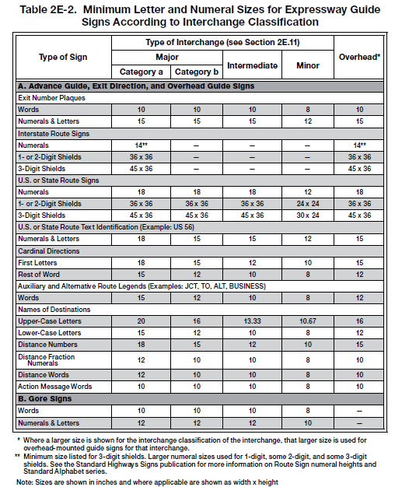
Section 2E.12 Size of Signs and Letters
Table 2E-2. Minimum Letter and Numeral Sizes for Expressway Guide Signs According to Interchange Classification
Minimum numeral and letter sizes for overhead-mounted expressway and freeway guide signs shown in the “Overhead” columns of
Tables 2E-2 and 2E-4
* Where a larger size is shown for the interchange classification of the interchange, that larger size is used for
overhead-mounted guide signs for that interchange.
** Minimum size listed for 3-digit shields. Larger numeral sizes used for 1-digit, some 2-digit, and some 3-digit
shields. See the Standard Highways Signs publication for more information on Route Sign numeral heights and
Standard Alphabet series.
Note: Sizes are shown in inches and where applicable are shown as width x height.
Notes:
Standard provisions in paragraph 05 were revised to clarify that the minimum numeral and letter sizes for overhead-mounted expressway and freeway guide signs shall be those shown in the “Overhead” columns of Tables 2E-2 and 2E-4, respectively, except where a larger minimum numeral or letter height is provided in the columns for the applicable type of interchange (major, intermediate, or minor).

Slide 7
Section 2E.14 Sign Borders
Revises Guidance to include that on unusually large signs with oversized letter heights, route shields, or other legend elements, the border should be 2.5 inches wide and should not exceed
3 inches in width
Notes:
Guidance in this section is revised to recommend that on unusually large signs with oversized letter heights, route shields, or other legend elements, the border should be 2.5 inches wide and should not exceed 3 inches in width.
FHWA did not include dimensions to define an “unusually large sign”. Rather, agencies have the flexibility to apply engineering judgment to make such a determination. That said, additional guidance states “In all cases, the width of the border should not exceed the stroke width of the lettering of the principal legend on the sign.”

Slide 8
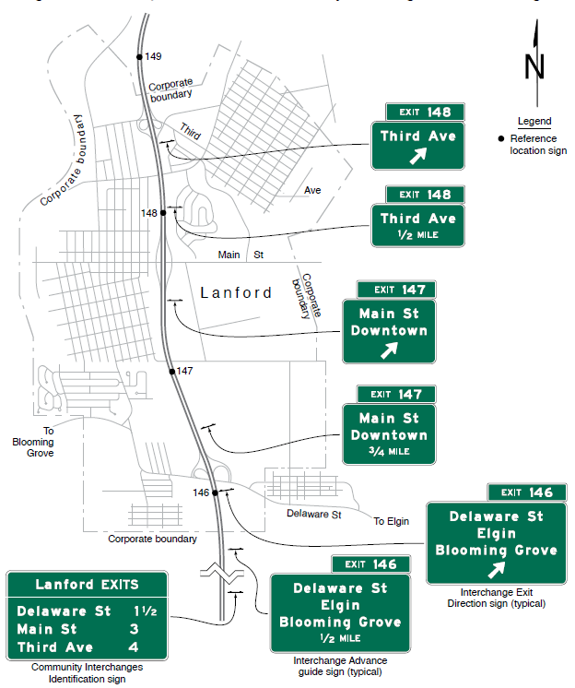
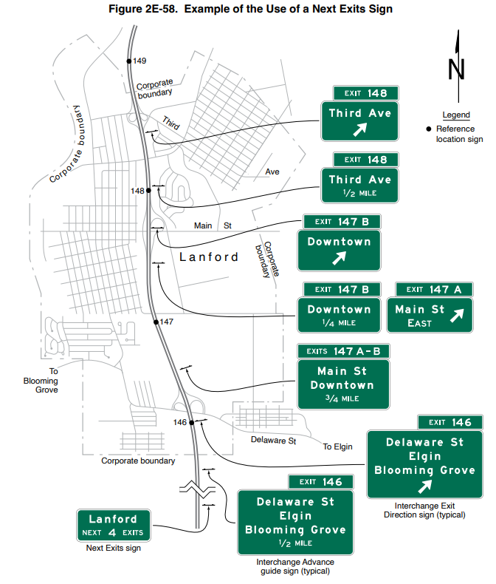
Section 2E.15 Amount of Legend on Guide Signs
Adds Support to describe the use of street names on Advance Guide and Exit Direction signs, based on the number of interchanges that serve a community
Figure 2E-56. Example of the Use of a Community Interchanges Identification Sign
Figure 2E-58. Example of the Use of a Next Exits Sign
Notes:
The following Support is added to provide users with additional information regarding proper and efficient community interchange signing.
Where only one interchange serves a community, the intersecting street name is generally superfluous to the city name on the Interchange Advance guide and Exit Direction signs. Where a community is served by multiple interchanges, the city name is typically displayed on either a Community Interchanges Identification sign (Section 2E.52) or a Next Exits sign (Section 2E.53). Each interchange is then identified by its intersecting roadway name on the Interchange Advance guide and Exit Direction signs rather than by the city name.

Slide 9
Section 2E.16 Abbreviations
Replaces existing Guidance and Standard paragraphs with a new Standard that requires abbreviations on freeway and expressway guide signs to comply with the provisions of Section 2D.07
Notes:
A new Standard requires abbreviations on freeway and expressway guide signs to comply with the provisions of Section 2D.07. Previous Guidance and Standard paragraphs were moved to Section 2D.07 with minor edits to remove repetitive content.

Slide 10
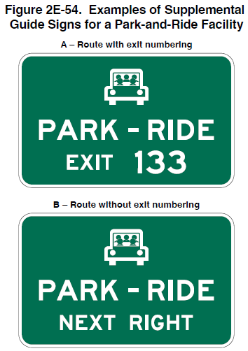
Section 2E.17 Symbols
Figure 2E-54. Examples of Supplemental Guide Signs for a Park-and-Ride Facility
Adds Support and Guidance
  Symbols not normally displayed on freeway and expressway signs:
    Exception: PARK – RIDE Supplemental guide sign
  General Information symbol provisions
Removes Option regarding educational plaques
A – Route with exit numbering
B – Route without exit numbering
Notes:
In Section 2E.17, the Standard regarding symbol designs is removed because it duplicates language in Section 2A.12.
A Support provision is added that symbols are not normally displayed on freeway and expressway guide signs, with one exception being the PARK – RIDE supplemental Guide sign which displays the carpool symbol.
A Guidance provision details how a General Information symbol sign (I Series) should be incorporated into the legend of a guide sign.
The Option to use educational plaques below symbol signs is removed, because such plaques could distort and overly complicate the intended message.

Slide 11
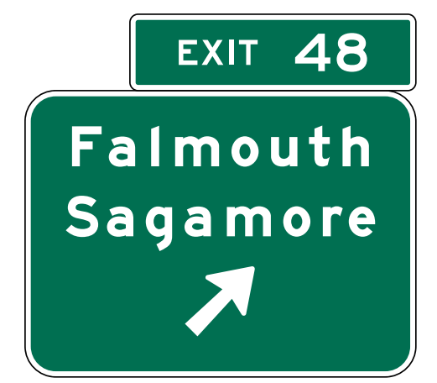
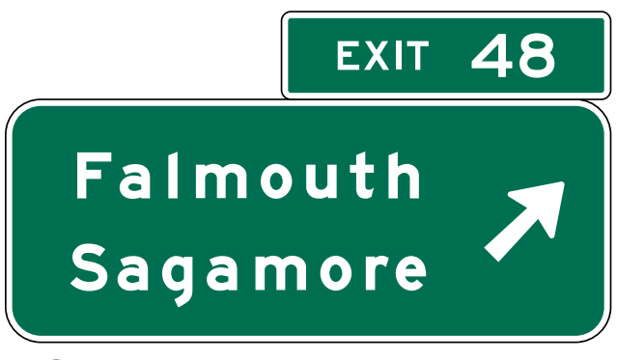
Section 2E.18 Arrows for Interchange Guide Signs
Directional arrows on post-mounted Exit Direction signs shall be located at the bottom portion of the sign and centered under the legend
Post-mounted Exit Direction sign located at beginning of taper
Overhead-mounted Exit Direction sign located at theoretical gore
Notes:
A Standard is revised to state that directional arrows on post-mounted Exit Direction signs shall be located at the bottom portion of the sign and centered under the legend. Note that Exit Direction signs not meeting this Standard do not need to be replaced until they reach the end of their service life, and the location of the arrow on the sign should have no appreciable difference in the overall size of the sign when designed in accordance with established sign layout criteria.
As a reminder, directional arrows on overhead Exit Direction signs shall be located on the side of the sign consistent with the direction of the exiting movement.

Slide 12
Section 2E.20 Lateral Offset
Adds exception to allow a lateral offset narrower than 6 feet for sign supports when shielded by a rigid traffic barrier
Notes:
A revised Standard states that except where shielded by a rigid traffic barrier, the minimum lateral offset outside the usable roadway shoulder for post-mounted freeway and expressway signs, or for overhead sign supports, shall be 6 feet.

Slide 13
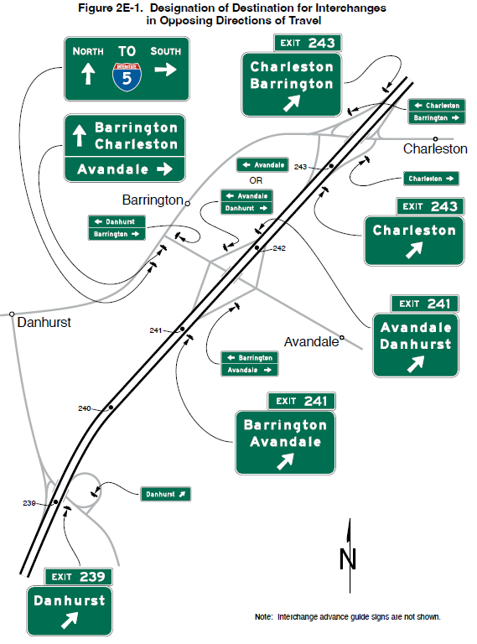
Section 2E.21 Interchange Guide Signs
Figure 2E-1. Designation of Destination for Interchanges in Opposing Directions of Travel
Interchange that provides the most direct or preferred access might differ in opposing direction of travel
For each direction of travel, guide signing to a destination should be via the exit with the most direct or preferred access
Note: Interchange Advance guide signs are not shown.
Notes:
A Support provision is added that in some instances the interchange that provides the most direct or preferred access to a destination might be different in opposing directions of travel due to circumstances such as the configuration of the crossroads, or the fact that an interchange is a partial interchange.
In concert with this, a Guidance provision is added recommending that for each direction of travel, guide signing to a destination should be via the exit with the most direct or preferred access, even when this results in a destination being served by different interchanges for opposing directions of travel.

Slide 14
Section 2E.22 Interchange Exit Numbering (1 of 3)
Revises Standard regarding suffix letters:
  Shall only be used where there is more than one exit associated with the reference mile point of the freeway
  Shall not be used to identify a downstream ramp split
  Shall be assigned in ascending alphabetical order starting with the letter A in the direction of travel with increasing exit numbers, and in descending alphabetical order ending in the letter A in the opposite direction of travel
Notes:
A Standard is revised regarding suffix letters. They shall only be used to supplement exit numbers where there is more than one exit associated with the reference mile point of the freeway. Suffix letters shall not be used for an exit ramp to identify a downstream ramp split providing access to multiple highways or different directions of the same highway.
For assigning letters, they shall be assigned in ascending alphabetical order starting with the letter A in the direction of travel with increasing exit numbers, and in descending alphabetical order ending in the letter A in the opposite direction of travel.

Slide 15

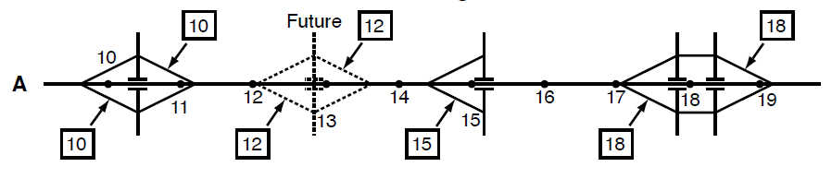
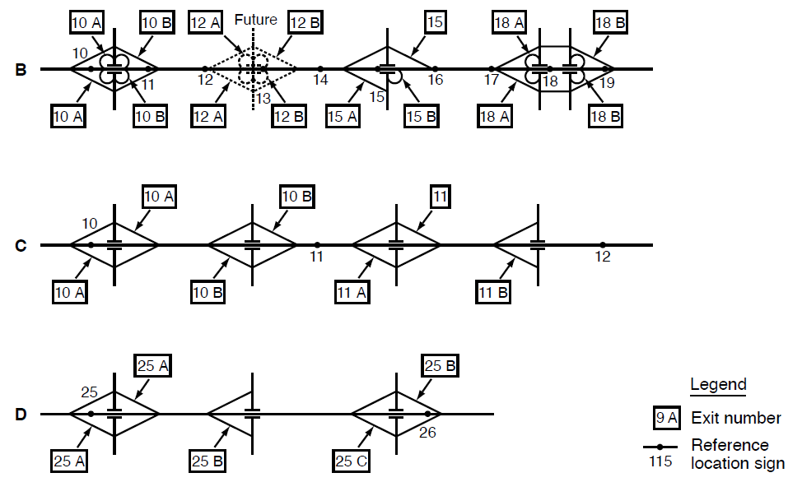
Section 2E.22 Interchange Exit Numbering (2 of 3)
Provides example of unequal number of exits in both directions of travel:
  Three exits eastbound, two exits westbound:
    Eastbound: Exit 25 A, Exit 25 B, Exit 25 C
    Westbound: Exit 25 B, Exit 25 A
Adds Guidance on exit numbering
Figure 2E-3. Examples of Interchange Exit Numbering
Example of exit numbering without suffixes
Example of exit numbering with suffixes
Notes:
A new Standard provision describes how to assign exit suffix letters where the number of exits are not equal on the two directions of travel on a highway. The exit suffix lettering for each direction shall be based on the number of exits in that direction. For example, at an interchange with three exits eastbound and two exits westbound, the suffix letters would ascend eastbound as A, B, C, and descend westbound as B, A.
A new Guidance provision recommends how an exit should be numbered based on the closest reference mile point location. To the extent practical, exit numbering should be determined based upon the location of the crossroad with respect to reference location signs. Examples are given in the recommendation, with references to new Figure 2E-3 where appropriate.
If a crossroad intersects the mainline approximately at or after Mile 15 and before Mile 16, the interchange should be designated as EXIT 15 (see Drawings A and B in Figure 2E-3).
If the interchange crossroad is split into two roadways by direction where one direction of the crossroad is downstream of Mile 18 and the other direction is upstream of Mile 18, the interchange exit number should be EXIT 18 (see Drawings A and B in Figure 2E-3).
If there are three closely-spaced interchanges, such as less than 1 mile apart, starting before Mile 16 and ending near or at Mile 17, the interchanges should be designated as EXIT 15, EXIT 16, and EXIT 17.
If there are multiple interchanges so closely spaced together that it is impracticable to designate the exit numbers by the freeway mainline reference mile numbers, suffix letters should be used as provided in this Section (see Drawings C and D in Figure 2E-3).
Since this is a Guidance, agencies are expected to use engineering judgment in difficult or unusual situations.

Slide 16
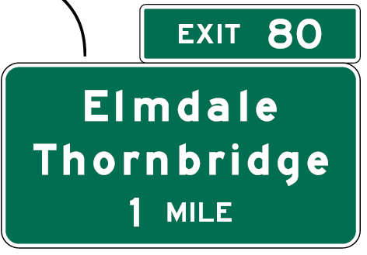
Section 2E.22 Interchange Exit Numbering (3 of 3)
Changes Guidance to Standard: Exit Number plaque shall be positioned above the top right-hand edge of the sign for an exit to the right
E1-5P
Advance Guide Sign
Notes:
A Guidance provision is changed to a Standard stating that an Exit Number plaque shall be positioned above the top right-hand edge of the sign for an exit to the right.

Slide 17
Section 2E.23 Interchange Advance Guide Signs (E1-1 through E1-3) (1 of 2)
Adds Standard: at least one Interchange Advance guide sign for all interchange classifications
Adds Guidance on distance displays:
  1,000 feet to 1 mile from exit, display distance to nearest ¼ mile
  Less than 1,000 feet from exit, display distance to nearest 100 feet
Notes:
A new Standard is added requiring at least one Interchange Advance guide sign for all interchange classifications. This requirement was previously implicit in previous editions of the MUTCD, and the change clarifies the intent of the language. It is important to provide at least one guide sign in advance of a freeway or expressway interchange because advance notice of exits provides road users the time necessary to change lanes to position themselves to take an exit safely, avoiding last-minute weaving conflicts and erratic maneuvers.
New Guidance is added which states that where an Interchange Advance guide sign is located more than 1,000 feet to ½ mile but not more than 1 mile from the exit, the distance displayed should be to the nearest ¼ mile. Where the distance to be displayed on an Interchange Advance guide sign is 1,000 feet or less, the distance should be displayed in feet, rather than miles, to the nearest 100 feet.

Slide 18
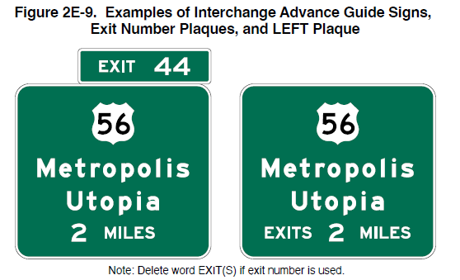
Section 2E.23 Interchange Advance Guide Signs (E1-1 through E1-3) (2 of 2)
Distances as fractions, not decimals
Position exit Number plaque above and abutting the Interchange Advance guide sign:
  On the top right-hand edge for exits to the right
Figure 2E-9. Examples of Interchange Advance Guide Signs, Exit Number Plaques, and LEFT Plaque
Note: Delete word EXIT(S) if exit number is used.
Notes:
Previous Guidance was changed to a Standard provision which requires distances to be displayed as fractions of a mile, rather than decimals, in all cases.
A Standard clarifies the position of the Exit Number plaque as being required above and abutting the signs. This is not a new requirement; rather, it is new wording to clarify the existing required position of the Exit Number plaque. A new Standard also requires that an Exit Number plaque shall be positioned to the top right-hand edge of the sign for numbered exits to the right. This provides consistency and clarification with similar provisions for Exit Direction signs and exits to the left.
Previous Guidance was changed to a Standard provision requiring the word “EXIT(S)” be omitted from the bottom line of Interchange Advance guide signs when exit numbers are used. The purpose of this change is for consistency in sign legend and to reduce unnecessary legend on signs.

Slide 19
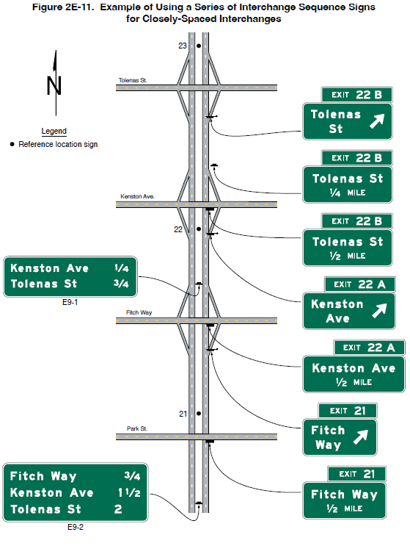
Section 2E.24 Interchange Sequence Signs
(E9-1 and E9-2)
Figure 2E-11. Example of Using a Series of Interchange Sequence Signs for Closely-Spaced Interchanges
Install in a series
Display the next two or three interchanges by name or route number with distances to the nearest ¼ mile
Notes:
A previous Support provision is changed to Standard, requiring that Interchange Sequence signs be installed in a series. Interchange Sequence signs shall display the next two or three interchanges by name or route number with distances to the nearest ¼ mile.

Slide 20
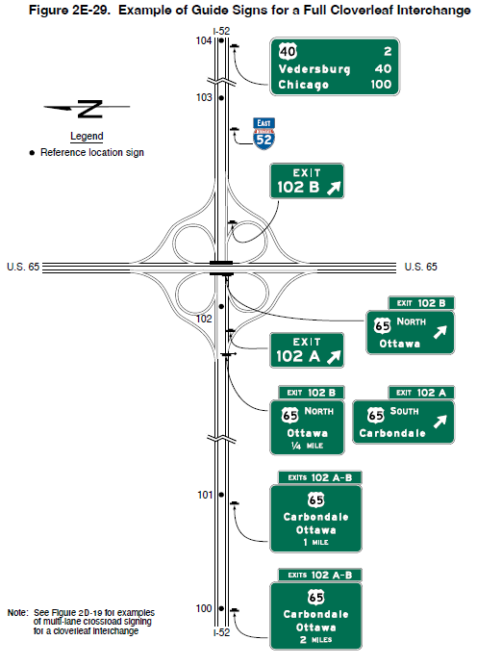
Section 2E.25 Exit Direction Signs (E4 Series) (1 of 2)
Standard: Exit Number plaque shall be above the top right-hand edge of the sign for numbered exits to the right
Guidance: overpass Exit Direction signing
Figure 2E-29. Example of Guide Signs for a Full Cloverleaf Interchange
Note: See Figure 2D-19 for examples of multi-lane crossroad signing for a cloverleaf interchange.
Notes:
Previous Guidance provisions were changed to Standard, clarifying that the Exit Number plaque shall be added above the top right-hand edge of the sign for numbered exits to the right. This change is a companion to the prior requirement that exit number plaques for numbered exits to the left are required to be on the left-hand edge of the sign, thereby meeting driver expectation in similar situations.
A previous Option provision was changed to Guidance to recommend where the freeway or expressway passes under the crossroad and the exit ramp is located beyond the overcrossing structure, that the overhead Exit Direction sign for the second exit should be placed either on the overcrossing structure or on a separate structure located immediately in front of the overcrossing structure.

Slide 21
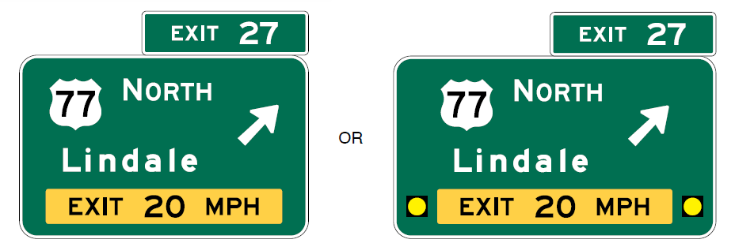
Section 2E.25 Exit Direction Signs (E4 Series) (2 of 2)
Option: warning beacons with EXIT XX MPH sign panel
Figure 2E-14. Example of Exit Direction Signs with Advisory Speed Panels and Flashing Yellow Beacons
Exit Direction sign with E13-2 sign panel
Exit Direction sign with E13-2 sign panel and flashing yellow beacons
Notes:
A new Option was added allowing the use of Warning Beacons with the EXIT XX MPH (E13-2) sign panel. As part of this, a new Standard was added to require the warning beacons to be placed at least 12 inches from the edges of the E13–2 sign panel, from the edge of the sign, and from any other legend within the guide sign, to provide adequate space around the beacons to reduce glare that can adversely impact the legibility of the sign legend. This is consistent with provisions in Chapter 4S – Flashing Beacons.

Slide 22

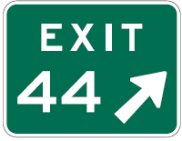
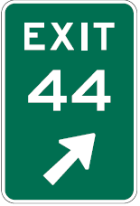









Section 2E.26 Exit Gore Signs and Plaque
(E5-1 Series)
Figure 2E-15. Exit Gore Signs and Plaques
Revises Standard: Exit Gore
sign required for each ramp
that departs from main roadway
Revises Option: Type 1 object marker may be installed 4 feet above ground
E5-1bP
E5-1
E5-1a
E5-1c
W13-1aP
E5-1bP
E5-1 or E5-1a
E5-1
W13-1aP
Figure 2C-17. Object Markers
Type 1 Object Markers (obstructions within the roadway)
OM1-1
OM1-2
OM1-3
Notes:
The Standard is revised to clarify that an Exit Gore sign is required for each ramp that departs from the main roadway.
An Option is revised to clarify that the Type 1 object marker may be installed 4 feet above the ground line on each sign support below the Exit Gore sign.

Slide 23


Section 2E.27 Pull-Through Signs (E6-1 Series and E6-2 Series)
Should not be used at exits with option lanes where full-width Overhead Arrow-per-Lane (OAPL) signs are used
Shall display route shield and cardinal direction of through route
May display the control city and down arrows
Figure 2E-16. Examples of Pull-Through Signs
E6-1
E6-1a
Note: The E6-2 and E6-2a sign designs correspond to the E6-1 and E6-1a sign designs, respectively, but with the addition of a down arrow on each.
Notes:
A revised Guidance statement clarifies that Pull-Through signs should not be used at exits with option lanes where full-width Overhead Arrow-per-Lane signs are being used.
A new Standard is added that when used, Pull-Through signs shall display the route shield and the cardinal direction for the through route with the option to display the control city and down arrows.

Slide 24
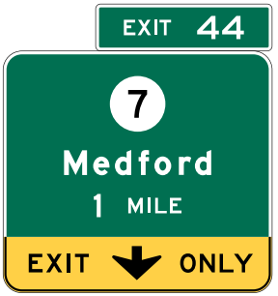
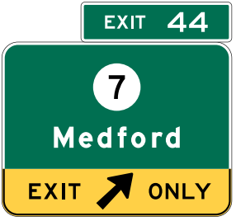


Section 2E.28 Signing for Interchange Lane Drops without an Optional Exit Lane (1 of 3)
Adds Option regarding arrow placement
Revises Standard for E11-1a and E11-1b placement
E11-1a
E11-1b
E11-1c
Notes:
An Option is added allowing that where an existing sign structure length or adjacent signs constrain the width or placement of the Interchange Advance guide sign on that structure, the down arrow may be positioned to the right or left of the words EXIT ONLY, instead of between the words, to allow for the positioning of the arrow over the approximate center of the lane. Where the width of the Exit Direction sign extends over the adjacent lane, the directional arrow may be placed to the right of the words EXIT ONLY for an exit to the right, or to the left of the words EXIT ONLY for an exit to the left, to allow for the positioning of the arrow over the dropped lane.
A Standard is revised to clarify that in retrofit situations where E11-1a and E11-1b sign panels are used, the references to the white down arrow apply to Advance guide signs.

Slide 25
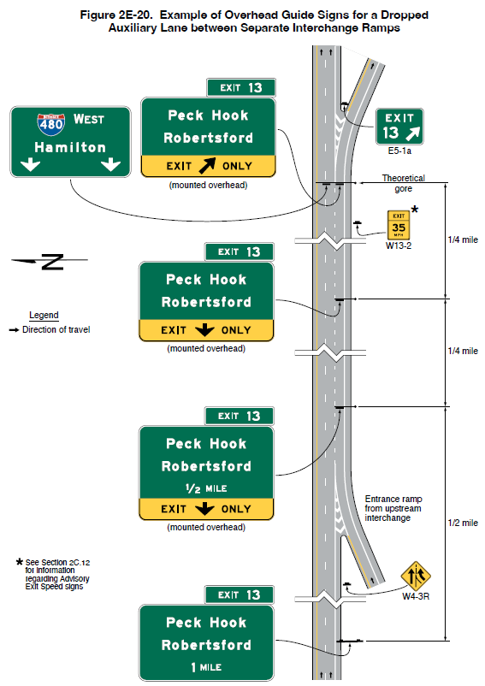
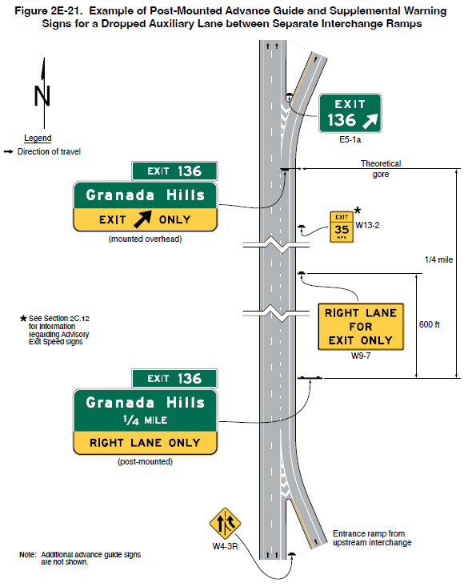
Section 2E.28 Signing for Interchange Lane Drops without an Optional Exit Lane (2 of 3)
Figure 2E-20. Example of Overhead Guide Signs for a Dropped Auxiliary Lane between Separate Interchange Ramps
Figure 2E-21. Example of Post-Mounted Advance Guide and Supplemental Warning Signs for a Dropped Auxiliary Lane between Separate Interchange Ramps
Adds Figures 2E-20 and
2E-21 for a dropped auxiliary lane between separate interchange ramps
Adds Guidance for RIGHT LANE ONLY post-mounted in limited cases where overhead Advance guide signs cannot be located
* See Section 2C.12
for information
regarding Advisory
Exit Speed signs
* See Section 2C.12
for information
regarding Advisory
Exit Speed signs
Note: Additional Advance guide signs
are not shown
Notes:
Two new figures are added that show examples of guide signs for a dropped auxiliary lane between separate interchanges using post-mounted and overhead guide signs.
Guidance is added which states that in limited cases where conditions are so constrained that it is impossible to locate an Interchange Advance guide sign either overhead or partly over the dropped lane, a post-mounted sign panel displaying the legend RIGHT (LEFT) LANE ONLY in a black legend on a yellow background should be substituted for the EXIT ONLY panel on that sign. In such cases, the Interchange Advance guide signs should be alternated with RIGHT (LEFT) LANE FOR EXIT ONLY (W9-7) signs.

Slide 26
Section 2E.28 Signing for Interchange Lane Drops without an Optional Exit Lane (3 of 3)
Adds Guidance: Warning of lane termination immediately after an exit ramp
Notes:
Guidance is added that where a mainline lane is terminated immediately after an exit ramp, overhead and/or post mounted warning signs should be used to warn traffic.

Slide 27
Section 2E.29 Signing by Type of Interchange (1 of 2)
Removes Standard requiring consistent interchange guide signing by type along a route:
  Revises Guidance to recommend signing layout for all interchanges of the same type to be similar
Adds Guidance recommending main roadway major guide signing be determined by specific interchange type for that direction of travel
Notes:
A previous Standard requiring interchange guide signing to be consistent for each type of interchange along a route was removed because there are instances where the signing for similar interchanges along a route would need to vary due to interchange spacing and other geometric features. As part of this change, the Guidance was revised to recommend that the signing layout for all interchanges of the same type should be similar.
There is a new Guidance provision recommending that when a single interchange combines a different type of ramp configuration for each direction of travel, the main roadway major guide signing should be determined by the specific interchange type for that direction of travel.

Slide 28
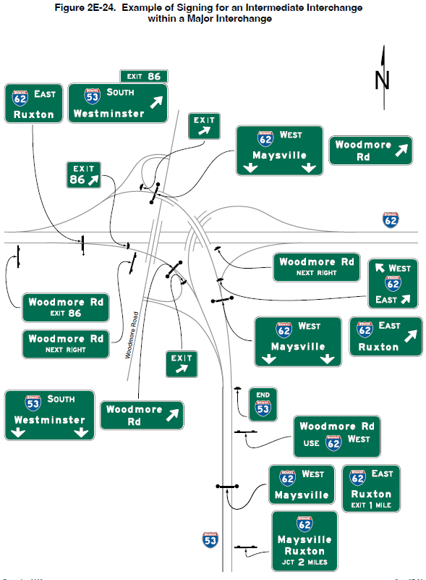
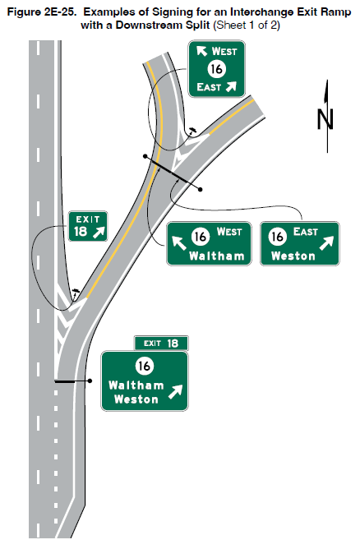
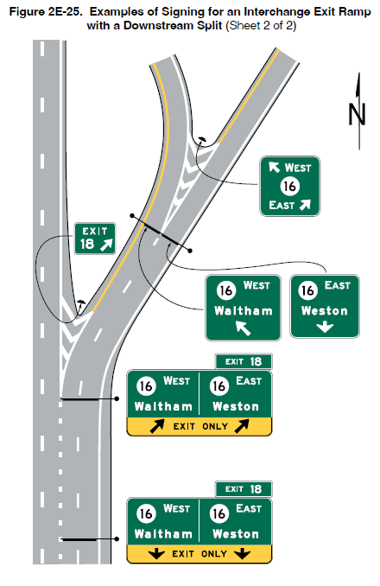
Section 2E.29 Signing by Type of Interchange (2 of 2)
Adds Figures 2E-24 and 2E-25 to illustrate an interchange exit ramp with a downstream split
Figure 2E-24. Example of Signing for an Intermediate Interchange
within a Major Interchange
Figure 2E-25. Example of Signing for an Interchange Exit Ramp
with a Downstream Split (Sheet 1 of 2)
Figure 2E-25. Example of Signing for an Interchange Exit Ramp
with a Downstream Split (Sheet 2 of 2)
Notes:
Two new figures showing examples of signing for an interchange exit ramp with a downstream split are added.

Slide 29
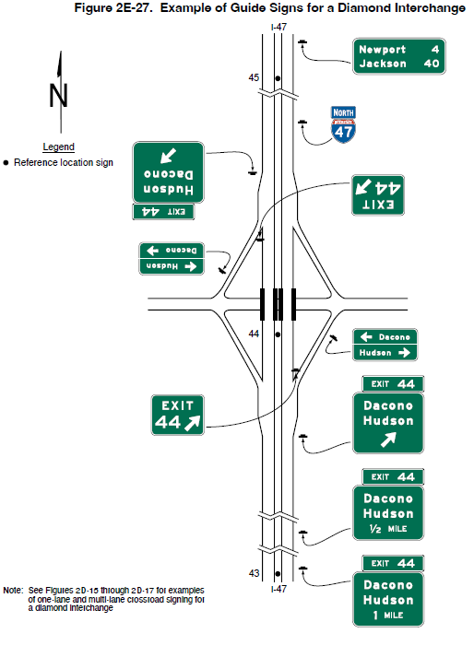
Section 2E.31 Diamond Interchange
Destination signs at the end of exit ramps should include each destination displayed on signs along main roadway
Figure 2E-27. Example of Guide Signs for a Diamond Interchange
Note: See Figures 2D-15 through 2D-17 for examples
of one lane and multi-lane crossroad signing for
a diamond interchange
Notes:
A new Guidance provision is added recommending that where the exit ramp allows traffic to turn in either direction onto the crossroad, a Destination sign that includes each destination displayed on the Advance, Exit Direction, and Supplemental guide signs along the main roadway for that exit should also be placed along the ramp.

Slide 30
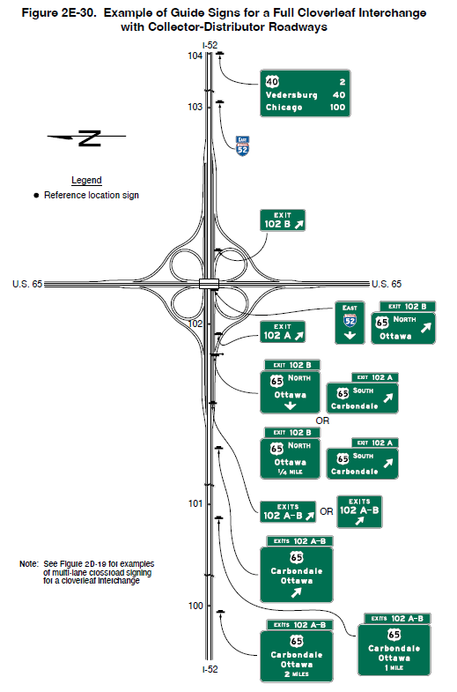
Section 2E.34 Cloverleaf Interchange with
Collector-Distributor Roadways
Figure 2E-30. Example of Guide Signs for a Full Cloverleaf Interchange with Collector-Distributor Roadways
Changes Option to Guidance regarding exit numbering
Note: See Figure 2D-19 for examples
of multi-lane crossroad signing
for a cloverleaf Interchange.
Notes:
A previous Option is changed to Guidance regarding exit numbering for cloverleaf interchanges with collector-distributor roadways to improve consistency.

Slide 31
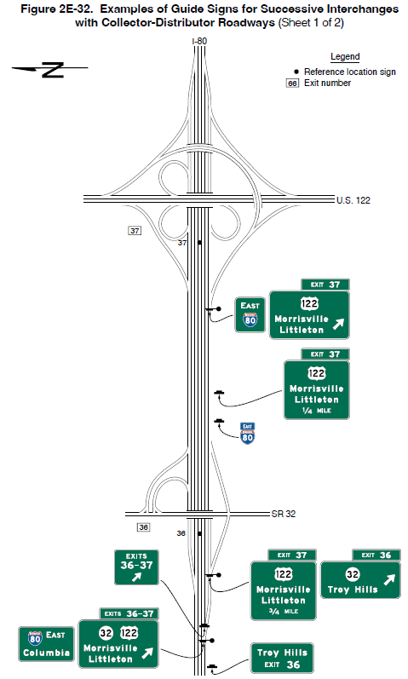
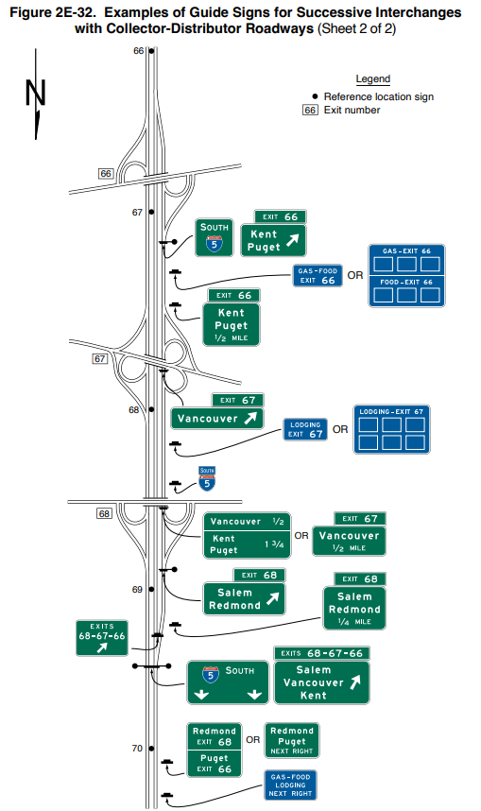
Section 2E.36 Collector-Distributor Roadways for Successive Interchanges
Figure 2E-32. Examples of Guide Signs for Successive Interchanges with Collector-Distributor Roadways (Sheet 1 of 2)
Figure 2E-32. Examples of Guide Signs for Successive Interchanges with Collector-Distributor Roadways (Sheet 2 of 2)
Adds Section
Includes Support, Guidance, and Figure
Notes:
A new Section 2E.36 is added that includes Support and Guidance provisions along with a new Figure for a collector-distributor roadway that provide access to multiple interchanges.
Recommendations where access to successive interchanges is provided from a single collector-distributor roadway, the number of lines of destination information displayed on the major guide signs on the main roadway approach to the collector-distributor roadway should comply with the provisions of Section 2E.15. Where additional destinations are displayed on the main roadway, those destinations should be displayed on Supplemental guide signs (see Section 2E.51) on the approach to the collector-distributor roadway.
Additional recommendations are provided where exit numbering is used. The exit numbers for exits accessed from the collector-distributor roadway should be displayed on the main roadway guide signs and an Exit Gore sign (see Section 2E.26) should be placed in the gore where the collector-distributor roadway departs from the main roadway

Slide 32
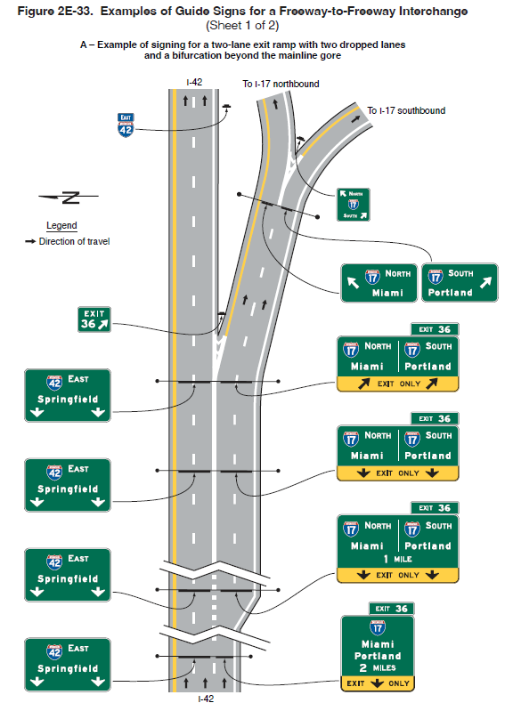
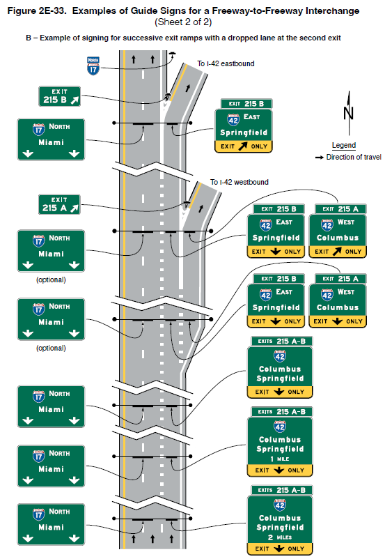
Section 2E.37 Freeway-to-Freeway Interchanges
Adds Standard: Roadway for the off-route shall be signed as an exit
Figure 2E-33. Examples of Guide Signs for a Freeway-to-Freeway Interchange (Sheet 1 of 2)
Figure 2E-33. Examples of Guide Signs for a Freeway-to-Freeway Interchange (Sheet 2 of 2)
A – Example of signing for a two-lane exit ramp with two dropped lanes
and a bifurcation beyond the mainline gore
B – Example of signing for successive exit ramps with a dropped lane at the second exit
Notes:
A Standard is added requiring the roadway for the off-route be signed as an exit. If exit numbering is used, the signs shall comply with the provisions of Section 2E.22. Distance messages on the Advance guide signs shall comply with the provisions of Section 2E.23.

Slide 33
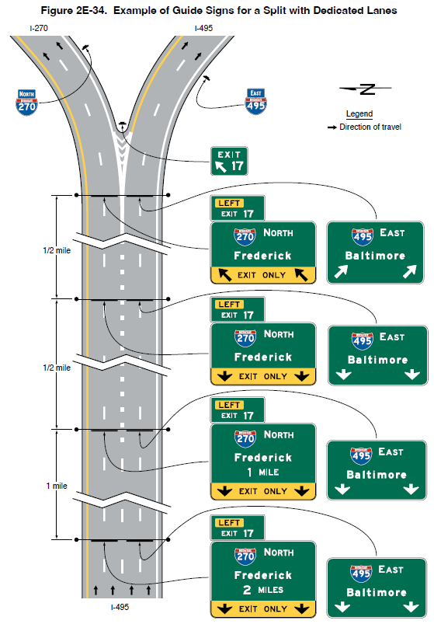
Section 2E.38 Freeway Split with Dedicated Lanes
Adds Section
Adds Standards to require overhead signing, arrows to match number of lanes and to be centered over lane
Figure 2E-33. Examples of Guide Signs for a Split with Dedicated Lanes
Notes:
New Section 2E.38 is added to clarify guide signing for a freeway split with dedicated lanes. Arrows on each Interchange Advance guide sign shall match the number of lanes present at the location of the Advance guide sign. Signs shall be mounted overhead, and any arrows used shall be located over the approximate center of the lane to which it applies. Where one roadway of the split carries the through route, the other roadway shall be signed as an exit.

Slide 34
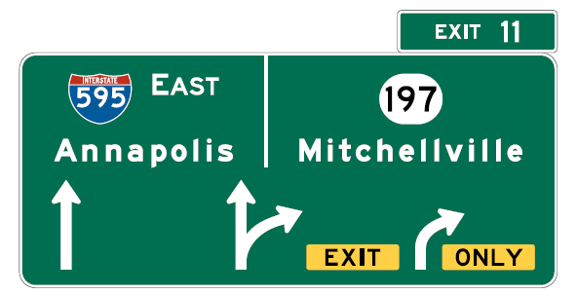
Section 2E.39 Signing for Option Lanes at Splits and Multi-Lane Exits
Revises Standard: Only OAPL guide signs shall be used for option lanes and splits at multi-lane exits. Diagrammatic Advance signs may only be used to supplement conventional or OAPL signs
Figure 2E-35. Examples of an Overhead Arrow-per-Lane Guide Sign for a Multi-Lane Exit with an Option Lane
Notes:
The Standard is revised to delete reference to use of Diagrammatic Advance guide signs for option lanes and splits at multilane exits. Only the Overhead Arrow-per-Lane design shall be used for this condition, for consistency with adopted provisions in Section 2E.40. Section 2E.41 describes the conditions for which Diagrammatic Advance guide signs may be used to supplement conventional or Overhead Arrow-per-Lane guide signs.

Slide 35
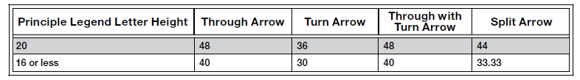
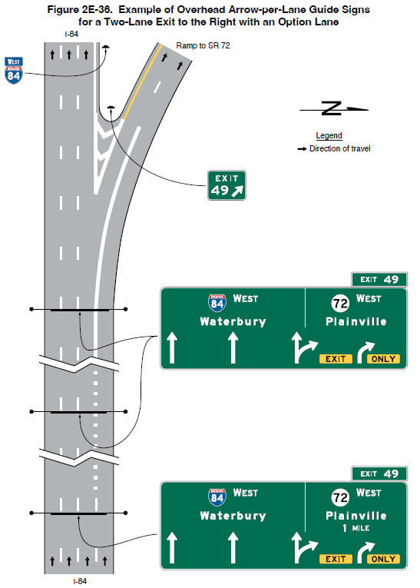
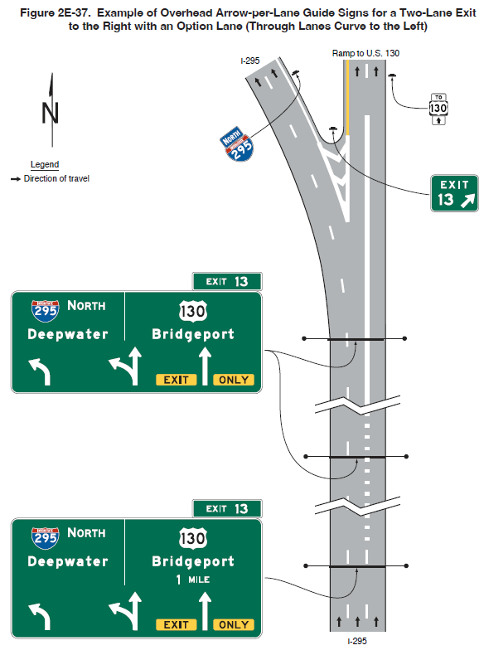
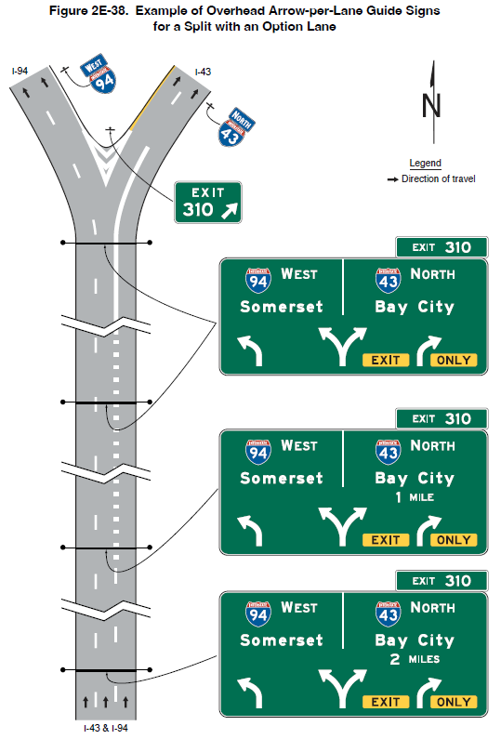
Section 2E.40 Design of Overhead Arrow-per-Lane Guide Signs for Option Lanes (1 of 2)
Clarifies that all new or reconstructed projects shall use OAPL signs
Removes requirement for arrows to show approximate degree of road curvature
Adds Standard referencing arrow heights in Table 2E-6
Table 2E-6. Overhead Arrow-per-Lane Arrow Height Based on Principal Legend Letter Height
Note: Letter and arrow heights are shown in inches.
Figure 2E-36. Example of Overhead Arrow-per-Lane Guide Signs for a Two-Lane Exit to the Right with an Option Lane
Figure 2E-37. Example of Overhead Arrow-per-Lane Guide Signs for a Two-Lane Exit to the Right with an Option Lane (Through Lanes Curve to the Left)
Figure 2E-38. Example of Overhead Arrow-per-Lane Guide Signs for a Split with an Option Lane
Notes:
An existing Standard provision is clarified in accordance with previous Official Ruling No. 2(09)-5(I). Overhead Arrow-per-Lane guide signs shall be used at all new or reconstructed freeway and expressway locations and at freeway and expressway locations where replacement of existing sign support structures is necessitated by reconstruction.
An existing Option is clarified that an existing overhead Exit Direction sign may remain at the theoretical gore on non-reconstructed locations, in conjunction with a replacement of the advance signs using the Overhead Arrow-per-Lane guide sign design.
A Standard is revised to delete the requirement that arrows on Overhead Arrow-per-Lane guide signs indicate the approximate degree of curvature when the through movement is on a curved alignment. This qualification is not needed because the designs of the arrows for this type of sign are standardized.
A Standard is added referencing the required arrow heights in Table 2E-6.

Slide 36
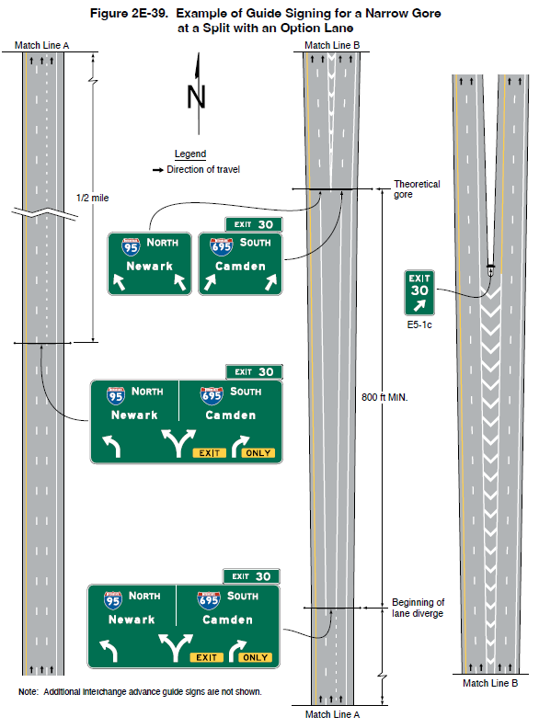
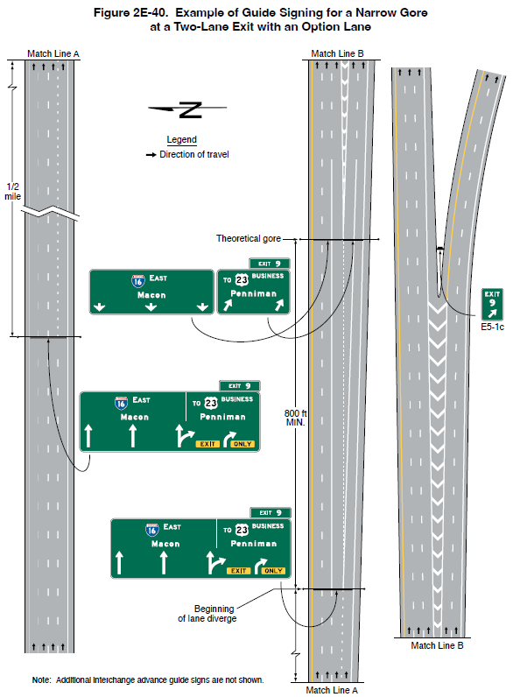
Section 2E.40 Design of Overhead Arrow-per-Lane Guide Signs for Option Lanes (2 of 2)
Adds Option allowing Destination signs near theoretical gore where the taper lane is
800 feet or more
Figure 2E-39. Example of Guide Signing for a Narrow Gore at a Split with an Option Lane
Figure 2E-40. Example of Guide Signing for a Narrow Gore at a Two-Lane Exit with an Option Lane
Note: Additional Interchange advance guide signs are not shown.
Note: Additional Interchange advance guide signs are not shown.
Notes:
An Option is added allowing additional signs indicating the destinations allowed by each lane in the vicinity of the theoretical gore to reinforce positive guidance where there is 800 feet or more between the beginning of the lane diverge and the theoretical gore.

Slide 37
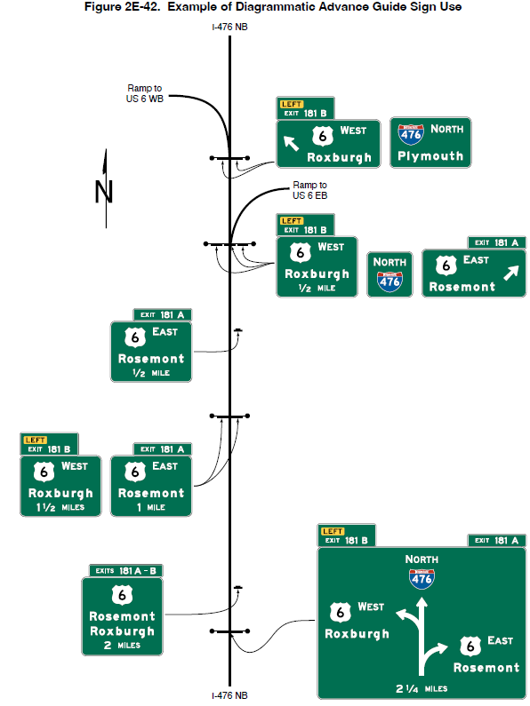
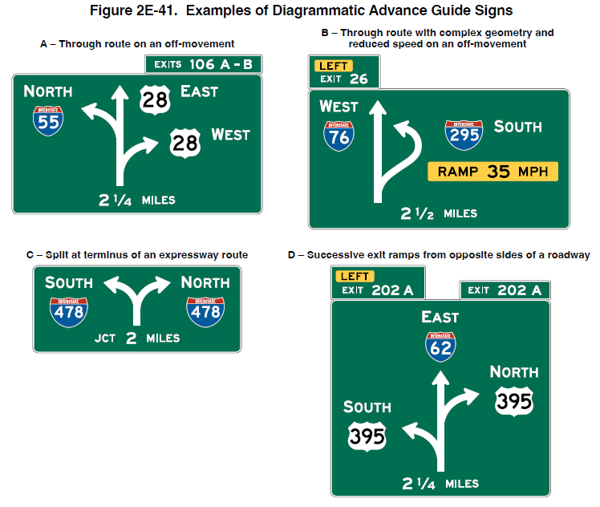
Section 2E.41 Design of Freeway and Expressway Diagrammatic Advance Guide Signs
Figure 2E-42. Examples of Diagrammatic Advance Guide Sign Use
Makes several changes in purpose and design
Adds Option allowing use in advance of interchange guide sign sequence or in lieu of an Interchange Advance guide sign at 2 miles
Revises Standard for Schematic graphic, no lane lines
Figure 2E-41. Examples of Diagrammatic Advance Guide Signs
A – Through route on an off-movement
B – Through route with complex geometry and reduced speed on an off-movement
C – Split at terminus of an expressway route
D – Successive exit ramps from opposite sides of the roadway
Notes:
There are several changes to this section regarding the use and design of Diagrammatic Guide Signs.
Though Diagrammatic Advance guide signs generally do not perform as well as Overhead Arrow-Per-Lane guide signs, they can still provide valuable information in situations where there is complex or unexpected roadway geometry by supplementing the other required interchange guide signs.
The Support provision is revised to describe the use of a Diagrammatic Advance guide sign that show a simplified graphic view of the exit departure arrangement in relationship to the main highway at an interchange. Its purpose is to provide advance notice of complex or unexpected road geometry or ramp departures at an interchange and/or depict successive decision points where additional context might be helpful to interpreting the subsequent primary Interchange Advance guide signs. Unlike Diagrammatic signs that were included in previous editions of the MUTCD, the Diagrammatic Advance guide sign does not depict which or the number of specific lanes that serve a particular destination or depict lanes added or reduced.
An Option is added allowing a Diagrammatic Advance guide sign to be used in advance of the interchange guide sign sequence, or in lieu of an Interchange Advance guide sign located 2 miles in advance of the exit, to supplement conventional or Overhead Arrow-per-Lane guide signs used for a downstream interchange.
The Standard providing design criteria is revised to state that a simplified schematic graphic of the relative through and off-ramp movements will be shown. The graphic shall not depict deceleration or auxiliary lanes. Arrow shafts shall not contain lane lines. Destination legends for off-movements shall be positioned to the side of the arrow from which the ramp departs. Additional revisions to the Guidance provision were made to recommend additional design criteria applicable to this revised Diagrammatic Advance guide sign use.
The changes are made because overhead arrow-per-lane signs have been shown to be superior to diagrammatic signs at option lanes, especially for older road users.

Slide 38
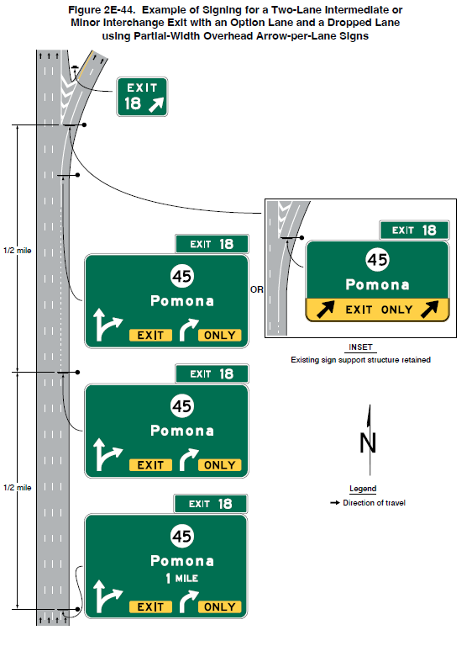
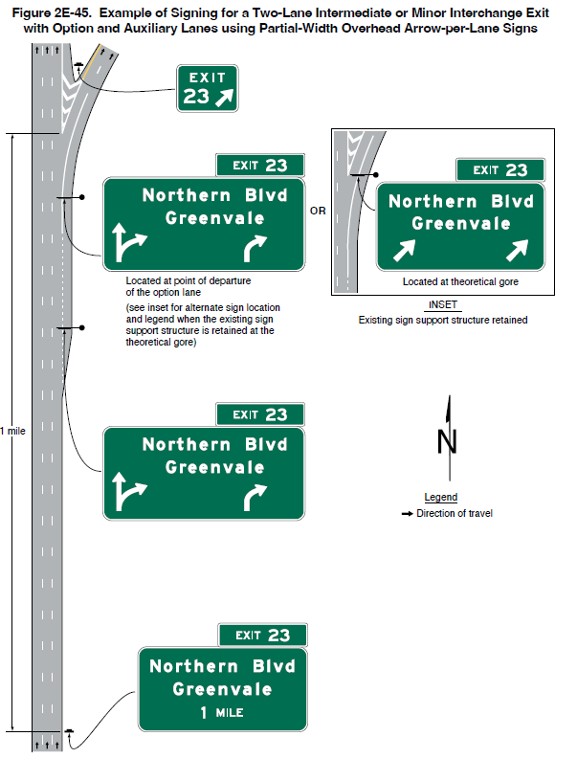
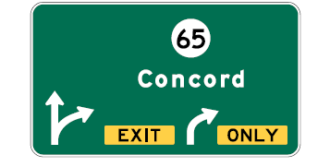
Section 2E.42 Signing for Intermediate and Minor Interchange Multi-Lane Exits with an Option Lane (1 of 2)
Recommends partial-width Overhead Arrow-per-Lane signs when full-width is not practical
Figure 2E-44. Example of Signing for a Two-Lane Intermediate or Minor Interchange Exit with an Option Lane and a Dropped Lane using Partial-Width Overhead Arrow-per-Lane Signs
Figure 2E-45. Example of Signing for a Two-Lane Intermediate or Minor Interchange Exit with Option and Auxiliary Lanes using Partial-Width Overhead Arrow-per-Lane Signs
Figure 2E-43. Example of a Partial-Width Overhead Arrow-per-Lane Guide Sign for Intermediate or Minor Interchanges
Notes:
A new Guidance provision is added recommending the use a partial-width form of the Overhead Arrow-per-Lane guide sign when full-width Overhead Arrow-per-Lane guide signing is not practical for signing for an intermediate or minor interchange that has a multi-lane exit with an option lane that also carries the through route. As part of this change, a Standard restricts displaying the through route and/or destination on the partial-width Overhead Arrow-per-Lane guide sign.
Two new figures show an example of signing for a two-lane intermediate or minor interchange exit with an option lane and a dropped lane using partial-width overhead arrow-per-lane signs and an example of signing for a two-lane intermediate or minor interchange exit with option and auxiliary lanes using partial-width overhead arrow-per-lane signs.

Slide 39
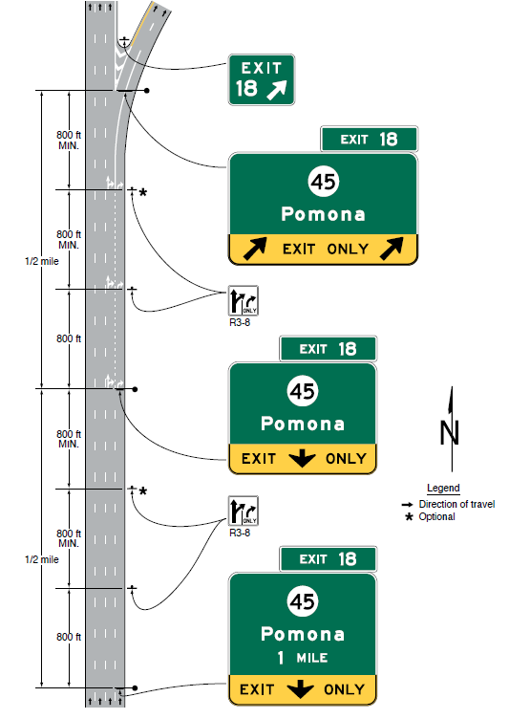
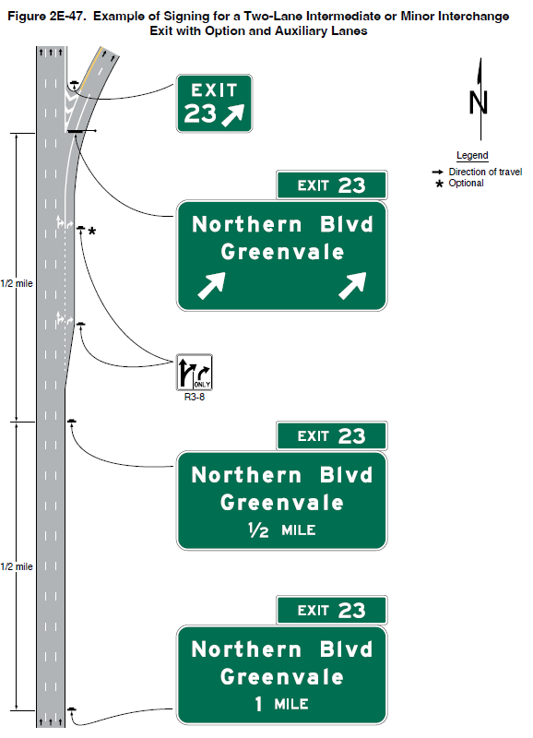
Section 2E.42 Signing for Intermediate and Minor Interchange Multi-Lane Exits with an Option Lane (2 of 2)
Adds new Figures 2E-46 and 2E-47
Figure 2E-46. Example of Signing for a Two-Lane Intermediate or Minor Interchange Exit with an Option Lane and a Dropped Lane
Figure 2E-47. Example of Signing for a Two-Lane Intermediate or Minor Interchange Exit with Option and Auxiliary Lane
Notes:
An Option provision is added allowing conventional signing where full-width Overhead Arrow-per-Lane guide signing is not practical.
One new figure shows an example of signing for a two-lane intermediate or minor interchange exit with an option lane and a dropped lane.
Another new figure shows an example of signing for a two-lane intermediate or minor interchange exit with option and auxiliary lanes.

Slide 40
Section 2E.45 Guide Signing in Tunnels and Similar Structures
Adds Section—Support, Option, Standard, and Guidance
Adds Guidance with recommendations for guide signs provided within the tunnel or similar structure
Notes:
This new section has Support, Option, Standard and Guidance provisions regarding the design of freeway and expressway guide signs in tunnels, which can present unique challenges not encountered elsewhere due to the extended and continuous distances of constrained vertical and horizontal clearances in which to place signs. These new provisions provide design flexibility to standard sign layouts when needed to accommodate such situations in tunnels.
Options include side by side sign legend arrangement (e.g., placing route shields to the left of the destination instead of above), placing the Exit Number plaque (see Section 2E.22) at the appropriate edge of the sign, reduced letter and numeral heights for the legend on Exit Number plaques, reduced letter heights for the destination and roadway names (when determined acceptable based on consideration of reduced speed and other relevant factors), and using Series D letters in lieu of Series E(modified) for unusually long destination and roadway names that cannot be adequately shortened or otherwise acceptably abbreviated.
Additional Guidance provisions are provided recommending that overhead signs in tunnels should have external or internal sign illumination, providing one or more Interchange Sequence signs (see Section 2E.24) on the approach to the tunnel, and considering the use of supplementary pavement markings inside the tunnel (e.g., word, arrow, and/or route shield markings).

Slide 41
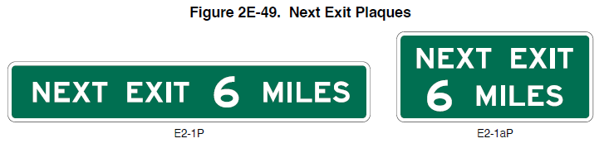
Section 2E.46 Next Exit Plaques
(E2-1P and E2-1aP)
Adds Guidance:
  Use E2-1P where width of Interchange Advance guide sign is greater than or equal to E2-1P plaque
  Use E2-1aP where width of E2-1P exceeds width of the Interchange Advance guide sign
Figure 2E-49. Next Exit Plaques
E2-1P
E2-1aP
Notes:
There is new Guidance that recommends the preferred practice for Next Exit plaques. Where the Next Exit plaque is used, the E2-1P plaque should be used where the width of the Interchange Advance guide sign is equal to or greater than the width of the E2-1P plaque. The E2-1aP plaque should be used where the width of the E2-1P plaque exceeds the width of the Interchange Advance guide sign.

Slide 42
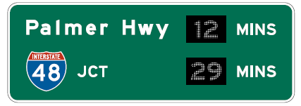
Section 2E.49 Post-Interchange Travel Time Sign (E7-4)
Adds Section
Provides Option to use travel time instead of distance to a destination
Adds Standard that Travel Time (E7-4) sign shall replace Distance sign in the series of post-interchange signs
Figure 2E.51. Example of a Post-Interchange Travel Time Sign
E7-4
Notes:
This new section includes provisions about the use of the Post-Interchange Travel Time Sign. At certain locations, it might be more meaningful to recurrent road users to display the travel time rather than the distance to a destination. Such instances might be areas of adverse roadway conditions due to weather, such as in mountain passes or high elevations, congestion that occurs during peak travel seasons, or recurring congestion.
The new Standard states that if used, the Post-Interchange Travel Time sign shall replace the Post-Interchange Distance sign in the series of post-interchange signs. Travel times shall not be used on Interchange guide signs.

Slide 43
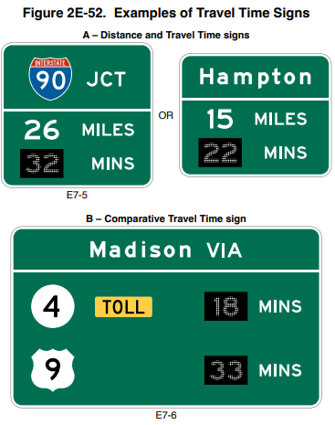
Section 2E.50 Distance and Travel Time Sign (E7-5) and Comparative Travel Time Sign (E7-6)
Adds Section
Revises Guidance on placement when used
Revises Standards on sign design
Figure 2E-52. Examples of Travel Time Signs
A – Distance and Travel Time signs
E7-5
B – Comparative Travel Time sign
E7-6
Notes:
This new section includes revised provisions about the use of the Distance and Travel Time sign and the Comparative Travel Time sign. Some locations might benefit from a travel time message displayed with the distance, or comparative travel times displayed for alternative routes to a common destination. These locations are often in advance of an urbanized area where interchanges become more closely spaced and/or in advance of a circumferential or other alternative route(s) where the road user can decide to divert depending on the destination. Nonetheless, these signs are typically located in advance of a decision point where the road user can divert to an alternate route to avoid recurring congestion.
Standard designs are addressed, and new Guidance provisions recommend placement locations when used. The Distance and Travel Time sign should be located between interchanges and away from the sequence of interchange guide signs or other major signs. The Comparative Travel Time sign should be located in advance of the sequence of interchange guide signs to provide adequate time for the road user to decide whether to reroute.

Slide 44
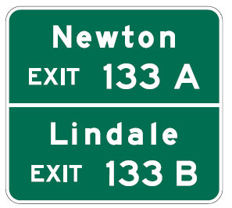
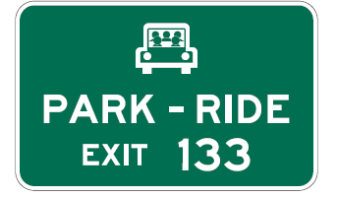
Section 2E.51 Supplemental Guide Signs
(E3 Series)
Figure 2E-53. Example of a Supplemental Guide Sign for a Multi-Exit Interchange
Adds Guidance: Should only be used where there is a demonstrated need for more destinations to be shown
Adds Standard with maximum:
  Two destinations from single interchange approach
  Four from single interchange along main roadway
Eliminates Option to use pictographs except for transit providers on a supplemental PARK-RIDE supplemental sign.
Figure 2E-54. Example of Supplemental Guide Sign for a Park-and-Ride Facility
Notes:
A new Guidance provision is added recommending that the use of Supplemental guide signs should be limited to situations where there is a demonstrated need to sign for more destinations from an interchange than those that are displayed on the Interchange Advance guide and Exit Direction signs. In addition, a Supplemental guide sign should not be installed unless a destination meets the criteria established by the State or agency policy.
A new Standard states that no more than two supplemental traffic generator destinations shall be signed from a single interchange approach and no more than four from a single interchange along the main roadway (i.e., the supplemental destinations do not have to be the same in both directions of travel along the main roadway such as in the case where a supplemental destination might have closer access from two different interchanges on the two directions).
In addition, guide signs for recreational or cultural interest destinations (covered in Chapter 2M) shall be considered as Supplemental guide signs, except where the interchange provides direct access to such a destination and the destination is instead displayed on the Interchange Advance guide and Exit Direction signs.
The Option to use pictographs for agencies, military bases, universities, or other government-approved institutions on supplemental guide signs is eliminated based on the results of a human factors evaluation. Research shows longer or additional glances, or both, toward guide signs with pictographs, indicating there might not be adequate time for a proper response due to the excessive informational load. One exception is provided in a revised Option statement to permit the pictograph of a transit provider to be displayed on the Park – Ride Supplemental guide sign or on a Supplemental guide sign for a transit facility.

Slide 45
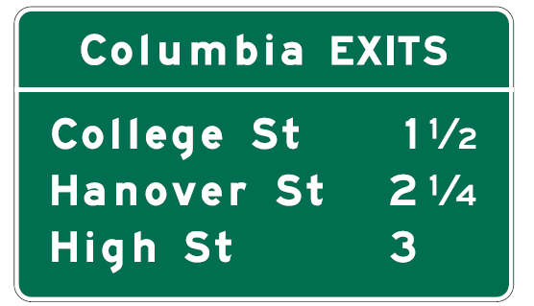
Section 2E.52 Community Interchanges Identification Signs (E9-4 and E9-5)
Interchange legend should be consistent between Interchange Advance guide, Exit Direction, and Community Interchanges Identification signs
Figure 2E-55. Example of a Community Interchanges Identification Sign
Notes:
A Guidance provision is revised to recommend that the legend displayed on the Interchange Advance guide and Exit Direction signs for each interchange should be consistent with the interchange names displayed on the Community Interchanges Identification sign. The name of the community displayed on the Community Interchanges Identification signs should be omitted from the legends of the Interchange Advance guide and Exit Direction signs.

Slide 46

Section 2E.53 Next Exits Signs (E9-3 and E9-3a)
Adds Guidance: Legend displayed on Next Exits sign should not be displayed on Interchange Advance guide and Exit Direction signs
Figure 2E-57. Example of a Next Exits Sign
E9-3
Notes:
A Guidance provision is added to recommend that the legend displayed on the Interchange Advance guide and Exit Direction signs for each interchange should not include the legend displayed on the Next Exits sign.

Slide 47

Section 2E.54 Weigh Station Signing
Figure 2E-59. Example of Weigh Station Signing on Freeways
Adds Support, Guidance, Options, and Standards
Adds Standard for the required sequence for Weigh Station signing
Adds Option allowing distances on signs to be adjusted
Adds Option for replacing WEIGH STATION with COMMERCIAL VEHICLE INSPECTION AREA legend
Notes:
The D8-1 or the D8-2 sign should include a changeable message element either within the sign border below the sign’s conventional legend, or mounted below the sign, which displays the message OPEN or CLOSED with a white legend on a black background.
The text COMMERCIAL VEHICLE INSPECTION AREA may be substituted for WEIGH STATION on all the D8 series signs.
Notes:
A new Standard provides the required standard sequence of signs for a Weigh Station on an expressway or freeway. The sequence includes:
A. An Advance Weigh Station Distance sign with the distance 1 MILE displayed,
B. An Advance Weigh Station Distance sign with the distance ½ MILE displayed, or a Weigh Station Advance Direction sign,
C. A Weigh Station Entrance Direction sign, and
D. A Weigh Station Gore sign (with the same legend as the Entrance Direction (D8-3) sign).
An Option allows the distances on the D8-1 signs to be adjusted if the spacing of 1 mile and ½ more are not practical, based on engineering judgment.
An Option is added which states that where State law requires trucks of a certain weight to enter the weigh station, a Weigh Station regulatory sign may be added to the sign sequence.
Where only commercial vehicle inspections are conducted in the inspection area and vehicles are not weighed, the WEIGH STATION legend of the D8 series signs may be replaced with the alternate legend, COMMERCIAL VEHICLE INSPECTION AREA.
An Option is added that states a plaque with the legend OPEN WHEN FLASHING may be added to one of the Advance Weigh Station Distance signs along with associated flashing beacons, in place of the changeable legend OPEN or CLOSED sign, to indicate when commercial vehicles are required to enter the weigh station.

Slide 48

Section 2E.56 Eisenhower Interstate System Signs (M1-10 and M1-10a)
Changes Guidance to Standard
Requires M1-10a sign to be used only in rest areas or other similar facilities
Figure 2E-61. Eisenhower Interstate System Signs
M1-10
M1-10a
Notes:
A Guidance provision is changed to Standard requiring that if used, the M1-10a sign shall be displayed only in rest areas or other similar facilities where the sign can be viewed by occupants of parked vehicles or by pedestrians. The M1-10a sign shall not be installed on Interstate highway mainlines, ramps, or other roadways where it can be viewed by vehicular traffic as the M1-10 is applicable in those locations.

Slide 49

Section 2E.57 Signs for Route
Diversion by Vehicle Class
Figure 2E-62. Example of Signing for Route Diversion by Vehicle Class
Adds Section
Applies to portions of highways where certain vehicles cannot proceed, such
as tunnels with low clearance, hazardous material restrictions, width restrictions
Recommends regulatory, warning,
and/or guide signs downstream to
notify road users
Notes:
A new Support provision is added which states that on some highways, a physical condition or highway feature might limit certain types or classes of vehicles from proceeding along that route due to a specific condition. Examples include, a restriction on taller legal-height vehicles through a tunnel with a low clearance; a restriction of hazardous materials through a tunnel or over a bridge; and a restriction on wider vehicles, such as large trucks, over a viaduct with narrow lanes.
A Guidance provision is added that recommends that where certain vehicles are prohibited at a downstream location along a route and those vehicles must divert to reach a through destination beyond that location, regulatory, warning, and/or guide signs advising those vehicle operators of the diversion should be installed in advance of the decision point to leave the through route for the diversion route.
An Option provision is added allowing modifications to the interchange and pull-through guide signs for the last point at which restricted vehicles must exit to incorporate regulatory and/or warning panels with word legends to display the regulations and/or warning messages relative to the vehicle class restriction.

Slide 50
Section Removed
Removes Section 2E.29 Signs for Intersections at Grade
The Section was inconsistent with grade-separated roadway signing principles (see Chapter 2D)
Notes:
Section 2E.29 Signs for Intersections at Grade is removed. The Section was inconsistent with grade-separated roadway signing principles.

Slide 51

FHWA’s National
Traffic Control Devices Program
for more information:
mutcd.fhwa.dot.gov
e–Subscribe Service
Official Rulings Database
Standard Highway Signs
Frequently Asked Questions
MUTCD News Feed
Notes:
This concludes this module. Additional modules on the MUTCD 11th Edition are available at the MUTCD Web Site at http://mutcd.fhwa.dot.gov/.
Almost anything related to the MUTCD that you need is at the official MUTCD Web site.
If you haven’t yet signed up for our e-Subscribe service, please take a moment to do so. We’ll send out a bulletin whenever new information is available so you can keep up-to-date. As subscribers, you’ll also hear about future Webinar and other opportunities first.

