Slide 1


Manual on Uniform Traffic Control Devices for Streets and Highways
An Overview of Changes in the 11th Edition
As published in the December 2023
Notice of Final Rule
Prepared by the
Federal Highway Administration’s
Office of Operations
Traffic Control Devices Program
Notes:
Welcome to the Manual on Uniform Traffic Control Devices for Streets and Highways—the MUTCD 11th Edition.
This series provides an overview of the significant changes in the MUTCD and was prepared by the FHWA’s Office of Operations Traffic Control Devices team. Each module address the changes in a specific area of the MUTCD.
Additional modules on the MUTCD 11th Edition are available at the MUTCD Web Site at http://mutcd.fhwa.dot.gov/. The series includes the following modules:
Part 1
Part 2:
Chapter 2A
Chapter 2B
Chapter 2C
Chapter 2D
Chapter 2E
Chapter 2F
Chapter 2G
Chapters 2H and 2I
Chapters 2J and 2K
Chapter 2L
Chapters 2M and 2N
Part 3
Part 4
Part 5
Part 6
Part 7
Part 8
Part 9

Slide 2
Disclaimers
Except for the statutes and regulations cited, the contents of this presentation do not have the force and effect of law and are not meant to bind the States or the public in any way. This presentation is intended only to provide information regarding existing requirements under the law or agency policies.
The Federal Highway Administration (FHWA) is the source of all images in this presentation unless otherwise indicated.
Notes:
(Disclaimer) Except for the statutes and regulations cited, the contents of this presentation do not have the force and effect of law and are not meant to bind the States or the public in any way. This presentation is intended only to provide information regarding existing requirements under the law or agency policies.
FHWA is the source of all images in this presentation unless otherwise indicated.

Slide 3
Overview of Changes in Chapter 2F
Manual on
Uniform Traffic Control Devices
2F
for Streets and Highways
An Overview of Changes in Chapter 2F
As published in the December 2023
Notice of Final Rule
Notes:
The remainder of this presentation will focus on the significant changes to Chapter 2F of the MUTCD.

Slide 4
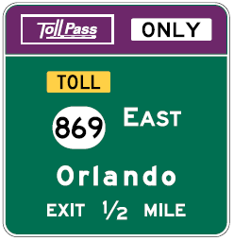
Chapter 2F Organization
New subchapter headings to organize sections:
  General
  Regulatory Signs
  Warning Signs
  Guide Signs
Notes:
Chapter 2F is reorganized with subchapter headings to improve usability of the MUTCD.

Slide 5
Section 2F.04 Regulatory Signs for Toll Plazas
Changes Option to Guidance
  Down arrows or diagonally downward-pointing directional arrows should be used if there is a need to clarify the applicability of the speed limit to a specific lane or to improve compliance
Notes:
An existing Option pertaining to speed limit sign placement at toll plazas was changed to Guidance to more clearly describe the intent of the provision.
Where speed limit signs are installed over a toll plaza lane on the toll plaza canopy, on the approach end of the toll booth island, on the toll booth itself, or on a vertical element of the canopy structure, then down arrows or diagonally downward-pointing directional arrows are recommended to supplement the speed limit signs if there is a need to clarify the applicability of a sign to a specific lane or to improve compliance.

Slide 6
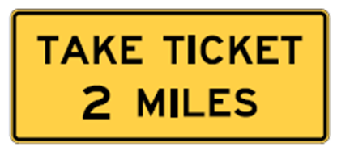
Section 2F.06 Pay Toll and Take Ticket Advance Warning Signs (W9-6 and W9-6e)
Adds Guidance for Take Ticket Advance warning sign and plaque mounting as follows:
  Take Ticket Advance Warning (W9-6e) sign should be installed overhead at ~1 mile and ½ mile in advance of mainline toll plazas
  If there is insufficient space for the Pay Toll (W9-6) or Take Ticket (W9-6e) sign, an existing Option allows the use of plaques per Section 2F.07
W9-6e
Notes:
In Sections 2F.06 through 2F.09, additional standard signs and plaques were added to provide practitioners with a standard sign for use on those facilities where tickets are issued to determine the length of travel for assessing toll fees.
In Section 2F.06, new Guidance recommends that the Take Ticket Advance Warning sign should be installed overhead at approximately 1 mile and ½ mile in advance of mainline toll plazas at which some or all lanes are required to come to a stop to take a toll ticket.
The existing Option allowing the use of a Pay Toll Advance Warning plaque, allows the use of a Take Ticket Advance Warning Plaque if there is insufficient space for the sign. See Section 2F.07.

Slide 7
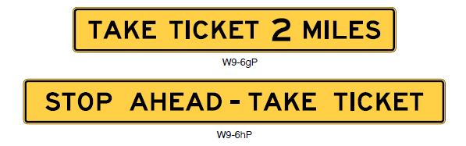
Section 2F.07 Pay Toll and Take Ticket Advance Warning Plaques (W9-6bP, W9-6dP, and W9-6gP)
Pay Toll or Take Ticket Advance Warning plaque may be installed above the appropriate guide sign(s) at the 1-mile and ½-mile advance locations to a toll plaza:
  Adds Option allowing the use of the Pay Toll (W9-6dP) plaque if the toll information is displayed on the guide sign that the plaque accompanies.
W9-6gP
Notes:
In Section 2F.07, the corresponding Take Ticket Advance Warning plaque was added to an existing Option provision. The Pay Toll or Take Ticket Advance Warning plaques may be installed above the appropriate guide sign(s) relating to toll payment types at the 1-mile and/or ½-mile advance locations on the approach to a toll plaza if there is insufficient space for the W9-6 or W9-6e sign at those advance locations.
There is an existing requirement to show the distance to the toll plaza, and except for toll-ticket facilities the toll for passenger or 2-axle vehicles, and an existing Option allows the distance to be omitted from the plaque if the distance is displayed on the guide sign that the plaque accompanies.
Similarly, if the toll information is displayed on the guide sign that the plaque accompanies, a new Option allows the use of the Pay Toll (W9-6dP) Advance Warning plaque.

Slide 8
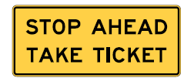
Section 2F.08 Stop Ahead Pay Toll and Take Ticket Warning Signs (W9-6a, W9-6f) and Section 2F.09 Stop Ahead Pay Toll and Take Ticket Warning Plaques (W9-6cP, W9-6hP)
Take Ticket warning sign should be installed overhead downstream from Take Ticket Advance Warning sign that is
½ mile in advance of mainline toll plaza:
  Stop Ahead Take Ticket warning plaque may be installed above the appropriate guide sign ½ mile in advance of mainline toll plaza if insufficient space to install Take Ticket sign at that location
W9-6f
W9-6hP
Notes:
In Section 2F.08, new Guidance recommends that the Take Ticket (W9-6f) warning sign should be installed downstream from the W9-6e sign that is ½ mile in advance of a mainline toll plaza where some or all of the lanes are required to come to a stop to take a toll ticket. The sign should be mounted overhead. The location of the overhead sign should coincide with the approximate location where the mainline lanes begin to widen on the approach to the toll plaza lanes.
In Section 2F.09, a new Option allows the Stop Ahead Take Ticket (W9-6hP) warning plaque to be installed above the appropriate guide sign at the location specified for the Take Ticket (W9-6f) sign if there is insufficient space for the W9-6f sign at that location.

Slide 9
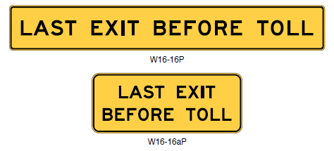
Section 2F.10 LAST EXIT BEFORE TOLL Warning Plaques (W16-16P and W16-16aP)
Adds W16-16aP LAST EXIT BEFORE TOLL plaque
Clarifies mounting location for W16-16P and W16-16aP plaques:
  Plaques should be installed above the appropriate guide signs for the exit but below the Exit Number or LEFT plaque if used
W16-16P
W16-16aP
Notes:
A new two-line alternative to the W16-16P LAST EXIT BEFORE TOLL plaque was added in Section 2F.10 and designated as W16-16aP. This additional plaque provides agencies design flexibility where the plaque is used above a narrow-width guide sign.
The LAST EXIT BEFORE TOLL warning plaque is recommended to be installed above the appropriate guide signs for the exit, but below the Exit Number or LEFT plaque if used.

Slide 10
Section 2F.12 Toll Facility and Toll Plaza Guide
Signs – General (1 of 3)
State Toll Route signs may be used in lieu of the State Route (M1-5) sign in combination with TOLL (W16-17P) warning plaque or TOLL panel:
  Sign shall incorporate the word TOLL using the same design features as that of the TOLL (W16-17P) warning plaque
  Interstate, Off-Interstate, and U.S. Route signs shall not be modified for tolled facilities
Notes:
A new Option allows a State Toll Route sign to be used in lieu of the State Route sign in combination with the TOLL warning plaque or the TOLL panel.
New Standards require that a State Toll Route sign shall incorporate into its design the word TOLL using the same letter height, legend, background colors, and overall plaque dimensions specified for the W16-17P warning plaque. The Interstate, Off-Interstate, and U.S. Route signs shall not be modified for tolled facilities.

Slide 11
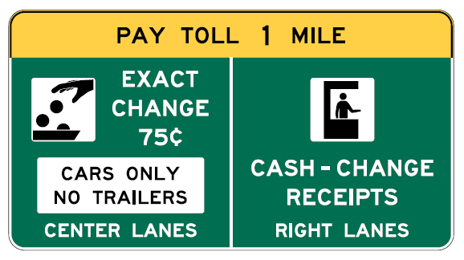
Section 2F.12 Toll Facility and Toll Plaza Guide
Signs – General (2 of 3)
Signs for attended lanes and Exact Change lanes at toll plazas shall incorporate the Toll Collector (M4-17) and Exact Change (M4-18) symbol panels
Optional
Required
Required
Required
Optional
Notes:
Continuing with Section 2F.12, the Toll Collector symbol is now required at attended lanes at toll plazas. The word legends such as FULL SERVICE, CASH, CHANGE, or RECEIPTS may supplement the symbol but are no longer required.
Similarly, the Exact Change symbol is not required at Exact Change lanes at toll plazas. The EXACT CHANGE word legend may supplement the required Exact change symbol panel but is no longer required.
These changes standardize the use of symbols in place of word messages where a symbol has been developed that provides at least equivalent levels of comprehension, legibility, and recognition, based on relevant research.

Slide 12
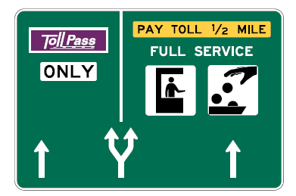
Section 2F.12 Toll Facility and Toll Plaza Guide
Signs – General (3 of 3)
Requires Overhead Arrow-per-Lane guide sign in advance of a location where the mainline lanes split to separate traffic entering Open-Road Electronic Toll Collection (ETC) lanes from lanes entering a toll plaza where other payment forms are accepted, and an option lane is present
Example of an Overhead
Arrow-per-Lane guide sign for a split with an option lane
Notes:
A new Standard requires that an Overhead Arrow-per-Lane guide sign shall be used in advance of a location where the mainline lanes split to separate traffic entering Open-Road ETC lanes from lanes entering a toll plaza where other methods of payment are accepted, and an option lane is provided at the split. An Overhead Arrow-per-Lane guide sign shall not be used if there is no option lane at the split.
Details for the arrow design will be included in the Standard Highway Signs publication.

Slide 13
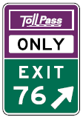
Section 2F.17 Guide Signs for Entrances to Electronic Toll Collection (ETC) Only Facilities (1 of 3)
Adds Option for the route number, TOLL warning panel, and NO CASH sign on advance guide sign
Allows Exit Gore signs for entrance ramps to include
the pictograph of the toll facility’s ETC payment system
and the word ONLY in a header panel or plaque
Allows additional ETC account program pictographs to be displayed on a separate informational guide sign with the legend ALSO ACCEPTED
Notes:
In Section 2F.17, an Option allows a separate information sign displaying the route number, the TOLL warning panel, and the legend NO CASH to be located within the sequence of the Advance guide signs on the approach to the entrance to an ETC Account-Only facility.
A new Option allows that Exit Gore signs for entrance ramps to such ETC Account-Only facilities may incorporate the pictograph of the toll facility’s ETC payment system and the word ONLY in a header panel or plaque.
A new option allows that if more than one ETC account program is accepted for toll payments on an ETC Account-Only facility, the additional accepted ETC account program pictographs may be displayed on a separate informational guide sign with the legend, ALSO ACCEPTED, within the sequence of advance guide signs for the entrance to the facility.

Slide 14
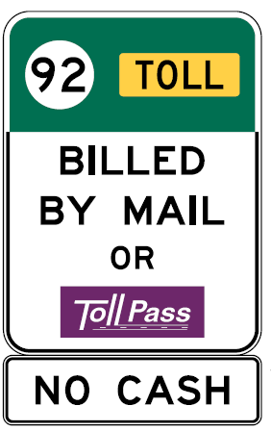
Section 2F.17 Guide Signs for Entrances to Electronic Toll Collection (ETC) Only Facilities (2 of 3)
Where vehicles are not required to have a registered ETC account:
  Guide signs shall comply with Chapter 2E and Section 2F.13
  Advance and Exit Direction guide signs shall not display an ETC pictograph or use purple as a background color
Information on accepted toll payments other than the ETC account program shall be provided on separate informational guide signs using the following legends:
  TOLL BILLED BY MAIL ONLY
  TOLL BILLED BY MAIL OR [ETC Pictograph]
Notes:
Continuing with Section 2F.17, new standards requires that where vehicles are not required to have a registered ETC account to use an ETC-Only facility, guide signs for the facility shall comply with the applicable provisions of Chapter 2E and specifically with the applicable provisions of Section 2F.13.
Advance and Exit Direction guide signs for the entrances to facilities that do not require registration in an ETC toll account program shall not display a pictograph of an accepted ETC payment system or use purple as a background color on any portion of the signs.
A new Standard requires that information on accepted toll payment methods for a facility that does not require registration in an ETC toll account program shall only be provided on a separate informational guide sign, if used, that displays one of the following legends: TOLL BILLED BY MAIL ONLY, if there is no alternative payment method; or TOLL BILLED BY MAIL OR ETC Account Pictograph, if the facility also accepts payments from registered users of an ETC account program.

Slide 15
Section 2F.17 Guide Signs for Entrances to Electronic Toll Collection (ETC) Only Facilities (3 of 3)
Adds Option to allow all ETC pictographs of accepted ETC accounts to be displayed on a separate informational guide sign below the TOLL BILLED BY MAIL OR legend:
  NO CASH plaque may be displayed below as well
Adds Guidance regarding the sequencing of advance signs for TOLL BILLED BY MAIL ONLY and TOLL BILLED BY MAIL OR [ETC Pictograph]
Notes:
A new option was added to allow additional ETC pictographs of accepted accounts. The option statement reads: If there is more than one ETC toll account program accepted, all ETC account program pictographs of the accepted ETC accounts may be displayed on the separate informational guide sign below the TOLL BILLED BY MAIL OR legend. A plaque with the legend NO CASH may be added below the signs described in Paragraph 10
of this Section.
New guidance was added regarding the sequencing of advance signs for TOLL BILLED signs. The guidance statement reads: The signs described in Paragraph 10 of this Section should be located within the sequence of Advance Guide signs for the entrance to the facility and/or at a location along the facility itself.

Slide 16
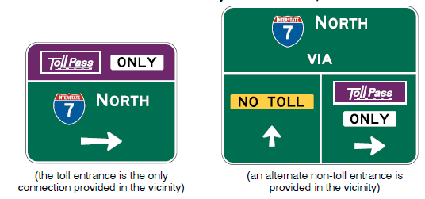
Section 2F.18 Guide Signs for ETC-Only Entrance Ramps to Non-Toll Highways
Adds a New Section
Requires signs to comply with Section 2F.17 provisions
Allows the NO TOLL panel to be included on top section of Exit Gore sign
Notes:
A new Section 2F.18 Guide Signs for Electronic Toll Collection Only Entrance Ramps to Non-Toll Highways was added. This section addresses ramps on which a toll is charged to manage congestion, limit access, or for other reasons. The toll ramp might be provided as an alternative to or in lieu of a ramp providing similar access without charging a toll.
Design of guide signs for this facility type shall comply with provisions in Section 2F.17.
An Option allows that the NO TOLL panel with black legend and yellow background may be included on the top section of the Exit Gore sign for an exit that provides access to the facility without charging a toll.

Slide 17

FHWA’s National
Traffic Control Devices Program
for more information:
mutcd.fhwa.dot.gov
e–Subscribe Service
Official Rulings Database
Standard Highway Signs
Frequently Asked Questions
MUTCD News Feed
Notes:
This concludes this module. Additional modules on the MUTCD 11th Edition are available at the MUTCD Web Site at http://mutcd.fhwa.dot.gov/.
Almost anything related to the MUTCD that you need is at the official MUTCD Web site.
If you haven’t yet signed up for our e-Subscribe service, please take a moment to do so. We’ll send out a bulletin whenever new information is available so you can keep up-to-date. As subscribers, you’ll also hear about future Webinar and other opportunities first.

