Slide 1


Manual on Uniform Traffic Control Devices for Streets and Highways
An Overview of Changes in the 11th Edition
As published in the December 2023
Notice of Final Rule
Prepared by the
Federal Highway Administration’s
Office of Operations
Traffic Control Devices Program
Notes:
Welcome to the Manual on Uniform Traffic Control Devices for Streets and Highways—the MUTCD 11th Edition.
This series provides an overview of the significant changes in the MUTCD and was prepared by the FHWA’s Office of Operations Traffic Control Devices team. Each module address the changes in a specific area of the MUTCD.
Additional modules on the MUTCD 11th Edition are available at the MUTCD Web Site at http://mutcd.fhwa.dot.gov/. The series includes the following modules:
Part 1
Part 2:
Chapter 2A
Chapter 2B
Chapter 2C
Chapter 2D
Chapter 2E
Chapter 2F
Chapter 2G
Chapters 2H and 2I
Chapters 2J and 2K
Chapter 2L
Chapters 2M and 2N
Part 3
Part 4
Part 5
Part 6
Part 7
Part 8
Part 9

Slide 2
Disclaimers
Except for the statutes and regulations cited, the contents of this presentation do not have the force and effect of law and are not meant to bind the States or the public in any way. This presentation is intended only to provide information regarding existing requirements under the law or agency policies.
The Federal Highway Administration (FHWA) is the source of all images in this presentation unless otherwise indicated.
Notes:
(Disclaimer) Except for the statutes and regulations cited, the contents of this presentation do not have the force and effect of law and are not meant to bind the States or the public in any way. This presentation is intended only to provide information regarding existing requirements under the law or agency policies.
FHWA is the source of all images in this presentation unless otherwise indicated.

Slide 3
Overview of Changes in Chapter 2G
Manual on
Uniform Traffic Control Devices
2G
for Streets and Highways
An Overview of Changes in Chapter 2G
As published in the December 2023
Notice of Final Rule
Notes:
The remainder of this presentation will focus on the significant changes to Chapter 2G of the MUTCD.

Slide 4
Chapter 2G Organization and Scope
New sub-chapter headings organize sections:
  General
  Regulatory Signs
  Warning Signs and Plaque
  Guide Signs
  Managed Lane Signs, Plaques, and Lane-Use Control Signals
Chapter 2G generally does not apply to bicycle lanes
Notes:
Chapter 2G is reorganized with subchapter headings to improve the usability of the MUTCD.
A new standard excludes bicycle lanes from the provisions of the Chapter unless otherwise provided. In general, information specific to bicycle facilities, including bicycle lanes is included in Part 9.

Slide 5
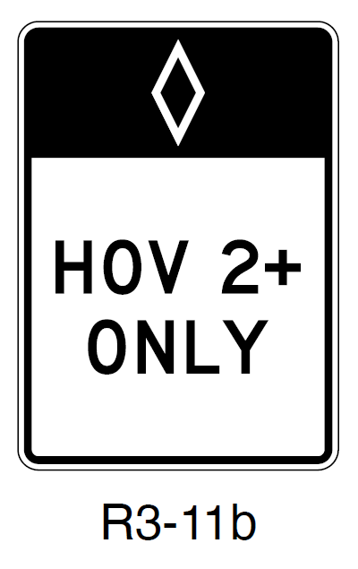
Section 2G.03 Regulatory Signs for Preferential Lanes – General
Minimum vertical clearance increased to 17 ft
Option removed to allow HOV abbreviation or diamond symbol
Diamond symbol required on preferential lane signs for
high-occupancy vehicles (HOVs)
R3-11b
Notes:
In Section 2G.03, the minimum vertical clearance for post-mounted preferential lane regulatory signs on a median barrier where lateral clearance is limited is increased from 14 feet to 17 feet. This is to provide consistency with Section 2A.15 which requires a 17-foot minimum vertical clearance for overhead signs that are over the lane or shoulder. This required minimum vertical clearance also applies to preferential lane warning and guide signs mounted on a median barrier where lateral clearance is limited, with provisions included in Sections 2G.08 and 2G.10 respectively.
The diamond symbol is required on preferential lane signs specific to high-occupancy vehicle lanes as all the standard signs for HOV lanes include the diamond symbol. A clarifying reminder, the diamond symbol shall not be used on the bus, taxi, or bicycle Preferential Lane signs.

Slide 6
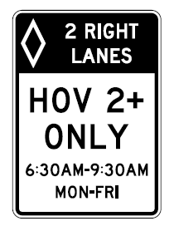
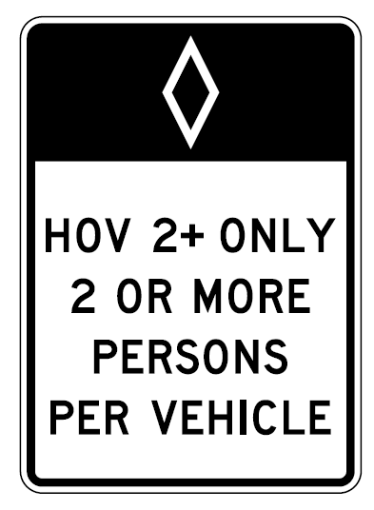
Section 2G.04 Vehicle Occupancy Definition Signs (R3-10 Series and R3-13 Series)
Adds Option to allow sequence of
R3-10 and R3-11a and signs to
be placed at ½-mile intervals
Clarifies Guidance that on conventional roads, the distance between preferential lane regulatory signs should be determined by engineering judgment based on speed, block length, and other site-specific considerations
R3-10
R3-11a
Notes:
In Section 2G.04, an Option is added to allow the placement interval of approximately one-half mile for R3–11a and R3–10 signs along the length of an HOV lane where access is restricted.
Existing Guidance was clarified such that the Preferential Lane regulatory sign sequence spacing of 800 to 1,000 feet is applicable to freeways and expressways. On conventional roads, the distance between Preferential Lane regulatory signs within each sequence should be determined by engineering judgment based on speed, block length, distances from adjacent intersections, and other site-specific considerations.

Slide 7
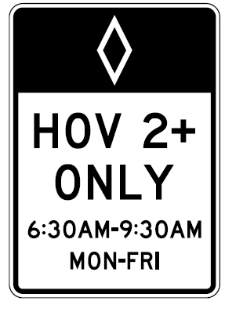
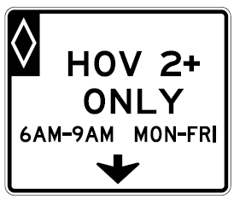
Section 2G.05 Preferential Lane Operation Signs (R3-11 Series and R3-14 Series)
Adds Guidance to increase height
of R3-11 and R3-14 for additional
lines of legend
Changes Standard requiring “24 HOURS” on signs in effect
full-time to an Option
Allows use of post-mounted R3-11 series signs on conventional roads, except where overhead signs are specifically required
R3-11
R3-14
Notes:
When a regulation is in effect during more than one time period of the day, such as during the morning and afternoon peak periods, the height of the R3-11 and R3-14 series signs should be suitably increased to accommodate the additional lines of legend.
The use of the 24 HOURS legend is now an Option instead of Standard for signs in effect full-time. Typically traffic regulations are assumed to be in effect on a full-time basis.
On conventional roads, R3-11 series post-mounted signs may be used in lieu of or, in addition to, overhead R3-14 series signs, except where overhead signs are required per Paragraph 13.

Slide 8
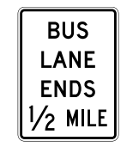
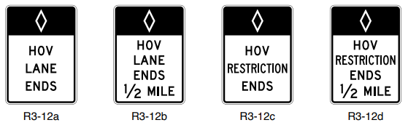
Section 2G.07 Preferential Lane Ends Signs
Sign placement ½ mile in advance of the end of a preferential lane applies to freeways and expressways
Sign placement on conventional roads should be determined by engineering judgment
R3-12b
R3-12d
R3-12h
Notes:
Clarification is added that the requirements for installing a Preferential Lane Ends sign one-half mile in advance of the termination of a preferential lane, or the point where a preferential lane restriction ends, applies specifically to freeways and expressways.
Preferential Lane Ends sign placement on conventional roads should be determined by engineering judgment.

Slide 9
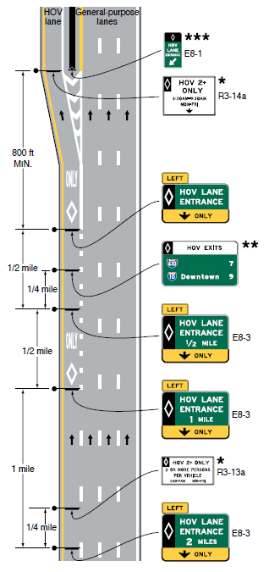
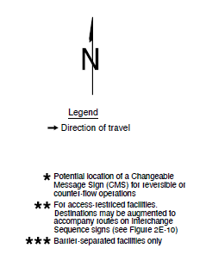
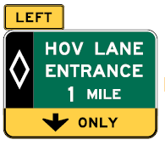
Section 2G.11 Signing for Initial Entry Points to Preferential Lanes
Figure 2G-8. Example of Advance Guide and Entrance Direction Signs for a General-Purpose Lane that Becomes a Preferential Lane
Requires Advance Guide sign
1 mile in advance when a
general-purpose lane becomes a preferential lane
Requires including a panel at bottom of the sign with a down arrow and “ONLY” in black legend on yellow
background
Notes:
For access to a managed lane on the right-hand side, the same signing sequence would be used with adjustments made to sign messages
Geometry is for illustrative purposes only; use locally applied geometric data
The minimum vehicle occupancy requirement and hours of operation on the sign may vary for each facility
See Chapter 3E for pavement markings
E8-3
Notes:
When a general-purpose lane becomes a preferential lane that does not provide continuous access with the adjacent general-purpose lanes, an Advance Guide sign is required at approximately one mile in advance of the initial entry point.
Consistent with existing requirements that Advance Guide signs for preferential lanes not include the word “EXIT” as users remain on the same route, the Advance Guide and Entrance Direction signs in this sequence shall include a panel at the bottom of the sign with a black legend and border on a yellow background displaying a down arrow and the word ONLY as illustrated in Figure 2G-8.

Slide 10
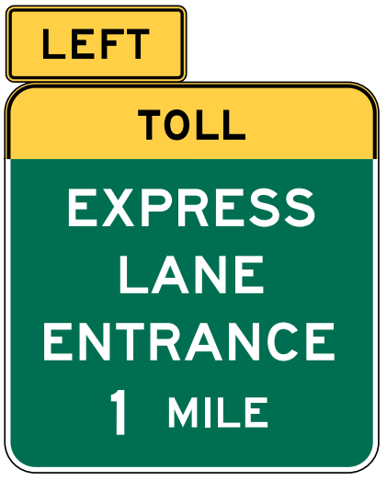

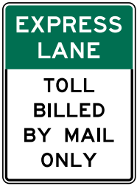
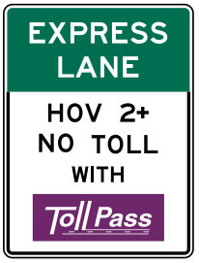
Section 2G.19 Guide Signs for Priced Managed Lanes
TOLL warning header panel required when registration in a
toll-account program is not required for travel in a managed lane
Toll payment informational signs are optional and may be posted separately within the sequence of primary guide signs
(optional)
Notes:
If registration in a toll-account program is not required for travel in a managed lane in which tolls are charged, then the electronic toll collection (ETC)-account pictograph shall not be displayed on primary guide signs directing traffic to the managed lane. In such cases, the purple header panel shall be replaced with a warning header panel with a black legend and border on a yellow background displaying the word TOLL.
Two new Options state how to sign for a variety of managed lane toll payment collection methods.
If the managed lane collects tolls only by post travel billing of registered vehicle owners, then the legend TOLL BILLED BY MAIL ONLY may be displayed on a separate information sign within the sequence of primary guide signs in advance of the entrance to the managed lane.
If the managed lane accepts payments from registered ETC accounts, but does not require registration to use the lane, then the pictographs of the accepted ETC account programs may be displayed on a separate information sign within the sequence of primary guide signs in advance of the entrance to the managed lane. The information sign may also display the legend TOLL BILLED BY MAIL OR in addition to the pictograph of the accepted ETC account program.
These provisions are further illustrated in Figure 2G-20.

Slide 11
Section 2G.20 Signs for Part-Time Travel on a Shoulder – General
Includes Support with factors to consider when planning traffic control for such operations
Includes a Standard requiring shoulders open to travel on a
full-time basis be signed as a travel lane
Adds Figure 2G-32
Notes:
New Section 2G.20 includes a Support provision with information regarding the general applicability of part-time travel on shoulders and factors to consider when planning traffic control for such operations.
In contrast to shoulders operated with part-time travel, shoulders opened to travel on a permanent, full-time basis are required to be signed and marked as a standard travel lane to be consistent with other travel lanes open on a full-time basis and to accommodate the expectancy of road users.
A new Figure, 2G-32 is added which is comprised of 4 sheets. Specific aspects of each sheet will be explored in more depth on the following slides.
See Section 3E.04 for provisions regarding the placement of markings on paved shoulders that are open for part-time travel.

Slide 12

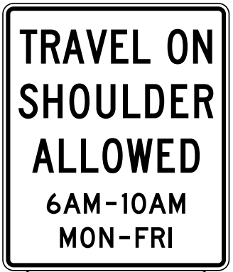
Section 2G.21 Regulatory Signs for Part-Time Travel on a Shoulder (1 of 3)
Requires periods of operation signs
OR
R3-51
R3-51d
Notes:
New Section 2G.21 includes requirements that standard signs and plaques shall be used to notify road users of the periods of operation that travel is allowed on a paved shoulder and to notify road users if certain classes of vehicles are not allowed to use the shoulder.
Different signs are specified to distinguish a variable operation from a fixed operation, and the signs are located every ½ mile or less to reaffirm when travel on the shoulder is allowed. For fixed periods of operation, a Part-Time Travel on Shoulder Operation (R3-51) sign shall be used. For variable operation, lane-use control signals shall be used, as discussed further in Section 2G.24. Optionally, the Part-Time Travel on Shoulder Variable Operation (R3-51d) sign with beacons may be used in lieu of the lane-use control signals.
If certain classes of vehicles are not allowed to use the shoulder during these periods, then a Selective Exclusion (R3-51aP or R3-51bP) plaque shall be mounted below the R3-51 or R3-51d sign. If the travel on the shoulder is restricted to certain classes of vehicles, then the regulatory signs shall display that information.
If the Selective Exclusion Plaques are not used, the Emergency Stopping Only Other Times (R3-51cP) plaque may be used.

Slide 13



Section 2G.21 Regulatory Signs for Part-Time Travel on a Shoulder (2 of 3)
Requires selective exclusion plaques
R3-51aP
OR
R3-51cP
R3-51bP
Notes:
New Section 2G.21 includes requirements that standard signs and plaques shall be used to notify road users of the periods of operation that travel is allowed on a paved shoulder and to notify road users if certain classes of vehicles are not allowed to use the shoulder.
Different signs are specified to distinguish a variable operation from a fixed operation, and the signs are located every ½ mile or less to reaffirm when travel on the shoulder is allowed. For fixed periods of operation, a Part-Time Travel on Shoulder Operation (R3-51) sign shall be used. For variable operation, lane-use control signals shall be used, as discussed further in Section 2G.24. Optionally, the Part-Time Travel on Shoulder Variable Operation (R3-51d) sign with beacons may be used in lieu of the lane-use control signals.
If certain classes of vehicles are not allowed to use the shoulder during these periods, then a Selective Exclusion (R3-51aP or R3-51bP) plaque shall be mounted below the R3-51 or R3-51d sign. If the travel on the shoulder is restricted to certain classes of vehicles, then the regulatory signs shall display that information.
If the Selective Exclusion Plaques are not used, the Emergency Stopping Only Other Times (R3-51cP) plaque may be used.

Slide 14
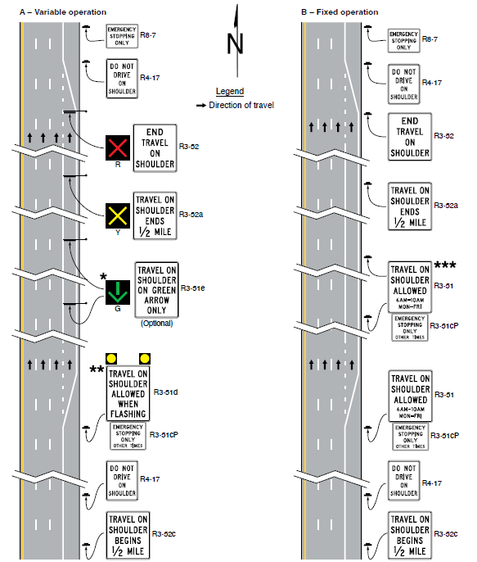
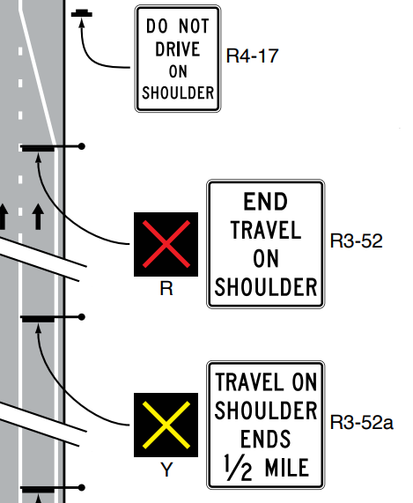
Section 2G.21 Regulatory Signs for Part-Time Travel on a Shoulder (3 of 3)
Figure 2G-32. Examples of Signing for Part-Time Travel on a Shoulder
(Sheet 1 of 4)
Requires sequence of signs where
part-time travel on shoulder ends
R4-17
R3-52
R3-52a
* Lane-use control signals (see Chapter 4T) located every ½ mile or less to reaffirm
shoulder travel allowed (DOWNWARD GREEN ARROW) or prohibited (RED X).
** A post-mounted TRAVEL ON SHOULDER ALLOWED WHEN FLASHING sign (R3-51d)
with beacons may be used in lieu of lane-use control signals at the same intervals.
*** The R3-51 sign is located every ½ mile or less to affirm when travel on shoulder is
allowed for fixed period applications.
Note: Consideration should be given to using
blank-out signs in place of the R3-51
and R3-52 series conventional signs
for part-time operations.
Notes:
A standard sequence of three signs is required to consistently communicate when shoulder travel is no longer allowed. Approximately ½ mile in advance of where part-time travel on shoulder ends, the TRAVEL ON SHOULDER ENDS (R3-52a) sign shall be used, followed by an END TRAVEL ON SHOULDER (R3-52) sign where traffic transitions from the shoulder back to a permanent highway lane travel. After this transition location a DO NOT DRIVE ON SHOULDER (R4-17) sign shall be used.
There are several additional recommended signs, and Figure 2G-32 Drawings A and B show example signing for a variable operation and a fixed operation, respectively.

Slide 15
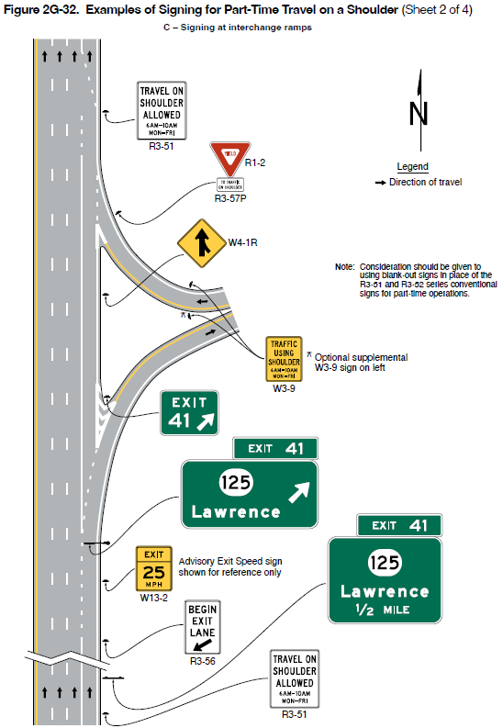
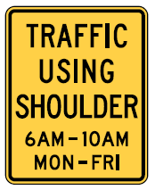
Section 2G.22 Warning Signs for Part-Time Travel on a Shoulder
Figure 2G-32. Examples of Signing for Part-Time Travel on a Shoulder
(Sheet 2 of 4)
C – Signing at interchange ramps
Recommends Traffic Using Shoulder (W3-9) sign on a ramp that enters a freeway or expressway
Allows the W3-9 sign to be used on a conventional road
Note: Consideration should be given to
using blank-out signs in place of the
R3-51 and R3-52 series conventional
signs for part-time operations.
* Optional supplemental
W3-9 sign on left
W3-9
Notes:
New Section 2G.22 recommends the TRAFFIC USING SHOULDER sign be used on a ramp that enters a freeway or expressway on which part-time travel on the shoulder is allowed.
An optional second TRAFFIC USING SHOULDER sign may be used on the left-hand side of the ramp opposite the recommended sign on the right-hand side of the ramp to provide greater visibility depending on ramp geometry and sight distance.
The TRAFFIC USING SHOULDER sign may also be used on a conventional road that is required to stop for or yield to the through street or highway on which part-time travel is allowed on the shoulder.

Slide 16
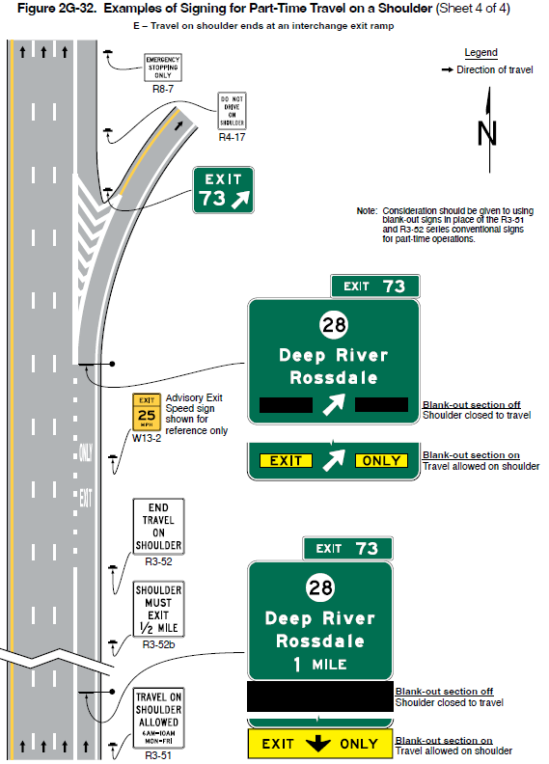
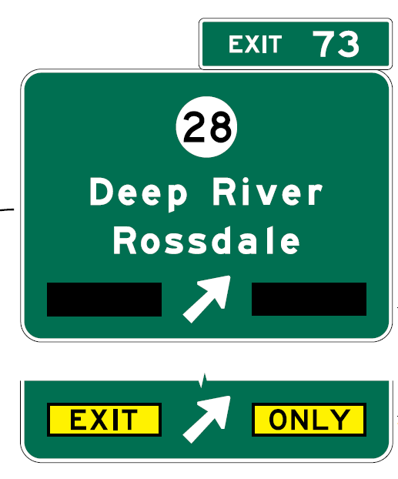
Section 2G.23 Guide Signs for Part-Time Travel on a Shoulder (1 of 2)
Figure 2G-32. Examples of Signing for Part-Time Travel on a Shoulder
(Sheet 4 of 4)
E – Travel on shoulder ends at an interchange exit ramp
Adds Standard requiring Advance and Exit Direction guide signs where a lane drop is created only during periods when a shoulder is open to travel to be:
  Overhead-mounted
  Modified to include a
  blank-out or changeable
  EXIT ONLY message
Note: Consideration should be given to using
blank-out signs in place of the R3-51
and R3-52 series conventional signs
for part-time operations.
Notes:
New Section 2G.23 adds a Standard requiring that where an interchange lane drop is created only during the periods when a shoulder is open to travel, the Advance and Exit Direction guide signs shall be overhead-mounted and shall be modified to include a blank-out or changeable EXIT ONLY message that complies with Section 2E.28 and is displayed only during the periods that the shoulder is open to travel.

Slide 17
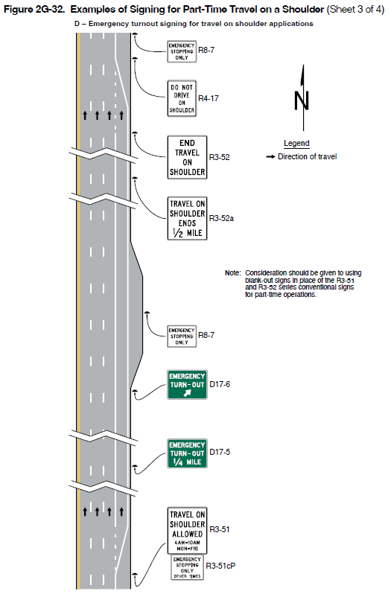
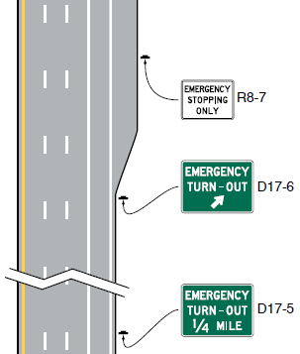
Section 2G.23 Guide Signs for Part-Time Travel on a Shoulder (2 of 2)
Figure 2G-32. Examples of Signing for Part-Time Travel on a Shoulder
(Sheet 3 of 4)
D – Emergency turnout signing for travel on shoulder applications
Recommends D17-5 and D17-6 signs where
turn-outs are provided
R8-7
Note: Consideration should be given to using
blank-out signs in place of the R3-51
and R3-52 series conventional signs
for part-time operations.
D17-6
D17-5
Notes:
Also in new Section 2G.23, where turn-outs are provided for emergency stopping during periods when travel is allowed on the shoulder, it is recommended to use Emergency Turn-Out Directional signs. Drawing D of Figure 2D-32 illustrates an example.

Slide 18
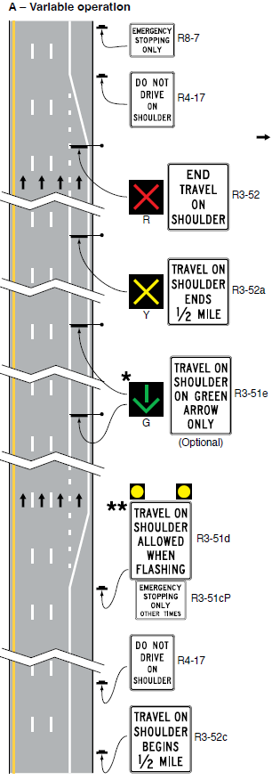
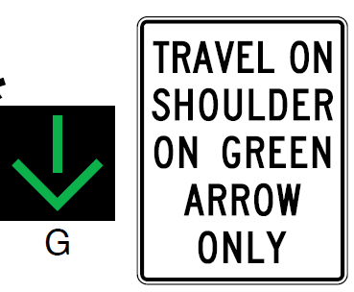
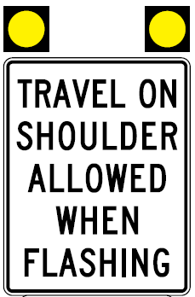
Section 2G.24 Lane-Use Control Signals for
Part-Time Travel on a Shoulder
Includes Option for the use of overhead
lane-use control signals for fixed time
periods of operation
Requires overhead lane-use control
signals for variable periods of operation
Includes requirements for the display
of DOWNWARD GREEN ARROW,
YELLOW X, RED X
Provides Options for using R3-51d, R3-51e signs
(Optional)
R3-51e
R3-51d
Notes:
New Section 2G.24 includes an Option that overhead lane-use control signals may be used above a shoulder on which part-time travel is allowed (i.e., fixed operations).
If used for part-time travel on a shoulder, lane-use control signals shall comply with Chapter 4T. Lane-use control signals are not required above the lanes adjacent to the shoulder. A steady RED X signal indication shall be used to close the shoulder to all travel except for emergency stopping.
If a variable period of operation is used, then overhead lane-use control signals shall be used and spaced approximately every one-half mile or less to reaffirm when travel on the shoulder is allowed. A downward green arrow indicates travel on the shoulder is allowed and a yellow X indicates that the shoulder is about to be closed to travel.
Additionally, during the period when travel is allowed on the shoulder, a lane-use control signal that continuously displays a steady YELLOW X signal indication shall be used approximately one-half mile in advance of the location where part-time travel on the shoulder ends, and then displays a steady RED X signal indication when the travel on shoulder ends. A lane-use control signal with a steady RED X signal indication shall be displayed at all times at the location where part-time travel on the shoulder ends.
As previously covered, post-mounted Part-Time Travel on Shoulder Variable Operation (R3-51d) signs with flashing beacons may be used in lieu of lane-use control signals at the same interval of approximately every one-half mile or less.
The TRAVEL ON SHOULDER ON GREEN ARROW ONLY (R3-51e) sign may be used as well.

Slide 19
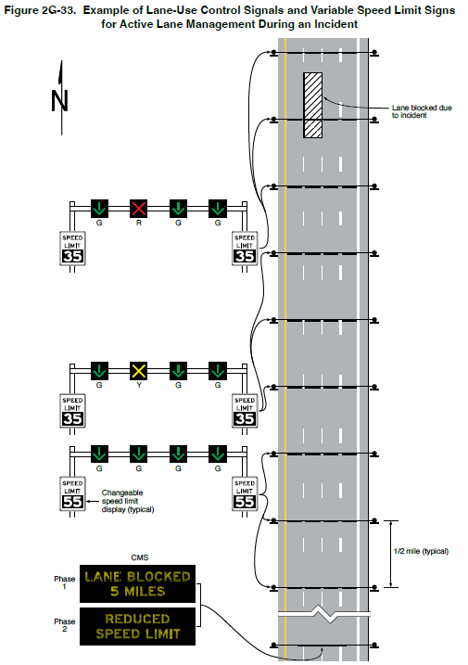
Section 2G.25 Lane-Use Control Signals for Active Lane Management on Freeways and Expressways
Figure 2G-33. Example of Lane-Use Control Signals and Variable Speed Limits Signs for Active Lane Management During an Incident
Adds Support describing active lane management
Requires following provisions in Chapter 4T for lane-use control signals
Describes relationship to supplement temporary traffic control devices
Recommends ½ mile spacing, or closer
Recommends minimizing the combination of
lane-use control signals with overhead signs
Notes:
New Section 2G.25 includes provisions for lane-use control signals used for active lane management, which is a component of active traffic management. The use of travel lanes and speed limits might be varied in real time in response to traffic conditions using lane-use control signals and/or changeable message signs. Figure 2G-33 shows an example.
The lane-use control signals shall follow the provisions in Chapter 4T. A steady YELLOW X signal indication warns road users to vacate the lane. A steady YELLOW X signal indication may be displayed on one or more lane-use control signals as conditions warrant to warn users to vacate the lane.
When operated in conjunction with a temporary planned lane closure, lane-use control signals shall be used only to supplement the temporary traffic control devices as provided in Part 6.
Lane-use control signals should be at one-half mile interval spacing, or closer depending on the roadway geometry, overcrossings or other sight obstructions, or ramp spacings.
Combining lane-use control signals with overhead sign support structures should be minimized to avoid overloading road users with too much information or conflicting or incorrect messages. An example of potential confusion is exclusive lane use or a lane drop implied by the display of a steady DOWNWARD GREEN ARROW signal indication below a guide sign.

Slide 20
Section 2G.26 Variable Speed Limits for Active Traffic Management on Freeways and Expressways
Adds Support provisions describing the use of variable speed limits and considerations for design and placement of the variable speed limit signs
Requires displaying the speed limit established by law, ordinance, regulation, or as adopted by the authorized agency based on an engineering study
Recommends basing the location and positioning of variable speed limit signs on an engineering study
Notes:
Variable speed limits signs are often used as an element of an overall congestion management plan, and careful consideration is needed in locating variable Speed Limit signs along the roadway.
The regulatory speed displayed on a variable Speed Limit sign shall comply with Paragraph 13 of Section 2B.21 and the “Standard Highway Signs” publication. The speed limits displayed shall be in multiples of 5 mph, and shall be established by law, ordinance, regulation, or as adopted by the authorized agency based on an engineering study.
Variable speed limit signs should be located such that the speed displayed is clearly associated to the lane or lanes intended to be regulated such that it would not present a conflict or confusion with other posted speed limits or advisory speeds for adjacent lanes, ramps, or roadways. Variable Speed Limit signs should not be located on overhead guide sign installations (see Section 2E.43).
In addition to the post-interchange Speed Limit sign (see Paragraph 17 of Section 2E.47), the spacing of variable Speed Limit signs on freeways and expressways should be based on an engineering study that considers such factors as recurring congestion, high-volume interchanges, weaving sections, and other location-specific factors that are known to affect travel speeds. The variable Speed Limit signs should be placed far enough in advance of known congestion points to adequately adjust the operating speed to minimize the extent of vehicle queuing.

Slide 21

FHWA’s National
Traffic Control Devices Program
for more information:
mutcd.fhwa.dot.gov
e–Subscribe Service
Official Rulings Database
Standard Highway Signs
Frequently Asked Questions
MUTCD News Feed
Notes:
This concludes this module. Additional modules on the MUTCD 11th Edition are available at the MUTCD Web Site at http://mutcd.fhwa.dot.gov/.
Almost anything related to the MUTCD that you need is at the official MUTCD Web site.
If you haven’t yet signed up for our e-Subscribe service, please take a moment to do so. We’ll send out a bulletin whenever new information is available so you can keep up-to-date. As subscribers, you’ll also hear about future Webinar and other opportunities first.

