Slide 1


Manual on Uniform Traffic Control Devices for Streets and Highways
An Overview of Changes in the 11th Edition
As published in the December 2023
Notice of Final Rule
Prepared by the
Federal Highway Administration’s
Office of Operations
Traffic Control Devices Program
Notes:
Welcome to the Manual on Uniform Traffic Control Devices for Streets and Highways—the MUTCD 11th Edition.
This series provides an overview of the significant changes in the MUTCD and was prepared by the FHWA’s Office of Operations Traffic Control Devices team. Each module address the changes in a specific area of the MUTCD.
Additional modules on the MUTCD 11th Edition are available at the MUTCD Web Site at http://mutcd.fhwa.dot.gov/. The series includes the following modules:
Part 1
Part 2:
Chapter 2A
Chapter 2B
Chapter 2C
Chapter 2D
Chapter 2E
Chapter 2F
Chapter 2G
Chapters 2H and 2I
Chapters 2J and 2K
Chapter 2L
Chapters 2M and 2N
Part 3
Part 4
Part 5
Part 6
Part 7
Part 8
Part 9

Slide 2
Disclaimers
Except for the statutes and regulations cited, the contents of this presentation do not have the force and effect of law and are not meant to bind the States or the public in any way. This presentation is intended only to provide information regarding existing requirements under the law or agency policies.
The Federal Highway Administration (FHWA) is the source of all images in this presentation unless otherwise indicated.
Notes:
(Disclaimer) Except for the statutes and regulations cited, the contents of this presentation do not have the force and effect of law and are not meant to bind the States or the public in any way. This presentation is intended only to provide information regarding existing requirements under the law or agency policies.
FHWA is the source of all images in this presentation unless otherwise indicated.

Slide 3
Overview of Changes in Chapters 2H and 2I
Manual on
Uniform Traffic Control Devices
2H
for Streets and Highways
2I
An Overview of Changes
Chapters 2H and 2I
As published in the December 2023
Notice of Final Rule
Notes:
This presentation will focus on the significant changes to Chapters 2H and 2I of the MUTCD.

Slide 4
Chapter 2H
General Information Signs
Notes:
Let us begin with the changes to Chapter 2H: General Information Signs.
General Information signs provide road users with navigational or orientation, geographic, or other information useful for traffic operational purposes.

Slide 5



General Information Signs
All signs are redesignated in Chapter 2H
Figure 2H-1. General Information and Miscellaneous Information Signs and Plaques
I3-10
Passengers Only
Ferry Terminal
I2-1
I2-2
I3-5
Airport
I3-6
Bus Station
I1-1
I4-2
I3-8
Light Rail
Transit Station
I3-9
Vehicle Ferry
Terminal
I3-7
Train Station
I4-1
Library
I3-10P
Advance Turn and Directional Arrow Auxiliary Plaques
For use with General Information Signs
Example of directional assembly
M5-1P
M5-2P
M5-3P
M6-1P
M6-2P
M6-3P
Notes:
All signs are re-designated in Chapter 2H to be consistent with the alphanumeric designations for all other signs in the MUTCD.

Slide 6
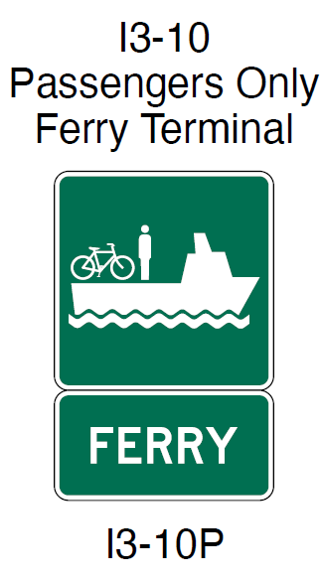
Section 2H.01 Scope
Adds Option allowing use of “Passengers Only
Ferry Terminal” sign with a FERRY plaque
Adds Standard prohibiting promotional
descriptive messages
Revises Standard clarifying exceptions to white legend with green background:
  State Welcome signs
  Acknowledgement signs
  Alternative Fuels Corridor signs
I3-10
Passengers Only
Ferry Terminal
I3-10P
Notes:
In Section 2H.01, there is a new Option to use a Passengers Only Ferry Terminal (I3-10) symbol sign with a FERRY (I3-10P) plaque mounted below to provide directional information to passenger only ferry terminals.
A new Standard statement prohibits promotional descriptive messages that are not relevant to navigation and orientation, such as “Scenic” or “Historic,” in the legends of General Information signs, except as otherwise provided in this Chapter or in cases where these terms are part of an official name, such as for a Scenic Byway or Historic District. This clarification is needed to ensure that traffic control devices are employed only for their intended purpose of regulating, warning, and guiding road users.
A Standard is revised to clarify that General Information signs shall have white legends and borders on green rectangular-shaped backgrounds, except for State Welcome signs, Acknowledgment signs, and Alternative Fuels Corridor signs.

Slide 7
Section 2H.02 Sizes of General Information Signs
Revises Option to add exception that larger sizes may not be used if a maximum allowable size is specified
Notes:
The Option allowing sign sizes to be larger than those contained in Table 2H–1 is revised to add an exception that larger sizes may not be used where a maximum allowable size is specified. This is to restrict the use of over-sized signs only to those situations where it is appropriate.

Slide 8
Section 2H.03 Airport Signs
Adds Standard prohibiting graphical representation of the specific airport in place of the specific airport name on guide signs
Changes Standard to Guidance regarding trailblazer signs prior to airport guide signs
Notes:
A new Standard is added that prohibits the use of airport pictographs or other graphical representation of the specific airport with or in place of the specific airport name on guide signs.
In addition, the Standard regarding trailblazer signs is changed to Guidance to recommend, and not require, these signs prior to the airport guide signs.

Slide 9
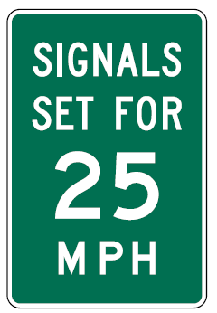
Section 2H.04 Traffic Signal Speed Sign (I1-1)
Adds Standard indicating an electronic-display changeable section of the traffic signal speed sign shall be a white legend on a black opaque or green background
Removes Standard regarding the minimum sign size as the information is in Table 2H-1
I1-1
Notes:
A new Standard is added to Section 2H.04 indicating that an electronic-display changeable section of the Traffic Signal Speed sign shall be a white legend on a black opaque or green background. This change is made to provide uniformity for this portion of the sign, consistent with the provisions for changeable message signs that allow the background portion of the sign to match the static sign.
Consistent with other changes to consolidate information, the Standard regarding the minimum sign size is removed, since it is shown in Table 2H-1.

Slide 10
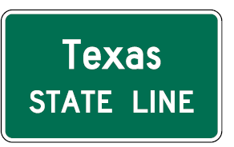
Section 2H.05 Jurisdictional Boundary Signs (I2-1) and Section 2H.07 State Welcome Signs
Adds sections differentiating between jurisdictional boundary and State Welcome signs:
  Jurisdictional Boundary signs: Mark the location of a jurisdictional boundary; white on green
  State Welcome signs: Mark the State line; legend and background colors may vary
I2-1
Notes:
Section 2H.05 is added to provide Option, Guidance, Standard and Support statements related to Jurisdictional Boundary signs (“Political Boundary signs” in the previous version of the MUTCD) and to differentiate between State Welcome signs and Jurisdictional Boundary signs.
Jurisdictional boundary signs mark the location of a jurisdictional boundary of a State, county, or municipality or the limits of an unincorporated municipal-level community, Tribal Nation, or governmental district where legal jurisdiction, road maintenance responsibility, or emergency response obligation changes.
Section 2H.07 is added to provide provisions for State Welcome signs. A State Welcome sign may be located at or in the vicinity of the State boundary. State Welcome signs may display the State seal or the State flag, the officially-adopted State motto or slogan, and the name of the Governor, in addition to the State name. State Welcome signs may use legend and background colors that provide adequate visual contrast rather than the standard sign colors.

Slide 11
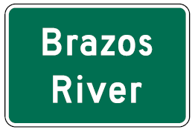
Section 2H.06 Geographical Feature Signs (I2-2)
Renumbers and retitles existing section
I2-2
Notes:
The section title was changed to better align with the stated intent of these signs, which is to orient road users on the roadway based on geographic features.

Slide 12
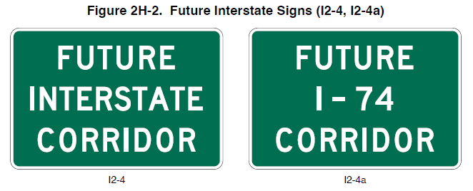
Section 2H.08 Future Interstate Corridor Signs
(I2-4 and I2-4a)
For use sparingly along an existing route in either of two circumstances:
  To be reconstructed as an interstate route
  Adjacent to a corridor through which an interstate route will be constructed
Either I2-4 or I2-4a sign may be used
once FHWA approves the route number
Figure 2H-2. Future Interstate Signs (I2-4, I2-4a)
I2-4
I2-4a
Notes:
Section 2H.08 is added to provide an Option, Standard, and Guidance regarding Future Interstate Corridor Signs (I2-4 and I2-4a).
The Future Interstate Corridor (I2-4 and I2-4a) signs may be used sparingly along an existing route that will be reconstructed as an Interstate route or along an existing route adjacent to a corridor through which an Interstate route will be constructed, in accordance with the Policy and Conditions stated in 23 CFR 470, Appendix C.

Slide 13
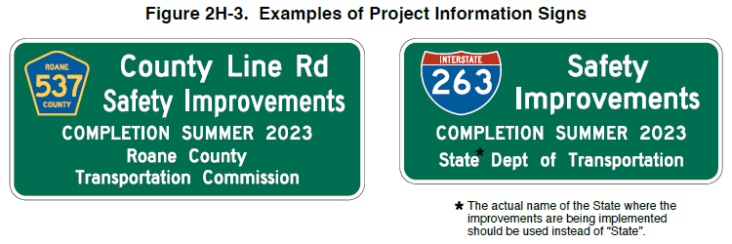
Section 2H.09 Project Information Sign (I2-5)
Support and Standard statements related to signs providing limited information on highway construction projects
Figure 2H-3. Examples of Project Information Signs
*
The actual name of the State where the improvements are being implemented should be used instead of “State.”
Notes:
Section 2H.09 is added to standardize the design and use of Project Information Signs and provides an Option, Standard, and Guidance regarding Project Information Signs (I2-5).
The Project Information (I2-5) sign provides limited information to road users about a highway construction project on which work is imminently forthcoming or ongoing.

Slide 14
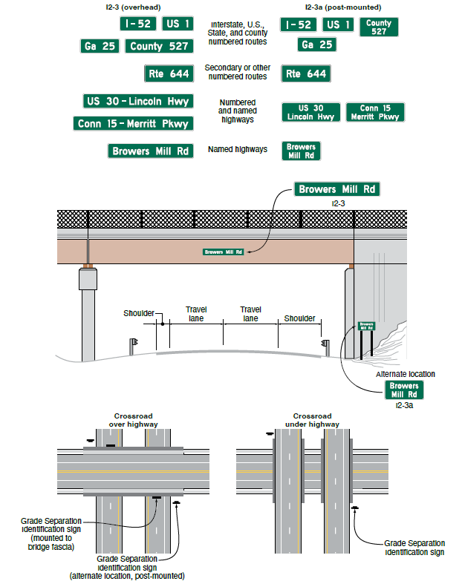
Section 2H.10 Grade-Separated Roadway Identification Signs (I2-3 and I2-3a)
Provides Options and Guidance on Grade-Separated Roadway Identification signs
  May be used to identify a grade separation of
  another highway or transportation facility
Figure 2H-4. Examples and Typical Placement of Grade Separation Identification Signs
Notes:
New Section 2H.10 provides options and guidance on the use of grade separated roadway identification signs.
The Grade-Separated Roadway Identification (I2-3 and, I2-3a) signs may be used to identify a grade separation of another highway or other transportation facility such as a railway, bikeway, or pathway.

Slide 15
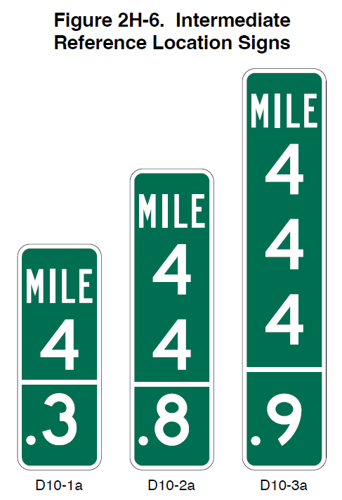
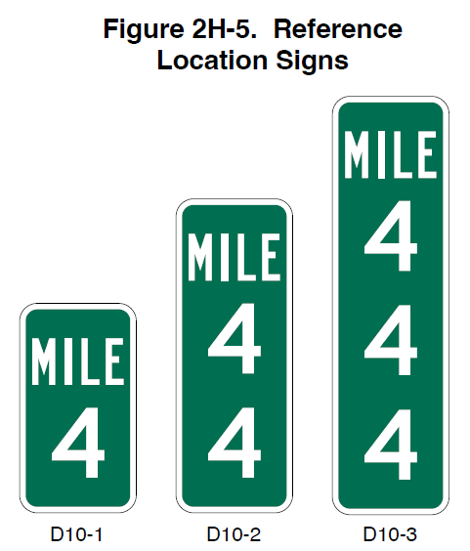
Section 2H.11 Reference Location Signs (D10-1 through D10-3) and Intermediate Reference Location Signs (D10-1a through D10-3a)
Revises Option to indicate that intermediate reference location signs may be installed at ¹/₁₀-mile, ²/₁₀-mile, or ½-mile intervals
Figure 2H-5. Reference Location Signs
Figure 2H-6. Intermediate Reference Location Signs
D10-1
D10-2
D10-3
D10-1a
D10-2a
D10-3a
Notes:
Section 2H.11 revises an Option to indicate that Intermediate Reference Location Signs may be installed at one tenth of a mile, two tenths of a mile, or one-half mile intervals.

Slide 16
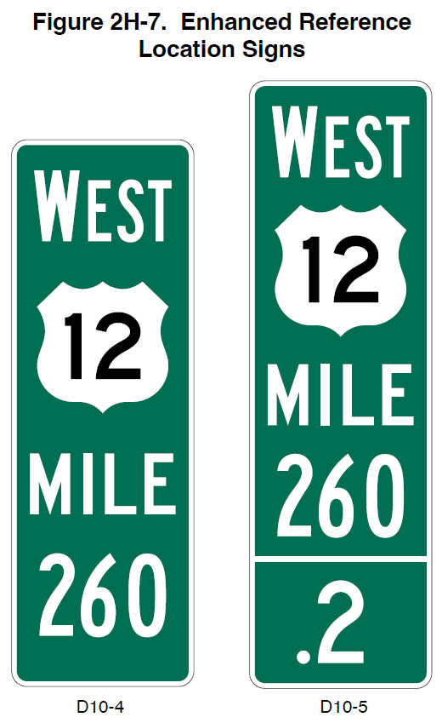
Section 2H.12 Enhanced Reference Location Signs (D10-4) and Intermediate Enhanced Reference Location Signs (D10-5)
Figure 2H-7. Enhanced Reference Location Signs
Revises Standard to clarify that the display of decimal point and zero numeral is required on intermediate enhanced reference location signs (D10-5) used at the integer mile point
Removes blue background Option to require green background
D10-4
D10-5
Notes:
Section 2H.12 adds a Standard to clarify that the display of decimal point and zero numeral is required on Intermediate Enhanced Reference Location (D10-5) signs used at the integer mile point.
The option allowing a blue background is removed, requiring all enhanced reference location signs to have a green background.

Slide 17
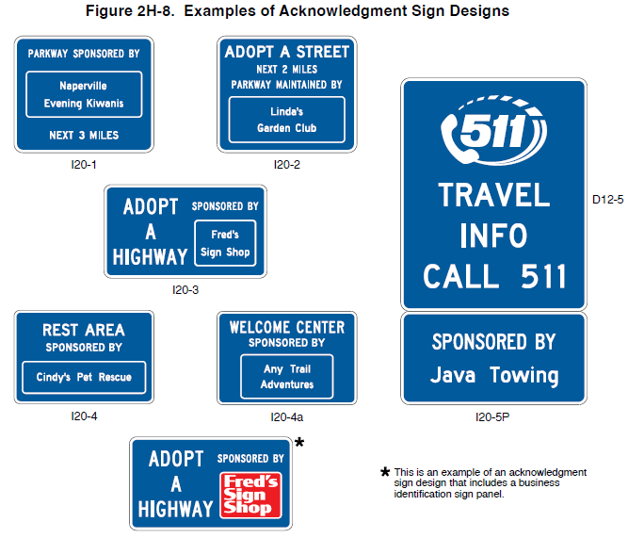
Section 2H.13 Acknowledgment Signs and Plaques (I20 Series) (1 of 2)
Changes Guidance to Standard to state that State or local acknowledgement sign policy shall include all provisions in this section
Adds Standard stating that acknowledgment signs and plaques shall have a white legend on a blue background
Adds Standard on “REST AREA” and “WELCOME CENTER” acknowledgment signs
Adds additional design provisions
I20-1
I20-2
I20-3
I20-4
I20-4a
Examples from Figure 2H-8
Notes:
In Section 2H.13, Guidance is changed to a Standard: “The State or local acknowledgment sign policy shall include all of the provisions regarding placement and design of Acknowledgment signs and plaques that are contained in this Section.” This change is made to ensure sign design and placement of these signs does not conflict with other provisions in the MUTCD.
A Standard is added to require Acknowledgment signs and plaques to have a white legend and border on a blue background. Acknowledgment signs shall be independent post-mounted roadside installations only and shall not be mounted overhead. This change is made to ensure these signs are consistent with other service type signs and maintain their purpose of acknowledging sponsors of services only.
An Option and Standard are added for Rest Area and Welcome Center Acknowledgement signs.
Additional design provisions related to orientation, dimension, area of the sign, and sizing the sign are added as well.

Slide 18
Section 2H.13 Acknowledgment Signs and Plaques (I20 Series) (2 of 2)
Adds Option allowing the name of the municipality or neighborhood in which the sponsoring outlet of a business is located if there are multiple locations in the same area
Adds Option allowing plaques to be mounted below specific general service signs
Adds Standard on acknowledgment plaque placement
D12-5
I20-5P
Example from Figure 2H-8
Notes:
An Option is added which states that if a specific outlet of a business with multiple locations in the same area is the sponsoring entity, such as a franchisee, the area reserved for the sponsor acknowledgment name or logo may include the name of the municipality or neighborhood in which the sponsoring entity is located.
An Option is added to permit Acknowledgement plaques to be mounted below General Service signs to acknowledge a sponsor of a corridor- or region- based highway related service including Radio-Weather Information (D12–1), Radio-Traffic Information (D12–1a), TRAVEL INFO CALL 511 (D12–5 and D12–5a), and Roadside Assistance (D12–6) signs.
Additionally, an Acknowledgment plaque shall not be mounted in conjunction with any other sign or traffic control device. An Acknowledgment plaque shall not be used alone or without one of the General Service signs specified in Paragraph 18 of this Section.

Slide 19
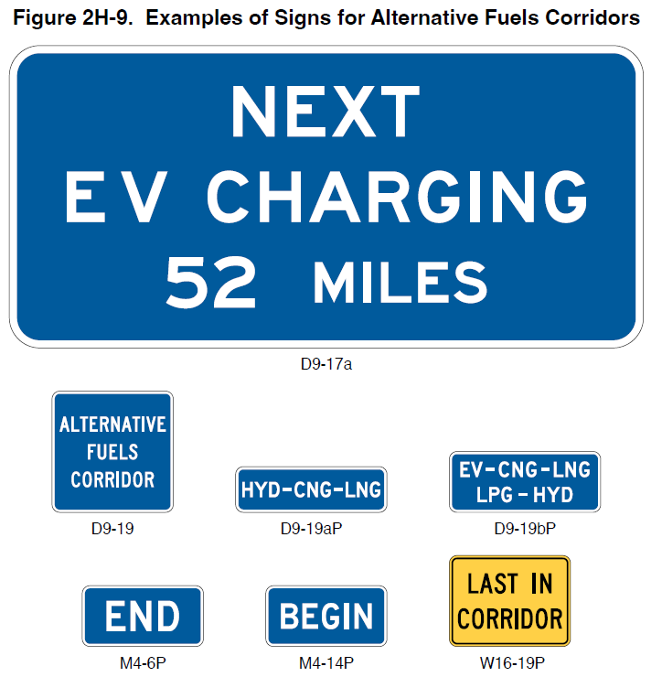
Section 2H.14 Alternative Fuels Corridor Sign
(D9-19) (1 of 2)
Figure 2H-9. Examples of Signs for Alternate Fuels Corridors
FHWA designates Alternative Fuels Corridor highway segments as “Corridor Ready”
Alternative fuel services include electric vehicle (EV) charging, compressed natural gas, liquid natural gas, liquified petroleum, and hydrogen
D9-17a
D9-19
D9-19aP
D9-19bP
M4-6P
M4-14P
W16-19P
Notes:
New Section 2H.14 is added to address signs for Alternative Fuels Corridors.
The Alternative Fuels Corridor sign informs road users of the highway segments that have been designated by FHWA as “Corridor Ready” and use either General Service or Specific Service signs in advance of each interchange or intersection for the fuel service along that corridor.
Eligible fuel services for Alternative Fuels Corridors are electric vehicle charging, compressed natural gas, liquid natural gas, liquified petroleum, and hydrogen.” (Preamble of Federal Register)

Slide 20
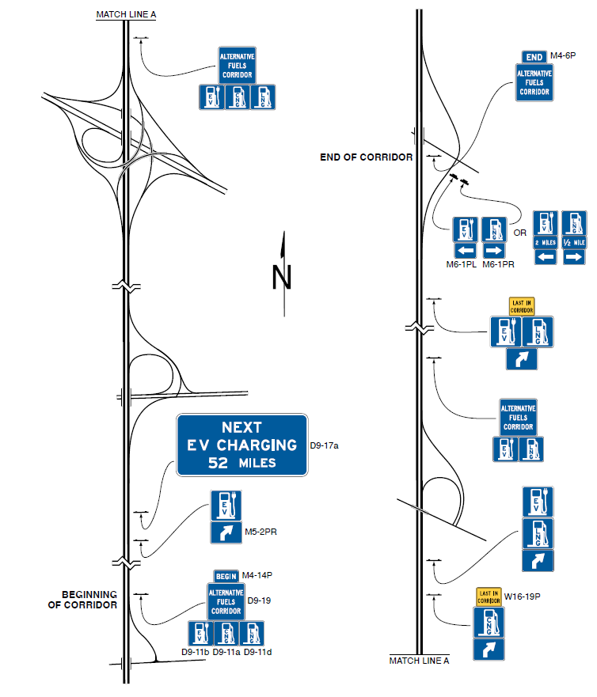
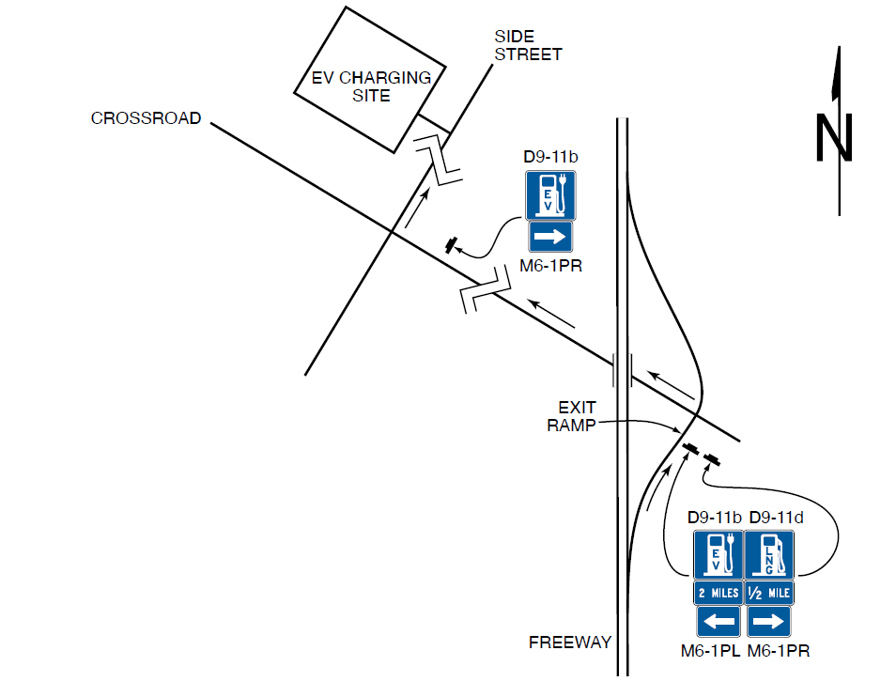
Section 2H.14 Alternative Fuels Corridor Sign
(D9-19) (2 of 2)
Figure 2H-10. Example of Signing for an Alternative Fuels Corridor
Figure 2H-11. Typical Signing from a Freeway Exit Ramp to a Service Facility
Notes:
In new Section 2H.14, two new figures are added showing examples of signing for an Alternative Fuels Corridor and typical signing from a freeway exit ramp to a service facility.

Slide 21
Chapter 2I
General Service Signs
Notes:
Let us now turn to the changes in Chapter 2I: General Service Signs.

Slide 22
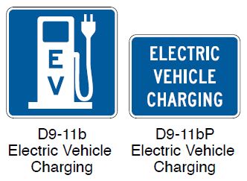

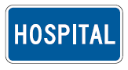

Section 2I.02 General Service Signs for Conventional Roads
Adds Standard for eligibility for EV charging
general service sign
Adds Standard for hospital “H” symbol (D9-2)
sign or “HOSPITAL” (D9-13aP) plaque be limited
to facilities that operate 24 hours per day, 7 days
per week
Adds Option for Emergency Medical Services
(D9-13) sign to be used for emergency medical
care facilities that do not operate on a full-time basis
D9-11b
Electric Vehicle
Charging
D9-11bP
Electric Vehicle
Charging
D9-13aP
Hospital
D9-2
Hospital
D9-13
Emergency
Medical Services
Notes:
A Standard is added for the EV Charging General Service sign eligibility criteria for Direct Current Fast Chargers provided in 23 CFR 35 680.106 and continuous operation at least 16 hours per day, 7 days per week.
A Standard is revised to specify that the use of the Hospital (D9-2) sign or the HOSPITAL (D9-13aP) plaque is limited to facilities that operate 24 hours per day, 7 days per week.
An Option is added that the Emergency Medical Services (D9-13) sign may be used for facilities that provide emergency medical care but do not operate on a full-time basis.

Slide 23
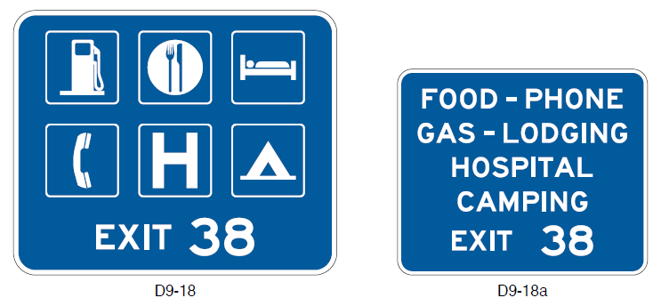
Section 2I.03 General Service Signs for Freeways and Expressways (1 of 2)
Adds Guidance: Where General Service signs are used along routes with exit numbering, the general service sign should include the exit number within the sign face
D9-18
D9-18a
Notes:
New Guidance is added that where General Service signs are used along routes with exit numbering, the General Service sign should include the exit number within the sign face.

Slide 24
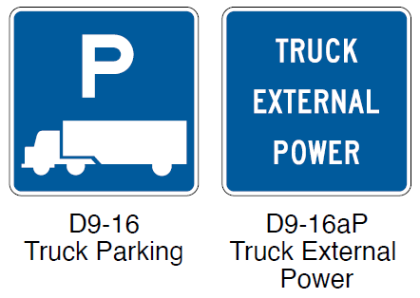
Section 2I.03 General Service Signs for Freeways and Expressways (2 of 2)
Changes criteria:
  Removes public telephone criteria
  Adds criteria for EV charging General Service sign
Adds Option for “TRUCK EXTERNAL POWER” plaque
D9-16
Truck Parking
D9-16aP
Truck External
Power
Notes:
Public telephones are removed from the criteria for General Service sign eligibility due to the prevalence of cell phones. Public telephone availability may still be considered in areas with poor cellular service.
Criteria are added for EV Charging General Service signs.
An option is added that states a TRUCK EXTERNAL POWER (D9-16aP) plaque may be mounted below the Truck Parking (D9-16) sign to indicate the availability of receptables providing power for electrical devices within the truck.

Slide 25
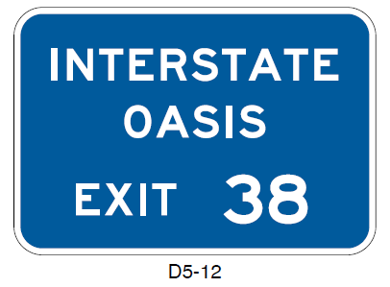
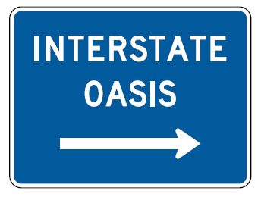
Section 2I.04 Interstate Oasis Signing (D5-12 Series)
Adds Option permitting the name of the business designated as an Interstate Oasis to be provided below the “INTERSTATE OASIS” legend on the D5-12 sign if Specific Service signing is not used at the interchange
Deletes Interstate Oasis symbol panel and related Standard
Adds “INTERSTATE OASIS” directional (D5-12b) sign
D5-12
D5-12b
Notes:
Guidance recommending that names or logos of businesses designated as Interstate Oasis not be included in the Interstate Oasis sign is removed. Instead, a new Option is added permitting the name of the business designated as an Interstate Oasis to be provided below the Interstate Oasis legend on the D5–12 sign if Specific Service signing is not used at the interchange. This change is based on experience with signing for the Interstate Oasis areas and recognizes that it may be appropriate to include business names.
The Interstate Oasis symbol panel is removed, along with the related Standard, based on poor comprehension of the symbol and the fact that no State currently uses the symbol.
Finally, a new Interstate Oasis Directional (D5–12b) sign is added to provide road users the direction and distance to the Interstate Oasis from an exit ramp.

Slide 26
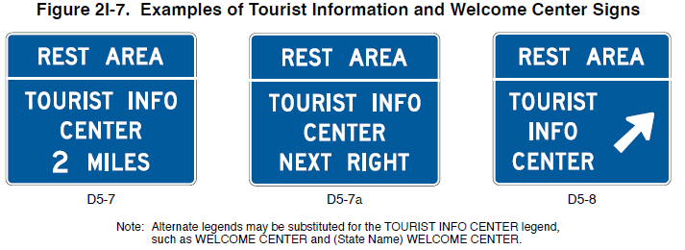
Section 2I.08 Tourist Information and Welcome Center Signs (D5-7 Series and D5-8)
Revises Guidance to recommend supplemental sign panels installed with Tourist Information or Welcome Center signs be limited to three
Figure 2I-7. Examples of Tourist Information and Welcome Center Signs
D5-7
D5-7a
D5-8
Note: Alternate legends may be substituted for the TOURIST INFO CENTER legend,
such as WELCOME CENTER and (State Name) WELCOME CENTER.
Notes:
The number of supplemental sign panels installed with Tourist Information or Welcome Center signs should be limited to three so as not to impose an undue informational load on the road user.

Slide 27

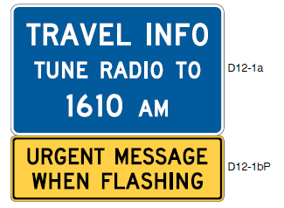
Section 2I.09 Radio Information Signing
(D12-1 Series)
Adds two signs:
  Radio-Traffic Information (D12-1a)
  “URGENT MESSAGE WHEN FLASHING” (D12-1bP):
    Adds Option to mount D12-1bP below D12-1 or D12-1a if supplemented by warning beacons that flash only when a message related to adverse travel conditions is being broadcast
D12-1a
D12-1bP
Notes:
Two new signs are added in Section 2I.09: Radio-Traffic Information (D12-1a) and Urgent Message When Flashing (D12-1bP).
An Option is added to mount the D12-1bP plaque below D12-1 or D12-1a sign when supplemented by warning beacons that flash only when a message related to adverse travel conditions is being broadcast.

Slide 28
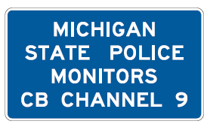
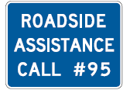
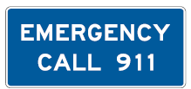
New Sections
Adds Section 2I.10 for Channel 9 monitored sign (D12-3)
Adds Section 2I.11 for “EMERGENCY CALL 911” sign
(D12-4)
Adds Section 2I.13 for new “ROADSIDE ASSISTANCE” sign (D12-6)
D12-3
D12-4
D12-6
Notes:
Two new sections are created specifically for the Channel 9 Monitored Sign and Emergency Call 911 Sign with options and standards previously in the MUTCD.
A new section is also added for the new Roadside Assistance Sign (D12-6).

Slide 29
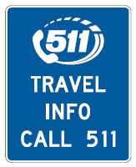
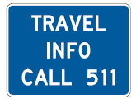
Section 2I.12 TRAVEL INFO CALL 511 Signs
(D12-5 and D12-5a)
Revises Option to allow a pictograph of the transportation agency or travel information service or program to be displayed in place of the “TRAVEL INFO CALL 511” legend on the D12-5a sign
Adds Standard regarding pictograph height
D12-5*
*The pictograph of the
transportation agency or the travel information service or program may be used in place of the 511 pictograph (see Section 2I.12)
D12-5a
Notes:
The Travel Info Call 511 Sign Option is revised to allow for pictographs to be displayed in place of the TRAVEL INFO CALL 511 legend. This change is made to provide agencies greater flexibility in program identification.
A Standard is added regarding the pictograph height. This change is made to provide uniformity in the size of travel information signing.
The maximum height of the pictograph shall not exceed the height of the 511 pictograph on the standard sign size specified for the roadway classification in Table 2H-1.

Slide 30
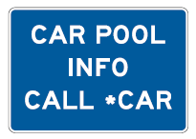
Section 2I.14 Carpool and Ridesharing Signing
(D12-2)
Revises Standard to include maximum horizontal dimension of 30 inches
D12-2
Notes:
For Section 2I.14 regarding Carpool and Ridesharing Signing, the Standard is revised to include that the maximum horizontal dimension is 30 inches. This change is made to maintain the primacy of other more critical signs.

Slide 31
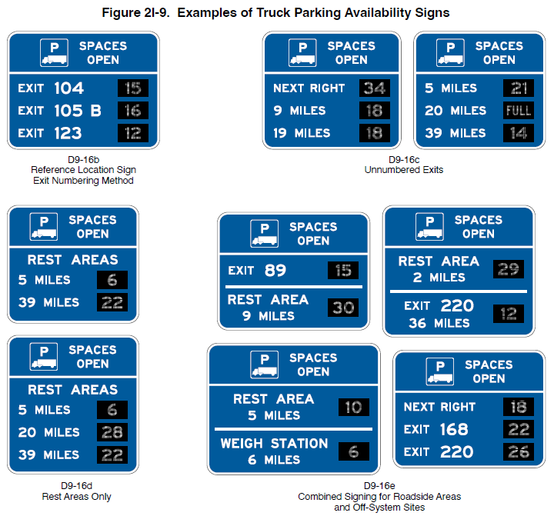
Section 2I.15 Signing for Truck Parking Availability
(D9-16b through D9-16e)
Figure 2I-9. Examples of Truck Parking Availability Signs
Adds Options, Standards, Guidance, and Support, as well as two figures on signing for truck parking availability
D9-16b
Reference Location Sign
Exit Numbering Method
D9-16c
Unnumbered Exits
D9-16e
Combined Signing for Roadside Areas
And Off-System Sites
D9-16d
Rest Areas Only
Notes:
New Section 2I.15 adds provisions for Truck Parking Availability signage that may be used to display the number of available truck parking spaces at roadside areas such as rest areas, welcome centers, and weigh stations, and at facilities off a highway that are open to the public and provide parking for commercial vehicles.
The Truck Parking Availability General Service (D9-16b through D9-16e) signs (see Figure 2I-9) shall include a changeable message element with a white changeable legend on a black opaque background that displays only the number of parking spaces currently available at each location or the legend FULL.
Truck Parking Availability signs should be located 3 to 5 miles in advance of the nearest parking facility. The parking facilities displayed on the sign should be no more than 60 miles from the sign location.

Slide 32

FHWA’s National
Traffic Control Devices Program
for more information:
mutcd.fhwa.dot.gov
e–Subscribe Service
Official Rulings Database
Standard Highway Signs
Frequently Asked Questions
MUTCD News Feed
Notes:
This concludes this module. Additional modules on the MUTCD 11th Edition are available at the MUTCD Web Site at http://mutcd.fhwa.dot.gov/.
Almost anything related to the MUTCD that you need is at the official MUTCD Web site.
If you haven’t yet signed up for our e-Subscribe service, please take a moment to do so. We’ll send out a bulletin whenever new information is available so you can keep up-to-date. As subscribers, you’ll also hear about future Webinar and other opportunities first.

