Slide 1


Manual on Uniform Traffic Control Devices for Streets and Highways
An Overview of Changes in the 11th Edition
As published in the December 2023
Notice of Final Rule
Prepared by the
Federal Highway Administration’s
Office of Operations
Traffic Control Devices Program
Notes:
Welcome to the Manual on Uniform Traffic Control Devices for Streets and Highways—the MUTCD 11th Edition.
This series provides an overview of the significant changes in the MUTCD and was prepared by the FHWA’s Office of Operations Traffic Control Devices team. Each module address the changes in a specific area of the MUTCD.
Additional modules on the MUTCD 11th Edition are available at the MUTCD Web Site at http://mutcd.fhwa.dot.gov/. The series includes the following modules:
Part 1
Part 2:
Chapter 2A
Chapter 2B
Chapter 2C
Chapter 2D
Chapter 2E
Chapter 2F
Chapter 2G
Chapters 2H and 2I
Chapters 2J and 2K
Chapter 2L
Chapters 2M and 2N
Part 3
Part 4
Part 5
Part 6
Part 7
Part 8
Part 9

Slide 2
Disclaimers
Except for the statutes and regulations cited, the contents of this presentation do not have the force and effect of law and are not meant to bind the States or the public in any way. This presentation is intended only to provide information regarding existing requirements under the law or agency policies.
The Federal Highway Administration (FHWA) is the source of all images in this presentation unless otherwise indicated.
Notes:
(Disclaimer) Except for the statutes and regulations cited, the contents of this presentation do not have the force and effect of law and are not meant to bind the States or the public in any way. This presentation is intended only to provide information regarding existing requirements under the law or agency policies.
FHWA is the source of all images in this presentation unless otherwise indicated.

Slide 3
Overview of Changes in Chapters 2J and 2K
Manual on
Uniform Traffic Control Devices
2J
for Streets and Highways
2K
An Overview of Changes
Chapters 2J and 2K
As published in the December 2023
Notice of Final Rule
Notes:
This presentation will focus on the significant changes to Chapters 2J and 2K of the MUTCD.

Slide 4
Chapter 2J
Specific Service Signs
Notes:
Let us begin with the changes to Chapter 2J: Specific Service Signs.
Specific Service signs display specific business identification logos of eligible commercial motorist services (gas, EV charging, food, lodging, camping, and attractions) available along a freeway or expressway.
This is in comparison to General Service signs, which display words or symbols to services including food, gas, EV charging, lodging, camping, public telephone, hospital, or tourist information services.

Slide 5
Sections 2J.01 Eligibility and 2J.12 Signing Policy
Replaces phrase: “Business identification sign panel” is used instead of “logo sign panel”
Changes Guidance to Standard:
  If specific service signing is used, there shall be a statewide policy on eligibility of the types of services
  There shall also be a highway agency signing policy
Notes:
Throughout Section 2J, the phrase “business identification sign panel” replaces the phrase “logo sign panel.” Logo refers to the specific logo or trademark of the business.
In Section 2J.01, Guidance is changed to Standard to improve consistency of the Specific Service Signing program. If States or local agencies elect to provide Specific Service signing, there shall be a statewide policy for such signing and criteria for the eligibility and availability of the various types of services. Statewide policies regarding Specific Signing already exist in a majority of states.
Section 2J.12 changes Guidance to Standard. It states that in addition to a statewide policy for eligibility of service providers, each highway agency that elects to use Specific Service signs shall establish a signing policy.
These changes are to ensure consistent and equitable signing criteria.

Slide 6
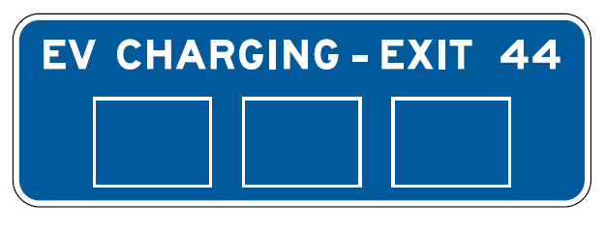
Section 2J.01 Eligibility
Revises Standard: Removal of 24-hour pharmacies as specific service
Adds Standard: Addition of Electric Vehicle (EV) charging as a specific service with eligibility criteria
From Figure 2J-2
Notes:
In Section 2J.01, Standard Paragraph 1 is revised to add electric vehicle (EV) charging to the list of eligible Specific Services, while removing 24-hour pharmacies. Throughout Section 2J, references to 24-hour pharmacies are removed and provisions for EV charging Specific Service signs are added. There has been little demand from 24-hour pharmacies for Specific Services signing; they will remain a General Service only.
“The market for alternative fuel vehicles and specifically EVs has grown in recent years as has demand for such vehicles and their corresponding fueling/charging infrastructure. The FHWA added provisions to the MUTCD to ensure adequate flexibility is available to sign for EV charging services and Alternative Fuels Corridors.” (Preamble of Federal Register)

Slide 7
Sections 2J.02 Application (1 of 2)
Revises Standard: No more than six business identification sign panels per sign:
  Other configurations are not allowed
Adds Guidance and Support: No more than four ATTRACTIONS business identification sign panels per sign
Notes:
In Section 2J.02, the Standard is revised to include that no more than six business identification sign panels shall be displayed on any one sign. Clarification is added that configurations or arrangements of business identification sign panels other than what is described shall not be allowed. If there are more than six eligible facilities for one or more categories of service, General Service signs for those services should be used instead, as the character of the area is no longer primarily rural.
Section 2J.02 adds Guidance and Support stating ATTRACTIONS business identification sign panels are limited to four, as attractions are not usually well-known, therefore requiring more time for road users to distinguish between attractions on an ATTRACTIONS sign than for other Specific Services.

Slide 8
Section 2J.02 Application (2 of 2)
Adds Guidance: If service type is no longer available, remove specific service sign so users do not interpret sign as a general service sign
Adds Option: If service may become available in the near future, service type legend may be covered instead if sign remains
Notes:
Section 2J.02 adds new Guidance recommending that if a service is no longer available from an interchange or intersection, then the sign should be removed. If the sign is to remain, but the service type is no longer available, then the service type legend should be covered, so that road users do not misinterpret the sign as a General Service sign implying the service is available.
An Option allows that if there is indication that this service may become available in the near future, the sign may be covered.

Slide 9
Section 2J.03 Logos and Business Identification Sign Panels (1 of 5)
Adds Guidance: Logo or trademark on a business identification sign panel should be consistent with the business identification signs at the business location
Adds Standard: Scanning graphics are prohibited on business identification sign panels
Notes:
Section 2J.03 adds Guidance recommending that the logo or trademark used on a business identification sign panel should be consistent with the business identification signs at the location of the business that are visible from the roadway. The Guidance provides consistency between the logo sign panel and the signing on the business and accommodates driver expectancy.
Section 2J.03 includes a new Standard that scanning graphics that are visible to the road user from the roadway for the purpose of obtaining information shall not be displayed on business identification sign panels, including on any logo displayed thereupon. Scanning graphics are graphics designed for scanning by machine, and include bar codes, quick-response (QR) codes or other matrix bar-code formats, or similar graphics.

Slide 10
Section 2J.03 Logos and Business Identification Sign Panels (2 of 5)
Removes Option: Border omission no longer allowable
Adds Standards:
  No promotion of services not directly related to the service category
  No promotion of availability of business identification sign panel space on specific service signs
  Prohibits slogans
Notes:
In Section 2J.03, the Option to allow the border to be omitted where business identification symbols or trademarks are used alone has been removed to ensure consistent apparent size and visibility of individual logos.
In Section 2J.03, the Standard regarding supplemental messages on business identification panels is revised to specifically prohibit additional amenities or products unrelated to the service category because those items are considered promotional advertising.
In Section 2J.03, a Standard is added to prohibit the display of messages related to the promotion or availability of business identification sign panel space on Specific Service signs.
In Section 2J.03, the Standard now states that slogans, such as marketing slogans associated with the business, shall not be displayed on business identification sign panels or the Specific Service sign itself. This is to ensure that promotional advertising is not present as it is not allowed on traffic control devices.

Slide 11
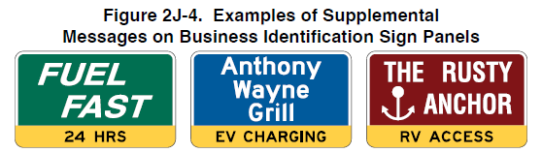
Section 2J.03 Logos and Business Identification Sign Panels (3 of 5)
Revises Guidance recommending supplemental messages should be displayed in a black legend on a yellow background
Removes Standard and Option specifying how circular “RV ACCESS” supplemental message should be displayed
Figure 2J-4. Examples of Supplemental
Messages on Business Identification Sign Panels
Notes:
Guidance is revised to recommend supplemental messages have a black legend on a yellow background for consistency across signs.
In Section 2J.03, the circular RV ACCESS supplemental message Standard and Option have been removed for consistency of supplemental messages.

Slide 12
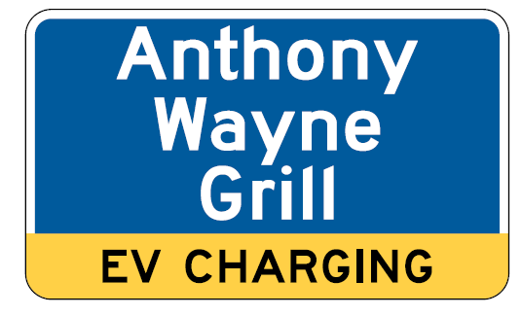
Section 2J.03 Logos and Business Identification Sign Panels (4 of 5)
Adds Standard: To be eligible for an “EV CHARGING” supplemental message on a business identification sign panel, the business shall:
  Offer EV charging to the general public without purchasing primary service; and
  Provide EV chargers meeting certain criteria based on service category
Example from Figure 2J-4
Notes:
A Standard is added to reflect the addition of EV CHARGING to Section 2J. The criteria for an EV CHARGING supplemental message on a business identification sign panel are added in a Standard in Section 2J.03
To be eligible for an EV CHARGING supplemental message on a business identification sign panel, the business shall:
Offer electric vehicle charging to the general public without purchasing the primary service (gas, food, lodging, camping, or attraction, as appropriate); and
For the service categories of gas, food, and attraction, provide EV chargers meeting the criteria for Direct Current Fast Chargers (DCFC) provided in 23 CFR 680.106; or
For the service categories of camping and lodging, provide EV chargers meeting the criteria for DCFCs provided in 23 CFR 680.106 and/or AC Level 2 Charging.

Slide 13
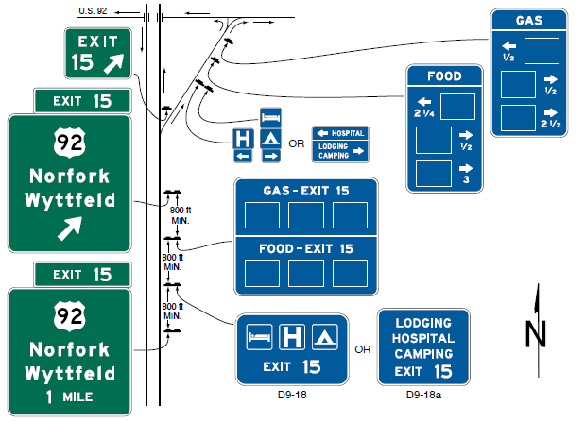
Section 2J.03 Logos and Business Identification Sign Panels (5 of 5)
Figure 2J-3. Example of General Service Signs
Used in Conjunction with Specific Service Signs
Adds Figure 2J-3
Note: If specific service ramp signs are used, their spacing should be at least 100
feet from the exit gore sign, from each other, and from the ramp terminal.
Notes:
Figure 2J-3 is added and shows how General Service signs can be used in conjunction with Specific Service signs.

Slide 14
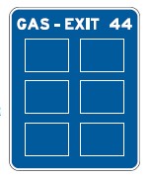
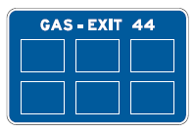
Sections 2J.01 Eligibility and 2J.03 Alternative Fuel Guidance
Revises Guidance: Removes alternative fuels from qualifications for gas business identification sign panel
Adds Option: Specifies that gas specific services may add supplemental message only if alternative fuel available
OR
SINGLE-EXIT INTERCHANGE
(ONE SERVICE)
Example from Figure 2J-1
Notes:
Guidance in Section 2J.01 is revised to remove alternative fuels from the qualifications for a GAS business identification sign panel. This is to eliminate driver confusion in the case of a facility offering alternative fuels only and not gasoline. GAS is to refer only to facilities that offer gasoline. A business that does not offer gasoline but offers alternative fuels shall not be signed using GAS Specific Service signs. A business that does not offer gasoline but offers alternative fuels may be signed using General Service signs for the alternative fuel provided.
Section 2J.03 adds an Option allowing an alternative fuel supplemental message to GAS services only where the alternative fuel is offered in addition to gasoline.
Alternative fuels are an important aspect of the 11th edition of the MUTCD, and include electric vehicle charging, compressed natural gas, liquefied natural gas, liquid propane gas, and hydrogen. These changes help create clarity for drivers along Alternative Fuels Corridors.

Slide 15
Sections 2J.02, 2J.06, and 2J.07 Distances
Revises Standard to clarify: Distances to eligible facilities shall not be displayed on specific service signs on the approach to an interchange
Adds Guidance: “NEXT EV CHARGING” sign should be used when distance is 50 miles or greater
Changes Guidance to Option: Distances less than ¼ mile on ramp specific service signs should be displayed to the nearest ¹/₁₀ mile
Notes:
In Section 2J.02, the Standard is revised to state explicitly that distances to eligible facilities shall not be displayed on the Specific Service signs on the approach to an interchange. While this practice has never been allowed, the 11th Edition clarifies this language to reflect the results of official experimentation and studies demonstrating that the display of distances requires too much time to read and reduces the effectiveness of these signs.
Section 2J.06 adds Guidance regarding EV Charging signs. When the distance to the next exit providing access to EV charging service is 50 miles or greater, the Next EV Charging sign should be used. When used, the Next EV Charging sign should be located directly after the General Service sign for the fuel type displayed in the signing sequence for the exit.
Section 2J.07 changes Guidance to an Option, allowing, but not recommending distances be displayed on Specific Service ramp signs. This gives agencies greater flexibility in determining whether to display the distance on Specific Service ramp signs. If distances are shown, distances of less than ¼ mile should be displayed to the nearest 1/10 mile.

Slide 16
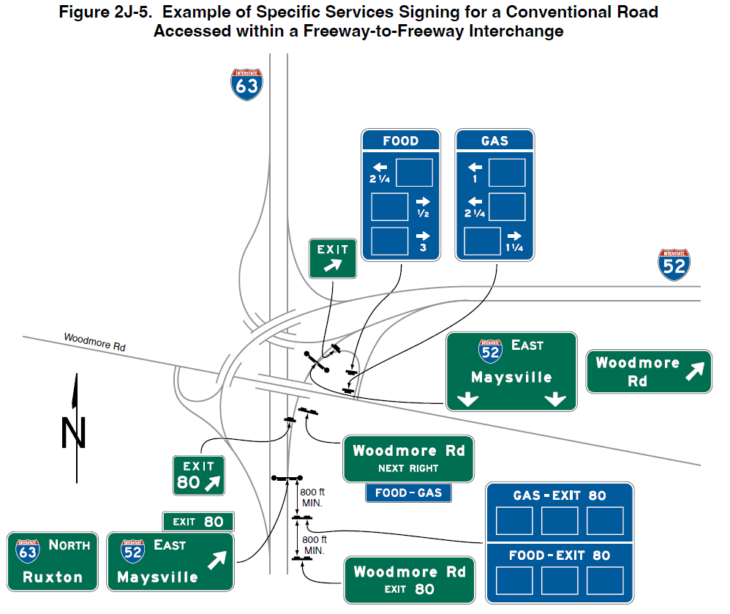
Section 2J.06 Signs at Interchanges
Adds Standard: Specific service signs shall not be used at
freeway-to-freeway interchanges, unless exit ramp also provides direct conventional road access
Adds Guidance: Adequate spacing for specific service ramp signs should be maintained
Figure 2J-5. Example of Specific Services Signing for a Conventional Road
Accessed within a Freeway-to-Freeway Interchange
Notes:
Section 2J.06 adds a Standard: Specific Service signs shall not be used at freeway-to-freeway interchanges except where the exit ramp also provides direct access to a conventional road within that interchange. New Figure 2J-5 shows an example. This revision was added to ensure drivers do not think a service is available on the freeway itself.
Section 2J.06 also adds Guidance that Specific Service ramp signs should be spaced at least 200 feet longitudinally from any Destination guide signs along the ramp. Longer longitudinal spacing should be provided between Specific Service ramp signs and any warning or regulatory signs along the ramp, and any intersection traffic control devices at the ramp terminal. This change is to ensure that adequate spacing between critical destination, warning, and regulatory signs along the ramp in maintained.

Slide 17
Section 2J.07 Single-Exit Interchanges
Revises Standard to clarify specific service ramp signs are required only when traffic is allowed to turn onto the crossroad in either direction from ramp, if businesses are not readily visible from the ramp
Changes Guidance to Option to allow specific service ramp signs to display distances to facility not visible from ramp
Adds Guidance to recommend displaying distances less than
¼ mile to nearest ¹/₁₀ mile
Notes:
In Section 2J.07, the Standard is revised to clarify that Specific Service ramp signs are only required in cases where traffic is allowed to turn on to the crossroad in either direction from the ramp, if businesses are not readily visible from the ramp.
Guidance is changed to an Option statement to allow, rather than recommend, that Specific Service ramp signs display distances to a facility when not visible from the ramp intersection.
New Guidance also recommends that when displayed, distances of less than 1⁄4 mile should be displayed to the nearest 1⁄10 mile.
These changes provide agencies greater flexibility in determining whether to display the distance on Specific Service ramp signs.

Slide 18
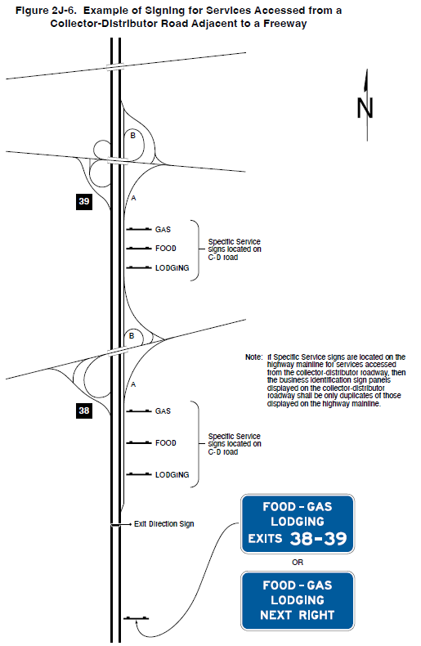
Section 2J.09 Collector-Distributor Roadways for Successive Interchanges
Figure 2J-6. Example of Signing for Services Accessed from a Collector-Distributor Road Adjacent to a Freeway
Adds Standards:
  No more than four specific service signs
  shall be on a highway mainline approach to a
  collector-distributor roadway:
  If more are needed, then use general service signs
If same business identification is shown on mainline and collector-distributor roadway, business identification sign panels must be duplicates
Note: If Specific Service signs are located on the
highway mainline for services accessed
from the collector-distributor roadway, then
the business identification sign panels
displayed on the collector-distributor
roadway shall be only duplicates of those
displayed on the highway mainline.
Notes:
Section 2J.09 Collector-Distributor Roadways for Successive Interchanges was added to address the application of mainline Specific Service signing when more than one interchange is accessed from the collector-distributor roadway.
New Standard: No more than four Specific Service signs shall be displayed on a highway mainline approach to a collector-distributor roadway.
New Standard: If more than four Specific Services signs would be required on the mainline in advance of the collector-distributor roadway in order to display all the business identification sign panels used on Specific Service signs in advance of the collector-distributor roadway exits, then General Service signs shall be used on the mainline to identify the types of services displayed on Specific Service signs on the collector-distributor roadway.
New Standard: If Specific Service signs are located on the highway mainline for services accessed from the collector-distributor roadway, then the business identification sign panels displayed on the collector-distributor roadway shall be only duplicates of those displayed on the highway mainline.

Slide 19
Section 2J.11 Signs at Intersections
Removes Standard requiring specific service information be incorporated into tourist-oriented direction signs (TODs) at intersections with both TODs and specific service signs
Replaces Standard with Guidance recommending specific service and TODs be sufficiently spaced
Adds Standard to clarify guide, warning, and regulatory signs be given priority if space is limited
Notes:
In Section 2J.11, the Standard that required Specific Service information be incorporated into tourist-oriented direction signs at intersections on conventional roads or expressways when both tourist-oriented directional signs and Specific Service signs are needed is removed. A new Guidance statement recommends that if both tourist-oriented information and specific service information are proposed to be used at the same intersection, the tourist-oriented directional and Specific Service signs should be spaced sufficiently apart from one another, as well as apart from other guide, warning, and regulatory signs, to avoid confusion and allow sufficient time for road users to read and react to the information.
A Standard is added that if sufficient space to provide appropriate reading and reaction to all proposed signs is not available, higher priority shall be given to guide, warning, and regulatory signs and either the tourist-oriented directional signs or the Specific Service signs, or both, shall not be used.
These changes are made to give agencies the flexibility to provide continuity of information on sign types.

Slide 20
Chapter 2K
Tourist-Oriented
Directional Signs
Notes:
Let us now turn to the changes in Chapter 2K: Tourist-Oriented Directional Signs.

Slide 21
Section 2K.01 Purpose and Application
Revises Standard to clarify that TODs shall be limited to rural highways
Removes Standard that required specific service information be incorporated into TODs at intersections with both TODs and specific service signs
Notes:
A Standard is revised to clarify that tourist-oriented directional signs shall be limited to rural highways. Tourist-oriented directional signs shall not be installed on conventional roads in urban or urbanized areas or on freeway or expressway main roadways or ramps.
A Rural Highway is a type of roadway normally characterized by lower volumes, higher speeds, fewer turning conflicts, and less conflict with pedestrians.
Consistent with the change in Section 2J.11, the requirement for specific service information to be incorporated into the tourist-oriented directional signs at intersections on conventional roads or expressways when both tourist-oriented directional signs and Specific Service signs are needed is removed.

Slide 22
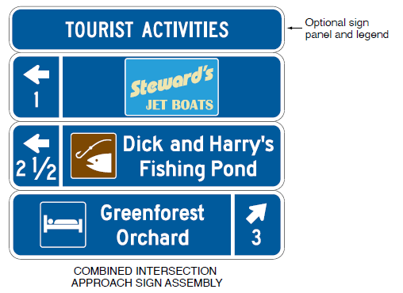
Section 2K.02 Design
Adds Standard:
  Recreational and cultural interest area symbols shall be white on a brown background
  Business identification sign panels shall not exceed 24 inches in width and 15 inches in height
Example from Figure 2K-1
Notes:
Section 2K.02 Design includes a new Standard that Recreational and Cultural Interest Area Symbols shall be white on a brown background. All other symbols are to be white on a blue background. Additionally, the Standard adds that business identification sign panels shall not exceed 24 inches in width and 15 inches in height.
This Standard is added to comply with sign colors as required in Chapter 2A and ensure the business identification sign panels are proportional in size with a tourist-oriented sign.

Slide 23
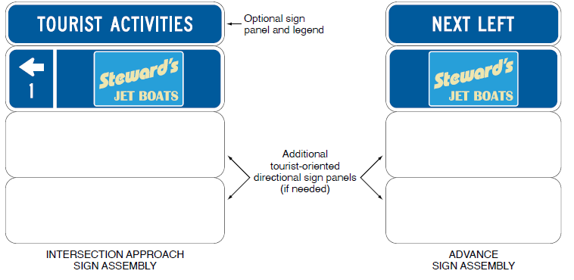
Section 2K.04 Arrangement and Size of Signs
Changes Guidance from four to three signs maximum in each assembly
Figure 2K-1. Examples of Tourist-Oriented Directional Signs
Notes:
Section 2K.04 changes the Guidance on the maximum number of signs installed in each assembly from four to three. This is to be consistent with Section 2E.10, which states that no more than two destination names or street names should be displayed on any Advance Guide sign or Exit Direction sign. This change is based on research that found road users cannot adequately process the information when more than three destination panels are present in a sign assembly. It is important to refrain from overloading road users with information that cannot be adequately processed.

Slide 24

FHWA’s National
Traffic Control Devices Program
for more information:
mutcd.fhwa.dot.gov
e–Subscribe Service
Official Rulings Database
Standard Highway Signs
Frequently Asked Questions
MUTCD News Feed
Notes:
This concludes this module. Additional modules on the MUTCD 11th Edition are available at the MUTCD Web Site at http://mutcd.fhwa.dot.gov/.
Almost anything related to the MUTCD that you need is at the official MUTCD Web site.
If you haven’t yet signed up for our e-Subscribe service, please take a moment to do so. We’ll send out a bulletin whenever new information is available so you can keep up-to-date. As subscribers, you’ll also hear about future Webinar and other opportunities first.

