Slide 1


Manual on Uniform Traffic Control Devices for Streets and Highways
An Overview of Changes in the 11th Edition
As published in the December 2023
Notice of Final Rule
Prepared by the
Federal Highway Administration’s
Office of Operations
Traffic Control Devices Program
Notes:
Welcome to the Manual on Uniform Traffic Control Devices for Streets and Highways—the MUTCD 11th Edition.
This series provides an overview of the significant changes in the MUTCD and was prepared by the FHWA’s Office of Operations Traffic Control Devices team. Each module address the changes in a specific area of the MUTCD.
Additional modules on the MUTCD 11th Edition are available at the MUTCD Web Site at http://mutcd.fhwa.dot.gov/. The series includes the following modules:
Part 1
Part 2:
Chapter 2A
Chapter 2B
Chapter 2C
Chapter 2D
Chapter 2E
Chapter 2F
Chapter 2G
Chapters 2H and 2I
Chapters 2J and 2K
Chapter 2L
Chapters 2M and 2N
Part 3
Part 4
Part 5
Part 6
Part 7
Part 8
Part 9

Slide 2
Disclaimers
Except for the statutes and regulations cited, the contents of this presentation do not have the force and effect of law and are not meant to bind the States or the public in any way. This presentation is intended only to provide information regarding existing requirements under the law or agency policies.
The Federal Highway Administration (FHWA) is the source of all images in this presentation unless otherwise indicated.
Notes:
(Disclaimer) Except for the statutes and regulations cited, the contents of this presentation do not have the force and effect of law and are not meant to bind the States or the public in any way. This presentation is intended only to provide information regarding existing requirements under the law or agency policies.
FHWA is the source of all images in this presentation unless otherwise indicated.

Slide 3
Overview of Changes in Chapter 2L
Manual on
Uniform Traffic Control Devices
2L
for Streets and Highways
An Overview of Changes in Chapter 2L
As published in the December 2023
Notice of Final Rule
Notes:
The remainder of this presentation will focus on the significant changes to Chapter 2L of the MUTCD.

Slide 4
Section 2L.01 Description of Changeable Message Signs (CMS)
Adds Standard prohibiting information other than inventory or maintenance-related information on front or back of CMS
Notes:
In Section 2L.01, a new Standard prohibits information other than inventory or maintenance-related information from being displayed on the front or back of a CMS or portable CMS. This change was made to ensure the traffic control messages displayed on these signs are not compromised by other miscellaneous or promotional information, consistent with the provisions for all traffic control devices.

Slide 5
Section 2L.02 Applications of Changeable Message Signs (1 of 2)
Adds Option allowing CMS messages for the purpose of improving traffic conditions by providing information on:
  Alternative means of transportation
  Electronic toll collection
  Carpooling
Adds Guidance recommending that CMSs not be used in place of conventional guide sign messages unless information occurs on a part-time basis
Notes:
In Section 2L.02, a new Option allows transportation-related messages for the purpose of improving traffic conditions, such as those providing information on alternative means of transportation, electronic toll collection, or carpooling may be displayed to remind or inform drivers of relevant options or opportunities for transportation.
New Guidance was added that CMS should not be used in place of conventional guide sign messages except for blank-out type signs used to display regulatory, warning, and guidance information that routinely reoccurs but only on a part-time basis. In addition, only elements of a sign that are subject to change should be in an electronic display. These changes were added to help ensure consistency in sign design by controlling the potential variability of information that should not change on a sign.

Slide 6
Section 2L.02 Applications of Changeable Message Signs (2 of 2)
Changes Guidance to Standard to require agencies with permanently-installed CMSs to establish and maintain a policy for the use and types of messages
Adds Guidance for AMBER (America’s Missing: Broadcast Emergency Response) alert messages
Adds Standard prohibiting other “alert” messages not related to traffic or travel conditions
Adds provisions for Homeland Security and emergency messages
Notes:
Previous Guidance was changed to a Standard to require that agencies that have permanently installed or positioned CMS have a policy regarding their use and the display of all types of messages used on CMS. Such policies shall define the types of messages that would be allowed, the priority of messages, the syntax of messages, the timing of messages, and other important messaging elements to ensure messages displayed meet the basic principles that govern the design and use of traffic control devices in general and traffic signs in particular as provided for in the MUTCD. Agencies that use CMS but do not have permanently-installed CMS are still recommended to have a similar policy.
New Guidance was added with recommendations specific to the display of AMBER alerts, recommending these message be kept as brief as possible to address the potential of overloading road users with detailed information and, when possible, use other sources to convey that detailed information associated with the alert.
A new Standard paragraph was added prohibiting other ‘‘alert’’ messages that are not related to traffic or travel conditions to emphasize that AMBER alert messages are a result of a statutory requirement and are the only ‘‘alert’’ exception to the statute that requires traffic control devices to be related to traffic control.
New Support, Standard, and Guidance statements were added regarding the use of messages related to homeland security and emergencies that affect traffic patterns, movement, or present other situations that are atypical. These provisions provide for messaging on CMS for such events while maintaining the integrity of, and respect for, CMS as a traffic control device.

Slide 7
Section 2L.03 Legibility and Visibility of Changeable Message Signs
Adds Guidance that electronic display of standardized regulatory and warning signs used individually or as part of the legend of a larger sign should conform to the minimum size requirements as the static versions of those signs in Chapters 2B and 2C
Notes:
In Section 2L.03, a new Guidance statement specifies that changeable message regulatory and warning signs displayed individually or as part of the legend of a larger sign should conform to the minimum size requirements as the conventional versions of those signs.

Slide 8
Section 2L.04 Design Characteristics of Messages
(1 of 4)
Adds Standard requiring portable CMSs used as arrow boards conform with sections 6L.05 and 6L.06 for display and operation
Adds Guidance recommending that warning beacons not be installed on CMSs
Revises Guidance recommending 18-inch letter height for CMS messages with two phases and higher information load
Notes:
In Section 2L.04, a new Standard paragraph requires portable CMS used as an arrow board with flashing or sequential display for a lane closure to conform with provisions in Section 6L.05 and 6L.06. This change was made for consistency of device operation used for the same application, because a CMS used in this manner is operating as an arrow board, which is allowed to have dynamic display.
Also, new Guidance was added recommending that warning beacons should not be used on CMS. Instead, CMS should be use predominately to display messages that are critical to real-time conditions.
The previous Guidance regarding letter height was revised to recommend 18-inch letter heights when a message is composed of two phases and higher information load, regardless of the speed limit, to optimize legibility distance and available viewing time.

Slide 9
Section 2L.04 Design Characteristics of Messages
(2 of 4)
Adds Option allowing CMSs to use character size of the conventional sign being replicated
Changes Guidance to Standard for background color to match standard sign background colors:
  Exception for CMS with only yellow or amber light-emitting diodes (LEDs)
Revises Guidance for LED matrix, signs with pixel spacing
>20 mm should display only word legends and no symbols or
route shields
Notes:
When a CMS is used to replicate a conventional sign, a new option allows the character size of the conventional sign being replicated.
The previous Guidance was changed to a Standard to require, not just recommend, that if a black background is used, the color used for the legend on the CMS match the background color that would be used on a standard sign for that type of legend. An exception and option is also added allowing CMS that only use yellow or amber LEDs may display a yellow or amber legend that does not match the background color used on standard sign.
The previous Guidance was revised to recommend where an LED matrix is used to form the changeable legend, signs with pixel spacing greater than 20mm should display only word legends, and no symbols or route shields. This change was made based on a review of manufacturer products and visual inspections of the appearance of legends on these types of signs, which indicate that these signs do not provide adequate resolution to display symbols with sufficient clarity for road user instant recognition and therefore should only be used for word messages.

Slide 10
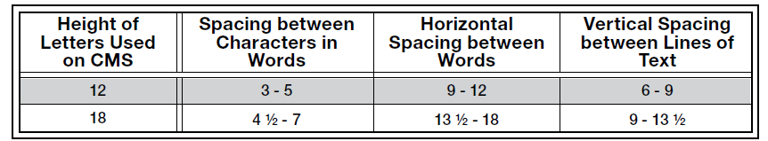
Section 2L.04 Design Characteristics of Messages
(3 of 4)
Adds Table 2L-1
Table 2L-1. Spacing between Message Characters, Words, and Lines of Text
Note: All units are in inches
Notes:
A new Table shows information for spacing between characters, words, and lines of text.

Slide 11
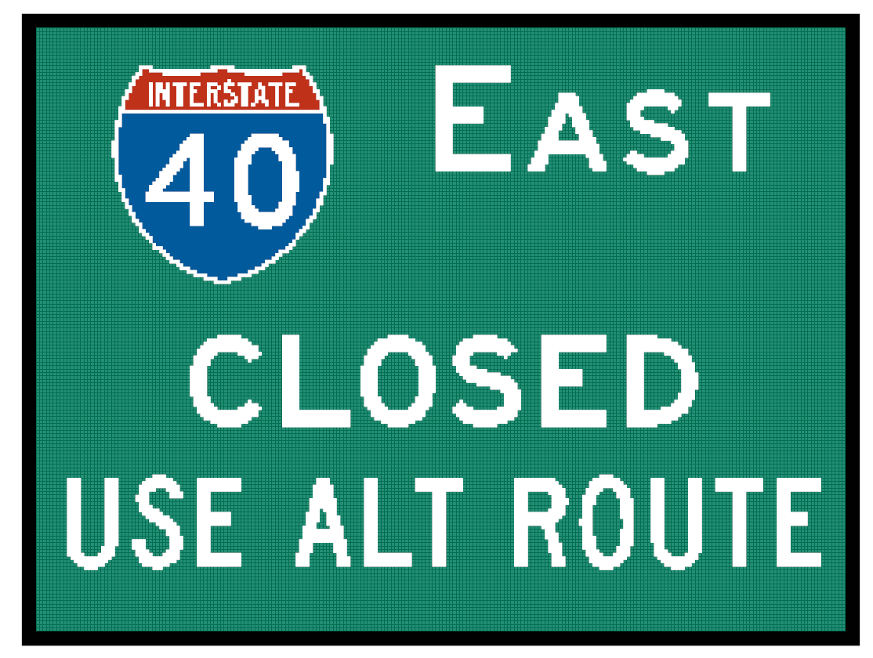
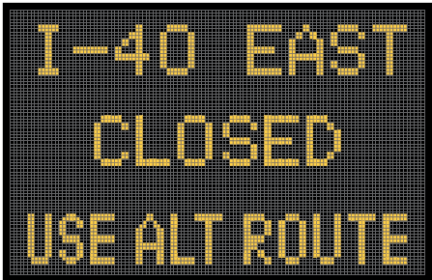
Section 2L.04 Design Characteristics of Messages
(4 of 4)
Adds Figure 2L-1 showing examples of CMS capability to display sign legends based on pixel pitch
Notes:
A new figure is added showing examples of CMS capability to display sign legends based on pixel pitch. Color full-matrix CMS with pixel pitches of 20 millimeters or less are typically capable of displaying legends nearly identical to conventional sign legends, including route shields and symbols as
provided in the MUTCD.
CMS with insufficient pixel density, typically with pixel pitches greater than 20 millimeters – whether full color or monochrome – are generally not capable of adequately displaying conventional sign legends with sufficient clarity and should only display monochrome word messages.

Slide 12
Section 2L.05 Message Length and Units of Information (1 of 2)
Revises Standard to clarify that each phase of a message is to be understood by itself, and the meaning of the entire CMS message is to be the same, regardless of the sequence of phases
Changes Guidance to Standard for abbreviations to comply with chapter 1D
Changes Guidance to Option to allow, not recommend, additional CMS if more than two phases are needed
Notes:
In Section 2L.05, the existing Standard clarifies that when a CMS contains more than one message phase, each phase shall be communicated so that the road user may understand each phase by itself regardless of the sequence in which it is read, and the entire message shall have the same meaning regardless of the sequence in which the phases are read. This change was made because it is important that road users be able to understand the intent of the message if they can only read one of the phases or when the phases are read in different order.
The previous Guidance was changed to a Standard to require, not just recommend, abbreviations within a CMS message comply with Section 1D.08.
Previous Guidance was also changed to an Option to clarify that adding additional CMS is an option available to agencies for displaying longer messages that would require more than two phases, which is the maximum number of phases allowed on a CMS.

Slide 13
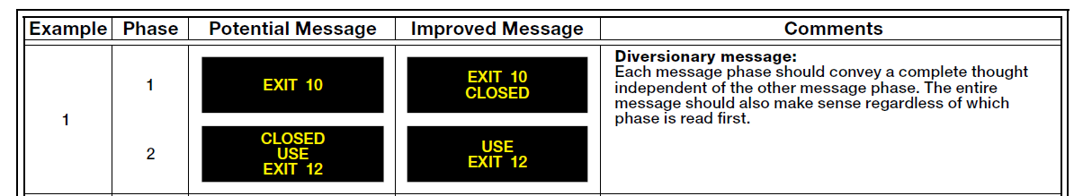
Section 2L.05 Message Length and Units of Information (2 of 2)
Adds Tables 2L-3 and 2L-4
Table 2L-3. Examples of Message Construction for CMS
Notes:
New Tables 2L-3 and 2L-4 provide examples of message construction for CMS and portable CMS. Each example shows the message content, layout, and phasing for a potential message and an improved message. The improved message for each example has been optimized for recognition, comprehension, and effectiveness.

Slide 14
Section 2L.06 Travel Time Messages
Adds Section for providing travel time messages on CMS
Recommends providing travel times to a specific destination or junction
Adds Options:
  Omit distances when providing comparative travel times on different routes to one destination
  Use reference-location-based exit numbers in lieu of destination name
Notes:
There is a new section, Section 2L.06, with Support, Guidance, and Option provisions for travel time messages. A new Guidance paragraph limits the number of travel times displayed to one when destination and distance are used as the point of reference.
A new Option excludes distances to a destination when comparative travel time displays are based on different routes to the destination.
Lastly, an Option allows display of up to two travel times when reference-location-based exit numbering is used as the point of reference in place of destination and distance.

Slide 15
Section 2L.07 Traffic Safety Campaign Messages
(1 of 2)
Adds section consolidating CMS safety message campaign information to one location
Adds Standard requiring CMS traffic control messages to have priority over traffic safety campaign messages
Adds Guidance recommending CMS safety messages avoid using obscure or secondary meaning, such as popular culture references, unconventional syntax, or humorous intention
Notes:
A new section, Section 2L.07, is added with Support, Guidance, and Standard paragraphs describing the display of traffic safety campaign messages as an ancillary use of CMS. This section consolidates all information related to traffic safety campaign messages to one location.
A new Standard paragraph is included that requires traffic control messages to have priority over traffic safety campaign messages.
A new Guidance paragraph is added recommending CMS traffic safety campaign messages with obscure meaning, references to popular culture, that are intended to be humorous, or otherwise use nonstandard syntax for a traffic control device, not be displayed because they can be misunderstood or understood only by a limited segment of road users and, therefore, degrade the overall effectiveness of the sign as an official traffic control device.

Slide 16
Section 2L.07 Traffic Safety Campaign Messages
(2 of 2)
Adds Guidance recommending CMS safety messages with penalties or enforcement warnings include coordinated enforcement efforts
Adds Guidance recommending CMS safety messages be part of an active safety campaign and coordinate with National Highway Traffic Safety Administration (NHTSA) safety campaigns
Notes:
A new Guidance paragraph includes recommending CMS traffic safety campaigns include coordinated enforcement efforts when penalties or enforcement warnings are part of the CMS message displayed to maintain the credibility of these signs and improve safety.
A new Guidance paragraph includes recommending that traffic safety campaign messages be part of an active, coordinated safety campaign that uses other media forms as the primary means of outreach, and that traffic safety campaign messages coordinate with the national safety campaigns on NHTSA’s communications calendar.

Slide 17

FHWA’s National
Traffic Control Devices Program
for more information:
mutcd.fhwa.dot.gov
e–Subscribe Service
Official Rulings Database
Standard Highway Signs
Frequently Asked Questions
MUTCD News Feed
Notes:
This concludes this module. Additional modules on the MUTCD 11th Edition are available at the MUTCD Web Site at http://mutcd.fhwa.dot.gov/.
Almost anything related to the MUTCD that you need is at the official MUTCD Web site.
If you haven’t yet signed up for our e-Subscribe service, please take a moment to do so. We’ll send out a bulletin whenever new information is available so you can keep up-to-date. As subscribers, you’ll also hear about future Webinar and other opportunities first.

