Slide 1


Manual on Uniform Traffic Control Devices for Streets and Highways
An Overview of Changes in the 11th Edition
As published in the December 2023
Notice of Final Rule
Prepared by the
Federal Highway Administration’s
Office of Operations
Traffic Control Devices Program
Notes:
Welcome to the Manual on Uniform Traffic Control Devices for Streets and Highways—the MUTCD 11th Edition.
This series provides an overview of the significant changes in the MUTCD and was prepared by the FHWA’s Office of Operations Traffic Control Devices team. Each module address the changes in a specific area of the MUTCD.
Additional modules on the MUTCD 11th Edition are available at the MUTCD Web Site at http://mutcd.fhwa.dot.gov/. The series includes the following modules:
Part 1
Part 2:
Chapter 2A
Chapter 2B
Chapter 2C
Chapter 2D
Chapter 2E
Chapter 2F
Chapter 2G
Chapters 2H and 2I
Chapters 2J and 2K
Chapter 2L
Chapters 2M and 2N
Part 3
Part 4
Part 5
Part 6
Part 7
Part 8
Part 9

Slide 2
Disclaimers
Except for the statutes and regulations cited, the contents of this presentation do not have the force and effect of law and are not meant to bind the States or the public in any way. This presentation is intended only to provide information regarding existing requirements under the law or agency policies.
The Federal Highway Administration (FHWA) is the source of all images in this presentation unless otherwise indicated.
Notes:
(Disclaimer) Except for the statutes and regulations cited, the contents of this presentation do not have the force and effect of law and are not meant to bind the States or the public in any way. This presentation is intended only to provide information regarding existing requirements under the law or agency policies.
FHWA is the source of all images in this presentation unless otherwise indicated.

Slide 3
Overview of Changes in Chapters 2M and 2N
Manual on
Uniform Traffic Control Devices
2M
for Streets and Highways
2N
An Overview of Changes
Chapters 2M and 2N
As published in the December 2023
Notice of Final Rule
Notes:
This presentation will focus on the significant changes to Chapters 2M and 2N of the MUTCD.

Slide 4
Chapter 2M
Recreational and Cultural Interest Area Signs
Notes:
The subject of Chapter 2M is Recreational and Cultural Interest Area signs.

Slide 5
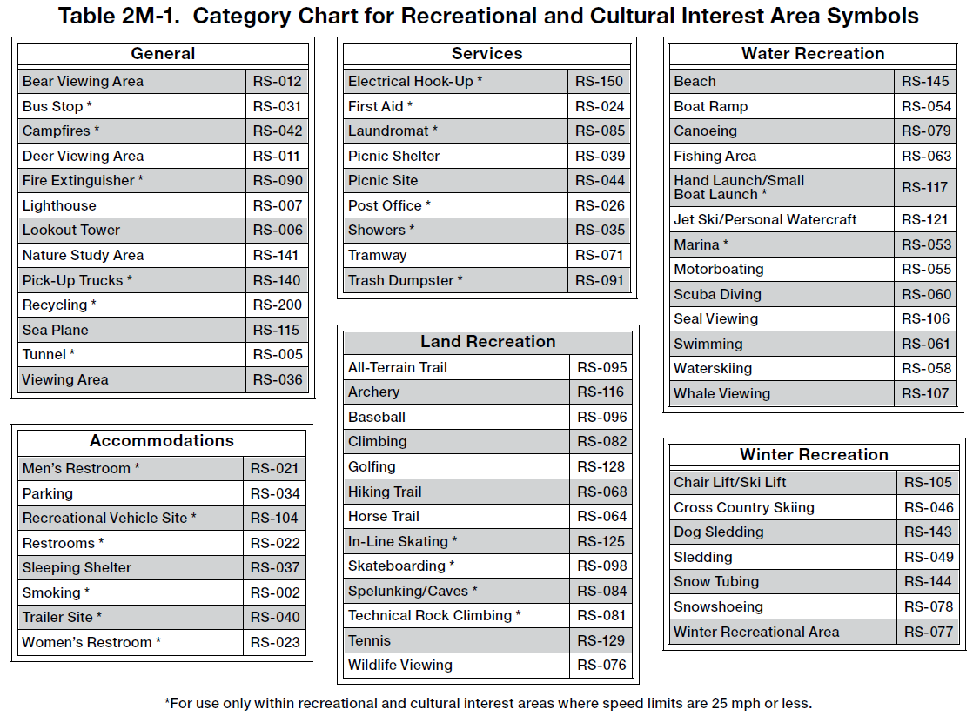
Section 2M.02 Application
Symbols for use only within recreational and cultural interest area facilities are noted in Table 2M-1
Table 2M-1. Category Chart for Recreational and Cultural Interest Area Symbols
* For use only within recreational and cultural interest areas where speed limits are 25 mph or less.
Notes:
Table 2M-1 is updated, retaining or removing symbols based on the Traffic Control Device Pooled Fund Study on the comprehension and legibility of select symbol signs. The table also indicates which symbols are for use only within recreational and cultural interest areas where speed limits are 25 mph or less.

Slide 6
Section 2M.04 General Design Requirements
Adds Standard clarifying General Information symbols shall match colors prescribed in Chapter 2H
Adds Standard clarifying General Service symbols shall match colors prescribed in Chapter 2I
Adds Option allowing General Information and Service symbol signs to have white legend on brown background for roadways inside recreational and cultural interest areas
Notes:
Section 2M.04 covers the General Design Requirements for Recreational and Cultural Interest Area Symbol Guide Signs. A new Standard was added that requires that General Information symbols used in conjunction with recreational and cultural interest area signing on roadways outside a recreational and cultural interest facility have the legend and background color of the symbol sign as prescribed in Chapter 2H. A similar Standard was added that requires General Service symbols to have the legend and background color of the symbol sign as prescribed in Chapter 2I.
A new Option was added allowing General Information symbol signs and General Service symbol signs on roadways inside a recreational and cultural interest area to have a white legend on a brown background.

Slide 7

Section 2M.06 Use of Educational Plaques
Removes Guidance recommending that educational plaques remain in place for at least 3 years
Notes:
In Section 2M.06, Guidance recommending that an educational plaque remain in place for at least 3 years after initial installation is removed to provide agencies with greater flexibility and consistency.

Slide 8
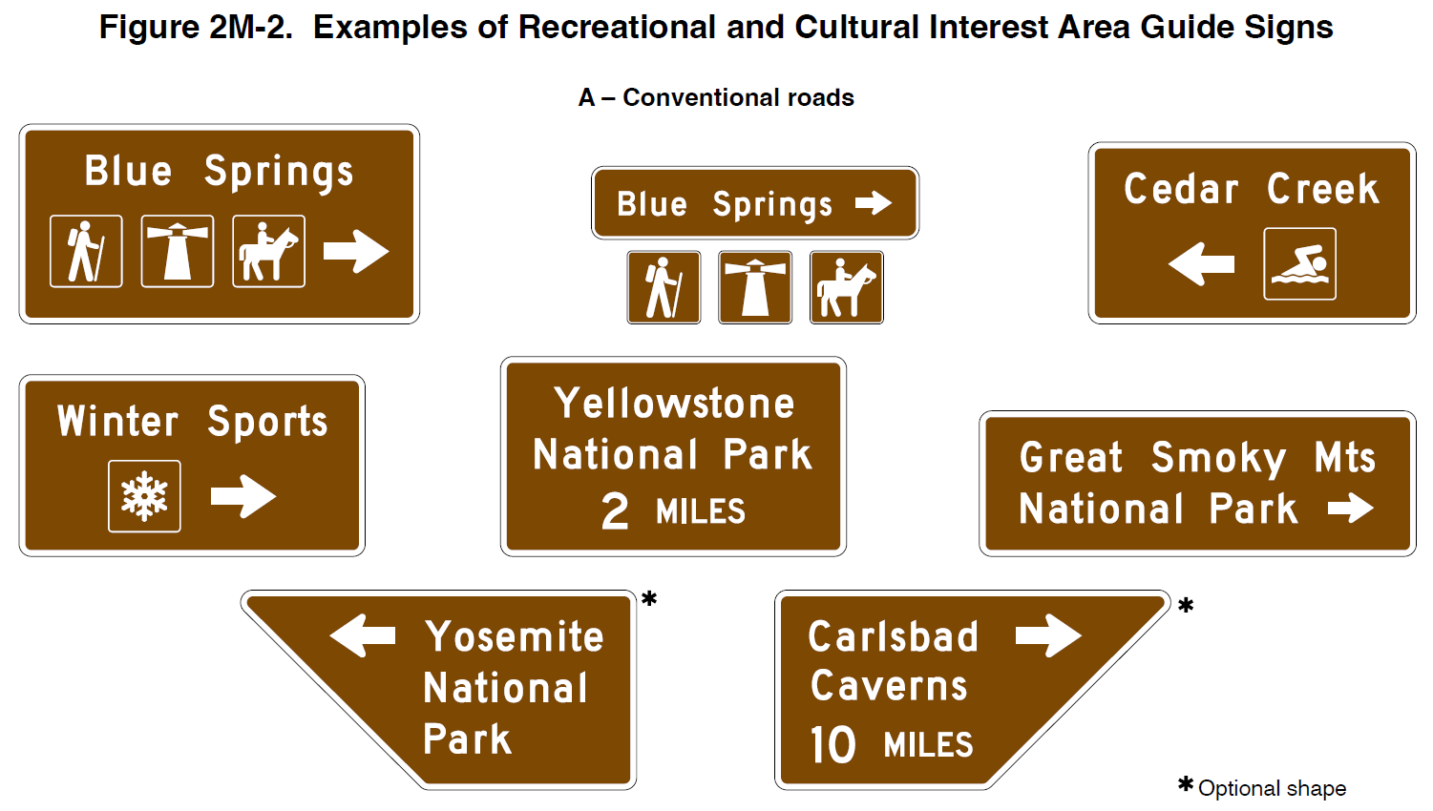
Section 2M.09 Destination Guide Signs
Rectangular shape now Standard
Trapezoidal shape now Option on conventional roads
Figure 2M-2. Examples of Recreational and Cultural Interest Area Guide Signs
New Standard describes trapezoidal shape with directional arrow
Optional shape
Notes:
In Section 2M.09, the prior Guidance is changed to Standard to require Supplemental Guide signs be rectangular in shape with a white legend on green or brown background, with the Option to use trapezoidal-shaped signs on conventional roads.
As part of this change, there is a new Standard describing the required shape of the trapezoidal sign when used with a directional arrow (as shown in the bottom 2 signs on the figure).

Slide 9
Section 2M.10 Memorial or Dedication Signing
Revises Guidance to clarify that design of memorial and dedication signs should be simple
Changes Option to Guidance regarding use of combination of lower-case letters with initial upper-case letters for lettering
Adds Standard prohibiting memorial or dedication signs from displaying a legend that implies that the highway has been officially renamed
Notes:
In Section 2M.10, the Guidance is changed to clarify that the design of memorial and dedication signs should be simple and dignified, devoid of any appearance of advertising, and in general compliance with other signing.
The Option regarding use of a combination of lower-case letters with initial upper-case letters is changed to Guidance.
Finally, a new Standard is added prohibiting memorial or dedication signs from displaying a legend that implies that the highway has been officially renamed. This change is to ensure positive guidance, consistency, and minimization of confusion in the information displayed to road users along a particular route.

Slide 10
Chapter 2N
Emergency Management Signs
Notes:
The subject of Chapter 2N is Emergency Management Signs.

Slide 11
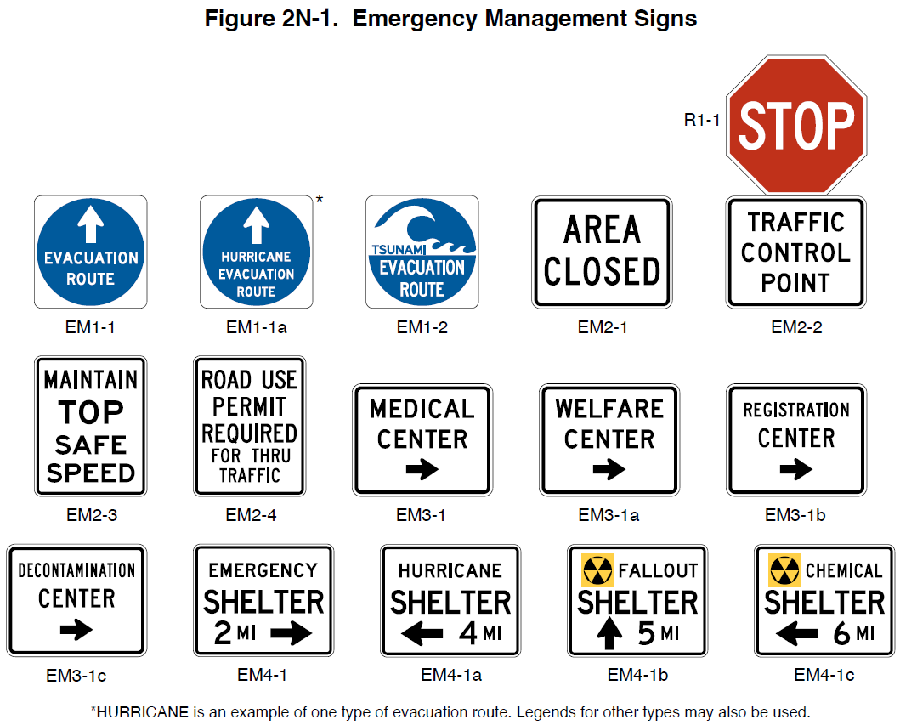
Section 2N.02 Sign Designation Changes
Redesignates all signs for consistency
Figure 2N-1. Emergency Management Signs
R1-1
EM1-1
EM1-1a
EM1-2
EM2-1
EM2-2
EM2-3
EM2-4
EM3-1
EM3-1a
EM3-1b
EM3-1c
EM4-1
EM4-1a
EM4-1b
EM4-1c
* HURRICANE is an example of one type of evacuation route. Legends for other types may also be used.
Notes:
All signs in Chapter 2N were redesignated to conform to the dual-numbering convention used throughout the rest of the MUTCD.

Slide 12
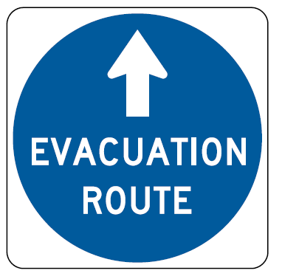
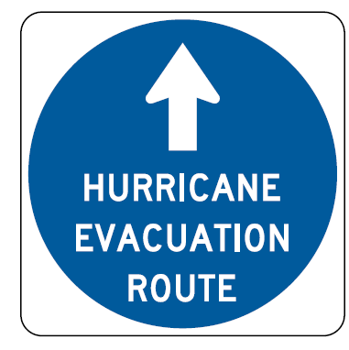
Section 2N.03 Evacuation Route Signs
(EM1-1 Series)
Adds Standard requiring directional arrow on EM1-1 Series signs
EM1-1
EM1-1a
Notes:
The EM1-1 series signs are now standardized and are required to include a white directional arrow. This was previously an Option.

Slide 13
Sections 2N.03 - 2N.05 Changes to Allow More Flexibility
Changes Standard to Guidance
  Placement of Evacuation Sign
  Use and placement of AREA CLOSED sign
  Use and placement of TRAFFIC CONTROL POINT sign
Notes:
Several changes in Chapter 2N allow agencies more flexibility for situations where Guidance is more appropriate than Standards. The following Standards are change to Guidance:
The placement of the Evacuation Route sign 150 to 300 feet in advance of, and at, any turn in an approved evacuation route, as well as installation elsewhere for straight-ahead confirmation where needed.
The use, placement, and mounting of the AREA CLOSED sign and the TRAFFIC CONTROL POINT sign.

Slide 14
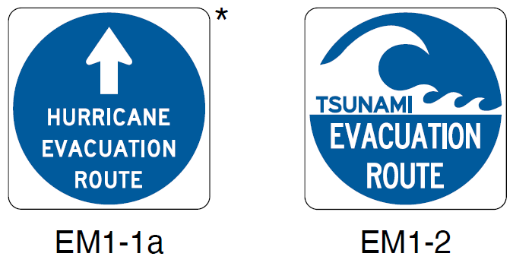






Section 2N.03 Evacuation Route Signs
Changes Option to Standard for Advance Turn and Directional Arrow plaques with white arrow and border on blue background with EM1-2 sign
Adds Guidance limiting use of specific Evacuation Route signs
Advance Turn and Directional Arrow Plaques
M5-1P
M5-2P
M5-3P
EM1-1a
EM1-2
*HURRICANE is an example of one type of evacuation route. Legends for other types may also be used.
M6-1P
M6-2P
M6-3P
Notes:
The Option is changed to a Standard, requiring an Advance Turn Arrow (M5 series) or Directional Arrow (M6 series) to have a white arrow and border on a blue background when used with an EM1-2 sign.
New Guidance is added recommending limiting the use of the specific Evacuation Route (EM1-1a and EM1-2) signs to areas where different evacuation conditions use different evacuation routes.

Slide 15

FHWA’s National
Traffic Control Devices Program
for more information:
mutcd.fhwa.dot.gov
e–Subscribe Service
Official Rulings Database
Standard Highway Signs
Frequently Asked Questions
MUTCD News Feed
Notes:
This concludes this module. Additional modules on the MUTCD 11th Edition are available at the MUTCD Web Site at http://mutcd.fhwa.dot.gov/.
Almost anything related to the MUTCD that you need is at the official MUTCD Web site.
If you haven’t yet signed up for our e-Subscribe service, please take a moment to do so. We’ll send out a bulletin whenever new information is available so you can keep up-to-date. As subscribers, you’ll also hear about future Webinar and other opportunities first.

