Slide 1


Manual on Uniform Traffic Control Devices for Streets and Highways
An Overview of Changes in the 11th Edition
As published in the December 2023
Notice of Final Rule
Prepared by the
Federal Highway Administration’s
Office of Operations
Traffic Control Devices Program
Notes:
Welcome to the Manual on Uniform Traffic Control Devices for Streets and Highways—the MUTCD 11th Edition.
This series provides an overview of the significant changes in the MUTCD and was prepared by the FHWA’s Office of Operations Traffic Control Devices team. Each module address the changes in a specific area of the MUTCD.
Additional modules on the MUTCD 11th Edition are available at the MUTCD Web Site at http://mutcd.fhwa.dot.gov/. The series includes the following modules:
Part 1
Part 2:
Chapter 2A
Chapter 2B
Chapter 2C
Chapter 2D
Chapter 2E
Chapter 2F
Chapter 2G
Chapters 2H and 2I
Chapters 2J and 2K
Chapter 2L
Chapters 2M and 2N
Part 3
Part 4
Part 5
Part 6
Part 7
Part 8
Part 9

Slide 2
Disclaimers
Except for the statutes and regulations cited, the contents of this presentation do not have the force and effect of law and are not meant to bind the States or the public in any way. This presentation is intended only to provide information regarding existing requirements under the law or agency policies.
The Federal Highway Administration (FHWA) is the source of all images in this presentation unless otherwise indicated.
Notes:
(Disclaimer) Except for the statutes and regulations cited, the contents of this presentation do not have the force and effect of law and are not meant to bind the States or the public in any way. This presentation is intended only to provide information regarding existing requirements under the law or agency policies.
FHWA is the source of all images in this presentation unless otherwise indicated.

Slide 3
Overview of Changes in Part 3
Manual on
Uniform Traffic Control Devices
3
for Streets and Highways
An Overview of Changes in Part 3
As published in the December 2023
Notice of Final Rule
Notes:
The remainder of this presentation will focus on the significant changes to Part 3 of the MUTCD.

Slide 4
General
Reorganizes to improve the continuity and flow of information
Adds Chapter 3C. Crosswalks
Notes:
Part 3 has been reorganized to improve the continuity and flow of information regarding the application of markings in the MUTCD by relocating various paragraphs and sections throughout the part. Long sections have been divided into several sections, each having a clearly understandable title and function. A new Chapter 3C – Crosswalks, has been created to compile information across multiple chapters into a single location.

Slide 5
Section 3A.02 Materials
Adds Option allowing use of clumps or droplets of material with visible open spaces of bare pavement between the material droplets as a marking system
Notes:
In Section 3A.02, Support was changed to an Option to allow the use of clumps or droplets of material as a marking. This provision is more appropriate as an Option statement to provide flexibility to agencies using these type of materials in place of traditional pavement marking systems that completely cover the pavement surface.

Slide 6
Section 3A.03 Colors
Adds Standard requiring both right-hand and left-hand edge lines on a reversible roadway to be white
Changes Option to Standard—markings that simulate official route signs, when used, shall have the same colors as those used for the signs
Clarifies Option for the use of black markings to enhance contrast on light-colored pavements
Notes:
In Section 3A.03 - Colors, a new Item C was added to an existing Standard to clarify that both the right-hand and left-hand edge lines shall be white on a reversible roadway.
An existing Option was changed to a Standard for markings that simulate official route signs. When used, this marking shall have the same colors as those used for the signs. This change was adopted to ensure uniformity in the application which will aid in recognition of the message.
An existing Option was clarified to allow the use of black pavement markings to enhance the contrast of other marking colors on light-colored pavements.

Slide 7
Section 3A.05 Maintaining Minimum Pavement Marking Retroreflectivity
Adds Section incorporating the minimum maintained pavement marking retroreflectivity Standards from Revision 3 of the 2009 MUTCD
Requires implementation and use of a method designed to maintain minimum levels of retroreflectivity for longitudinal pavement markings
Retains compliance date of September 6, 2026
Notes:
Section 3A.05 incorporates the minimum maintained pavement marking retroreflectivity Standards from Revision 3 of the 2009 MUTCD, with no changes. This Standard requires agencies to implement and use of a method designed to maintain minimum levels of retroreflectivity for longitudinal pavement markings. The compliance date of September 6, 2026, remains in place for agencies to implement and use their selected method to maintain the defined minimum levels of pavement marking retroreflectivity.

Slide 8
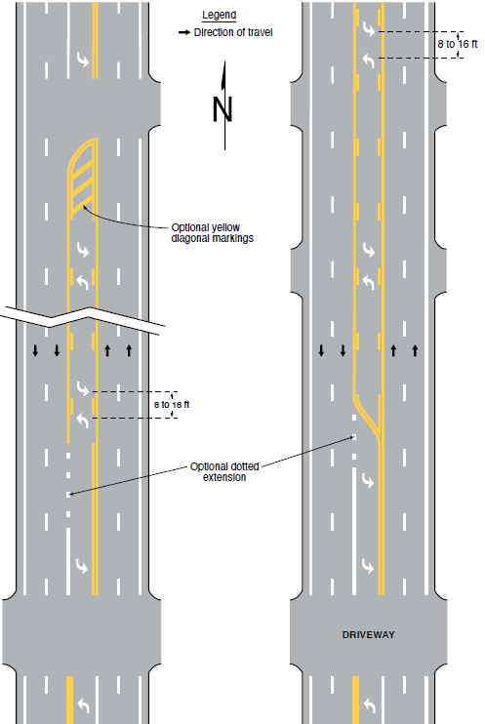
Section 3B.05 Pavement Markings for Two-Way
Left-Turn Lanes
Figure 3B-7. Examples of Two-Way Left-Turn Lane Marking Applications
A – Intersecting Cross Streets
B – Intersecting Driveways
Adds Guidance paragraph discouraging extending two-way
left-turn lane markings to intersections
Adds Option statement indicating that two-way left-turn lanes can be transitioned to exclusive left-turn lanes
Revises Figure 3B-7 accordingly
Notes:
This new section takes content from previously existing sections.
A new Guidance paragraph was added to discourage extending two-way left-turn lane markings to intersections and an Option statement was added indicating that two-way left turn lanes can be transitioned to exclusive left turn lanes.
Figure 3B–7 was modified to illustrate these points. This change improves intersection safety by minimizing conflicts between corresponding left-turn movements.

Slide 9
Section 3B.06 White Lane Line Pavement Markings (1 of 2)
Changes Option to Guidance recommending solid white lane lines on approaches to intersections to separate adjacent mandatory turn lanes
Adds Guidance recommending use of solid white lane lines at toll collection points to separate toll lanes, payment methods, channelized movements, or obstructions
Notes:
In Section 3B.06 an Option was changed to Guidance to recommend, rather than just allow, solid white lane lines on approaches to intersections to separate adjacent mandatory turn lanes. New Guidance was also added to recommend the use of solid white lane lines at toll collection points to separate toll lanes, payment methods, channelized movements, or obstructions.

Slide 10
Section 3B.06 White Lane Line Pavement Markings (2 of 2)
Adds Option allowing solid white lane lines:
  To separate contiguous through traffic lanes on an approach to an intersection
  To separate through traffic lanes from auxiliary lanes
  On approaches to crosswalks across multilane roadways
Adds Option allowing curved transitions where an edge line, channelizing line, or dotted extension line changes direction
Notes:
A new Option paragraph was added allowing solid white lane lines to separate contiguous through traffic lanes on an approach to an intersection; to separate through traffic lanes from auxiliary lanes; and on approaches to crosswalks across multilane roadways.
A new Option paragraph was also added to allow curved transitions where an edge line, channelizing line, or dotted extension line changes direction. This change was based on the recognition that many agencies currently use curved, rather than angular, transitions for changes in direction.

Slide 11
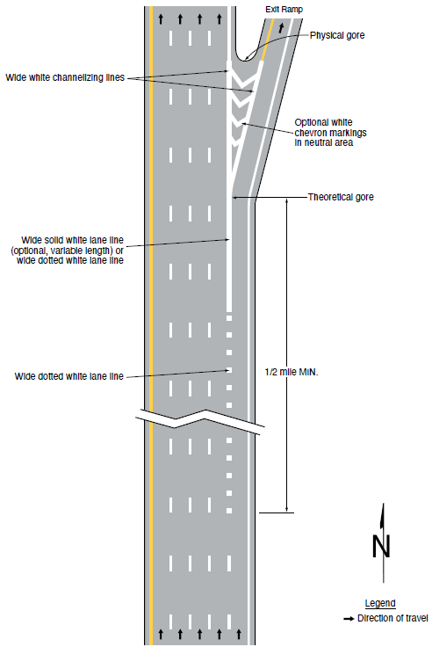
Section 3B.07 White Lane Line Markings for
Non-Continuing Lanes
E – Route split with option lane
Adds Standard requiring a wide dotted white lane line in advance of freeway route splits with an option lane
Adds Drawing E in Figure 3B–11 showing an example of a route split with option lane
Changes Option to Standard requiring normal width dotted white lane line extensions for deceleration lanes at exit ramps
Notes:
A new section 3B.07 was created using material from a previously existing Section, with new material added.
A new Item C was added to an existing Standard on the use of wide dotted white lane lines. The new Standard requires the use of a wide dotted white lane line in advance of freeway route splits with an option lane. This change provides consistency with requirements for similar situations in which traffic in one of the lanes must depart from the main route.
In concert with this change, Drawing E was added (showing an example of a route split with option lane) to Figure 3B–11 Examples of Applications of Freeway and Expressway Lane-Drop Markings.
Also, an Option was changed to a Standard requiring normal width dotted white lane line extensions for deceleration lanes at exit ramps.

Slide 12
Section 3B.08 Channelizing Lines
Adds two Standard paragraphs requiring channelizing lines on:
  Both sides of the neutral area for bifurcations created from open-road tolling lanes that bypass a conventional toll plaza
  Both sides of the neutral area formed at access and egress points to and from a managed-lane facility
Notes:
In Section 3B.08, two new Standard paragraphs were added. The first requires channelizing lines on both sides of the neutral area for bifurcations created from open-road tolling lanes that bypass a conventional toll plaza. The second requires channelizing lines on both sides of the neutral area formed at access and egress points to and from a managed-lane facility. This change guides road users around the neutral area either to general purpose lanes or the tolling and/or managed lanes.

Slide 13
Section 3B.11 Application of Pavement Markings Through Intersections or Interchanges
Changes Standard to Guidance:
  Pavement markings extended into an intersection or interchange area should be at the least the same width as the line markings they extend
Adds exception to a Standard to allow solid lines to extend edge lines through intersections where there is no intersecting approach
Notes:
In Section 3B.11 part of an existing Standard was changed to Guidance to recommend, not require, that pavement markings extended into or continued through an intersection or interchange area be the same width as the line markings they extend.
An exception was added to an existing Standard to allow solid lines to extend edge lines through the parts of intersections where there is no intersecting approach. This change is based on feedback from designers for situations like the top of a T-intersection.

Slide 14
Section 3B.12 Lane-Reduction Transitions
Adds Guidance paragraph lists recommending markings for
lane-reduction transitions
Adds Option permitting the minimum taper length to be less than 100 feet on roadways where operating speed is less than 25 mph
Adds Option allowing the use of a dotted white line between the point where the broken white lane line is terminated and the point where the transition taper begins
Notes:
In Section 3B.12, a new Guidance paragraph and list were added for recommended markings for lane-reduction transitions, comprising information throughout the Section and contained in Figure 3B–14. Much of this information was previously in the figure but not the text.
A new Option paragraph was added permitting the minimum taper length to be less than 100 feet on roadways where operating speed is less than 25 mph based on common practice and to provide practitioner flexibility on low-speed roadways.
An additional Option was added which allows the use of a dotted white line between the point the broken white lane line is terminated to the point where the transition taper begins.

Slide 15
Section 3B.13 Approach Markings for Obstructions
Adds Option paragraph allowing the minimum taper length to be less than 100 feet on roadways where the operating speed is less than 25 mph
Notes:
In Section 3B.13, a new Option paragraph was added allowing the minimum taper length to be less than 100 feet where the operating speed is less than 25 mph. This change was based on engineering judgment to provide practitioner flexibility on low-speed roadways.

Slide 16
Section 3B.17 Raised Pavement Markers Substituting for Pavement Markings
Changes Guidance to Standard requiring non-retroreflective raised pavement markers shall not be used alone to substitute for other pavement markings, without supplemental retroreflective or internally illuminated markers
Notes:
In Section 3B.17, a Guidance paragraph was elevated to a Standard to state that non-retroreflective raised pavement markers shall not be used alone, to substitute for other pavement markings, without supplemental retroreflective or internally illuminated markers. This change is based on the importance of retroreflectivity for motorists and potential challenges for machine vision systems.

Slide 17
Section 3B.18 Curb Markings for Parking Regulations
Changes Support and Standard paragraphs to Guidance to provide additional flexibility when determining if parking signs should be provided based on the site conditions
Notes:
In Section 3B.18, existing Support and Standard paragraphs were changed to Guidance to provide additional flexibility when determining if parking signs should be provided based on site conditions.

Slide 18
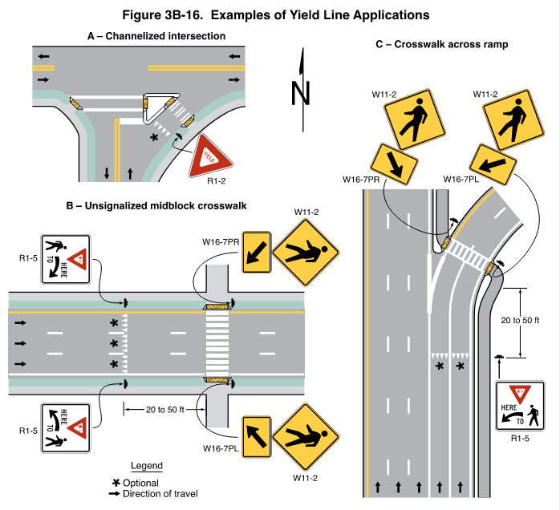
Section 3B.19 Stop and Yield Lines (1 of 2)
Changes Option to Standard requiring one of the following when installing a yield line:
  Yield (R1-2) sign
  Yield Here to Pedestrians
  (R1-5 or R1-5a)
  Bicycles Yield to Pedestrians
  (R9-6) sign
  Yield Here to Trail Crossings (R1-5d) sign
Figure 3B-16. Examples of Yield Line Applications
A – Channelized intersection
C – Crosswalk across ramp
B – Unsignalized midblock crosswalk
W11-2
Notes:
In Section 3B.19, an Option was changed to Standard to require, rather than just allow, a Yield (R1–2) sign, Yield Here to Pedestrians (R1–5 or R1–5a), Bikes Yield to Pedestrians (R9–6) sign, Yield Here to Trail Crossings (R1-5d) sign, or some other traffic control device that requires vehicles to Yield when installing a yield line. This change clarifies ambiguity in the previous Option statement that the pavement marking cannot be installed without an enforceable regulatory sign.

Slide 19
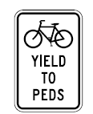
Section 3B.19 Stop and Yield Lines (2 of 2)
Adds Option allowing the use of Bicycles Yield to Pedestrians (R9-6) sign if a yield line is used on a bicycle facility
R9-6
Notes:
A new Option was added to allow the use of a Bicycles Yield to Pedestrians (R9-6) sign if a yield line is used on a bicycle facility.

Slide 20
Section 3B.20 Word, Symbol, and Arrow Pavement Markings - General
Adds Option paragraph allowing pavement words, symbols, and arrows to be proportionally reduced in size by 25% on roadways where the operating speed is less than 25 mph
Notes:
In Section 3B.20, retitled, “Word, Symbol, and Arrow Pavement Markings—General” a new Option paragraph was added allowing pavement words, symbols, and arrows to be reduced in size by 25%, but in relative proportion to the associated full-size word, symbol, or arrow on roadways where the operating speed is less than 25 mph to provide practitioner flexibility on low-speed roadways.

Slide 21
Section 3B.22 Symbol Pavement Markings
Adds two Guidance statements related to the use of route shield markings in option lanes
Adds Option paragraph allowing the use of a pedestrian symbol pavement marking for facilities that are reserved exclusively for pedestrian use
Notes:
In new Section 3B.22, two Guidance statements were added related to the use of route shield markings in option lanes based on research.
A new Option paragraph was added allowing the use of a pedestrian symbol pavement marking that may be used on portions of facilities such as shared-use paths that are reserved exclusively for pedestrian use. The symbol should not be used on the roadway or shoulder. It may be used at locations where shared facilities transition to separate facilities for different types of users.

Slide 22
Section 3B.29 Speed Hump and Speed Table Markings
Adds Option allowing discontinuation of center line markings, lane line markings, and edge line markings on the profile of the speed hump
Adds Standard requiring installation of crosswalk markings when a speed hump specifically incorporates a crossing movement for pedestrians, bicycles, or equestrians
Notes:
In Section 3B.29, a new Option paragraph was added to allow discontinuing center line markings, lane line markings, and edge line markings on the profile of the speed hump.
A new Standard paragraph was added requiring the installation of crosswalk markings when a speed hump specifically incorporates a crossing movement for pedestrians, bicycles, or equestrians.

Slide 23
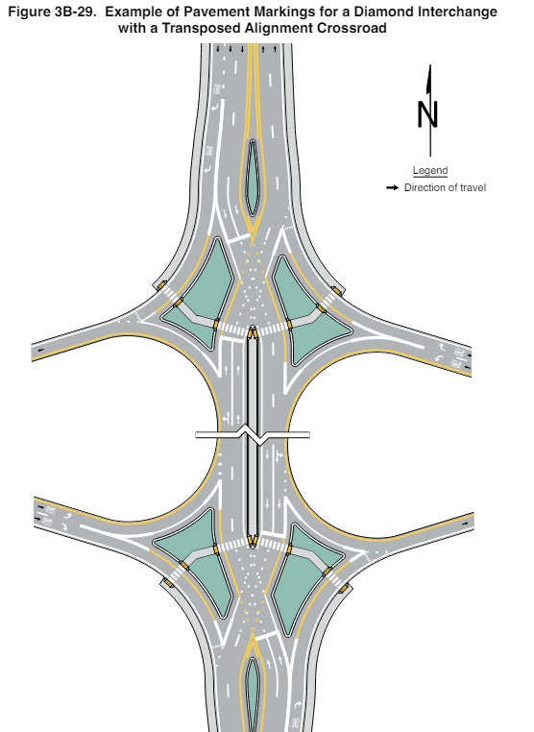
Section 3B.31 Markings for a Diamond Interchange with a Transposed Alignment Crossroad
Figure 3B-29. Example of Pavement Markings for a Diamond Interchange with a Transposed-Alignment Crossroad
Adds new Sections with Standards, Guidance, and Support
Adds new Figure 3B-29
Notes:
A new section numbered and titled, ‘‘Section 3B.31 Markings for Diamond Interchanges with Transposed Alignment Crossroads’’ was added which contains Standards, Guidance, and Support for markings used at these types of interchanges. This information was added based on an FHWA research study that has shown that there is potential for wrong-way movements, especially at the crossing points, at these unconventional interchanges. The new information contains Standards for edge lines, lane use arrows, and wrong-way arrows as well as a restriction for flush median islands. The section also contains Guidance recommending edge and lane line extensions through the crossing points and a Support paragraph referencing crosswalk and pedestrian movement information in Section 3C.11 and 9G.05.
Figure 3B-29 was added to illustrate the new provisions.
Figure 3B–29 was added to illustrate an example of markings at this type of interchange.
Also, a new section numbered and titled, “Section 3C.11 Crosswalks at Diamond Interchanges with Transposed Alignment Crossroads” was added to provide Support and Guidance paragraphs regarding pedestrian movements through these unconventional interchanges. This new section was added based on information contained in a research study that found that pedestrian movements require special considerations to avoid violating driver expectancy or disorienting pedestrians.

Slide 24
Section 3C.02 Application of Crosswalk Markings
Adds Standard requiring crosswalk markings at non-intersection crossing locations
Recommends other traffic control devices in addition to crosswalk markings at locations:
  Where posted speed limits are 40 mph or greater
  Where there is a crash threat due to multiple lane crossings or limited sight distance
  When adequate visibility cannot be provided by parking prohibitions
Adds Guidance recommending crosswalk markings at locations controlled by traffic control signals
Notes:
A new Chapter 3C titled “Crosswalk Markings” has been created to place all the information and provisions for crosswalk markings in one location.
In Section 3C.02, a new Standard was added requiring crosswalk markings if an agency makes the determination to legally establish a crosswalk at a non-intersection location. This change was made to improve safety for pedestrians at locations where vehicles may not expect pedestrian crossings. The engineering study criteria for installing marked crosswalks at an uncontrolled approach has also been revised.
An existing Guidance paragraph was revised to state that other traffic control devices or measures should be considered, in addition to the installation of crosswalks, across uncontrolled roadways at locations with posted speed limits 40 mph or greater. Additional measures should also be considered where there are multiple lanes to cross or if sight distance is limited. Some of the additional measures to be considered include other traffic control devices and applications designed to reduce traffic speeds, shorten crossing distances, enhance driver awareness of the crossing, or provide active warning of pedestrian presence. These changes are based in research and will improve safety for pedestrians at locations where vehicles may not expect pedestrian crossing, reducing pedestrian crash potential.
New Guidance was also added recommending crosswalk markings at locations controlled by traffic control signals, unless engineering judgment indicates they are not needed to direct
pedestrians to the proper crossing path. In conjunction with this pedestrian enhancement, new Guidance was also added in Section 4D.02 to recommend pedestrian signal heads be installed for each marked crosswalk at a location controlled by a traffic control signal. The intended outcome of these revisions is to improve safety for pedestrians crossing at signalized intersections.

Slide 25

Section 3C.03 Design of Crosswalk Markings (1 of 2)
Adds classifications for crosswalks:
  Transverse line
  High-visibility
Adds Standard paragraph requiring that paving materials used to function as transverse lines to establish a marked crosswalk shall be retroreflective
Adds Standard paragraphs requiring a minimum width of 6 feet for marked crosswalks and a minimum width of 8 feet for crosswalks at non-intersections and where the posted speed limit is 40 mph or greater
Notes:
In Section 3C.03, crosswalks are now classified as either “transverse line crosswalks” or “high visibility crosswalks”.
A new Standard paragraph was added requiring that paving materials used to function as transverse lines to establish a marked crosswalk shall be retroreflective.
New Standard paragraphs were also added requiring a minimum width of 6 feet for marked crosswalks and a minimum width of 8 feet for crosswalks at non-intersections and where the posted speed limit is 40 mph or greater. This change is intended to improve the visibility and recognition of pedestrian crosswalks.

Slide 26
Section 3C.03 Design of Crosswalk Markings (2 of 2)
Revises Guidance recommending use of high-visibility crosswalk markings at non-intersection locations
Changes Guidance to Standard requiring crosswalk markings to be located so that the curb ramps are within the extension of the crosswalk markings
Adds Guidance paragraph recommending that transverse crosswalk markings extend across the full width of the pavement or edge of intersecting crosswalk
Notes:
A Guidance paragraph was revised to recommend using high-visibility crosswalk markings at marked crosswalks at non-intersection locations to reduce pedestrian crash potential.
In addition, crosswalk markings are now required, rather than recommended, to be located so that the curb ramps are within the extension of the crosswalk markings. This change was made to better accommodate pedestrians with disabilities.
Lastly, a new Guidance paragraph was added recommending that transverse crosswalk markings extend the full width of the pavement or edge of intersecting crosswalk to discourage diagonal crossing between crosswalks.

Slide 27
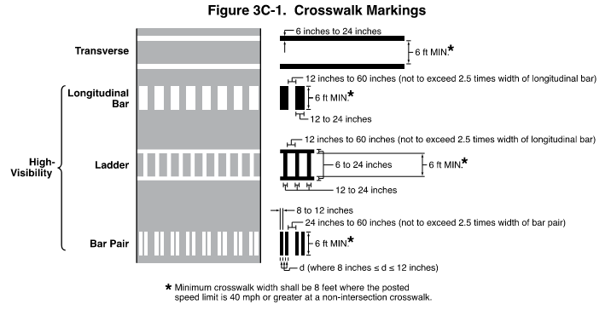
Section 3C.04 Transverse Line Crosswalks
Adds Guidance recommending transverse line crosswalk markings be limited to locations controlled by traffic control signals or on approaches controlled by STOP or YIELD signs
Adds Figure 3C-1
Figure 3C-1. Crosswalk Markings
* Minimum crosswalk width shall be 8 feet where the posted speed limit is 40 mph or greater at a non-intersection crosswalk.
Notes:
Section 3C.04 was added to include new Guidance and Support paragraphs for transverse crosswalks, which are comprised of two parallel transverse lines.
Guidance was added to recommend transverse line crosswalk markings be limited to locations controlled by traffic control signals or on approaches controlled by STOP or YIELD signs. This change is adopted due to the effectiveness of high visibility crossings and the importance of pedestrian safety.
A new Figure 3C–1 illustrates transverse and high visibility crosswalks.

Slide 28
Section 3C.05 High-Visibility Crosswalks
Adds Section with provisions for the various types of
high-visibility crosswalks including longitudinal bar, perpendicular, and double-paired designs
Figure 3C-1. Crosswalk Markings
* Minimum crosswalk width shall be 8 feet where the posted
speed limit is 40 mph or greater at a non-intersection crosswalk.
Notes:
Section 3C.05 includes the provisions for the various types of high-visibility crosswalks including longitudinal bar, perpendicular, and double-paired designs. This section provides agencies with three standard alternatives to improve crosswalk visibility when desired and is consistent with an FHWA research study on crosswalk patterns.
These crosswalk types are illustrated in Figure 3C–1.

Slide 29
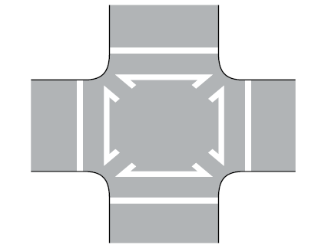
Section 3C.10 Crosswalks for Exclusive Pedestrian Phases that Permit Diagonal Crossings
Adds Guidance recommending that the segments of the crosswalk markings that facilitate the diagonal crossing should not use high-visibility crosswalk markings
Figure 3C-2. Example of Crosswalk Markings for an Exclusive Pedestrian Phase
that Permits Diagonal Crossing
Note: High-visibility crosswalks can be
used for the crosswalks around
the perimeter of the intersection
Notes:
Section 3C.10 was created for crosswalks for exclusive pedestrian phases that permit diagonal crossings.
A new Guidance paragraph was added recommending that the segments of the crosswalk markings that facilitate the diagonal crossing should not use high visibility crosswalk markings since diagonal crossings are typically permitted only when all vehicular movements are stopped at a signalized intersection and because high-visibility diagonal markings through the intersection could be confusing to turning vehicles.

Slide 30
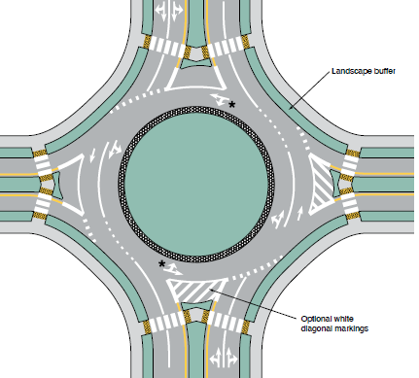
Section 3D.02 White Lane Line Pavement Markings for Roundabouts
Adds Option describing the use of channelizing lines and chevron and diagonal markings on approaches to and within the circulatory roadway
Notes:
In Section 3D.02, a new Option allows channelizing lines and chevron and diagonal markings to be used on the approaches to and within the circulatory roadway of multi-lane roundabouts to separate traffic lanes, discourage lane changing, and/or compensate for off-tracking of larger trucks and vehicles.

Slide 31
Section 3D.06 Arrow Pavement Markings for Roundabouts
Adds Guidance:
  Recommends not using lane-use arrows on single-lane approaches
  Recommends using lane-use arrows for approaches with double left or double right turns
Adds Standard prohibiting lane-use arrow pavement markings between a crosswalk and wide dotted line
Changes Option to Guidance recommending use of lane-use arrows to match the type of arrows used on the corresponding regulatory lane-use signs
Notes:
In Section 3D.06, new Guidance was added to recommend not using lane-use arrows on single-lane approaches to circular intersections. Guidance was also added to recommend lane-use arrows on two-lane approaches to circular intersections and for approaches with double left or double right turns. These changes improve consistency in the application of lane use arrows at circular intersections and are based on an NCHRP study.
In addition, a new Standard paragraph was added prohibiting lane-use arrow pavement markings between a crosswalk and wide dotted line(s) entering the circular roadway. This change was made because road users need adequate advance notification of the permitted movements within each lane and this area of the approach is often obscured by stopped vehicles.
An existing Option was changed to Guidance to recommend, rather than just allow, lane use arrows on the roundabout approaches to match the type of arrows (normal or elongated) used on the corresponding regulatory lane-use signs. This change was made to improve consistency between signing and markings for better driver comprehension.

Slide 32
Section 3E.03 Preferential Lane Word and Symbol Markings
Adds BUS STOP and TAXI STAND as required word markings for their respective uses
Changes Standard to Guidance regarding preferential lanes with two or more permitted uses to select either symbols or word markings, or both
Adds Option allowing lane-use arrow markings to be placed on the curb lanes on approaches to an intersection to signify non-preferential users can use the lane for turning movements
Adds prohibition on the use of word or symbol markings denoting motorcycle and Inherently Low Emission Vehicles (ILEV)
Notes:
In Section 3E.03, BUS STOP and TAXI STAND were added as required word markings for their respective uses in preferential lanes.
In addition, the Standard was changed to Guidance to recommend, not require, the word or symbol marking where multiple preferential lane uses are allowed in a single lane.
An Option was added to allow lane-use arrow markings to be placed on the curb lanes on approaches to an intersection to signify non-preferential users can use the lane for turning movements. This was added since it may not be immediately clear to road users when the curb lane is converted from a general-purpose lane to a preferential lane.
Lastly, new Standard and Support paragraphs were adopted restricting the use of word or symbol markings denoting motorcycle and Inherently Low Emission Vehicles (ILEV). This change was made because motorcycle and ILEV vehicle use is communicated using regulatory signing to complement high occupancy vehicle regulations and simplifies enforcement functions.

Slide 33
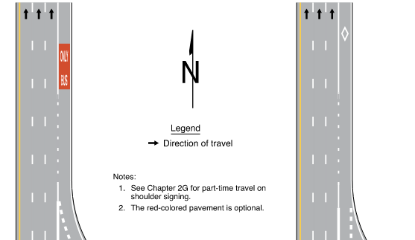
Section 3E.04 Markings for Part-Time Travel on a Shoulder
Figure 3E-5. Markings for Part-Time Travel on Shoulder and
Application of Pavement Word Markings (Sheet 1 of 3)
Adds new Section with Standard, Guidance, Option, and Support paragraphs for situations where shoulders are designated for use during peak hour conditions
Adds Figures 3E-5 and 3E-6
A – Right-hand shoulder –
transit use only
B – Right-hand shoulder –
HOV allowed
Notes:
  See Chapter 2G for part-time travel on
  shoulder signing.
  The red-colored pavement is optional.
Notes:
A new Section 3E.04 is added to include the provisions for Markings for Part-Time Travel on a Shoulder. This section covers situations where shoulders are designated for use during peak hour conditions to increase roadway capacity. Revisions and new material were based on a Transit Cooperative Research Program Report and to address increasing needs of agencies to add roadway capacity in constrained urban areas.
New Figures 3E–5 and 3E–6 were added to illustrate examples of markings for part time travel on a shoulder.

Slide 34
Section 3F.02 Longitudinal Markings
Adds Guidance paragraphs recommending solid white lane line markings to separate toll lanes, payment methods, or to channelize movements at toll plazas and that the solid lines begin at the upstream end of the full-width toll lane and continue to the toll plaza
Changes part of the Standard to Guidance regarding maximum widths of purple solid longitudinal markings
Notes:
Section 3F.02 addresses longitudinal markings at toll plazas. In this section, two new Guidance paragraphs were added recommending solid white lane line markings to separate toll lanes, payment methods, or to channelize movements at toll plazas. It also recommends that the solid lines begin at the upstream end of the full-width toll lane and continue to the toll plaza.
Part of the existing Standard paragraph for maximum widths of purple solid longitudinal markings was changed from Standard to Guidance to provide additional practitioner flexibility.

Slide 35
Chapter 3G. Delineators
Section 3G.02:
  Adds Standard that delineators be mounted on crashworthy supports
  Adds Guidance to use delineators of the appropriate color to indicate lane-reduction transitions where either an outside or inside lane merges into an adjacent lane
Section 3G.03 adds an Option allowing Chevron Alignment
(W1-8) signs to be used instead of, or in addition to, delineators
Notes:
A new Standard was added in Section 3G.02 requiring delineators to be mounted on crashworthy supports. This requirement provides consistency with Part 6 – Temporary Traffic Control.
Section 3G.02 also adds a new Guidance paragraph recommending to use delineators of the appropriate color to indicate lane-reduction transitions where either an outside or inside lane merges into an adjacent lane. This change provides consistency in the application of delineators in other Sections.
In Section 3G.03, a new Option was added to clarify the optional use of Chevron Alignment (W1-8) signs instead of or in addition to delineators as provided in Section 2C.08.

Slide 36
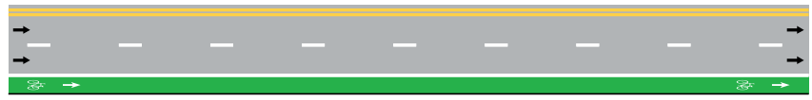
Chapter 3H. Colored Pavement
Yellow
White
Green (new) for bicycle facilities
Red (new) for public transit systems
Purple (new) for ETC Account-Only lanes
Notes:
Chapter 3H was expanded to add new colored pavement applications. The new colors are green for bicycle facilities, red for public transit systems, and purple for electronic toll collection (ETC) account-only preferential lanes. Sections for each new color and their provisions have also been added.

Slide 37
Section 3H.03 Aesthetic Surface Treatments (1 of 2)
New provisions to emphasize that aesthetic surface treatments differ from colored pavement:
  Aesthetic treatments serve no traffic control purpose and are not traffic control devices
  Colored pavement serves a traffic control purpose (as specified in the MUTCD)
The MUTCD does not prohibit aesthetic surface treatments but does limit how they interact with official traffic control devices:
  Cannot mimic, obscure, or otherwise adversely impact the effectiveness of traffic control devices
Notes:
Section 3H.03 includes new provisions for Aesthetic Surface Treatments. It is intended to emphasize that aesthetic surface treatments differ from colored pavements as they do not serve traffic control purposes and are not traffic control devices. They cannot mimic traffic control devices. New provisions provide limits on how aesthetic surface treatments interact with official traffic control devices.
Surface treatments that are purely aesthetic:
do not include retroreflective elements;
do not communicate regulations, guidance, warnings, or other information to road users;
and do not interfere with or mimic traffic control devices.
These aesthetic surface treatments are sometimes referred to as “street murals” or “asphalt art,” and might be a single solid color or might include multiple colors. Because these treatments are not intended to control traffic by their function and design, they are generally outside the scope of the MUTCD, which does not categorically prohibit them within the roadway right-of-way. Rather, the local or State authorities with jurisdiction over the roadway determine whether an aesthetic surface treatment is appropriate on a street, as might be allowed by Federal, State, or local statute, regulation, or policy and, of course, an analysis of the safety impacts to all road users.
However, the MUTCD does address those cases where the treatment might interfere with, mimic, or obscure an official traffic control device.
When the roadway surface treatment does interact with or start to interfere with official traffic control devices, then the MUTCD addresses that interaction to ensure that the integrity of the traffic control device is preserved by introducing new Standards and Guidance.
Aesthetic surface treatments shall not be of a surface that can confuse pedestrians with vision disabilities that rely on tactile treatments or cues for navigation.
Colors used for aesthetic surface treatments shall not be within the ranges of acceptable colors for official traffic control devices.
Patterns used for aesthetic surface treatments must be devoid of advertising and shall not be designed to encourage road users to remain in, engage, or interact with the pattern.
Prudent judgment should prevail in any assessment of whether the efficacy of a traffic control device could be compromised by the proximity of something else within the right-of-way.

Slide 38
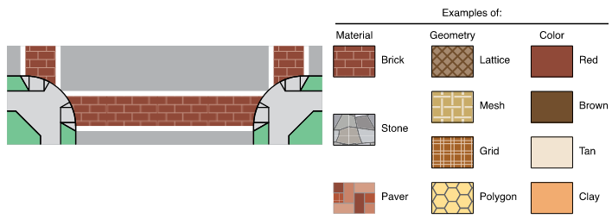
Section 3H.03 Aesthetic Surface Treatments (2 of 2)
Adds Figure 3H-1 providing common examples of colors for aesthetic surface treatments
Figure 3H-1. Aesthetic Treatments for Transverse Crosswalks
Notes:
The new Figure 3H–1 was also added to illustrate common examples of colors for aesthetic surface treatments. These changes reflect an FHWA Official Ruling which was issued in response to a trend by some agencies toward installing aesthetic treatments on roadway pavement that include bright colors, visually complex graphics, images, or words. This section is necessary because it is important that these treatments not resemble or interfere with the uniform appearance of traffic control devices, which could confuse and distract road users.

Slide 39
Section 3I.01 Channelizing Devices
Adds Option paragraph clarifying orange-colored channelizing devices are allowed to emphasize pavement markings outside of temporary traffic control zones provided the devices are not permanent
Notes:
In Section 3I.01, an Option paragraph was added to clarify that orange-colored channelizing devices are allowed to emphasize pavement markings outside of temporary traffic control zones, if the devices are not permanent.
This Option was added to facilitate use of channelizing devices in emergency incidents and planned special events, because it is usually not practical for police officers or other authorized personnel to obtain and deploy channelizing devices that match the color of the existing pavement markings.

Slide 40
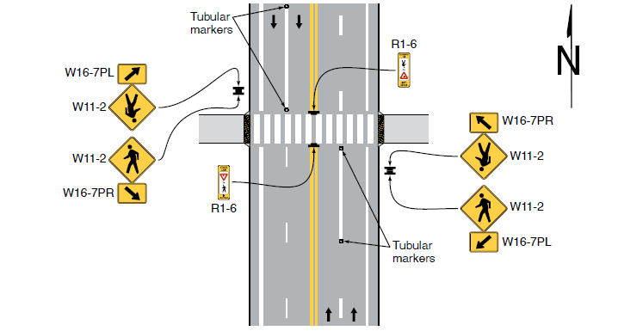
Section 3I.02 Tubular Markers
Adds new Section with Standard, Guidance, Option, and Support paragraphs providing size requirements and recommended spacing
Figure 3I-1. Examples of Tubular Markers Supplementing Pavement Markings in Advance of an Unsignalized Crosswalk (Sheet 2 of 2)
C – Tubular markers supplementing lane lines with in-street pedestrian crossing sign on centerline
Notes:
New Section 3I.02 was added with provisions to address size requirements and recommended spacing for tubular markers. This change was made because the use of tubular markers have become more common and there is a need to enhance uniformity. Portions of this new section are based on an FHWA Official Interpretation on this topic.
A new Figure 3I-1 was added to illustrate examples of tubular markers supplementing pavement markings in advance of unsignalized crosswalks.

Slide 41
Section 3J.02 Approach-End Treatment
Modifies Guidance recommending either an approach-end treatment or curb markings, or both at the ends of islands first approached by traffic
Modifies Guidance adding a recommendation for raised bars or buttons that project more than 1 inch above the pavement surface to be marked with retroreflective materials
Notes:
In Section 3J.02, the existing Guidance was modified to recommend either an approach-end treatment, or curb markings, or both at the ends of islands first approached by traffic. This change improves operations and safety at islands and decision points and meets driver expectation when encountering these facilities.
Also, a Guidance was revised to add a recommendation for raised bars or buttons that project more than 1 inch above the pavement surface to be marked with retroreflective materials. This change enhances conspicuity.

Slide 42
Section 3J.03 Islands Designated by Pavement Markings
Adds Standard paragraphs for pavement marking color requirements for islands and to clarify criteria for islands previously located throughout Part 3
Adds Option allowing colored pavement
Adds Option paragraph allowing both chevron and diagonal markings of the same color within the same island
Notes:
A new Section 3J.03 was added which includes new Standard paragraphs for pavement marking color requirements for islands and clarifies criteria for islands previously located throughout Part 3.
A New Option was added that allows the area within the flush island delineated by pavement markings to use colored pavement in accordance with the provisions of Chapter 3H.
A new Option paragraph was added, allowing both chevron and diagonal markings of the same color within the same island.

Slide 43
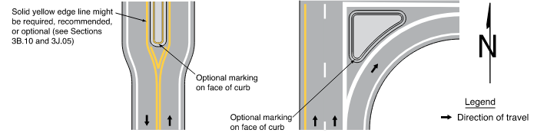
Sections 3J.04 Curb Markings for Raised Islands and 3J.05 Pavement Markings for Raised Islands
Includes provisions for the application of approach-end treatments, channelizing lines, edge lines, and chevron or diagonal markings for raised islands
Adds Figures 3J-3, 3J-4, and 3J-5
Figure 3J-3. Examples of Curb Markings for Raised Islands
A – Median nose
B – Channelizing island
Notes:
Sections 3J.04 and 3J.05 includes provisions for the application of approach-end treatments, channelizing lines, edge lines, and chevron or diagonal markings for raised islands. These changes improve consistency in the application of markings for raised islands, improve operations and safety at islands and decision points, and meet driver expectation when encountering these facilities.
New Figure 3J–3 illustrates an example of the use of curb markings for raised islands.
Figures 3J–4 and 3J-5 were added to illustrate an example of the use of diagonal markings in buffer areas between the channelizing line and the raised island.

Slide 44
Section 3J.07 Sidewalk Extensions Designated by Pavement Markings
Adds provisions addressing sidewalk extensions designated by pavement markings (not physical construction):
  Recommends that channelizing devices be used to provide enhanced conspicuity
  Can be used to:
    Extend the sidewalk or other pedestrian space
    Reduce pedestrian crossing distance
    Alter roadway geometry for speed management
    Improve pedestrian safety
Notes:
Section 3J.07 contains a completely new section on Sidewalk Extensions that are designated by pavement markings, but not physical construction. Sidewalk Extensions reclaim a portion of the roadway, sometimes including portions of parking lanes, shoulders, and the traveled way, and repurpose those areas for use by pedestrians. Sidewalk extensions provide pedestrians more area to gather while waiting to cross the street and a shorter distance to cross the vehicle travel lanes. These new provisions can help create a safer and more pedestrian-accommodating roadway environment.
There is also a new Figure 3J–6, illustrating examples of sidewalk extensions designated by pavement marking and channelization.

Slide 45

FHWA’s National
Traffic Control Devices Program
for more information:
mutcd.fhwa.dot.gov
e–Subscribe Service
Official Rulings Database
Standard Highway Signs
Frequently Asked Questions
MUTCD News Feed
Notes:
This concludes this module. Additional modules on the MUTCD 11th Edition are available at the MUTCD Web Site at http://mutcd.fhwa.dot.gov/.
Almost anything related to the MUTCD that you need is at the official MUTCD Web site.
If you haven’t yet signed up for our e-Subscribe service, please take a moment to do so. We’ll send out a bulletin whenever new information is available so you can keep up-to-date. As subscribers, you’ll also hear about future Webinar and other opportunities first.

