Slide 1


Manual on Uniform Traffic Control Devices for Streets and Highways
An Overview of Changes in the 11th Edition
As published in the December 2023
Notice of Final Rule
Prepared by the
Federal Highway Administration’s
Office of Operations
Traffic Control Devices Program
Notes:
Welcome to the Manual on Uniform Traffic Control Devices for Streets and Highways—the MUTCD 11th Edition.
This series provides an overview of the significant changes in the MUTCD and was prepared by the FHWA’s Office of Operations Traffic Control Devices team. Each module address the changes in a specific area of the MUTCD.
Additional modules on the MUTCD 11th Edition are available at the MUTCD Web Site at http://mutcd.fhwa.dot.gov/. The series includes the following modules:
Part 1
Part 2:
Chapter 2A
Chapter 2B
Chapter 2C
Chapter 2D
Chapter 2E
Chapter 2F
Chapter 2G
Chapters 2H and 2I
Chapters 2J and 2K
Chapter 2L
Chapters 2M and 2N
Part 3
Part 4
Part 5
Part 6
Part 7
Part 8
Part 9

Slide 2
Disclaimers
Except for the statutes and regulations cited, the contents of this presentation do not have the force and effect of law and are not meant to bind the States or the public in any way. This presentation is intended only to provide information regarding existing requirements under the law or agency policies.
The Federal Highway Administration (FHWA) is the source of all images in this presentation unless otherwise indicated.
Notes:
(Disclaimer) Except for the statutes and regulations cited, the contents of this presentation do not have the force and effect of law and are not meant to bind the States or the public in any way. This presentation is intended only to provide information regarding existing requirements under the law or agency policies.
FHWA is the source of all images in this presentation unless otherwise indicated.

Slide 3
Overview of Changes in Part 4
Manual on
Uniform Traffic Control Devices
4
for Streets and Highways
An Overview of Changes in Part 4
As published in the December 2023
Notice of Final Rule
Notes:
The remainder of this presentation will focus on the significant changes to Part 4 of the MUTCD.

Slide 4
General
Reorganizes Part 4 by dividing some existing long Chapters and Sections into several Chapters or several Sections, and by moving certain material to new locations within Part 4 to consolidate similar information in one place
Notes:
Part 4 was reorganized by dividing some existing long chapters and sections into several chapters or several sections. Some material was moved to new locations within Part 4 to consolidate similar information in one place.
This reorganization creates a more logical flow of information and makes it easier for users to find the content they need.

Slide 5
Section 4C.01 Studies and Factors for Justifying Traffic Control Signals
Changes traffic signal warrants from Standard to Guidance
Reinforces that other factors, beyond the warrants, be considered as part of the engineering study to justify installation of traffic control signals
Provides flexibility for agencies to consider other relevant factors in addition to reliance on the numerical warrant analysis alone
Note: a traffic control signal does not necessarily result in improved safety in every case
Notes:
Signal warrants are changed from Standard to Guidance to reinforce that other factors, beyond the warrants, can be considered as part of the engineering study to justify installation of traffic control signals. Agencies can, in fact, install a traffic control signal if a warrant is not met, but they are required to conduct the engineering study that demonstrates that the installation of a signal will improve the overall safety and/or operation of the intersection.
Agencies have the necessary flexibility to consider all relevant factors in determining the need for a traffic control signal. The safe and efficient movement of all road users is the primary consideration in the engineering study to determine whether a traffic control signal should be installed rather than some other type of control or roadway configuration.
It is important to note that control by a traffic signal does not necessarily result in improved safety in every case. The purpose of the engineering study is to evaluate all relevant factors based on the specific location.

Slide 6
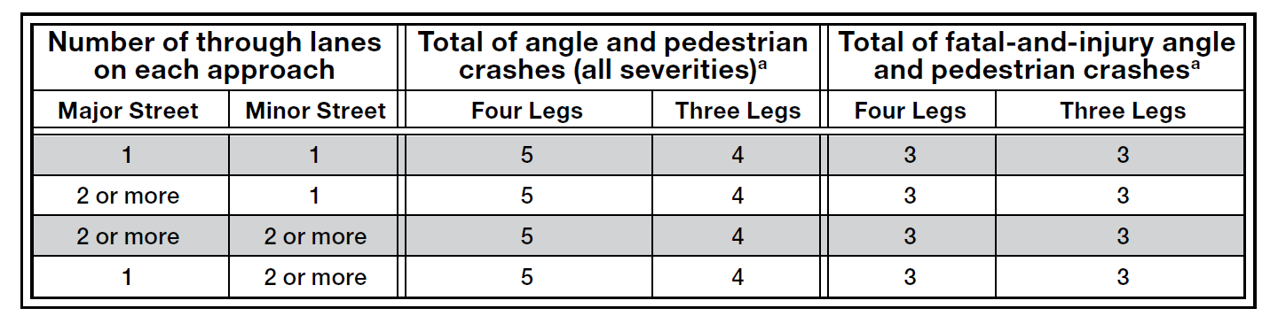
Section 4C.08 Warrant 7, Crash Experience
Revises Warrant 7 based on Interim Approval 19 and new research
Adds Option for agencies to calibrate based on local Highway Safety Manual safety performance functions (SPFs)
Table 4C-2. Minimum Number of Reported Crashes in a One-Year Period
ª Angle crashes include all crashes that occur at an angle and involve one or more vehicles on the major street and one or more vehicles on the minor street
Notes:
Warrant 7 was revised based on Interim Approval 19 and findings contained in NCHRP Project 07-18, “Crash Experience Warrant for Traffic Signals.” Based on comments received, an Option was added to allow agencies to calibrate Highway Safety Manual safety performance functions (SPFs) to their own crash data or develop their own SPFs to produce agency specific average crash frequency values.
Four new tables are provided with selection criteria based on updated signal warrant criteria for 1-year and 3-year periods, crash type, and
severity, as well as major street speed and intersection location (urban vs.
rural context).

Slide 7
Section 4D.01 Design Features of Traffic Control Signals - General
Revises Standard requiring the design and operation of traffic control signals to take into consideration the needs of all modes
Revises Standard to Guidance to allow more flexibility when considering signalized midblock crosswalks within 300 feet of the nearest traffic control signal
Notes:
In Section 4D.01, a revised Standard paragraph was added requiring the design and operation of traffic control signals to take into consideration the needs of all modes of traffic to enhance mobility and safety for all modes of travel.
Also, an existing Standard was revised and changed to Guidance to allow more flexibility when conducting an engineering study for signalized midblock crosswalks and closely spaced traffic control signals at intersections. The previous standard emphasized progression of motor vehicle traffic, but the new Standard allows agencies more flexibility to consider the needs of all modes of travel to achieve safe and efficient operation.

Slide 8

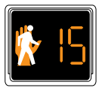
Section 4D.02 Provisions for Pedestrians
Requires pedestrian signal heads in four specific cases, and they may be used under other conditions
Recommends pedestrian signal heads at all traffic control signals with marked crosswalks
Notes:
Section 4D.02 contains a Standard that requires pedestrian signal heads to be used in conjunction with vehicular traffic control signals under any of 4 conditions, unless the pedestrian crossing is prohibited:
If the basis for traffic signal installation was justified by an engineering study and meeting either Warrant 4, Pedestrian Volume or Warrant 5, School Crossing
If an exclusive pedestrian signal phase or a leading pedestrian interval is provided with all conflicting vehicular movements being stopped
At an established signalized school crossing; or
Where there are existing pedestrian accommodations and engineering judgment determines that multi-phase signal indications (such as split-phase timing) would tend to confuse or cause conflicts with pedestrians using a crosswalk guided only by vehicular signal indications
A new Guidance statement recommends pedestrian signal heads be installed for each marked crosswalk at a location controlled by a traffic control signal.

Slide 9
Section 4D.06 Visibility, Aiming, and Shielding of Signal Faces
Adds Standard prohibiting the use of ancillary legends on signal face backplates
Notes:
In Section 4D.06 a new Standard was added prohibiting the use of ancillary legends (such as lane use, movement prohibitions, cardinal directions, bike signal, etc.) on signal face backplates. This change was adopted because backplates are used to improve the contrast between the traffic signal and its surroundings, and adding a legend reduces the contrast and could reduce driver comprehension. Section 2B.60 allows the installation of signs adjacent to signal faces to provide the purpose or operation, as needed.

Slide 10
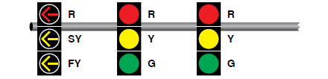
Section 4D.07 Lateral Positioning of Signal Faces
Adds Option for modifications to existing traffic signals to allow
3-foot separation between separate turn signal faces and the nearest traffic signal face for a different movement
C
C
L
L
3 feet min.
FY = flashing yellow; G = green; R = red; SY = steady yellow; Y = yellow.
Notes:
In Section 4D.07, a new Option was added for modifications to existing traffic signals to allow the separation between a separate turn signal face and the nearest traffic signal face to be reduced to 3 feet, horizontally from the nearest traffic signal face for a different movement on the same approach. This change was adopted to provide flexibility for agencies to utilize existing signal mast arms when making operational changes.

Slide 11
Section 4D.11 Temporary and Portable Traffic Control Signals
Revises Standard to provide agencies more flexibility in determining how they operate temporary and portable traffic control signals
Adds Option permitting temporary traffic signals to operate in semi-actuated mode instead of being placed in flashing mode
Notes:
In Section 4D.11, an existing Standard was revised to provide agencies more flexibility in temporary traffic signal control operations. A new Option permits temporary traffic signals to operate in semi-actuated mode instead of being placed in flashing mode. These changes reflect improvements in technology that provide greater operating capability for these devices.

Slide 12
Section 4E.02 Size of Vehicular Signal Indications
Adds Standard requiring all arrow signal indications to be 12-inch
Modifies Option allowing circular flashing beacons to be 8-inch
Adds Option allowing the use of different sizes of signal indications in the same face or signal head
Notes:
In Section 4E.02 (prior Section 4D.07), a new Standard was added requiring all arrow signal indications to be twelve-inch to enhance safety and conspicuity of the arrow legend.
The existing Option was modified to allow 8-inch circular indications in a flashing beacon based on an Official Ruling from the 2009 MUTCD.
A new Option was added allowing the use of different sizes of signal indications in the same face or signal head. This option is a variation of an option in the 2003 MUTCD. Even though this was implied in the 2009 MUTCD, this new Option provides agencies explicit flexibility to install twelve-inch arrows with eight-inch circular displays if the conditions permit eight-inch circular displays.

Slide 13
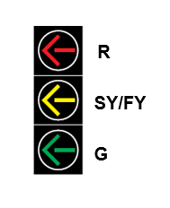
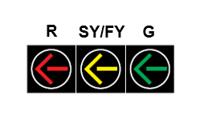
Flashing Yellow Arrow (FYA) (1 of 2)
Adds Option: three-section signal faces using FYA in the middle section
FY = flashing yellow; G = green; R = red; SY = steady yellow.
Notes:
Two new options have been added for Flashing Yellow Arrow (FYA). The first is the optional use of three-section signal faces using flashing yellow arrow (FYA) signal indications that use the middle section to show both the FYA and the steady yellow arrow in Section 4F.08 and Section 4F.15.
This change allows agencies to convert existing three-section protected-only left-turn and right-turn signal faces to three section FYA signal faces and provides more opportunities to implement variable mode left-turn and right-turn phasing.

Slide 14
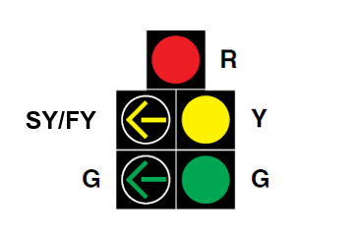
Flashing Yellow Arrow (FYA) (2 of 2)
Adds Option: FYA and the steady yellow arrow in the same section for five-section signal face
FY = flashing yellow; G = green; R = red; SY = steady yellow; Y = yellow.
Notes:
Similarly, a new option is added to allow displaying both the FYA and the steady yellow arrow in the same section for five-section shared left-turn/right-turn signal faces operating in protected/permissive mode in Section 4F.02, 4F.09, and Section 4F.16. This change is based on Interim Approval 17, an FHWA Official Ruling from the 2009 MUTCD, and supporting research.

Slide 15
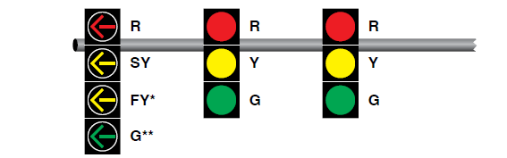
Section 4F.08 Signal Indications for Protected/Permissive Mode Left-Turn
Movements in a Separate Signal Face
Modifies Standard allowing the display of a steady left-turn RED ARROW immediately following the steady left-turn YELLOW ARROW signal indication to provide a red clearance interval
Allows two permissible left-turn sequences:
  G – SY – FY – SY – R
  or
  G – SY – R – FY – SY – R
FY = flashing yellow; G = green; R = red; SY = steady yellow; Y = yellow.
Notes:
In Section 4F.08, a Standard was modified to allow the display of a steady left-turn red arrow immediately following the steady left-turn yellow arrow signal indication to provide a red clearance interval, enabling the opposing traffic to start up before releasing the permissive left-turn movement. It is also permitted to go from the steady left-turn yellow arrow to a flashing left-turn yellow arrow without providing the steady left-turn red arrow. This same concept is included in Section 4F.15 for protected/permissive right-turn movements.

Slide 16
Section 4F.15 Signal Indications for Protected/Permissive Mode Right-Turn
Movements in a Separate Signal Face
Allows the display of a steady right-turn RED ARROW signal indication immediately following the steady right-turn YELLOW ARROW signal indication to provide a red clearance interval
Adds a requirement to display a steady right-turn YELLOW ARROW and, if needed, a steady right-turn RED ARROW following the flashing right-turn YELLOW ARROW for permissive right-turn movements changing to protected right-turn movements
Notes:
In Section 4F.15, the display of a steady right-turn red arrow signal indication immediately following the steady right-turn yellow arrow signal indication is allowed to provide a red clearance interval, enabling the opposing traffic to start up before releasing the permissive right-turn movement.
A new requirement is added to display a steady right-turn yellow arrow and if needed, steady right-turn red arrow following the flashing right-turn yellow arrow for permissive right-turn movements changing to protected right-turn movements when there is an opposing permissive left-turn movement that is being terminated simultaneously. This change was adopted because a yellow change interval and red clearance interval might be needed during a right-turn overlap to allow opposing permissive left-turn traffic to clear the intersection.

Slide 17
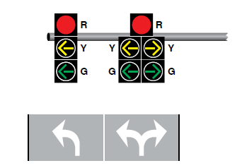
Section 4F.16 Signal Indications for Approaches with No Through Movement (1 of 2)
Adds Option allowing the continuous display of a steady CIRCULAR RED signal indication
Adds Standard prohibiting the display of CIRCULAR GREEN and CIRCULAR YELLOW signal indications for certain situations
G = green; R = red; Y = yellow.
Notes:
Section 4F.16 contains additional provisions regarding signal displays in situations where all traffic on an approach must turn onto the intersecting roadway. A new Option is added to allow the continuous display of a steady circular red signal indication while a steady or flashing YELLOW Arrow, or a steady GREEN ARROW signal indications is being displayed. The continuous display of steady CIRCULAR RED is intended to reinforce that there is no through movement for safety-critical locations.
Another new Standard prohibits the display of circular green and circular yellow signal indications in the following cases:
The posted or statutory speed limit on the approach is 35 mph or higher,
The one-way roadway that opposes the approach is an exit ramp from a freeway or
expressway, or
The one-way roadway that opposes the approach has a posted or statutory speed limit of 35 mph or higher.
These changes are intended to improve safety by minimizing the potential for road users driving straight through in the wrong direction onto a one-way roadway or exit ramp.

Slide 18
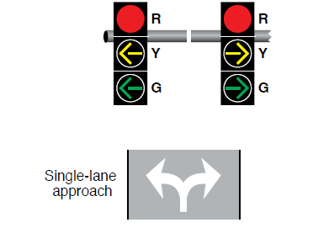
Section 4F.16 Signal Indications for Approaches with No Through Movement (2 of 2)
Adds Standard providing an exception to the requirement for a minimum of two primary signal faces for the turning movement that is considered to be the major movement on a single-lane approach with no through movement
G = green; R = red; Y = yellow.
Notes:
Another new Standard is added to Section 4F.16 that provides an exception to the requirement of a minimum of two primary signal faces for the turning movement that is considered to be the major movement from the approach. This exception only applies to single-lane approaches with no through movement where left and right turns occur from a single shared lane. Without the exception, three signal faces would have been required for a single lane in this scenario.

Slide 19
Section 4F.19 Preemption Control of Traffic Control Signals
Adds Option permitting the display of a distinctive indication to inform law enforcement personnel who are escorting traffic (such as a parade or a funeral procession) that the traffic control signal has changed because it has been preempted
Notes:
In Section 4F.19, a new Option was added permitting the display of a distinctive indication to inform law enforcement personnel who are escorting traffic (such as a parade or a funeral procession) that the traffic control signal has changed because it has been preempted. This change was adopted based on a recommendation from the National Transportation Safety Board.

Slide 20
Section 4G.04 Flashing Operation – Transition Out of Flashing Mode
Adds Guidance providing two recommended display sequences for transitioning out of yellow-red flashing mode where there is a common major-street green interval
Revises the existing recommendation for display sequences for transitioning out of yellow-red flashing mode where there is not a common major-street green interval
Notes:
In Section 4G.04, a new Guidance paragraph was added providing two recommended display sequences for transitioning out of yellow-red flashing mode where there is a common major-street green interval.
The existing Guidance was revised for display sequences for transitioning out of yellow-red flashing mode where there is not a common major-street green interval. The revised Guidance recommends that flashing red signal indications for the minor street should immediately change to steady red signal indications. The flashing yellow signal indications for the through movements on the major street should change to steady yellow signal indications followed by a steady red clearance interval before changing to green signal indications for the major traffic movement on the major street.

Slide 21
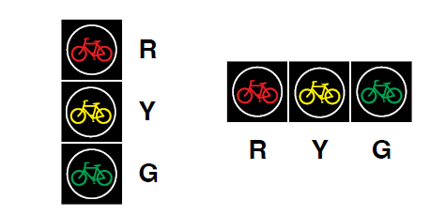
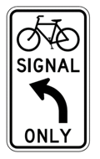
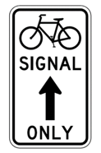
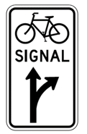
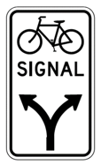
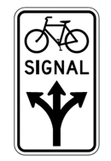
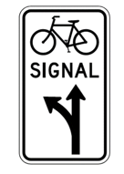
Chapter 4H Bicycle Signals (1 of 3)
Adds Chapter 4H based on Interim Approval 16 (IA-16), which addressed bicycle signal faces
Complements related information on bicycle facilities in Part 9
G = green; R = red; Y = yellow.
R10-40
R10-40a
R10-41
R10-41a
R10-41b
R10-41c
Notes:
A new Chapter 4H Bicycle Signals was added, that includes provisions for the application, design, and operation of bicycle signals. This chapter contains twelve sections and provisions related to the use, application, size, placement, mounting height, intensity and light distribution, and yellow change and red clearance intervals for Bicycle Signal Faces. The provisions are based on the Interim Approval 16 and multiple experimentations across the Country.
The use of green arrow signal indications in the same signal face with bicycle signal indications is not allowed. Instead, permissible movements for bicyclists controlled by the bicycle signal face are now provided by use of Bicycle Signal Signs located adjacent to the bicycle signal face.

Slide 22

Chapter 4H Bicycle Signals (2 of 3)
Provides a protected movement for bicyclists
Allows separation of bicyclists in space and time
Maintains provision from IA-16 that bicycle movements shall not be allowed concurrently with turning motor vehicle movements
Prohibits flashing YELLOW BICYCLE indication allowing conflicting movements with turning motorists
Notes:
Bicycle signals provide a protected movement for bicyclists. The provision of a protected movement for bicyclists allows the separation of bicyclists from motorists in space and time and is supported by the Safe System approach to improving safety for all road users.
A key provision in IA-16 was maintained stating that bicycle movements shall not be allowed concurrently with turning motor vehicle movements. A Flashing Yellow Bicycle Signal Indication allowing motor vehicle turning movements concurrently with bicycle movements is also prohibited.

Slide 23
Chapter 4H Bicycle Signals (3 of 3)
Prohibits bicycle signal faces at pedestrian hybrid beacons (PHBs):
  PHB is a pedestrian-specific device
  Statutory obligation to provide for protection of vulnerable road users
  Consider other treatments to accommodate bicycle mobility and safety (geometric, roadway configuration changes)
Notes:
The 11th Edition retains the prohibition on the use of bicycle signal faces at pedestrian hybrid beacons. Recognizing that bicyclists are vulnerable road users, they benefit from applying a safe system approach, which is to separate them in space and time from conflicting traffic movements. Where the crossing is a shared-use path or bicycle traffic is otherwise expected, the use of the PHB with bicycle signal faces would contravene this approach. The PHB was developed as a pedestrian-specific device based on representative pedestrian behavior and characteristics.

Slide 24
Public Right-of-Way Accessibility Guidelines (PROWAG)
U.S. Access Board issued PROWAG Final Rule (88 FR 53604), August 8, 2023
PROWAG and MUTCD 11th Edition rulemakings were done concurrently, and the timing precluded the consideration of final PROWAG provisions in the new MUTCD
PROWAG is not an enforceable Federal standard under the Americans with Disabilities Act of 1990 (ADA)¹ until the U.S. Department of Justice (USDOJ) and the U.S. Department of Transportation (USDOT) adopt standards consistent with PROWAG through separate rulemaking processes
  ¹Pub. L. No. 101-336 (July 26, 1990).
Notes:
Before we discuss the specific details relating to accessibility and pedestrian traffic control devices, lets review the Public Right-of-Way Accessibility Guidelines (more commonly known as PROWAG) and how it relates to the 11th Edition of the MUTCD.
At the same time that a final rule was in development for the new MUTCD, the U. S. Access Board was developing its final rule for PROWAG. However, the timing of the Access Board’s action did not allow for the new PROWAG to be addressed in the new MUTCD.
It is important to note that PROWAG provides guidelines, not enforceable Federal standards. These guidelines are not enforceable under the Americans with Disabilities Act until the U. S. Department of Justice and the US Department of Transportation adopt standards consistent with PROWAG through separate rulemaking processes.

Slide 25
Chapter 4I Pedestrian Control Features
Improves Guidance on pedestrian push button proximity to sidewalk curb ramps
Clarifies ‘‘easy activation’’ of pedestrian push buttons as no more than 5 pounds of force to activate
Expands Guidance on push button location at intersections in Section 4I.05 and Figure 4I-2 and Figure 4I-3
Notes:
The Guidance recommends that push buttons should be capable of easy activation requiring no more than 5 pounds of force, and push buttons should not require tight grasping, pinching, or twisting of the wrist.
Section 4I.05 includes several new criteria for pushbutton locations to provide practitioners with additional guidance related to the placement of pedestrian push buttons in relation to curb ramps, crosswalks, shoulders, and the edge of pavement.

Slide 26
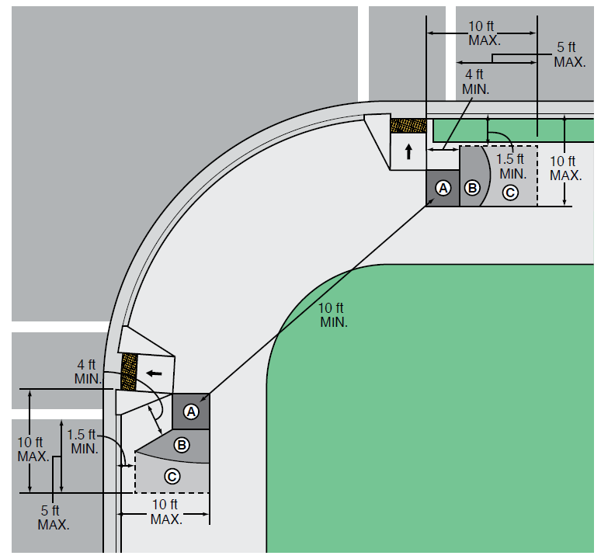
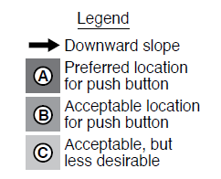
Figure 4I-2 Preferred Push Button Location Area
Expands Guidance for push button locations
Notes:
Figure 4I-2 illustrates push button location areas by defining three zones: preferred, acceptable, and acceptable, but less desirable. It also illustrates the recommended 5-foot maximum distance from the push button to the outside edge of the marked crosswalk farthest from the intersection, as well as the recommended 10-foot separation distance between two pedestrian push buttons on the same corner.
Provisions related to accessible pedestrian signals and detectors is addressed in Chapter 4K later in this presentation.

Slide 27
Section 4I.06 Pedestrian Intervals and Signal Phases (1 of 2)
Adds Standard requiring the display of a flashing red signal indication when the pedestrian signal heads at a pedestrian hybrid beacon are displaying a flashing UPRAISED HAND signal indication
Revises the minimum buffer interval from 3 seconds to 2 seconds
Notes:
In Section 4I.06, a new Standard is added requiring the display of a flashing red signal indication when the pedestrian signal heads at a pedestrian hybrid beacon are displaying a flashing Upraised Hand signal indication. This change was adopted to be consistent with the specified operation of pedestrian hybrid beacons in new Section 4J.03.
The existing Standard was also revised to reduce the minimum buffer interval from 3 seconds to 2 seconds. This change was based on successful experimentation.

Slide 28
Section 4I.06 Pedestrian Intervals and Signal Phases (2 of 2)
Revises recommendation for calculating pedestrian clearance time based on crossing distance measured from the edge of the pavement rather than from the shoulder or edge of the traveled way
Adds new Guidance recommending that where a leading pedestrian interval is used without accessible pedestrian signals (APS), the minimum required time for the walk interval should be the time provided for the leading pedestrian interval plus 7 seconds
Notes:
Existing Guidance was revised to recommend calculating pedestrian clearance time based on crossing distance measured from the edge of the pavement rather than from the shoulder or edge of the traveled way. This change was adopted because pedestrians who are waiting for a walk indication typically do not feel safe waiting on a paved shoulder and instead wait at the edge of the pavement.
Also, new Guidance was added recommending that where a leading pedestrian interval is used without APS, the minimum required time for the Walk interval should be the time provided for the leading pedestrian interval plus 7 seconds.

Slide 29
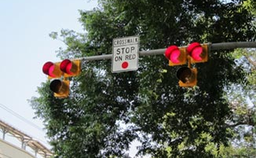
Section 4J.01 Application of Pedestrian Hybrid Beacons
Adds provisions to Support expanding use:
  Includes Option to reduce vehicle and pedestrian thresholds as much as 50% based on usage by pedestrians with slower walking speeds
  Agencies have flexibility to consider other relevant factors in addition to reliance on the volume thresholds alone
Notes:
The Pedestrian Hybrid Beacon is part of FHWA’s Proven Safety Countermeasure Initiative to address pedestrian crash risk.
The 11th Edition includes new Options to provide more flexibility in justifying the installation of PHBs with a significant reduction in the threshold volumes based on usage by pedestrians with slower walking speeds. Similar to the engineering study for traffic control signals, other factors in addition to the volume thresholds may support the installation of PHBs at locations where the thresholds are not met.

Slide 30
Section 4J.02 Design of Pedestrian Hybrid Beacons (1 of 2)
Removes Guidance recommending against placement at or within 100 feet of intersections
Adds Standard requiring a STOP sign when installed at or immediately adjacent to an intersection
Adds Guidance recommending accessible pedestrian signals
Notes:
In Section 4J.02, Guidance in the 2009 MUTCD recommending against installing pedestrian hybrid beacons within 100 feet of a side street or driveway was removed allowing installation at intersections. This change was adopted based on an FHWA evaluation study of field implementations of pedestrian hybrid beacons installed at or near intersections, which found that there were no significant safety or operational problems with such locations
A new Standard was added requiring a Stop sign for the minor-street approach when a pedestrian hybrid beacon is installed at or immediately adjacent to an intersection.
Lastly, a new Guidance statement was added recommending accessible pedestrian signals be installed in conjunction with a pedestrian hybrid beacon.

Slide 31
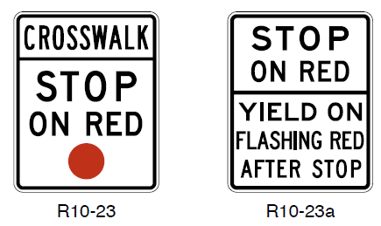
Section 4J.02 Design of Pedestrian Hybrid Beacons (2 of 2)
Changes Standard to Option for the R10-23 or R10-23a sign
Adds Standard prohibiting the use of bicycle signal faces at a pedestrian hybrid beacon
R10-23
R10-23a
Notes:
An existing Standard was changed to Option to allow, not require, the CROSSWALK STOP ON RED (R10-23) or STOP ON RED–PROCEED ON FLASHING RED WHEN CLEAR (R10-23a) signs.
A new Standard prohibiting the use of bicycle signal faces at a pedestrian hybrid beacon was added because the speed at which bicyclists are able to enter and traverse the crosswalk would make it unsafe to allow a green or yellow bicycle symbol signal indication to be shown at the same time that a flashing red signal indication is shown to motorists. If the motorists are shown a steady red signal indication for the entire length of time that the bicycle signal face is showing a green or yellow bicycle symbol signal indication and a red clearance interval, the hybrid beacon would essentially be functioning as a traffic control signal, and not as a pedestrian hybrid beacon.

Slide 32
Chapter 4K Accessible Pedestrian Signals and Detectors
Decision on where to use Accessible Pedestrian Signals (APS) is subject to requirements of the ADA and Section 504 of the Rehabilitation Act of 1973¹
11th Edition recommends audible information devices (AIDs) at rectangular rapid flashing beacons (RRFB), pedestrian-actuated Warning Beacons, and In-Roadway Warning Lights at crosswalks
  ¹Pub. L. No. 93-112 (September 26, 1973).
Notes:
In order to avoid potential conflict with PROWAG, all content related to Accessible Pedestrian Signals in the final rule is limited to the technical aspects of how APS are to operate, along with support that explains the purpose and benefit of using APS to make signals accessible. However, the decision of when to use APS is subject to the requirements of the Americans with Disabilities Act and Section 504 of the Rehabilitation Act of 1973.
It should be emphasized that while agencies can base their determination whether to use APS on an engineering study, they can also implement area-wide use of APS installations as an agency policy without the need to conduct individual studies by location.
The 11th Edition now recommends that audible information devices—which differ from APS—be provided for pedestrian-activated warning devices that do not include pedestrian signal heads. Examples of these devices include RRFBs, pedestrian-actuated warning beacons, and in-roadway warning lights. An important distinction between APS and AIDs is that AIDs do not provide an audible or vibrotactile indication informing a pedestrian to begin their crossing. The audible message provided should be “WARNING LIGHTS ARE FLASHING”.

Slide 33
Sections 4K.03 Walk Indications
Clarifies that percussive tones indicating the walk interval are required when push buttons are separated by 10 feet or more on an individual corner of an intersection
Specifies speech messages indicating the walk interval are only permitted when push buttons on an individual corner of an intersection are separated by less than 10 feet
Adds Standard requiring accessible pedestrian signal speech messages in a language other than English to follow the message first stated in English
Notes:
Section 4K.03 was revised to clarify that percussive tones indicating the WALK interval are required when the push buttons are separated by 10 feet or more on an individual corner of an intersection. Speech messages indicating the WALK interval are only permitted when the push buttons are separated by less than 10 feet.
The criteria for percussive tones versus speech messages is to be applied for each individual corner of an intersection. There is no implied intent to use speech messages for all corners if other individual corners meet the criteria for the preferred percussive tones.
Section 4K.03 also adds a new Standard addressing accessible pedestrian signal speech messages in a language other than English. If used, the speech message shall be first stated in English, followed by the speech message in a second language. This change was adopted to establish consistency in the order of such messages when an optional secondary message in a language other than English is used.

Slide 34
Section 4K.04 Vibrotactile Arrows and Locator Tones
Adds Option allowing the push button locator tone to default to deactivated mode when the steady UPRAISED HAND is displayed if a passive pedestrian detection system is implemented that activates the locator tone when a pedestrian is present within a 12-foot radius from the push button location
Notes:
In Section 4K.04 (prior Section 4E.12), a new Option was added to allow the push button locator tone to default to deactivated mode during periods when the steady UPRAISED HAND is displayed for the associated crosswalk if a passive pedestrian detection system is implemented that activates the locator tone when a pedestrian is present within a 12-foot radius from the push button location, in accordance with Official Ruling No. 4(09)–26(I).

Slide 35
Section 4K.05 Extended Push Button Press Features (1 of 2)
Changes Option to Guidance recommending audible beaconing be initiated by an extended push button press
Revises a Standard to require the volume of the locator tone to be increased up to a maximum volume of 100 A-weighted decibels (dBA) during the pedestrian change interval when audible beaconing is used
Notes:
In Section 4K.05, the existing Option was changed to Guidance to recommend that audible beaconing be initiated by an extended push button press.
An existing Standard is revised to require the volume of the locator tone be increased up to a maximum volume of 100 dBA during the pedestrian change interval when audible beaconing is used.

Slide 36
Section 4K.05 Extended Push Button Press Features (2 of 2)
Addresses loudspeaker mounting location with audible beaconing:
  Required at the far end of the crosswalk, 7 to 10 feet above the pavement
  Recommended to be within the width of the crosswalk
Adds Option permitting the sound level of the accessible pedestrian signal walk indication and subsequent push button locator tone to be increased by an extended push button press
Notes:
Section 4K.05 also adds new requirements for the location of the loudspeaker when audible beaconing is used. The loudspeaker is required to be mounted at the far end of the crosswalk at a height of 7 to 10 feet above the pavement. A new Guidance paragraph was added recommending that the audible beaconing loudspeaker at the far end of the crosswalk should be located within the width of the crosswalk.
These changes were adopted based on ‘‘NCHRP 3–62 Accessible Pedestrian Signals: A Guide to Best Practices.’’
In addition, a new Option was added to permit the sound level of the accessible pedestrian signal walk indication and subsequent push button locator tone to be increased by an extended push button press.

Slide 37
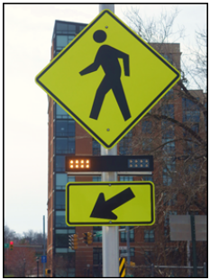
Chapter 4L Rectangular Rapid Flashing Beacons
Adds Option to use a sign conspicuity device for uncontrolled, marked crosswalks
Shall only be used to supplement dual, post-mounted W11-2 (Pedestrian), S1-1 (School), or W11-15 (Trail) crossing warning signs with diagonal downward arrow (W16-7P) plaques or a single overhead sign without the plaque
Notes:
A new Chapter numbered and titled, ‘‘Chapter 4L Rectangular Rapid Flashing Beacons’’ (RRFBs) was added that includes three new sections and provisions for the application, design, and operation of rectangular rapid flashing beacons used to supplement pedestrian warning signs at uncontrolled, marked crosswalks.
RRFBs consist of two rapidly-flashed rectangular-shaped yellow indications, each with an LED-array based pulsing light source. The new provisions are based on the Interim Approval 21, a research study performed on the effectiveness of various flash patterns, and FHWA official interpretations and experimentations. RRFBs have been shown to achieve high rates of compliance at a low relative cost in comparison to other more restrictive devices that provide comparable results. RRFBs demonstrate their highest driver compliance rates when they are used on streets or roadways with fewer lanes and lower speeds.
RRFBs shall only be used to supplement dual, post-mounted W11-2 (Pedestrian), S1-1 (School), or W11-15 (Trail) crossing warning signs with diagonal downward arrow (W16-7P) plaques. They can also be installed with a single overhead sign without the plaque.

Slide 38
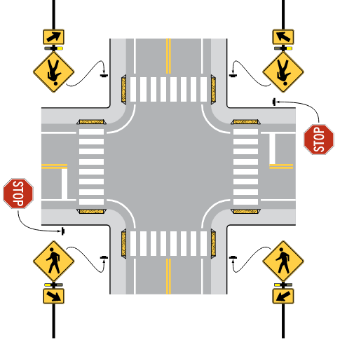
Section 4L.02 Design of Rectangular Rapid Flashing Beacons
RRFBs may be installed at intersections with more than one crosswalk on the same uncontrolled approach
When activated, the RRFBs on both approaches shall simultaneously commence operation
Notes:
RRFBs may be installed at intersections with more than one crosswalk on the same uncontrolled approach. When activated, the RRFBs on both approaches shall simultaneously commence operation of their rapid flashing indications and shall also cease operation simultaneously.
If placed overhead, the signs may be placed approximately over the center of the intersection rather than adjacent to the crosswalk. For overhead installations, the RRFB unit can be mounted directly above the top of sign or below the bottom of the sign.

Slide 39
Chapter 4P Traffic Control Signals for Freeway Entrance Ramps
Changes display requirements for two-lane entrance ramps versus entrance ramps with three or more lanes
Adds Option expanding the exception to the 8-foot minimum lateral separation of signal faces requirement to apply to entrance ramps with two or more controlled lanes (not just one lane)
Prohibits flashing LED units within the legend or border of signs to inform road users that a regulation is in effect or that a condition is present
Notes:
In Section 4P.02, the display requirements are now different for two-lane entrance ramps versus entrance ramps with three or more lanes. For two-lane entrance ramps that are separately controlled, at least two ramp control signals shall be provided for each lane. For three or more entrance ramp lanes that are separately controlled, one ramp control signal shall be provided over the approximate center of each lane. These changes are consistent with an official interpretation from the 2009 MUTCD.
A new Option was added to expand the existing exception to the requirement of 8-foot minimum lateral separation of signal faces for one-lane entrance ramps to apply to entrance ramps with two or more controlled lanes.
The RAMP METERED WHEN FLASHING sign shall be supplemented with a Warning Beacon (see Section 4S.03) that flashes when the ramp control signal is in operation controlling the flow of traffic entering the freeway. Flashing light-emitting diode (LED) units shall not be used within the legend or border of the sign for this purpose.

Slide 40
Section 4S.01 General Design and Operation of Flashing Beacons
Adds Standard establishing 8 inches and 12 inches as the two nominal diameter sizes for flashing beacon signal indications
Adds Option to allow the use of backplates with flashing beacons
Notes:
In Section 4S.01, a new Standard was added establishing eight-inch and twelve-inch as the two nominal diameter sizes for flashing beacon signal indications in accordance with an Official Ruling from the 2009 MUTCD.
An option was also added to allow the use of backplates with a flashing beacon to enhance visibility.

Slide 41
Section 4S.02 Intersection Control Beacon
Requires 12-inch signal indications:
  Where both flashing beacon and lane-use control signal indications are viewed simultaneously
  Where the signal face is more than 120 feet beyond the stop line
Recommends 12-inch signal indications:
  Where the approach speed is higher than 40 mph
  Where only post-mounted flashing beacon signal faces are used
Notes:
In Section 4S.02, a new Standard is added requiring twelve-inch signal indications for Intersection Control Beacons facing approaches where road users view both flashing beacon indications and lane use control signal indications simultaneously or where the nearest flashing beacon signal face is more than 120 feet beyond the stop line, unless a supplemental near-side flashing beacon signal face is provided.
New Guidance is added recommending twelve-inch signal indications for Intersection Control Beacons facing approaches where the speed is higher than 40 MPH or where only post-mounted flashing beacon signal faces are used.

Slide 42
Section 4S.04 Speed Limit Sign Beacon
Deletes Option allowing Speed Limit Sign Beacon within the border of a School Speed Limit sign
Maintains Option to allow Speed Limit Beacon to supplement the School Speed Limit sign
Notes:
In Section 4S.04, an existing Option allowing Speed Limit Sign Beacons within the border of a School Speed Limit Sign was deleted. A Speed Limit Sign Beacon may still be used to supplement a fixed or variable Speed Limit sign to indicate that the displayed speed limit is in effect. The Speed Limit Sign Beacons just cannot be located within the border of the sign.

Slide 43
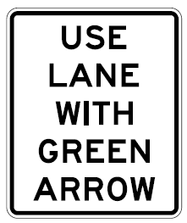
Section 4T.01 Application of Lane-Use Control Signals
Adds Option allowing a USE LANE(S) WITH GREEN ARROW (R10-8) sign
Notes:
In Section 4T.01 (prior Section 4M.01) a new Option was added allowing the use of a USE LANE(S) WITH GREEN ARROW (R10–8) sign in conjunction with lane-use control signals, for consistency with Section 2B.62 (existing Section 2B.53).

Slide 44

FHWA’s National
Traffic Control Devices Program
for more information:
mutcd.fhwa.dot.gov
e–Subscribe Service
Official Rulings Database
Standard Highway Signs
Frequently Asked Questions
MUTCD News Feed
Notes:
This concludes this module. Additional modules on the MUTCD 11th Edition are available at the MUTCD Web Site at http://mutcd.fhwa.dot.gov/.
Almost anything related to the MUTCD that you need is at the official MUTCD Web site.
If you haven’t yet signed up for our e-Subscribe service, please take a moment to do so. We’ll send out a bulletin whenever new information is available so you can keep up-to-date. As subscribers, you’ll also hear about future Webinar and other opportunities first.

