Slide 1


Manual on Uniform Traffic Control Devices for Streets and Highways
An Overview of Changes in the 11th Edition
As published in the December 2023
Notice of Final Rule
Prepared by the
Federal Highway Administration’s
Office of Operations
Traffic Control Devices Program
Notes:
Welcome to the Manual on Uniform Traffic Control Devices for Streets and Highways—the MUTCD 11th Edition.
This series provides an overview of the significant changes in the MUTCD and was prepared by the FHWA’s Office of Operations Traffic Control Devices team. Each module address the changes in a specific area of the MUTCD.
Additional modules on the MUTCD 11th Edition are available at the MUTCD Web Site at http://mutcd.fhwa.dot.gov/. The series includes the following modules:
Part 1
Part 2:
Chapter 2A
Chapter 2B
Chapter 2C
Chapter 2D
Chapter 2E
Chapter 2F
Chapter 2G
Chapters 2H and 2I
Chapters 2J and 2K
Chapter 2L
Chapters 2M and 2N
Part 3
Part 4
Part 5
Part 6
Part 7
Part 8
Part 9

Slide 2
Disclaimers
Except for the statutes and regulations cited, the contents of this presentation do not have the force and effect of law and are not meant to bind the States or the public in any way. This presentation is intended only to provide information regarding existing requirements under the law or agency policies.
The Federal Highway Administration (FHWA) is the source of all images in this presentation unless otherwise indicated.
Notes:
(Disclaimer) Except for the statutes and regulations cited, the contents of this presentation do not have the force and effect of law and are not meant to bind the States or the public in any way. This presentation is intended only to provide information regarding existing requirements under the law or agency policies.
FHWA is the source of all images in this presentation unless otherwise indicated.

Slide 3
Overview of Changes in Part 5
Manual on
Uniform Traffic Control Devices
5
for Streets and Highways
An Overview of Changes in Part 5
As published in the December 2023
Notice of Final Rule
Notes:
The remainder of this presentation will focus on the significant changes to Part 5 of the MUTCD.

Slide 4
New Part
Chapter 5A. General
Chapter 5B. Provisions for Traffic Control Devices
Provisions that are exclusively for those agencies seeking to better accommodate driving automation systems to support automated vehicles (AVs)
Notes:
The purpose of this new Part 5 in the 11th Edition is to provide agencies with general considerations for vehicle automation as they assess their infrastructure needs, prepare their roadways for AV technologies, and to support the safe integration of AVs.

Slide 5
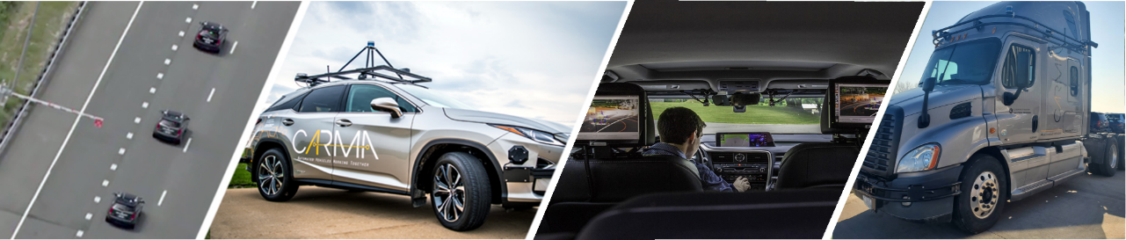
Section 5A.01 Scope and Purpose
Support statement with general information about AV technologies, the MUTCD, and the purpose of the new part
Source: FHWA.
Notes:
Section 5A.01 contains a Support statement with general information about the scope of this part, AV technologies, the MUTCD, and the purpose of the new part.

Slide 6
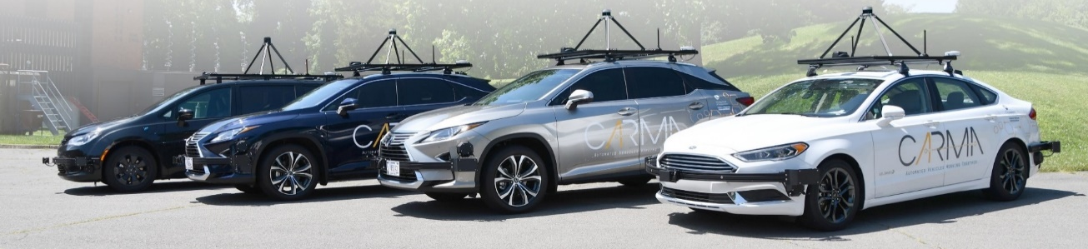
Section 5A.02 Overview of Automated Vehicles and Connected Vehicles
Support statement describing various types of AV technology and sensors that AVs use
Source: FHWA.
Notes:
Section 5A.02 includes a Support statement describing various types of AV technology and sensors used by AVs. It also describes the basic abilities of connected vehicle technology.

Slide 7
Section 5A.03 Definitions and Terms
Support statement with several definitions for terms used extensively in AV technology:
  Advanced driver assistance system (ADAS)
  Automated driving system (ADS)
  Automation levels
  Cooperative automation
  Driving automation system (DAS)
  Dynamic driving task (DDT)
  Operational design domain (ODD)
Notes:
Section 5A.03 includes a Support statement with several definitions for terms used extensively in AV technology. The definitions are summarized from those found in the Society of Automotive Engineers Standard SAE J3016.99 In addition to the terms, Table 5A-1 shows the levels of automation from Level 0 through Level 5.

Slide 8
Section 5A.04 Traffic Control Device Design and Use
Considerations (1 of 2)
Support statement describes the challenges related to the interaction between traffic control devices and DASs
Guidance statement recommends agencies:
  Adopt traffic control device maintenance policies and or practices that consider both the human vehicle operator and DAS technology needs
  Use engineering judgment to determine traffic control device selection and placement with similar considerations
Notes:
Section 5A.04 Traffic Control Device and Use Considerations includes Support and Guidance statements regarding the interaction between driving automation systems and the selection and use of traffic control devices.
A Support statement describes the challenges related to the interaction between traffic control devices and DAS.
There is also a Guidance statement recommending agencies adopt maintenance policies and or practices that consider both the human vehicle operator and DAS technology needs, and to use engineering judgment to determine traffic control device selection and placement with similar consideration.

Slide 9
Section 5A.04 Traffic Control Device Design and Use
Considerations (2 of 2)
Support and Guidance statements list the fundamental principles and considerations to be applied in evaluating traffic control devices and other maintenance to support AV technologies during maintenance and infrastructure improvements
Notes:
There are also Support and Guidance statements regarding the use of a systematic approach to help agencies with traffic control device selection, application, and maintenance that should follow fundamental principles and considerations to be applied to support of AV technologies during maintenance and infrastructure improvements.

Slide 10
Chapter 5B. Provisions for Traffic Control Devices
Section 5B.01 Signs
Section 5B.02 Markings
Section 5B.03 Highway Traffic Signals
Section 5B.04 Temporary Traffic Control
Section 5B.05 Traffic Control for Highway-Rail and Highway-Light Rail Transit Grade Crossings
Section 5B.06 Traffic Control for Bicycle Facilities
Notes:
Chapter 5B, Provisions for Traffic Control Devices, contains sections that parallel the Parts of the Manual. There are sections for signs, markings, traffic signals, temporary traffic control, traffic control at railroad and light rail transit grade crossings, and traffic control for bicycle facilities.
Each section contains Support Statements describing the interaction between driving automation systems and traffic control devices in the subject area. Guidance statements provide recommendations to agencies who are seeking to better accommodate driving automation systems to support AVs. In many cases, these recommendations can also benefit human drivers.

Slide 11
Section 5B.01 Signs (1 of 2)
Standard requires that a sign to support DASs:
  Shall not use any scanning graphics not visible to the human eye
  Shall have no loss of resolution or recognition for the road user
Notes:
Section 5B.01 Signs, is the only Section in Chapter 5B that contains a Standard Statement. The Standard requires that any scanning graphics used on a sign to support driving automation systems shall not be visible to the human eye and the sign shall have no loss of resolution or recognition for the road user.

Slide 12
Section 5B.01 Signs (2 of 2)
Guidance recommends agencies consider:
  Clearly associating signs to the specific lane or road to which they apply, such as parallel lanes or roads with different speed limits or restrictions
  Employing information spreading practices to minimize informational load and sign clutter
  Retaining standard sign designs as much as possible
  Providing for greater consistency through the light-emitting diode (LED) refresh rate in illuminated portions of electronic-display signs
Notes:
Section 5B.01 includes the following guidance statements related to signs:
Clearly associating the sign location and application with the displayed message to the specific lane or road to which it applies, such as in the case of parallel roads or lanes with different speed limits or restrictions.
The practice of sign and information spreading to limit the amount of information displayed in one location or on one sign to minimize sign clutter.
Signs with designs that are otherwise not provided for in this Manual or the “Standard Highway Signs” publication are designed based on the standardized sign design practices and features as provided for in this Manual for the type of sign, the location, and the characteristics of the roadway on which it is used.
The refresh rate of LEDs in the illuminated portion of electronic-display signs to provide for greater consistency in driving automation system detection.

Slide 13
Section 5B.02 Markings
Guidance recommends agencies consider:
  Normal-width longitudinal lines at least 6” wide
  Edge lines at least 6” wide
  Dotted-edge line extensions
  Chevron markings in neutral areas of exit gores
  Raised pavement markers as a supplement, not substitute, for pavement markings
  Uniform contrast markings on light-colored pavement
  Broken lines with uniform marking and gap length
Notes:
Section 5B.02 includes the following Guidance statements related to Markings:
Normal width longitudinal lines of at least 6 inches in width.
Edge lines of at least 6 inches in width.
Dotted edge line extensions along all entrance and exit ramps, all auxiliary lanes, and all tapers where a deceleration or auxiliary lane is added.
Chevron markings in the neutral areas of exit gores to distinguish them from travel lanes
Raised pavement markers only as a supplement to, rather than as a substitute for, pavement markings.
Uniform contrast markings on light-colored pavements to create greater contrast.
Broken lines with uniform marking and gap length.

Slide 14
Section 5B.03 Highway Traffic Signals
Guidance recommends considering:
  Placing signals consistently (post/overhead)
  Providing a consistent number of signal faces for approach lanes and signal indications and clusters
  Choosing a consistent refresh rate of LED signals
  Providing signal faces with backplates
  Using flashing yellow arrow signal indications for permissive turns
Notes:
Section 5B.03 includes the following Guidance statements related to Highway Traffic Signals:
Consistent signal face placement along corridors with respect to overhead mounting versus post mounting on the side of the roadway.
Consistent number of signal faces for approach lanes and the selection of signal indications and signal clusters along a corridor to promote uniform displays for identical or similar situations.
” FHWA included a Guidance statement with a list of considerations that should be used to accommodate machine vision used to support the automation of vehicles and benefit the performance of the human vehicle operator. The list includes consistency along a corridor of traffic signal design and placement with respect to approach lanes, and consistent LED refresh rates.
In concert with this change, FHWA adopted a Support statement describing the challenges in achieving corridor-based consistency necessary for machine vision. Information is provided on the benefits of using vehicle-to-infrastructure (V2I) technology for traffic signal systems to address inconsistencies in a corridor.

Slide 15
Section 5B.04 Temporary Traffic Control (1 of 2)
Guidance recommends considering:
  Consistent sign types, spacing, mounting heights
  “END ROAD WORK” sign to establish the end of the temporary traffic control (TTC) zone
  Wider retroreflective material on, or reduced spacing of, channelizing devices
  Continuous markings at the beginning of TTC zones and in lane transitions
Notes:
Section 5B.04 includes Guidance statements related to Temporary Traffic Control:
Consistent type, spacing, and mounting height of signs
Use of the END ROAD WORK (G20-2) sign to establish the end of the TTC zone
Wider retroreflective material on, or reduced spacing of, channelizing devices
Continuous markings at the beginning of TTC zones and in lane transitions

Slide 16
Section 5B.04 Temporary Traffic Control (2 of 2)
Temporary raised pavement markers only as a supplement to, rather than as a substitute for, pavement markings
Removal or obliteration of pavement markings that are no longer applicable as soon as practicable for long-term stationary operations in the temporary traveled way
Notes:
Temporary raised pavement markers only as a supplement to, rather than as a substitute for, pavement markings
Removal or obliteration of pavement markings that are no longer applicable as soon as practicable, for long-term stationary operations in the temporary traveled way

Slide 17
Section 5B.05 Traffic Control for Highway-Rail and
Highway-Light Rail Transit Grade Crossings
Guidance recommends considering:
  Placement of signs and markings be consistent within a corridor at both passive and active highway-rail grade crossings
  Removal of signs and pavement markings associated with railroad crossings and tracks that are out of service
Notes:
Section 5B.05 includes the following Guidance statements related to Traffic Control for Railroad and Light Rail Transit Grade Crossings:
Consistent placement of signs and markings for passive and active grade crossings along a corridor.
Removal of signs and pavement markings associated with grade crossings that are out of service.

Slide 18
Section 5B.06 Traffic Control for Bicycle Facilities
Guidance recommends considering:
  Use of an “END” (R3-9dP) plaque with a “BIKE LANE” (R3-17) sign to indicate the end of a bicycle lane that is merging with other traffic
  Use of bicycle “LANE ENDS” (W9-5) and bicycle merging (W9-5a) warning signs in advance of the end of a bicycle lane and where a merging maneuver might occur
Notes:
Section 5B.06 includes the following Guidance statements related to Traffic Control for Bicycle Facilities:
Use of an END plaque with a BIKE LANE sign to indicate the end of a bicycle lane that is merging with other traffic
Use of Bicycle Lane Ends and Bicycle Merging warning signs in advance of the end of a bicycle lane and where a merging maneuver might occur
As a reminder, all of the guidance statements in Chapter 5B are intended to provide recommendations for consideration by agencies who are seeking to better accommodate driving automation systems to support AVs. It is important to note that in many cases, these recommendations will also be beneficial for human drivers.

Slide 19

FHWA’s National
Traffic Control Devices Program
for more information:
mutcd.fhwa.dot.gov
e–Subscribe Service
Official Rulings Database
Standard Highway Signs
Frequently Asked Questions
MUTCD News Feed
Notes:
This concludes this module. Additional modules on the MUTCD 11th Edition are available at the MUTCD Web Site at http://mutcd.fhwa.dot.gov/.
Almost anything related to the MUTCD that you need is at the official MUTCD Web site.
If you haven’t yet signed up for our e-Subscribe service, please take a moment to do so. We’ll send out a bulletin whenever new information is available so you can keep up-to-date. As subscribers, you’ll also hear about future Webinar and other opportunities first.

