Slide 1


Manual on Uniform Traffic Control Devices for Streets and Highways
An Overview of Changes in the 11th Edition
As published in the December 2023
Notice of Final Rule
Prepared by the
Federal Highway Administration’s
Office of Operations
Traffic Control Devices Program
Notes:
Welcome to the Manual on Uniform Traffic Control Devices for Streets and Highways—the MUTCD 11th Edition.
This series provides an overview of the significant changes in the MUTCD and was prepared by the FHWA’s Office of Operations Traffic Control Devices team. Each module address the changes in a specific area of the MUTCD.
Additional modules on the MUTCD 11th Edition are available at the MUTCD Web Site at http://mutcd.fhwa.dot.gov/. The series includes the following modules:
Part 1
Part 2:
Chapter 2A
Chapter 2B
Chapter 2C
Chapter 2D
Chapter 2E
Chapter 2F
Chapter 2G
Chapters 2H and 2I
Chapters 2J and 2K
Chapter 2L
Chapters 2M and 2N
Part 3
Part 4
Part 5
Part 6
Part 7
Part 8
Part 9

Slide 2
Disclaimers
Except for the statutes and regulations cited, the contents of this presentation do not have the force and effect of law and are not meant to bind the States or the public in any way. This presentation is intended only to provide information regarding existing requirements under the law or agency policies.
The Federal Highway Administration (FHWA) is the source of all images in this presentation unless otherwise indicated.
Notes:
(Disclaimer) Except for the statutes and regulations cited, the contents of this presentation do not have the force and effect of law and are not meant to bind the States or the public in any way. This presentation is intended only to provide information regarding existing requirements under the law or agency policies.
FHWA is the source of all images in this presentation unless otherwise indicated.

Slide 3
Overview of Changes in Part 6
Manual on
Uniform Traffic Control Devices
6
for Streets and Highways
An Overview of Changes in Part 6
As published in the December 2023
Notice of Final Rule
Notes:
The remainder of this presentation will focus on the significant changes to Part 6 of the MUTCD.

Slide 4
General (1 of 2)
Reorganized Part 6
Added new Chapters and Sections
Consolidated similar information from various Sections
Changed some mandate levels
Notes:
Part 6 was reorganized to improve the flow of information and make it easier for users of the MUTCD to find the content they need. In some cases, this involved the creation of new Chapters and Sections that do not exist in the 2009 MUTCD.
Some existing long chapters and sections have been divided into several chapters and/or several sections, with each having a clearly understandable title.
Also, certain material has been moved to new locations within Part 6 to consolidate similar information in one place.
The mandate level (Standard, Guidance, Option) of some text in Part 6 was changed. The changes in mandate level are for two primary reasons:
to be consistent with other related provisions elsewhere in the MUTCD, or
to provide added flexibility.
In numerous cases, Standards have been reduced to Guidance for reasons of needed flexibility.
There are also numerous instances of new Options added to modify a Standard, again for added flexibility.

Slide 5
General (2 of 2)
Eliminated vague and undefined terms
Removed redundancies
Notes:
Throughout Part 6, various editorial revisions were made to eliminate the use of vague and undefined terms, such as ‘‘reasonably safe,’’ replacing such phrases with more appropriate language.
Also, text from various sections was eliminated where such material duplicated or was very similar to existing text in other sections within Part 6 or elsewhere in the MUTCD.

Slide 6
Mobility of Pedestrians in Work Zones (1 of 4)
Revisions throughout Part 6 to strengthen protection of vulnerable road users:
  Consistent with Section 11135 of the Infrastructure Investment and Jobs Act, Pub. L. No. 117-58
Public Right-of-Way Accessibility Guidelines (PROWAG) and the 11th Edition:
  Future rulemaking will be needed to implement new provisions of PROWAG pertinent to Part 6
Notes:
Content in Part 6 dealing with the important topic of mobility were revised and strengthened to help better protect vulnerable road users.
These changes were in keeping with the Infrastructure Investment and Jobs Act section 11135. Most of the revisions were editorial in nature.
At the same time that a final rule was in development for the new MUTCD, the U. S. Access Board was developing its final rule for PROWAG. While there has been significant agency coordination on the PROWAG rulemaking, the timing of the Access Board’s action did not allow for the new PROWAG requirements to be addressed in the MUTCD 11th Edition. It is important to note that PROWAG provides guidelines, not enforceable Federal standards. These guidelines are not enforceable under the Americans with Disabilities Act until the US Department of Justice and the US Department of Transportation adopt standards consistent with PROWAG through separate rulemaking processes.

Slide 7
Mobility of Pedestrians in Work Zones (2 of 4)
Sidewalk closure during construction and accessible pedestrian access—text revisions
Eliminated text that refers to a level of usage by pedestrians with disabilities as a basis for taking certain accessibility-related actions
Eliminated text suggesting accommodation of pedestrians with disabilities is sometimes unnecessary
Notes:
Several Guidance statements related to sidewalk closure during construction and accessible pedestrian access were revised.
Under Title II of the Americans with Disabilities Act (ADA), all State and local governments are required to take appropriate steps to ensure that their communications with people with disabilities are as effective as communications with others. This means that whatever information is conveyed by or on behalf of a public entity must be as clear and understandable to people with disabilities as it is for people who don’t have disabilities.
When sidewalks are closed temporarily due to construction, it is important for the closure to be communicated to pedestrians in a manner that is accessible to pedestrians with vision disabilities. The language in Part 6 was strengthened to address this need.
Text in Part 6 that refers to a level of usage by pedestrians with disabilities as a basis for taking certain accessibility-related actions was eliminated, because the need to comply with the ADA does not depend on the frequency with which the facility is used by pedestrians with disabilities.

Slide 8
Mobility of Pedestrians in Work Zones (3 of 4)
Guidance on detectable edging standards
Figure 6P-28 (detailed on the next slide) and notes revised and amplified with additional details for temporary pedestrian facilities in a sidewalk detour or diversion
Notes:
Guidance on detectable edging standards to provide positive guidance through work areas has been clarified.
Figure 6P-28 is provided to show additional details for temporary pedestrian facilities when a sidewalk detour or diversion is used to accommodate pedestrians in a work zone.
Text suggesting that the accommodation of pedestrians with disabilities is sometimes unnecessary was also eliminated, and Figure 6P-28 (the Typical Application for sidewalk closures and diversions) and its accompanying notes were substantially revised and amplified.

Slide 9
Mobility of Pedestrians in Work Zones (4 of 4)
Figure 6P-28 (Typical Application (TA)-28)
2009 MUTCD
11th Edition MUTCD
Notes:
This slide shows a portion of TA-28 dealing with a sidewalk diversion, as it appeared in the 2009 MUTCD (on the left) and as it appears in the new 11th Edition MUTCD (on the right).
Notice that the minimum width of the diversion walkway has been increased and other design details related to accessibility have also changed.

Slide 10
Positive Protection (1 of 2)
Section 6M.02 Positive Protection and Temporary Traffic Barriers—new text on positive protection
Reflects 23 Code of Federal Regulations 640.1108 (Work Zone Safety Management Measures and Strategies)
Guidance encourages use of longitudinal traffic barriers and other positive protection devices
Support provision lists applicable situations for positive protection
Notes:
What is Positive Protection? It is provided by devices designed to help prevent penetration by vehicles into the work area while minimizing injuries to vehicle occupants, and to protect workers, bicyclists, and pedestrians.
Significant new text on positive protection was added to the MUTCD in Section 6M.02. This reflects the regulations in the Code of Federal Regulations on Work Zone Safety Management Measures and Strategies (23 CFR 640.1108).
New Guidance was added to recommend that, “at a minimum, longitudinal traffic barriers and/or other positive protection devices should be considered in work zone situations that place workers at increased risk from motorized traffic, and where positive protection devices offer the highest potential for improved safety for workers and road users.”
In the same Section, new Support information was added, listing 5 specific circumstances where positive protection could be applicable.

Slide 11
Positive Protection (2 of 2)
Adds Guidance statement in Section 6K.11 to indicate that temporary lane separators should not be used to shield obstacles or provide positive protection for workers or pedestrians
TAs: Note added to 28 of the TAs for option to use positive protection
Notes:
This new Guidance in Section 6K.11 was added because temporary lane separators have not met the crashworthiness criteria for temporary traffic barriers.
Also, a new Option note was added to 28 of the TA’s about use of positive protection.

Slide 12
Late Merge (1 of 3)
Adds Section 6N.19
Adds regulatory and warning signs for this condition:
  STAY IN LANE TO MERGE POINT (R4-9a)
  MERGE HERE TAKE TURNS (W9-2a)
Various optional changeable message sign messages
Notes:
Late merges are increasingly being used by agencies to reduce the length of queued traffic where work activities temporarily necessitate a reduction in the number of lanes. This strategy has been proven to reduce rear-end crashes in certain conditions.
A new Section 6N.19 has been added covering this topic.
New regulatory and warning signs have been added for use with late merges to encourage drivers to stay in all lanes all the way to the merge point, rather than moving early out of the lane being closed.
A new figure has also been added to illustrate the use of the signs.
Also, new text has been added detailing optional messages that can be displayed on CMS, both upstream from the merge and at the merge point, to further emphasize the late merge.

Slide 13
Late Merge (2 of 3)
R4-9a
W9-2a
Notes:
Here are the two new signs added for late merge situations.

Slide 14
Late Merge (3 of 3)
Notes:
And here is a portion of new Figure 6N-1 showing how the new signs work in a series of signs approaching the late merge point.

Slide 15
Pedestrians and Bicyclists
Many changes in Part 6 to better address pedestrians and bicyclists in temporary traffic control (TTC) zones
The following slides cover the key changes on this topic
Notes:
The following slides discuss the key changes in Part 6 regarding pedestrians and bicyclists.

Slide 16
Chapter 6C
Adds Chapter 6C on pedestrian and worker safety
Relocates text from 2009 Chapter 2D and includes edits, also adds substantial new text on pedestrian and worker safety
Notes:
As a part of the reorganization of Part 6, a new Chapter 6C was created. It consists of text relocated from the 2009 MUTCD’s Chapter 2D, plus substantial new text on pedestrian and worker safety.

Slide 17
Section 6C.02 Pedestrian Considerations
Advance notification of a sidewalk closing changed from Standard to Guidance
Adds Option statement about accommodating pedestrians if project personnel attend a short-term work zone
Adds Guidance statement that recommends designing TTC zones to minimize conflicts between vehicular and pedestrian movements
Notes:
In Section 6C.02 Pedestrian Considerations, the paragraph about advance notification of a sidewalk closing was edited and changed from Standard to Guidance. This change was made because advance notification of a sidewalk closing is not always possible, especially in emergencies, therefore it is not appropriate to require advance notification in all cases.
In addition, an Option statement was added about accommodating pedestrians if a short-term work zone is attended by project personnel. Establishing an alternate pedestrian route may not be necessary if the work can be stopped and pedestrians can navigate the work zone. This new Option provides more flexibility while maintaining pedestrian safety and convenience.
A new Guidance statement was also added to recommend designing TTC zones to minimize conflicts between vehicular and pedestrian movements, due to the likelihood of high pedestrian presence in roadways open to public travel.

Slide 18
Section 6K.02 Pedestrian Channelizing Devices
Relocates information from existing Section 6F.63 and adds Standard, Guidance, Option, and Support information for pedestrian channelizing devices
Conditions for which these devices should be used
Design details
Notes:
A new Section 6K.02 Pedestrian Channelizing Devices was created, containing information relocated from existing Section 6F.63. Also, new Standard, Guidance, Option, and Support information was added to address the use of pedestrian channelizing devices for closing sidewalks and delineating an alternate pedestrian route within the work area.
Guidance was added recommending conditions for which pedestrian channelizing devices should be used.
Standard, Guidance, and Options were also added to provide additional design details.

Slide 19
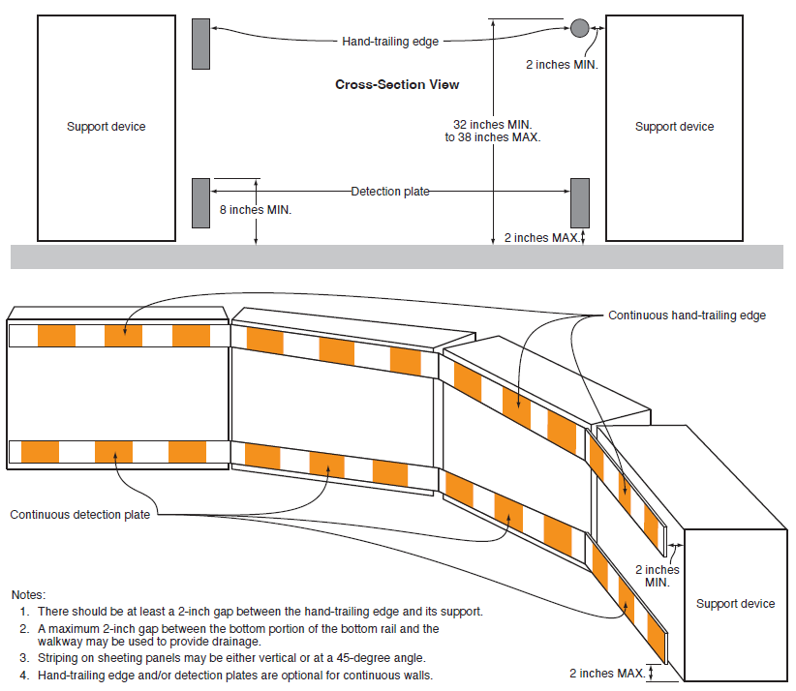
Figure 6K-2
Notes:
There should be at least a 2-inch gap between the hand-trailing edge and its support.
A maximum 2-inch gap between the bottom portion of the bottom rail and the walkway may be used to provide drainage.
Striping on the sheeting panels may be either vertical or at a 45-degree angle.
Hand-trailing edge and/or detection plates are optional for continuous walls.
Notes:
A new Figure 6K–2 was added to illustrate an example of a pedestrian channelizing device, including hand trailing for pedestrians with vision disabilities.

Slide 20
Section 6N.04 Work Affecting Pedestrian and Bicycle Facilities
Adds Guidance that the continuity of a bikeway should be maintained through TTC zone if practical
Adds Guidance on bike detours
Support information explains circumstances where continuity is especially important
Notes:
In Section 6N.04 Work Affecting Pedestrian and Bicycle Facilities, text retained from the 2009 MUTCD provides extensive provisions for accommodating pedestrians. Substantial new Guidance, Option, and Support text has been added to provide additional information for accommodating bicycles through TTC zones.
The Guidance includes recommending that a bikeway should be maintained through the TTC zone if practical, and how to provide a bike route detour if that is necessary.
The Support explains certain circumstances where bikeway continuity through a TTC zone is especially important.

Slide 21
Chapter 6P Typical Applications for Bicycle Facilities (1 of 3)
Adds five new TAs for bicycle facilities:
  Adds Figures 6P-47 through 6P-51: illustrates and describes five different situations involving work impacting bicycle facilities
  Supplements new text information in section 6N.04
Notes:
In Chapter 6P Typical Applications, FHWA added five new Typical Application figures along with notes to accompany them to illustrate and describe work impacting bicycle facilities. These new TA’s supplement the new text information in Section 6N.04.

Slide 22
Chapter 6P Typical Applications for Bicycle Facilities (2 of 3)
Figure 6P-47. Bicycle Lane Closure Without a Detour
Figure 6P-48. Bicycle Lane Closure With an On-Road Detour
Figure 6P-49. Shared-Use Path Closure With a Diversion
Figure 6P-50. On-Road Detour for a Shared-Use Path
Figure 6P-51. Paved Shoulder Closure With a Bicycle Diversion Onto a Temporary Path
Notes:
These are the topics discussed and illustrated in the 5 new TA’s about work impacting bicycle facilities.

Slide 23
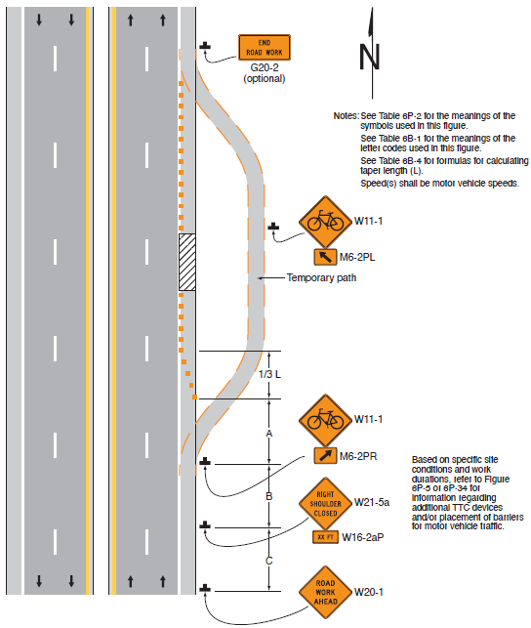
Chapter 6P Typical Applications for Bicycle Facilities (3 of 3)
Portion of TA-51 (Paved Shoulder Closure With Bicycle Diversion Onto Temporary Path)
Notes: See Table 6P-2 for the meanings of the symbols used in this figure.
See Table 6B-1 for the meanings of the letter codes used in this figure.
See Table 6B-4 for formulas for calculating taper length (L).
Speed(s) shall be motor vehicle speeds.
Based on specific site
conditions and work
durations, refer to Figure
6P-5 or 6P-34 for
information regarding
additional TTC devices
and/or placement of batteries
for motor vehicle traffic.
  Source: FHWA.
Notes:
To give you an example of one of the new TA’s for work impacting bicycle facilities, here is a portion of TA-51.

Slide 24
Chapter 6P Typical Applications for Work at Roundabouts (1 of 3)
Adds three new TA Figures along with notes to accompany them
Adds Figures 6P-52 through 6P-54: illustrates and describes procedures for work at a roundabout
Notes:
Figures 6P–52 through 6P–54 illustrate and describe procedures for work at roundabouts.

Slide 25
Chapter 6P Typical Applications for Work at Roundabouts (2 of 3)
Figure 6P-52. Short-Term or Short-Duration Work in a Circular Intersection
Figure 6P-53. Flagging Operation on a Single-Lane Circular Intersection
Figure 6P-54. Inside Lane Closure on a Multi-Lane Circular Intersection
Notes:
These are the topics discussed and illustrated in the 3 new TA’s about work at roundabouts.

Slide 26
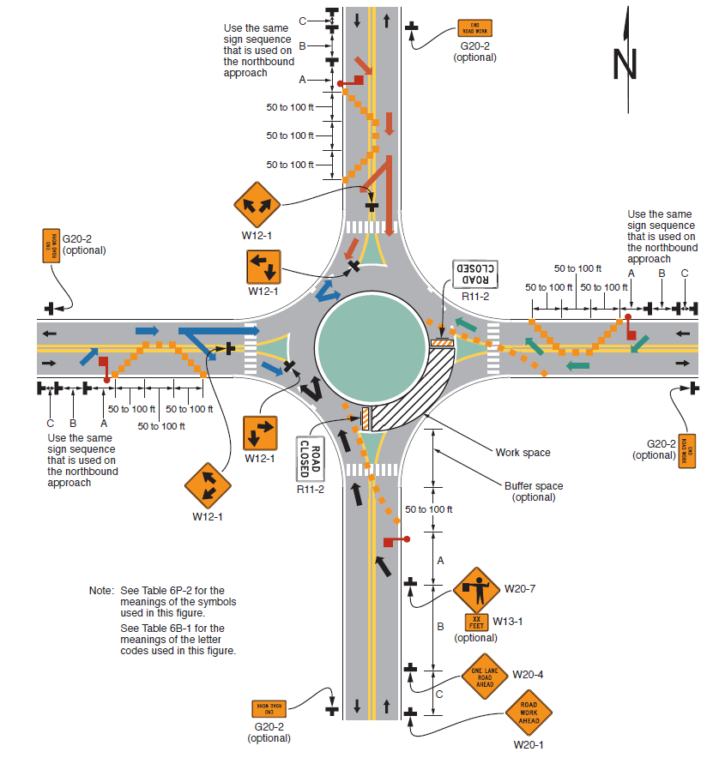
Chapter 6P Typical Applications for Work at Roundabouts (3 of 3)
Portion of TA-53 (Flagging Operation on Single-Lane Circular Intersection)
Note: See Table 6P-2 for the
meanings of the symbols
used in this figure.
See Table 6B-1 for the
meanings of the letter
codes used in this figure.
Notes:
Here is an example of the new TA’s for work at roundabouts. This shows a portion of TA-53, just to illustrate some of the detail included in the 3 new TA’s for roundabouts.

Slide 27
Pilot Car Operations: Section 6E.04 (1 of 2)
Allows PILOT CAR FOLLOW ME sign to be mounted either on top or on the rear of the pilot vehicle
Pilot car operations shall be coordinated with flagging or other control methods
G20-4
Notes:
In Section 6E.04 Pilot Car Method, the Standard statement was revised to allow mounting of the sign either on top or on the rear of the pilot vehicle.
Also, it was clarified that pilot car operations shall be coordinated with flagging or other control methods, as this is necessary for safety.

Slide 28
Pilot Car Operations: Section 6E.04 (2 of 2)
Automated flagger assistance device (AFAD) in pilot car operations must be operated by flagger, and AFAD is not to be left unattended when operating
Signing should be considered if TTC signals are used in pilot car operations and have long wait times
Notes:
Also, a new Standard was added to require a flagger to operate any Automated Flagger Assistance Device (AFAD) in pilot car operations. The flagger must be stationed not in the pilot car but near or within the line of sight of the AFAD, and the AFAD is not to be left unattended while in operation.
Guidance was also added that if temporary traffic control signals are used in pilot car operations and wait times might be long, signing to notify drivers of the wait time and/or pilot car operation should be considered.

Slide 29
Assessing Queue Lengths
Adds Guidance in Sections 6A.02 and 6N.13 recommending assessment of expected queue length
Possible adjustments to TTC plan, such as increasing spacing and number of signs, use of more conspicuous devices, and other adjustments
Notes:
In Sections 6A.02 and 6N.13, new Guidance was added about assessment of expected queue lengths. The new Guidance is based on the findings of NTSB/HAR–15/02 Multivehicle Work Zone Crash I–95 Cranbury, New Jersey.
Work zone lane closures could result in a lengthy stopped or slow-moving queue of vehicles that might extend past the normal location of the signs shown in the typical advance warning area.
For this reason, an assessment of the expected queue length should be a part of the TTC plan design process, because it might result in adjustments to the sign spacing and number of signs as well as the use of more conspicuous devices to increase the distance and conspicuity of the advance warning area.

Slide 30
Section 6B.01 Temporary Traffic Control Plans
Adds Guidance statement recommending the development of a TTC plan for any activity that will affect road users
For unplanned and emergency situations—where practicable
Notes:
In Section 6B.01 Temporary Traffic Control Plans, FHWA added a Guidance statement recommending the development of a TTC plan for any activity, either planned or unplanned, that will affect road users, because TTC plans for such activities are an important element of roadway safety.
“A TTC plan should be developed for planned activities that will affect road users. A TTC plan should be developed for unplanned and emergency situations where practicable.”

Slide 31
Section 6D.02 STOP/SLOW Paddle for
Hand-Signaling
Adds Option to allow the use of a STOP/STOP or SLOW/SLOW paddle in certain situations where appropriate
Complements similar new Option in Section 6D.05
Notes:
A new Option was added to allow the use of a STOP/STOP or SLOW/SLOW paddle in certain situations where it would be appropriate for the flagging operation.
Consistent with this change new Option text was also added in Section 6D.05 Flagger Procedures: “In certain conditions, it may be more appropriate for a flagger to use a STOP/STOP or a SLOW/SLOW paddle to convey the appropriate message to approaching road users and avoid confusing those that are approaching the operation from the opposing direction.”

Slide 32
Section 6H.07 New Interior Lane Shift Sign
Changes design and name of W9-3 sign
Replaces 2009 MUTCD word legend sign “CENTER LANE CLOSED AHEAD” with new interior lane shift symbol sign
2009 MUTCD
W9-3
11th Edition MUTCD
W9-3
Notes:
The previous word legend W9-3 sign has been replaced with a new symbol sign, and the sign name has been changed to Interior Lane Shift to reflect that it can be used for a lane shift when any interior lane is closed, not just a “center” lane.

Slide 33
Section 6L.03 STOP/SLOW Automated Flagger Assistance Devices (1 of 2)
Adds Option for the use of a new “WAIT ON STOP”–“GO ON SLOW” sign combining the messages of the two existing signs
Notes:
In Section 6L.03 STOP/SLOW Automated Flagger Assistance Devices, a new Option was added for use of a new WAIT ON STOP–GO ON SLOW sign combining the messages of the two individual signs, to provide additional flexibility in the signing used with this type of AFAD.

Slide 34
Section 6L.03 STOP/SLOW Automated Flagger Assistance Devices (2 of 2)
Notes:
This shows a portion of Figure 6L-1 Example of Use of a Stop/Slow AFAD. It illustrates how the new WAIT ON STOP-GO ON SLOW sign can be used instead of 2 separate signs.

Slide 35
Section 6N.05 Work Outside of the Shoulder
Revises Option to Guidance: If work vehicles are on the shoulder, a “SHOULDER WORK” sign should be used
W21-5
Notes:
In Section 6N.05 Work Outside of the Shoulder, a sentence about the use of a SHOULDER WORK sign if work vehicles are on the shoulder was revised from Option to Guidance, for enhanced safety.

Slide 36
Section 6O.01 General
Adds Guidance containing an explanation of safe positioning of emergency vehicles arriving at an incident
Replaces former definition in 2009 MUTCD
Notes:
In Section 6O.01, Guidance was added to include an explanation of safe positioning of emergency vehicles arriving at an incident. The 2009 MUTCD had a definition of the term “safe-positioned” but that has been deleted in favor of a more detailed explanation in Section 6O.01:
“Emergency vehicles arriving at an incident should be positioned in a manner that attempts to protect both the responders performing their duties and road users traveling through the incident scene, while minimizing, to the extent practical, disruption of the adjacent traffic flow. Emergency vehicle positions should optimize traffic flow through the incident scene. All emergency vehicles that subsequently arrive should be positioned in a manner that does not interfere with the established temporary traffic flow.”

Slide 37

FHWA’s National
Traffic Control Devices Program
for more information:
mutcd.fhwa.dot.gov
e–Subscribe Service
Official Rulings Database
Standard Highway Signs
Frequently Asked Questions
MUTCD News Feed
Notes:
This concludes this module. Additional modules on the MUTCD 11th Edition are available at the MUTCD Web Site at http://mutcd.fhwa.dot.gov/.
Almost anything related to the MUTCD that you need is at the official MUTCD Web site.
If you haven’t yet signed up for our e-Subscribe service, please take a moment to do so. We’ll send out a bulletin whenever new information is available so you can keep up-to-date. As subscribers, you’ll also hear about future Webinar and other opportunities first.

