Slide 1


Manual on Uniform Traffic Control Devices for Streets and Highways
An Overview of Changes in the 11th Edition
As published in the December 2023
Notice of Final Rule
Prepared by the
Federal Highway Administration’s
Office of Operations
Traffic Control Devices Program
Notes:
Welcome to the Manual on Uniform Traffic Control Devices for Streets and Highways—the MUTCD 11th Edition.
This series provides an overview of the significant changes in the MUTCD and was prepared by the FHWA’s Office of Operations Traffic Control Devices team. Each module address the changes in a specific area of the MUTCD.
Additional modules on the MUTCD 11th Edition are available at the MUTCD Web Site at http://mutcd.fhwa.dot.gov/. The series includes the following modules:
Part 1
Part 2:
Chapter 2A
Chapter 2B
Chapter 2C
Chapter 2D
Chapter 2E
Chapter 2F
Chapter 2G
Chapters 2H and 2I
Chapters 2J and 2K
Chapter 2L
Chapters 2M and 2N
Part 3
Part 4
Part 5
Part 6
Part 7
Part 8
Part 9

Slide 2
Disclaimers
Except for the statutes and regulations cited, the contents of this presentation do not have the force and effect of law and are not meant to bind the States or the public in any way. This presentation is intended only to provide information regarding existing requirements under the law or agency policies.
The Federal Highway Administration (FHWA) is the source of all images in this presentation unless otherwise indicated.
Notes:
(Disclaimer) Except for the statutes and regulations cited, the contents of this presentation do not have the force and effect of law and are not meant to bind the States or the public in any way. This presentation is intended only to provide information regarding existing requirements under the law or agency policies.
FHWA is the source of all images in this presentation unless otherwise indicated.

Slide 3
Overview of Changes in Part 7
Manual on
Uniform Traffic Control Devices
7
for Streets and Highways
An Overview of Changes in Part 7
As published in the December 2023
Notice of Final Rule
Notes:
The remainder of this presentation will focus on the significant changes to Part 7 of the MUTCD.

Slide 4
Consolidated Material
Combines four Sections of Chapter 7A into two
Combines seven Sections of Chapter 7B into one
Removes material found in other areas of the Manual
Notes:
Part 7 is reorganized to improve the flow of information. In some cases, sections within chapters were combined to make it easier to find content, or content was moved to other sections within Part 7 so that subject material is all in one location. In addition, some material was removed that is already discussed in other parts of the manual.

Slide 5


7B.03 School Crossing Signs (1 of 4)
New Option allows a school crossing assembly (S1-1) sign at:
  Yield approaches to circular intersections
  Channelized right turn lanes controlled by a YIELD sign
Standard in 7B.03:
The S1-1 sign shall not be installed on approaches controlled by STOP or YIELD signs, except . . .
S1-1
W16-7P
Notes:
New Options allow a School Crossing Assembly on Yield approaches to roundabouts and channelized right turn lanes controlled by a Yield sign where the crosswalk is at least 20 feet in advance of the yield point. These options are provided as specific exceptions to the Standard statement that prohibits installing a School Crossing assembly on an approach controlled by a STOP or a YIELD sign.

Slide 6
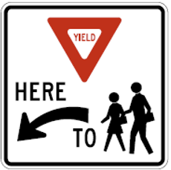

7B.03 School Crossing Signs (2 of 4)
New Option allows a “YIELD HERE TO” (or “STOP HERE FOR”) pedestrians (R1-5a or R1-5c) sign in advance of a marked crosswalk on a multi-lane approach within a school zone
R1-5a
R1-5c
Notes:
Another new Option was added to allow a Yield Here To (Stop Here For) Pedestrians (R1–5a or R1–5c) sign in advance of a marked crosswalk on a multi-lane approach in a school zone in accordance with the provisions in Section 2B.19.

Slide 7
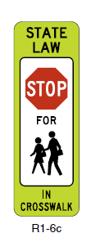
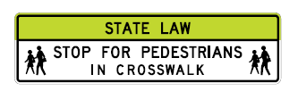
7B.03 School Crossing Signs (3 of 4)
New Standard: When used at an uncontrolled crossing, the In-Street or Overhead Pedestrian Crossing sign shall be used only as a supplement to a School Crossing assembly at the crosswalk location
S1-1
W16-7P
R1-9c
R1-6c
Notes:
For consistency with requirements adopted in Chapter 2B, a corresponding new Standard is added requiring In-Street or Overhead Pedestrian Crossing signs to be used only as a supplement to a School Crossing assembly with a diagonal downward-pointing arrow (W16-7P or W16-7aP) plaque at an uncontrolled crosswalk location.

Slide 8




7B.03 School Crossing Signs (4 of 4)
In-Street School
Crossing sign
R1-6b
R1-6c
Overhead School Crossing sign
R1-9b
R1-9c
Notes:
The name of the In-Street School Children Crossing sign is modified to In-Street School Crossing sign to be more consistent with other signs that it supplements and more accurately describe the use of the sign. Similarly, the Overhead Pedestrian School Crossing sign is renamed Overhead School Crossing sign.

Slide 9
Section 7B.05 School Speed Limit Signs and
Plaques
Revises Guidance for the maximum beginning point of a reduced school speed limit zone in advance of school grounds or school crossings:
  From 200 ft to 500 ft
Adds Standard requiring a Speed Limit Sign Beacon be used to identify periods when a school speed limit is in effect
Incorporates Reduced School Speed Limit Ahead sign provisions from previous Section 7B.16
Notes:
This Section is retitled Section 7B.05 “School Speed Limit Signs and Plaques”
Guidance paragraph 6 is revised to recommend 500 feet as the maximum beginning point of a reduced school speed limit zone in advance of school grounds. In the 2009 MUTCD, the recommended maximum beginning point was 200 feet.
A new Standard requires a Speed Limit Sign Beacon (as discussed in Section 4S.04) be used to identify the periods that the school speed limit is in effect when a School Speed Limit When Flashing (S5‑1) sign or a Speed Limit (R2‑1) sign with a supplemental WHEN FLASHING (S4‑4P) plaque is used.
Finally, this section incorporates information from previous Section 7B.16 (Reduced Speed Limit Ahead Sign).

Slide 10
Section 7B.06 Higher Fines Zone Signs and Plaques in School Areas (1 of 4)
Standard clarifies that if speeding is the only violation subject to higher fines, the supplemental plaques, if used, shall be posted with the “SCHOOL SPEED LIMIT” (S5-1) sign and shall not be below the School Zone (S1-1) sign
Standard also requires a “BEGIN HIGHER FINES ZONE” (R2-10) sign be placed at the point where the higher fines begin if the area subject to higher fines does not begin at the School Zone sign
Notes:
All text regarding higher fines signs and plaques is now in a new Section 7B.06 that deals solely with this topic.
A Standard statement clarifies that if speeding is the only violation subject to higher fines, the supplemental plaques (such as FINES HIGHER, FINES DOUBLE, or $XX FINE), if used, shall be posted with the School Speed Limit (S5-1) sign and shall not be below the School Zone (S1-1) sign.
A Standard also requires a BEGIN HIGHER FINES ZONE (R2-10) be placed at the point where the higher fines begin, if the area subject to higher fines does not begin at the School Zone sign.

Slide 11





Section 7B.06 Higher Fines Zone Signs and Plaques in School Areas (2 of 4)
Option allows placement of fine-related plaques beneath the School Zone sign if a “BEGIN HIGHER FINES ZONE” (R2-10) sign is used downstream of the school zone
Adds Guidance clarifying that duplicate plaques for fines should be omitted if
other traffic violations in addition to exceeding the speed limit are subject
to higher fines
S1-1
S4-3P
OR
OR
R2-6P
(optional)
R2-6aP
(optional)
R2-6bP
(optional)
Notes:
A new Option allows supplemental plaques regarding fines to be placed beneath the School Zone sign when a BEGIN HIGHER FINES ZONE sign is used downstream of the School Zone.
Also, there is a new Guidance paragraph that clarifies that duplicate plaques for fines should be omitted if other traffic violations, in addition to exceeding the speed limit, are subject to higher fines. This is based on an Official Ruling* from the 2009 MUTCD.
*Official Ruling No. 7(09)–3(I)

Slide 12
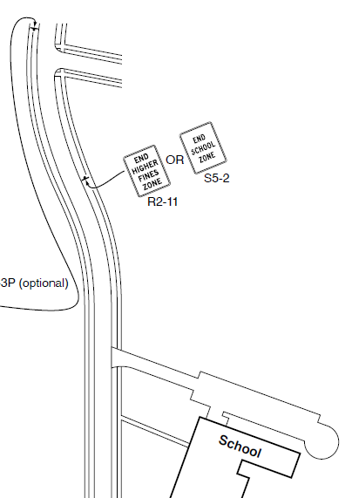
Section 7B.06 Higher Fines Zone Signs and Plaques in School Areas (3 of 4)
Option allows an “END SCHOOL ZONE” (S5-2) sign instead of a combination of an “END HIGHER FINES ZONE” (R2-11) sign and an “END SCHOOL SPEED LIMIT” (S5‑3) sign when higher fines zone ends at the same point as a reduced school speed limit zone
S5-2
R2-11
School
Notes:
A new Option allows an END SCHOOL ZONE (S5‑2) sign instead of a combination of an END HIGHER FINES ZONE sign and an END SCHOOL SPEED LIMIT (S5‑3) sign when higher fines zone ends at the same point as a reduced school speed limit zone.

Slide 13
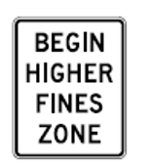


Section 7B.06 Higher Fines Zone Signs and Plaques in School Areas (4 of 4)
Option allows “BEGIN HIGHER FINES ZONE” sign and
fine-related plaques to be omitted where a statute establishes the higher fines zone
R2-6P
R2-6aP
R2-10
Notes:
A new Option allows the BEGIN HIGHER FINES ZONE sign, FINES HIGHER, FINES DOUBLE, and $XX FINE plaques to be omitted where the higher fines zone is established by statute.

Slide 14

Section 7D.01 Adult Crossing Guards
Incorporates information previously in Section 7D.02
Removes previous guidance on minimum qualifications for adult crossing guards:
  Now recommends that jurisdictions should have policies and procedures for adult crossing guard
Notes:
Information regarding adult crossing guards previously contained in Section 7D.02 is incorporated into Section 7D.01.
Guidance including specific minimum qualifications for adult crossing guards is removed and, in its place, a new Guidance paragraph is added that jurisdictions should have policies and procedures for the selection, qualifications, and training of adult crossing guards.

Slide 15
Section 7D.02 Operating Procedures for Adult
Crossing Guards
Incorporates information previously in Section 7D.04
Adds Standard requiring that the “STOP” paddle comply with the provisions for a “STOP/SLOW” paddle (per Section 6D.02)
Deletes Options and Standard regarding the flashing lights due to redundance with Part 6
Notes:
The existing Standard from that was previously in Section 7D.04 is incorporated into Section 7D.02.
Also, there’s a Standard requiring that the STOP paddle comply with the provisions for a STOP/SLOW paddle as indicated in Section 6D.02. Note: this language is not a new requirement; rather it is referring users to the appropriate requirement in Part 6 – Temporary Traffic Control.
Language regarding flashing lights on the STOP paddle that was redundant with the information in Part 6 has been removed.

Slide 16

FHWA’s National
Traffic Control Devices Program
for more information:
mutcd.fhwa.dot.gov
e–Subscribe Service
Official Rulings Database
Standard Highway Signs
Frequently Asked Questions
MUTCD News Feed
Notes:
This concludes this module. Additional modules on the MUTCD 11th Edition are available at the MUTCD Web Site at http://mutcd.fhwa.dot.gov/.
Almost anything related to the MUTCD that you need is at the official MUTCD Web site.
If you haven’t yet signed up for our e-Subscribe service, please take a moment to do so. We’ll send out a bulletin whenever new information is available so you can keep up-to-date. As subscribers, you’ll also hear about future Webinar and other opportunities first.

