Slide 1


Manual on Uniform Traffic Control Devices for Streets and Highways
An Overview of Changes in the 11th Edition
As published in the December 2023
Notice of Final Rule
Prepared by the
Federal Highway Administration’s
Office of Operations
Traffic Control Devices Program
Notes:
Welcome to the Manual on Uniform Traffic Control Devices for Streets and Highways—the MUTCD 11th Edition.
This series provides an overview of the significant changes in the MUTCD and was prepared by the FHWA’s Office of Operations Traffic Control Devices team. Each module address the changes in a specific area of the MUTCD.
Additional modules on the MUTCD 11th Edition are available at the MUTCD Web Site at http://mutcd.fhwa.dot.gov/. The series includes the following modules:
Part 1
Part 2:
Chapter 2A
Chapter 2B
Chapter 2C
Chapter 2D
Chapter 2E
Chapter 2F
Chapter 2G
Chapters 2H and 2I
Chapters 2J and 2K
Chapter 2L
Chapters 2M and 2N
Part 3
Part 4
Part 5
Part 6
Part 7
Part 8
Part 9

Slide 2
Disclaimers
Except for the statutes and regulations cited, the contents of this presentation do not have the force and effect of law and are not meant to bind the States or the public in any way. This presentation is intended only to provide information regarding existing requirements under the law or agency policies.
The Federal Highway Administration (FHWA) is the source of all images in this presentation unless otherwise indicated.
Notes:
(Disclaimer) Except for the statutes and regulations cited, the contents of this presentation do not have the force and effect of law and are not meant to bind the States or the public in any way. This presentation is intended only to provide information regarding existing requirements under the law or agency policies.
FHWA is the source of all images in this presentation unless otherwise indicated.

Slide 3
Overview of Changes in Part 8
Manual on
Uniform Traffic Control Devices
8
for Streets and Highways
An Overview of Changes in Part 8
As published in the December 2023
Notice of Final Rule
Notes:
The remainder of this presentation will focus on the significant changes to Part 8 of the MUTCD.

Slide 4
Chapter 8A
General

Slide 5
Section 8A.01 Introduction
Officially recognizes the term “Diagnostic Team” for consistency with Federal Railroad Administration (FRA) regulations
Defines the makeup of the Diagnostic Team:
  Highway agency with jurisdiction
  Regulatory agency with statutory authority (if applicable)
  Railroad company and transit agency (if applicable)
Notes:
Support is added to define the Diagnostic Team to be made up of the highway agency with jurisdiction, the regulatory agency with statutory authority (if applicable), and the railroad company and/or transit agency (if applicable). This was added to be consistent with 49 CFR part 222 (a Federal Railroad Administration regulation) and because there are many variables to be considered and multiple entities that need to be engaged to evaluate and implement traffic control devices at grade crossings.
The Diagnostic Team is jointly involved in performing the engineering study of grade crossings and the traffic control devices that are associated with them. This change is made to encourage coordination and cooperation between the appropriate knowledgeable parties of interest.
References to the Diagnostic Team are added throughout Part 8 where applicable.

Slide 6
Section 8A.02 Highway-Light Rail Transit (LRT) Grade Crossings
Highlights that LRT vehicles in a semi-exclusive alignment have right-of-way over other road users
Clarifies that LRT vehicles in a mixed-use alignment do not have right-of-way over other road users at grade crossings and intersections
Adds Guidance to recommend rail preemption in certain situations
Adds Option to allow traffic signal priority or preemption in
mixed-use alignments as determined by Diagnostic Team
Notes:
This new section takes content from a previously existing section.
It highlights that LRT vehicles at grade crossings in a semi-exclusive alignment have right-of-way over other road users. Clarification is added that in a mixed-use alignment, LRT vehicles at grade crossings and intersections do not have the right-of-way over other road users.
Guidance is revised to recommend that if a highway-LRT grade crossing is equipped with flashing-light signals and is located 200 feet or less from an intersection or midblock location controlled by a traffic control signal, a pedestrian hybrid beacon, or an emergency-vehicle hybrid beacon, the intersection should be provided with rail preemption.
An Option is added that where LRT vehicles are operating in a mixed-use alignment, traffic signal priority or preemption may be used as determined by a Diagnostic Team.

Slide 7
Section 8A.03 Traffic Control Systems and Practices at Grade Crossings
Requires Diagnostic Team to make recommendations based on the engineering study
Adds Option to allow general maintenance or minor operational changes without a Diagnostic Team review
Notes:
A new Standard requires that before any new grade crossing traffic control system is installed or before modifications are made to an existing system, approval shall be obtained from the highway agency with jurisdiction, the regulatory agency with statutory authority (if applicable), and the railroad company and/or transit agency. The Diagnostic Team members shall make a recommendation, documented in an engineering study, on new grade crossing traffic control systems and on proposed changes to an existing grade crossing traffic control system.
This change is made to take into consideration that there are a large number of significant variables, and no single standard system of traffic control devices is universally applicable for all grade crossings.
A new Option statement allows that general maintenance activities or minor operational changes to the grade crossing traffic control system that do not have a negative impact on the overall operation of the traffic control system can be made without a Diagnostic Team. This change is made to provide agencies with more flexibility and to reduce the burden on Diagnostic Team members for minor changes.

Slide 8
Section 8A.05 Engineering Studies at Grade Crossings
Adds Option that allows a regulatory agency with statutory authority to approve grade crossing traffic control system
Adds Guidance with a list of factors that should be considered in the engineering study
Notes:
A new Option allows that the regulatory agency with statutory authority (if applicable) may approve the grade crossing traffic control system.
A new Guidance statement recommends factors that should be considered in determining which traffic control devices are appropriate to install at a grade crossing.

Slide 9
Section 8A.06 Uniform Provisions
Adds Guidance statement to consider vehicle queues when adding raised median island to supplement an automatic gate
Recommends discontinuing two-way left-turn lanes in vicinity of grade crossing by either:
  Making the lane for left turns in one direction only
  Installing yellow diagonal markings in the lane:
    Consider supplemental tubular markers
Adds Option to extend automatic gate across the lane where yellow diagonal markings are used
Notes:
Guidance is revised to include that where a raised median island is installed supplemental to an automatic gate to discourage road users from driving around a lowered gate, the Diagnostic Team should consider the length of the vehicle queues that typically form on the approach to the grade crossing when determining how far in advance of the grade crossing to extend the island.
If the roadway at a grade crossing includes a two-way left-turn lane, the two-way left-turn lane should be discontinued in the immediate vicinity of the grade crossing by installing median islands, by designating the lane for left turns in one direction only, or by installing yellow diagonal markings in the lane. If yellow diagonal markings are used, the use of channelizing devices, such as supplemental tubular markers, should also be considered.
An Option is added that if yellow diagonal markings are used, extending the automatic gate across the lane may be considered.

Slide 10
Section 8A.07 Minimum Track Clearance Distance and Clear Storage Distance
Expands discussion of minimum track clearance distance beyond the information provided in the Part 1 definition
Adds Support statement that better explains how minimum track clearance distance is measured
Adds a reference to an illustration of minimum track clearance distance in the Highway-Rail Crossing Handbook
Notes:
This new Section adds Support statements that explain how to determine the minimum track clearance distance at a grade crossing. There are several factors to be considered, which are outlined in the Support. A new reference to an illustration in the Highway-Rail Crossing Handbook is also provided.

Slide 11
Section 8A.08 Adjacent Grade Crossings
Adds Guidance and Support statements to address closely spaced grade crossings
Clarifies details for adjacent grade crossings within 200 ft of each other, as measured along the highway between the inside rails
Notes:
This new section provides Support and Guidance regarding adjacent grade crossings, for example separate railroads, or a railroad and an LRT alignment operating in parallel corridors. Adjacent grade crossings exist within 200 feet of each other as measured along the highway between the inside rails. The Guidance recommends the Diagnostic Team consider the possibility that rail traffic might arrive at a grade crossing when rail traffic is already occupying the adjacent grade crossing.

Slide 12
Section 8A.09 Grade Crossing Elimination
Adds Option to allow an engineering study to evaluate eliminating a grade crossing
Revises Standard to require that traffic control devices be removed from grade crossings that are eliminated, and the devices be covered or turned from view in the interim period prior to removal
Notes:
A new Option states that if a particular grade crossing appears to be redundant or unnecessary for motor vehicle, pedestrian, and bicycle traffic, an engineering study may be conducted to determine the costs and benefits of eliminating the crossing. Guidance is provided on conducting the engineering study.
A Standard is revised to state that where a grade crossing is eliminated, the traffic control devices for the crossing shall be removed, and shall be covered or turned from view in the interim period prior to removal.

Slide 13
Section 8A.13 Temporary Traffic Control Zones
Adds Support that temporary traffic control (TTC) planning is needed when traffic detoured over existing grade crossing
Adds Guidance recommending:
  Railroad company or transit agency involvement in TTC planning
  Law enforcement be present where the TTC reverses traffic direction at the grade crossing and no modifications are made at active crossings
  Agency and stakeholder input into the TTC plan when traffic is detoured over an existing passive grade crossing
Notes:
Support is revised to include that temporary traffic control planning is needed when traffic is detoured over an existing grade crossing.
Guidance is added that the railroad company or transit agency should be part of the temporary traffic control planning process for temporary traffic control over an active grade crossing. Where a grade crossing warning system is not modified to support the temporary traffic control operation, at least one uniformed law enforcement officer should be in place at all times that rail traffic might approach or occupy the grade crossing.
Additional Guidance is provided for cases where traffic is detoured over an existing passive grade crossings. The new Guidance includes agencies and stakeholders that should have input into the TTC plan and factors that should be considered.

Slide 14
Chapter 8B
Signs

Slide 15
Section 8B.02 Sizes of Grade Crossing Signs
Clarifies that sizes for grade crossing signs listed in Table 8B-1 are minimum sizes
Table 8B-1 Grade Crossing Sign and Plaque Minimum Sizes (Sheet 1 of 2)
Sign or Plaque | Sign Designation | Section | Conventional Road Single Lane | Conventional Road Multi- Lane | Expressway | Minimum | Oversized
Stop | R1-1 | 8B.04, 8B.05 | 30 x 30 | 36 x 36 | 36 x 36 | — | 48 x 48
Yield | R1-2 | 8B.04, 8B.05 | 30 x 30 x 30 | 36 x 36 x 36 | 36 x 36 x 36 | — | 48 x 48 x 48
No Right Turn – Train (symbol) | R3-1a | 8D.10 | 24 x 30 | 30 x 36 | — | — | —
No Left Turn – (Train symbol) | R3-2a | 8D.10 | 24 x 30 | 30 x 36 | — | — | —
Do Not Stop on Tracks | R8-8 | 8B.07 | 24 x 30 | 24 x 30 | 36 x 48 | — | 36 x 48
Tracks Out of Service | R8-9 | 8B.08 | 24 x 24 | 24 x 24 | 36 x 36 | — | 36 x 36
Stop Here When Flashing | R8-10 | 8B.09 | 24 x 36 | 24 x 36 | — | — | 36 x 48
Notes:
Clarification is added that the sizes of grade crossing signs in Table 8B-1 are the minimum sizes. An Option statement allows the use of larger signs if needed.

Slide 16
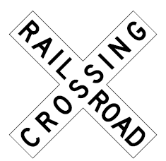
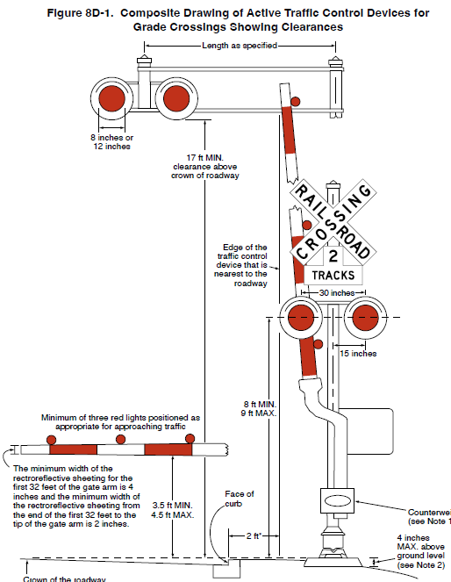
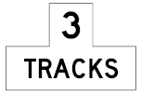
Section 8B.03 Grade Crossing (Crossbuck) Sign (R15-1) and Number of Tracks Plaque (R15-2P) at Active and Passive Grade Crossings (1 of 2)
Figure 8D-1. Composite Drawing of Active Traffic Control Devices for Grade Crossing Showing Clearances
Option changed to Standard requiring minimum of one Crossbuck sign at active LRT grade crossing
Number of Tracks plaque required below Crossbuck sign where two or more tracks at active and passive grade crossings
Length as specified
8 inches or 12 inches
17 ft MIN.
clearance above
crown of roadway
R15-1
Edge of the traffic control device that is nearest to the roadway
30 inches
15 inches
Minimum of three red lights positioned as appropriate for approaching traffic
8 ft MIN.
9 ft MAX.
The minimum width of the retroreflective sheeting for the first 32 feet of gate arm is 4 inches and the minimum width of the retroreflective sheeting from the end of the first 32 feet to the tip of the gate arm is 2 inches
R15-2P
3.5 ft MIN.
4.5 ft MAX.
Face of curb
Counterweight
(see Note 1)
2 ft *
4 inches
MAX. above
ground level
(see Note 2)
Crown of the roadway
Notes:
An Option is changed to Standard to require a minimum of one Crossbuck sign on each highway approach to every highway-LRT grade crossing where flashing-light signals or automatic gates are used, alone or in combination with other traffic control devices. This change is made to ensure that road users understand why a gate is present.
A Standard is revised to require that if there are two or more tracks at a grade crossing, the number of tracks shall be indicated on a supplemental Number of Tracks plaque. The Standard previously only applied to passive crossings. This change is made because the presence of two or more tracks at a crossing adds complexity for road users and additional risks, such as in situations in which trains occupy both tracks, where the tracks are spaced such that a vehicle could become stuck between the tracks, or where the visibility of the second track is limited. This revision improves safety by providing uniformity for multitrack crossings that accommodates the expectancy of the road user.

Slide 17
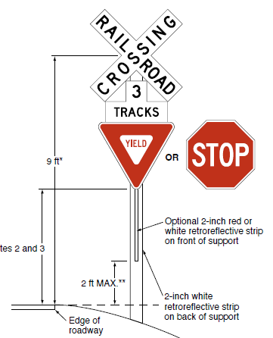
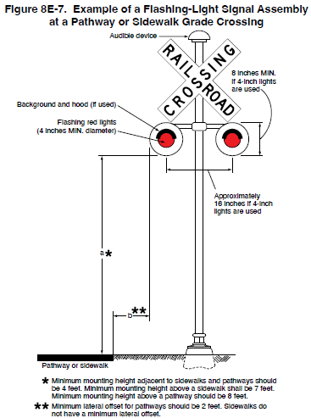
Section 8B.03 Grade Crossing (Crossbuck) Sign (R15-1) and Number of Tracks Plaque (R15-2P) at Active and Passive Grade Crossings (2 of 2)
Requires retroreflective white material not less than 2 inches in width on back of Crossbuck only at passive crossings
  Optional at active crossings
Revises Guidance on minimum clearance dimensions from nearest rail
Adds Guidance: 9-ft mounting height measured to center of Crossbuck
Figure 8B-2. Crossbuck Assembly with a YIELD or STOP Sign on the Crossbuck Sign Support
Height may be varied as required by local conditions and may be increased to accommodate signs mounted below the Crossbuck sign
Measured to the elevation of the near edge of the roadway
9 ft *
OR
Optional 2-inch red or white retroreflective strip on front of support
See Notes 2 and 3
2 ft MAX. **
2-inch white retroreflective strip on back of support
Edge of roadway
Notes:
YIELD or STOP signs are used only at passive crossings. A STOP sign is used only if an engineering study determines that is appropriate for that particular approach.
Mounting height shall be at least 4 feet of installations of YIELD or STOP signs on existing Crossbuck sign supports.
Mounting height shall be at least 5 feet for new installations in rural areas and at least 6 feet for new installations in areas where parking or pedestrian movements are likely to occur.
Notes:
A Standard is revised to reduce the requirement for retroreflective white material on the back of the Crossbuck sign to apply only to passive grade crossings. This change is made because active grade crossings have signals or warning lights for traffic control device conspicuity. An Option is added that a strip of retroreflective white material may be added on the back of each Crossbuck sign at active grade crossings, as this may improve visibility of the grade crossing during power outages.
Guidance is revised that minimum clearance dimensions for crossbuck signs relative to the proximity to the nearest rail should conform to the requirements of the railroad company and/or transit agency, and the regulatory agency with statutory authority (if applicable).
New Guidance recommends that the mounting height to the center of Crossbuck signs be approximately 9 feet. An Option allows this mounting height to vary as require by local conditions and to accommodate signs mounted below the Crossbuck sign.

Slide 18
Section 8B.04 Crossbuck Assemblies with YIELD or STOP Signs at Passive Grade Crossings (1 of 2)
Adds Guidance for inadequate clear storage distance at passive crossing located on a stop approach to a highway-highway intersection
Adds Standard to address passive grade crossings near signalized highway-highway intersections controlled by a traffic control signal that is not preempted
Notes:
This slide addresses passive grade crossings near highway-highway intersections.
Guidance is added recommending that where a passive grade crossing is located on a stop-controlled approach and the clear storage distance is less than the length of the design vehicle, and where adequate sight distance to oncoming traffic on the parallel roadway is available to road users stopped on the approach to the grade crossing, consideration should be given to installing a STOP sign at the Crossbuck Assembly instead of at the highway-highway intersection. If the STOP sign is installed at the Crossbuck Assembly instead of at the highway-highway intersection, the Diagnostic Team should consider installing some other intersection traffic control device at the highway-highway intersection.
A new Standard requires that if a Crossbuck Assembly is installed on the approach to a passive grade crossing located at a highway-highway intersection controlled by a traffic control signal that is not interconnected with the grade crossing and not preempted by the approach of rail traffic, a Diagnostic Team shall be convened to determine the appropriate traffic control devices. A STOP sign shall not be installed on a Crossbuck Assembly in this situation.

Slide 19
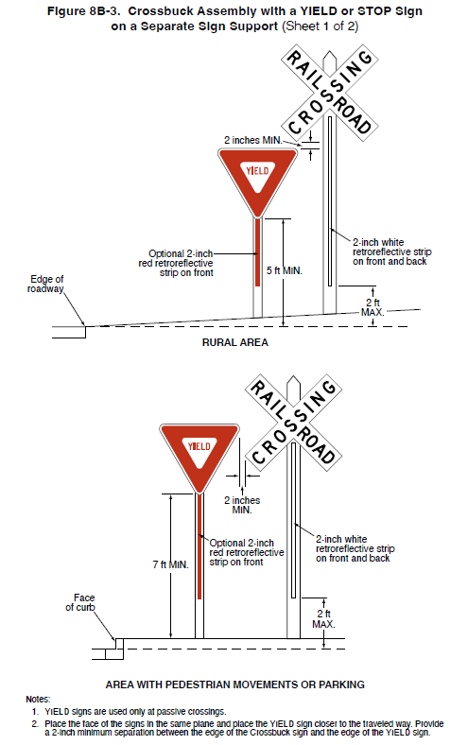
Section 8B.04 Crossbuck Assemblies with YIELD or STOP Signs at Passive Grade Crossings (2 of 2)
Figure 8B-3. Crossbuck Assembly with a YIELD or STOP Sign on a Separate Sign Support (Sheet 1 of 2)
Revises Standard to address mounting height minimums for STOP or YIELD signs
Revises Guidance to recommend STOP or YIELD sign be placed in the same plane as the Crossbuck if on separate supports
Revises Standard to address round sign support white retroreflective strip
2 inches MIN.
Optional 2-inch red retroreflective strip on front
2-inch white retroreflective strip on front and back
Edge of roadway
5 ft MIN.
2 ft
MAX
RURAL AREA
2 inches MIN.
Optional 2-inch red retroreflective strip on front
2-inch white retroreflective strip on front and back
7 ft MIN.
Face
of curb
2 ft
MAX
AREA WITH PEDESTRIAN MOVEMENTS OR PARKING
Notes:
1. YIELD signs are used only at passive crossings.
2. Place the face of the signs in the same plane and place the YIELD sign closer to the traveled way. Provide
a 2-inch minimum separation between the edge of the Crossbuck sign and the edge of the YIELD sign.
Notes:
A Standard is revised to clarify that on existing Crossbuck sign supports, the minimum mounting height for YIELD and STOP signs is 4 feet. On new Crossbuck sign supports or when mounted on separate supports, the minimum mounting height is 5 feet in rural areas and 7 feet in areas where parking or pedestrian movements are likely to occur.
Guidance is revised to state that if a YIELD or STOP sign is installed for a Crossbuck Assembly at a grade crossing on a separate support than the Crossbuck sign, the YIELD or STOP sign should be placed in the same plane as the Crossbuck sign and closer to the traveled way than the Crossbuck sign. The minimum separation between the nearest point of the YIELD or STOP sign and the nearest point of the Crossbuck sign should be 2 inches.
Standards are revised to include that a white retroreflective strip wrapped around a round support for the full length of the support from the Crossbuck Sign or Number of Tracks plaque to within 2 feet above the near edge of the roadway shall satisfy the requirement of a vertical strip of retroreflective white material on the back each Crossbuck sign support at passive grade crossings as long as the round support has an outside diameter of at least 2 inches.

Slide 20
Section 8B.06 Grade Crossing Advance Warning Signs (W10-1 through W10-4)
Revises Standard by adding a new exception that Grade Crossing Advance Warning signs are not required at
highway-LRT grade crossings where Crossbuck signs are not used
Notes:
A Standard was revised to add a new exception that states Grade Crossing Advance Warning signs are not required at highway-LRT grade crossings where Crossbuck signs are not used.

Slide 21
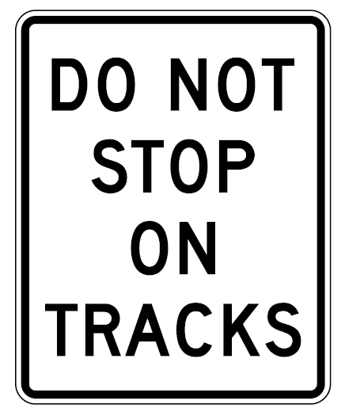
Section 8B.07 DO NOT STOP ON TRACKS Sign (R8-8)
Adds Guidance to use R8-8 sign if motor vehicle queues are likely to extend onto the tracks
R8-8
Notes:
Guidance is added that a DO NOT STOP ON TRACKS sign should be used at any location where vehicle queues are likely to extend on to the tracks. This change is made to simply the Guidance about when to use the sign.
A new Support statement is added to list the types of conditions that could result in vehicles queuing onto the tracks.

Slide 22
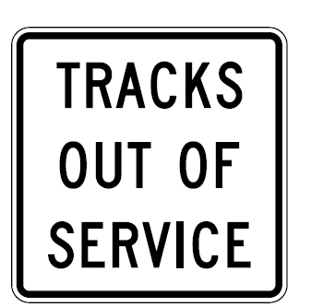
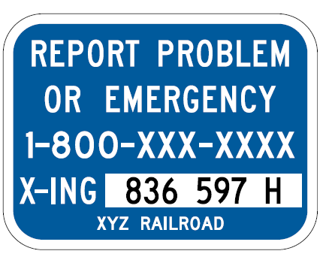
Section 8B.08 TRACKS OUT OF SERVICE Sign (R8-9)
Adds Standard requiring Emergency Notification System (ENS) sign (I13-1) at out-of-service tracks
+
R8-9
I13-1
Notes:
A new Standard is added requiring that where tracks are out of service, even if a TRACKS OUT OF SERVICE sign has been installed, an Emergency Notification System sign shall be retained at the grade crossing and shall be visible to road users, until the tracks have been removed or paved over.
While not explicitly stated, the Diagnostic Team may deviate from this Standard based on a documented engineering study in limited cases where the ENS phone service has been discontinued in conjunction with the tracks being out of service.

Slide 23
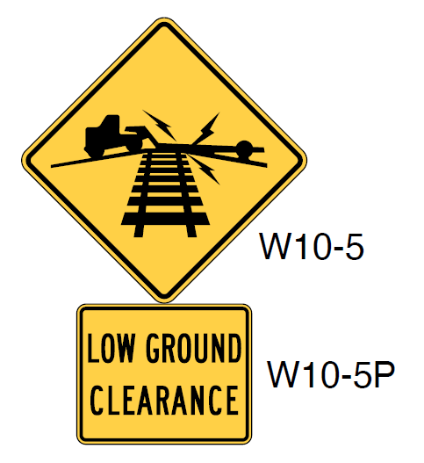
Section 8B.16 Low Ground Clearance Grade Crossing Sign (W10-5)
Consider other vehicle types and combinations
Use word message warning signs and selective exclusion regulatory signs
W10-5
W10-5P
Notes:
Guidance and Support are added regarding other vehicle types and combinations that face the potential risk of hanging up at a grade crossing.
Word message warning signs and selective exclusion regulatory signs for specific vehicle types and combinations should be used in addition to, or in place of, the Low Ground Clearance Grade Crossing sign.
This change includes a compliance date of 5 years for agencies to assess and install additional signing (if needed) at known low ground clearance locations identified in their grade crossing inventories. More information on the compliance date is available in the slide presentation for Part 1 of the 11th Edition.

Slide 24
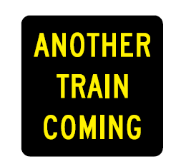
Section 8B.18 Another Train Coming Sign (W10-16)
Includes Guidance that the Diagnostic Team should make the decision
Adds Option to supplement with a warning beacon
W10-16
Activated
Blank-Out
Notes:
A new Section is added regarding the Another Train Coming activated blank-out sign. It can be used to provide notification of another train coming at multi-track crossings or where users might not consider the arrival of another train on a different track. The decision to use this sign is made by the Diagnostic Team based on collision history, train speeds and volumes, operating plans and/or schedules, and the presence of a nearby station or transit center. The sign may also be supplemented with a warning beacon as discussed in Section 4S.03.

Slide 25
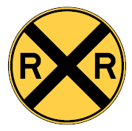
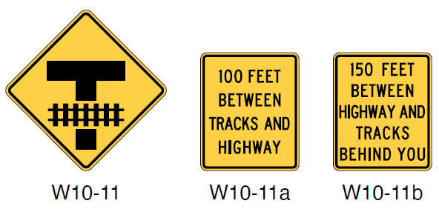
Section 8B.21 Storage Space Signs (W10-11,
W10-11a, and W10-11b)
Adds Standard: Storage Space (W10-11) signs shall not be used as a replacement for the Grade Crossing Advance Warning sign
If used, Storage Space signs shall be mounted on a separate post than the Grade Crossing Advance Warning sign
W10-1
W10-11a
W10-11b
Required
W10-11
Notes:
A new Standard prohibits the use of a Storage Space signs as a replacement for the required Grade Crossing Advance Warning sign. If used, the Storage Space sign shall be used in addition to the W10-1 sign and shall be mounted on a separate post. This clarification is intended to emphasize the importance and priority of the Grade Crossing Advance Warning sign on the approach.

Slide 26
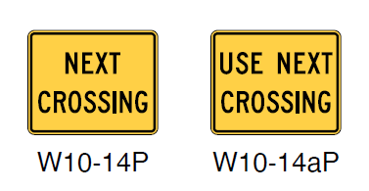
Section 8B.24 Next Crossing Plaques (W10-14P and W10-14aP)
NEXT CROSSING sign indicates the condition applies at the next crossing location
USE NEXT CROSSING sign warns applicable road users to cross at a subsequent crossing to avoid the condition
W10-14P
W10-14aP
Notes:
A new Section is added regarding the optional use of NEXT CROSSING plaques. These plaques may be used in conjunction with Low Ground Clearance or Skewed Crossing warning signs. The Next Crossing plaque indicates the condition applies at the next crossing location a road user will encounter. The Use Next Crossing plaque warns applicable road users to cross at a subsequent crossing to avoid the condition. The Use Next Crossing plaque is one of the strategies to be considered when assessing low ground clearance situations as part of the discussed previously compliance date requirement.

Slide 27
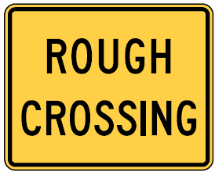
Section 8B.25 ROUGH CROSSING Plaque
(W10-15P)
Adds Option clarifying use of the ROUGH CROSSING plaque
ROUGH CROSSING plaque may be placed under the Grade Crossing Advance Warning (W10-1 through W10-4) sign
For use where road users may need to reduce speed or take other appropriate action due to surface or condition of the grade crossing
W10-15P
Notes:
A new Option is added to the use of ROUGH CROSSING plaques. They may be mounted below the Grade Crossing Advance Warning sign to provide supplemental information that the surface or condition of the grade crossing might require a reduced speed or some other appropriate action by the road user.

Slide 28
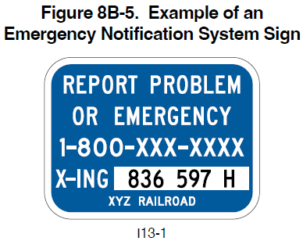
Section 8B.27 Emergency Notification System Sign (I13-1) (1 of 2)
Required for all highway-rail grade crossings and all highway-LRT grade crossings with automatic gates or flashing light signals
Sign shall be retroreflective
Minimum sign dimensions shall be 12-inch width and 9-inch height
May use black legend on white background for grade crossing inventory number
I13-1
Notes:
Guidance was changed to a Standard to require installation of Emergency Notification System (ENS) signs for all highway-rail grade crossings and all highway-LRT grade crossings with automatic gates or flashing light signals. The ENS sign shall be retroreflective. This change is made to be consistent with Federal Railroad Administration (FRA) regulations.
A new Standard requires minimum 12-inch width and 9-inch height dimensions, as well as number and letter heights for the ENS sign to be consistent with new requirements circulated by the FRA.
A new Option allows the seven-character grade crossing inventory number to be shown on the sign as a black legend on a white rectangular background. This change is made to allow additional flexibility in sign production methods.

Slide 29

Section 8B.27 Emergency Notification System Sign (I13-1) (2 of 2)
Attach to Crossbuck Assemblies or grade crossing signal masts on the right-hand side of roadway approach
Should be visible when gate arm is vertical or horizontal
May be mounted on separate posts and additional
ENS signs may be used
May be oriented perpendicular or parallel to traffic
May include NOTICE header panel to improve conspicuity
I13-1
Notes:
A new Guidance statement recommends that ENS signs be attached to the Crossbuck Assemblies or grade crossing signal masts on the right-hand side of each roadway approach to the grade crossing. This change is made to provide uniformity in sign placement. The ENS sign should be visible when the automatic gate arm is in either the vertical or horizontal position.
A new Option allows Emergency Notification signs to be located on a separate post and permits additional Emergency Notification signs to be installed at a grade crossing. Based on FRA comments, ENS signs may be oriented perpendicular or parallel to approaching traffic.
A new Option was also included to allow a NOTICE header panel above the ENS sign to enhance sign conspicuity.

Slide 30
Chapter 8C
Markings
Notes:
A new Chapter 8C is added containing previously existing content and new content regarding pavement markings at grade crossings. Markings were previously included with signs in Chapter 8B. Unless otherwise provided in this Chapter, the provisions of Part 3 are applicable to the design and location of pavement markings at grade crossings.

Slide 31
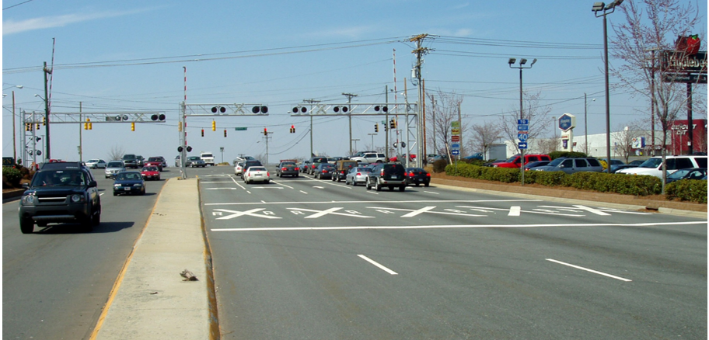
Section 8C.02 Grade Crossing Pavement Markings
(1 of 2)
Changes Guidance to Standard: Requires grade crossing markings in each approach
lane at multi-lane grade crossings to be identical
New Standard also requires
this treatment for LRT-Grade Crossings where Crossbuck sign is used
Notes:
Guidance is changed to a Standard to require identical grade crossing markings in each approach lane that crosses the tracks at multi-lane grade crossings. A new Standard requires that grade crossing pavement markings shall be placed in each approach lane on all paved approaches to highway-LRT grade crossings where a Crossbuck sign is placed at the grade crossing. Based on an engineering study, the diagnostic team may exclude grade crossing pavement markings at highway-rail grade crossings where the posted or statutory speed limit is less than 40 MPH or in urban areas under certain conditions.

Slide 32
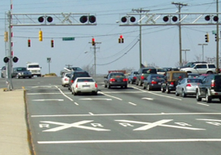
Section 8C.02 Grade Crossing Pavement Markings
(2 of 2)
Adds Guidance: If supplemental pavement marking symbols are placed between the Grade Crossing Advance Warning sign and grade crossing, the downstream transverse line should be at least 50 ft upstream from the stop or yield line at the grade crossing
50 FT MIN.
Notes:
New Guidance recommends that if supplemental pavement marking symbol(s), such as turn arrows, are placed between the Grade Crossing Advance Warning sign and the grade crossing, the downstream transverse line should be at least 50 feet upstream from the stop or yield line at the grade crossing. This is intended to avoid the appearance that the downstream transverse line is the stop line or that the downstream transverse line and the stop line form a crosswalk.

Slide 33
Section 8C.03 Stop and Yield Lines
Adds Guidance for placement of a stop line at active grade crossings where road users are controlled by flashing-light signals. The Stop line should be:
  At a right angle to the traveled way
  Approximately 8 ft in advance of the flashing-light signals or automatic gate (if present), whichever is farther from the track
  No closer than 15 ft in advance of nearest rail
Adds Standard for placement of stop line at active grade crossings where road users are controlled by a traffic control signal. The stop line shall:
  Follow Guidance above
  Be placed so it complies with Part 4 for lateral and longitudinal positioning of signal faces
Notes:
New Guidance clarifies the position of the stop line at an active grade crossing where road users are controlled by flashing-light signals. The stop line should be approximately 8 feet from the flashing-light signal or the automatic gate (if present), whichever is farther from the track. It should be no closer than 15 feet from the nearest rail. This new Guidance reinforces what was shown in Figure 8B-6 of the 2009 MUTCD.
A new Standard is added for active grade crossings where road users are controlled by a traffic control signal. In addition to the Guidance above, the Standard requires the stop line to also be positioned so it complies with Sections 4D.07 and 4D.08 for lateral and longitudinal positioning of the signal faces.

Slide 34
Section 8C.04 Lane-Use Arrow Markings
Adds Standard: Lane-use arrow markings that indicate a turning movement from a lane that crosses the track shall not be placed between the stop line for the grade crossing and the track
Adds Guidance: Lane-use arrow markings that indicate a turning movement from a lane that crosses the track should not be placed less than 100 ft before the stop line for the grade crossing or less than 20 ft beyond the farthest rail
Notes:
A new Section 8C.04 is added to provide a Standard and Guidance on the placement of lane-use arrow markings. This change is made to address recent train-auto crashes in which a roadway user made an improper turn and turned onto the railroad track rather than at an adjacent intersection immediately beyond the grade crossing. In these crashes, an arrow pavement marking denoting an exclusive lane was located on the roadway between the stop line for the grade crossing and the track area.
The new standard prohibits placement of lane-use arrow markings that indicate a turning movement from a lane that crosses the track between the stop line for the grade crossing and the track.
The new Guidance statement says lane-use arrow markings that indicate a turning movement from a lane that crosses the track should not be placed less than 100 feet before the stop line for the grade crossing or less than 20 feet beyond the farthest rail after crossing the track.

Slide 35
Section 8C.05 Edge Lines, Lane Lines, Center Lines, Raised Pavement Markers, and Tubular Markers
Adds Guidance: If edge lines, lane lines, or center lines are used on an approach to a grade crossing, the edge lines, lane lines, and center lines should extend up to and across the grade crossing
Several exceptions are included as Option statements
The Diagnostic Team may also recommend the use of raised pavement markers or tubular markers to supplement the pavement markings
Notes:
A new Section 8C.05 is added regarding edge lines, lane lines, center lines, raised pavement markers, and tubular markers. This change is made to address recent train-auto crashes in which a roadway user made an improper turn and turned onto the railroad track rather than at an adjacent intersection immediately beyond the grade crossing. In these crashes, the roadway edge line stopped near the stop line for the grade crossing and did not continue across the track area. Several Option statements allow deviations from the Guidance statement, including cases where the highway surface in the crossing area is unable to retain pavement markings.
Tubular markers may be used to supplement the edge lines that extend up to and across the grade crossing and should be installed in accordance with the clearance requirements of the railroad company or transit agency. If used, the tubular markers shall be the same color as the edge line they supplement.

Slide 36
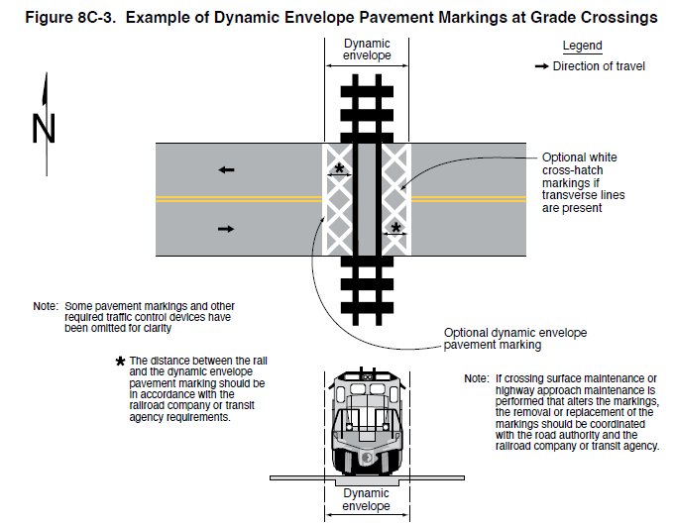
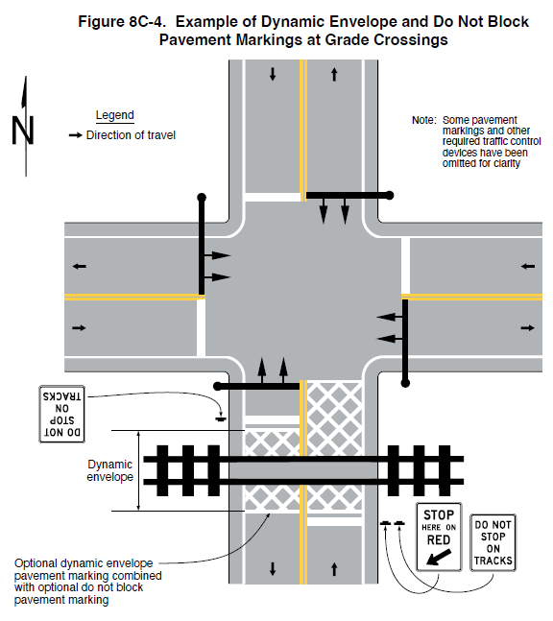
Section 8C.06 Dynamic Envelope and Do Not Block Pavement Markings
Revised Standard allows range of 4 to 24 inches in width
Adds Option: May use white cross-hatching lines to supplement
Figure 8C-3. Example of Dynamic Envelope Pavement Markings at Grade Crossing
Figure 8C-4. Example of Dynamic Envelope and Do Not Block
Pavement Markings at Grade Crossing
Dynamic envelope
Legend
Direction of travel
Note:
Legend
Some pavement markings and other required traffic control devices have been omitted for clarity.
Optional white cross-hatch markings if transverse lines are present
Direction of travel
Note:
Some pavement markings and other required traffic control devices have been omitted for clarity.
Optional dynamic envelope
pavement marking
The distance between the rail
and the dynamic envelope pavement marking should be
in accordance with the
railroad company or transit
agency requirements
Dynamic envelope
Note:
If crossing surface maintenance or highway approach maintenance is performed that alters the markings, the removal or replacement of the markings should be coordinated
with the road authority and the railroad company or transit agency.
Optional dynamic envelope pavement marking combined with optional do not block pavement marking
Dynamic envelope
Notes:
A Standard is revised to allow the pavement markings for a dynamic envelope to be between 4 inches and 24 inches in width.
To discourage vehicles from stopping on the tracks, an Option is added to allow white cross-hatching lines to be placed on the highway pavement within the dynamic envelope as a supplement to, but not as a substitute for, the solid white lines. White cross-hatching lines may also be placed on the pavement to mark areas adjacent to the dynamic envelope where vehicles are not intended to stop or stand.

Slide 37
Chapter 8D
Flashing-Light Signals, Automatic Gates, and Traffic Control Signals

Slide 38
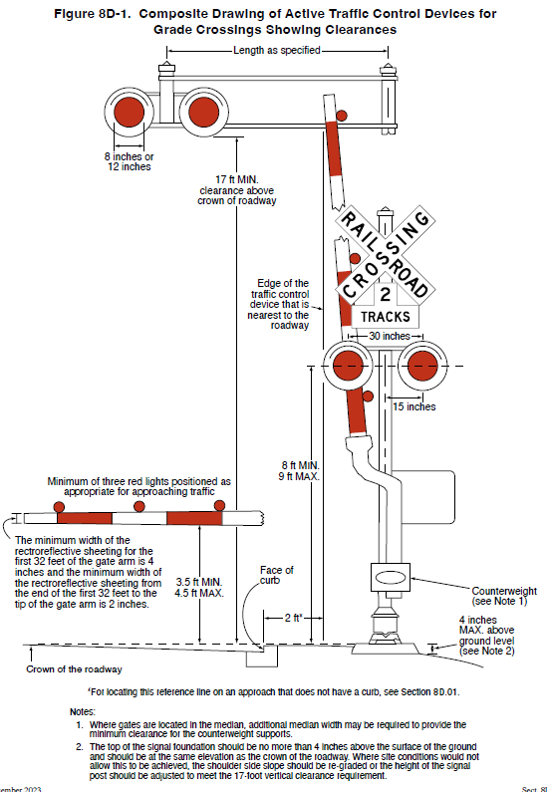
Section 8D.02 Flashing-Light Signals
Figure 8D-1. Composite Drawing of Active Traffic Control Devices for Grade Crossings Showing Clearances
Number of Tracks plaque should be as low as practicable above flashing-light signal backgrounds
One pair of flashing lights should be provided per approach lane of the roadway
Consider additional flashing-light signals if storage is lacking or to provide supplemental warning to pedestrians
Length as specified
8 inches or 12 inches
17 ft MIN.
clearance above
crown of the roadway
Edge of the traffic control device that is nearest to the roadway
30 inches
15 inches
Minimum of three red lights positioned as appropriate for approaching traffic
8 ft MIN.
9 ft MAX.
The minimum width of the retroreflective sheeting for the first 32 feet of the gate arm is 4 inches and the minimum width of the retroreflective sheeting from the end of the first 32 feet to the tip of the gate arm is 2 inches.
3.5 ft MIN.
4.5 ft MAX.
Face of curb
Counterweight
(see Note 1)
2 ft *
4 inches
MAX. above
ground level
(see Note 2)
Crown of the roadway
For locating this reference line on an approach that does not have a curb, see Section 8D.01.
Notes:
1. Where gates are located in the median, additional median width may be required to provide the minimum clearance for the counterweight supports.
2. The top of the signal foundation should be no more than 4 inches above the surface of the ground and should be at the same elevation as the crown of the roadway. Where site conditions would not allow this to be achieved, the shoulder side slope should be re-graded or the height of the signal post should be adjusted to meet the 17-foot vertical clearance requirement.
Notes:
Several new Guidance statements are added regarding the use of flashing-light signals. New Guidance recommends that the bottom of the Number of Tracks plaque (when used) should be located as low as practicable above the flashing-light signal backgrounds. The Crossbuck sign should be located just above the Number of Tracks plaque or, if no plaque is present, the bottom of the Crossbuck sign should be located as low as practicable above the flashing-light backgrounds.
Support is added which states that additional information regarding sizes and clearances of components used on flashing-light signals can be found in Part 3 of the “2023 AREMA Communications and Signals Manual” published by the American Railway Engineering and Maintenance-of-Way Association.
New Guidance recommends that if flashing-light signals are used, at least one pair of flashing lights should be provided for each approach lane of the roadway. The center-to-center distance between the two red lights in a flashing-light unit should be approximately 30 inches. The mounting height of the flashing-light units, measured from the center of the flashing-light unit housing to the elevation of the crown of the roadway, should be between 8 feet and 9 feet. The top of the support pole foundation should be no more than 4 inches above the surface of the ground and should be at the same elevation as the crown of the roadway.
New Guidance recommends that where the storage distance for vehicles approaching a grade crossing is less than a design vehicle length, the Diagnostic Team should consider providing additional flashing-light signals aligned toward the movement turning toward the grade crossing. The Diagnostic Team should consider the use of additional flashing-light signals to provide supplemental warning to pedestrians, especially on one-way streets and divided highways.

Slide 39
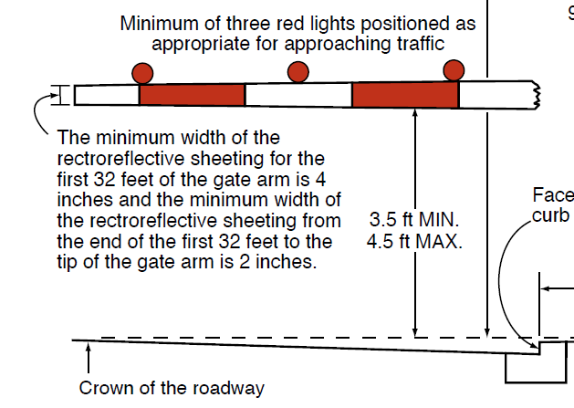
Section 8D.03 Automatic Gates
Width of retroreflective sheeting shall be:
  At least 4 inches for the first 32 ft of gate arm length
  At least 2 inches beyond 32 ft to tip of gate arm
Gate arm lights shall flash alternately in unison with flashing-light signals
Gate arm should be 3.5 ft to 4.5 ft above roadway crown when in down position
Minimum of three red lights positioned as appropriate for approaching traffic
The minimum width of the retroreflective sheeting for the first 32 feet of the gate arm is 4 inches and the minimum width of the retroreflective sheeting from the end of the first 32 feet to the tip of the gate arm is 2 inches.
Face curb
3.5 ft MIN.
4.5 ft MAX.
Crown of the roadway
Notes:
A new Standard requires that the width (which becomes the height of the retroreflective sheeting when the automatic gate is in the down position) of the retroreflective sheeting on the front of the gate arm shall be at least 4 inches for the first 32 feet of gate arm length measured from the center of the gate mast. The front of the gate arm beyond 32 feet to the tip of the gate shall have retroreflective sheeting at least 2 inches in width. This change was made to provide adequate visibility and to address tapered gate arms that are longer than 32 feet in length.
A Standard is revised to require that when activated, the gate arm light nearest the tip shall be illuminated continuously and the other gate arm lights shall flash alternately in unison with the flashing-light signals such that the left-most flashing gate arm light(s) flashes simultaneously with the left-hand light of the flashing-light signals and the right-most flashing gate arm light(s) flashes simultaneously with the right-hand light of the flashing-light signals.
New Guidance recommends that the height of the gate arm when it is in the down position should be between 3.5 feet and 4.5 feet above the crown of the roadway. This dimension was previously shown in a figure but was not included in the MUTCD text. When the gate arm is in the down position, no portion of the counterweight should extend into the traveled way, sidewalk, or pathway.

Slide 40
Section 8D.04 Use of Active Traffic Control Systems at LRT Grade Crossings
Adds Standards:
  If LRT speeds exceed 25 mph, an active traffic control system is required
  If LRT speeds exceed 40 mph, an active traffic control system with automatic gates is required
Adds Guidance:
  If LRT speeds are 25 mph or less, an active traffic control system should be used unless the Diagnostic Team determines otherwise
  If LRT speeds exceed 20 mph at highway-LRT grade crossing at a non-intersection location, traffic control signals should not be used in lieu of flashing-light signals
Notes:
New Standards are added for LRT Grade Crossings based on the operating speeds of the LRT. At highway-LRT grade crossings where LRT speeds exceed 25 mph, active traffic control systems shall be used. At highway-LRT grade crossings where LRT speeds exceed 40 mph, the active traffic control system shall include automatic gates. These changes were made to improve safety at highway-LRT grade crossings.
New Guidance statements are added for two other scenarios:
If LRT speeds are 25 mph or less an active traffic control system should be used unless the diagnostic team determines that the use of Crossbuck Assemblies, STOP signs alone, or YIELD signs alone would be adequate.
Where the highway-LRT grade crossing is at a location other than an intersection and LRT speeds exceed 20 mph, traffic control signals should not be used in lieu of flashing-light signals.

Slide 41
Section 8D.05 Exit Gate and Four-Quadrant Gate Systems
Adds Support clarifying the difference between an Exit Gate system and a Four-Quadrant Gate system
Adds Standard: Exit gates to be timed to allow a design vehicle to clear the tracks
Adds Guidance: Exit gates should be independently controlled for each direction of roadway traffic
Notes:
New Support is added to clarify the difference between an Exit Gate System and a Four-Quadrant Gate System.
A new Standard requires that if an Exit Gate system is present, the queue exit gate clearance time shall be long enough to permit the exit gate arm to lower after a design vehicle of maximum length is clear of the minimum track clearance distance. This allows time for a design vehicle to clear the tracks and not become entrapped between the gates on the tracks while a train is approaching.
New Guidance recommends that exit gates should be independently controlled for each direction of roadway traffic. This aligns with industry practice.

Slide 42
Section 8D.08 Use of Traffic Control Signals at Grade Crossings
Revises Option to include a specific maximum train speed of
10 mph or less to clarify where traffic control signals may be used instead of flashing-light signals to control road users at a highway-rail grade crossing
Adds Support statement to reference Sections 8D.04 and 8D.14 for information on use of traffic control signals at highway-LRT grade crossings
Notes:
An Option is revised to include a specific maximum train speed of 10 MPH or less to clarify where traffic control signals may be used instead of flashing-light signals to control road users. This typically may occur at industrial highway-rail grade crossings and other places where train movements are very slow, such as in switching operations where the maximum speed of trains is 10 mph or less. This change is made to improve clarity and be consistent with FRA track classifications.
A Support statement is added to point practitioners to Sections 8D.04 and 8D.14 for information on the use of traffic control signals at highway-LRT grade crossings.

Slide 43
Section 8D.09 Preemption of Highway Traffic Signals at or Near Grade Crossings
Extensive new material on preemption
Includes many changes in response to the National Transportation Safety Board’s investigation into the fatal train/school bus crash in Fox River Grove, IL
Compliance date: 10 years (January 18, 2034):
  Assessment and determination of appropriate treatment to achieve compliance with MUTCD provisions on preemption, movement prohibition, pre-signals, and queue cutter signals​
  Agencies have flexibility to schedule upgrades and improvements
Notes:
Extensive new material has been added to the 11th Edition regarding traffic signal preemption at grade crossings. This new material is intended to provide consistency with the changes in the industry resulting from the National Transportation Safety Board’s investigation into the causes of the fatal train/school bus crash in Fox River Grove, Illinois.
Many provisions are added to prevent vehicles from being trapped on the tracks due to preemption and to account for situations not covered in the previous edition of the MUTCD.
A 10-year compliance date was established due to the critical safety issues when traffic control signals and pedestrian hybrid beacons are located at or near highway-rail and highway-light rail transit grade crossings. It is important that assessments be made of such crossings to determine what treatments are needed at each location to achieve compliance with the various MUTCD requirements in Sections 8D.09 through 8D.12 regarding preemption, movement prohibition, pre-signals, and queue cutter signals.
A 10-year compliance date has been established for agencies to make these assessments and determination of appropriate treatments to achieve compliance. The date does not apply to the implementation of the needed treatments. Agencies are granted flexibility to determine the schedule for installation of improvements based on availability of funding and other safety priorities through the systematic replacement and upgrade of traffic control devices as currently prescribed in the MUTCD for other traffic control devices.

Slide 44
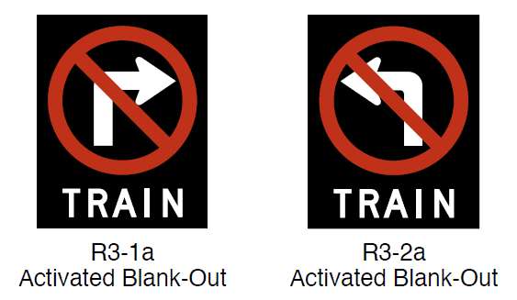
Section 8D.10 Movements Prohibited During Preemption
Adds Guidance to prohibit movements toward a grade crossing during preemption:
  Should prohibit all protected/permissive and protected-only turn movements with steady red arrow indications
  Should prohibit through movements with steady circular red indications
  Should prohibit permissive-only turning movements with blank-out turn prohibition signs
R3-1a
Activated Blank-Out
R3-2a
Activated Blank-Out
Notes:
Section 8D.10 adds new Guidance to prohibit movements toward a grade crossing during preemption. During preemption, protected/permissive and protected-only turn movements should be prohibited with steady red arrow signal indications. Steady circular red signal indications should be shown to through movements. Blank-out turn prohibition signs R3-1a and R3-2a should be used to prohibit permissive-only turning movements towards the grade crossing. The word TRAIN is added to the sign based on a recommendation from the National Transportation Safety Board. The recommendation is intended to address the issue of turning vehicles stopped in a through lane when the signal is green.

Slide 45
Sections 8D.11, 8D.12, and 8D.13
Section 8D.11 includes extensive new material on the use of
pre-signals
Section 8D.12 is a new section that addresses queue cutter signals at or near grade crossings
Section 8D.13 is a new Section that addresses Warning Beacons or LED-Enhanced Warning Signs at grade crossings
Notes:
Section 8D.11 includes extensive new material on the use of Pre-signals. Pre-signals are generally used where the grade crossing is located less than 200 feet from a downstream signalized intersection.
Section 8D.12 is a new section that addresses Queue Cutter Signals at or near grade crossings. A queue cutter signal is a traffic control signal that controls one direction of traffic at a grade crossing to minimize the possibility of vehicles stopping within the minimum track clearance distance. A queue cutter signal has a similar purpose as a pre-signal, but the difference is that a queue cutter signal is independent from the downstream signalized intersection, whereas a pre-signal is part of the downstream signal.
Section 8D.13 is a new section that addresses Warning Beacons or LED-Enhanced Warning Signs at grade crossings. Warning Beacons or LEDs within the legend, symbol, or border of the sign are optional devices that may be used to supplement warning signs installed at or on an approach to a grade crossing if additional emphasis is desired for the warning sign. The Warning Beacon or LED-enhanced sign may operate continuously or be activated upon the approach or presence of rail traffic.

Slide 46
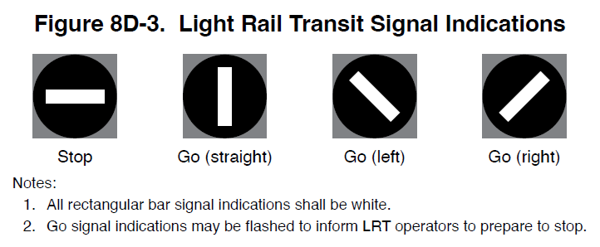
Section 8D.15 Use of LRT Signals for Control of LRT Vehicles at Highway-LRT Grade Crossings
Standard clarified: Color of LRT signal indications shall be white
Adds Option to allow clustered LRT signal sections or multiple LRT indications displayed from a single housing
Figure 8D-3. Light Rail Transit Signal Indications
Stop
Go (straight)
Go (left)
Go (right)
Notes:
1. All rectangular bar signals indications shall be white.
2. Go signal indications may be flashed to inform LRT operators to prepare to stop.
Notes:
A new Standard clarifies that if special LRT signal indications are used, the color of the LRT signal indications shall be white. An Option is added to allow individual LRT signal sections to be displayed to form clustered signal faces, or for multiple LRT signal indications to be displayed using a single housing. FHWA proposes these changes to improve consistency in the use of LRT signal indications.

Slide 47
Chapter 8E
Pathway and Sidewalk Grade Crossings

Slide 48
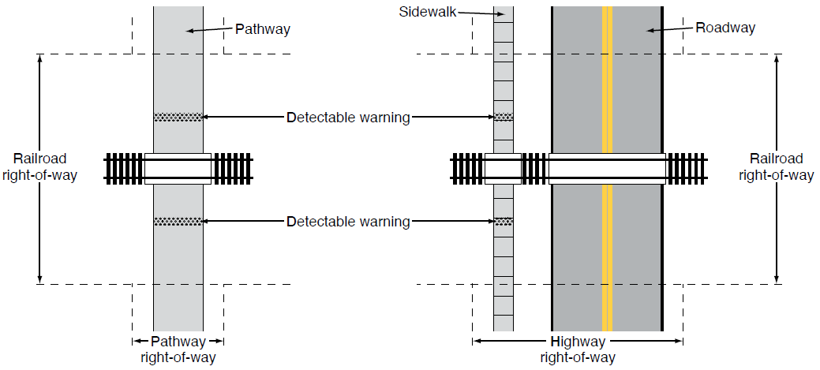
Section 8E.01 Purpose
Adds provisions for sidewalk grade crossings
Expands provisions for pathway grade crossings
Figure 8E-1. Illustration of the Difference between a Pathway Grade Crossing and a Sidewalk Grade Crossing
A – Pathway grade crossing
B – Sidewalk grade crossing
Notes:
A new Chapter 8E has been added to include provisions for both Pathway and Sidewalk grade crossings. Extensive new material has been added to address the safety of pedestrians interacting with trains.
Section 8E.01 explains the difference between pathways and a sidewalks and why they are treated differently when it comes to grade crossing traffic control devices. A pathway is independent from a roadway, such that the traffic control devices for the roadway grade crossing do not exert an influence over or provide adequate warning to pathway users. A sidewalk typically runs parallel to a roadway within the highway right-of-way and is close enough to the edge of the roadway’s traveled way that the traffic control devices for the roadway grade crossing can frequently exert an influence over or provide adequate warning to sidewalk users.

Slide 49
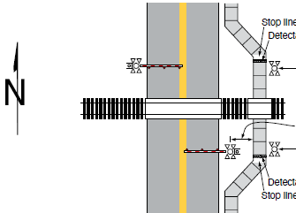
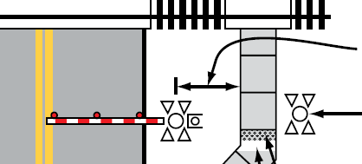
Section 8E.02 Use of Standard Devices, Systems, and Practices
Placing sidewalk outside of area occupied by grade crossing traffic control devices is desirable
Offset distance between edge of pathway and sidewalk to center of roadway warning device
Figure 8E-2. Example of an Active Traffic Control System for a Sidewalk or Pathway Grade Crossing
Stop line (if used)
Detectable warning
Flashing-light signal
a > 25 ft
Flashing-light signal
Close-up
Detectable warning
Stop line (if used)
a > 25 ft
Notes:
The dimension “a” is the distance from the edge of the sidewalk grade crossing to the center of the traffic control warning devices at the grade crossing.
If a ≤ 25 feet, flashing-light signals may be omitted at a pathway or sidewalk grade crossing (see Section 8E.07).
Flashing-light signal
Notes:
A new Support statement in Section 8E.02 explains that when designing new sidewalk grade crossings, placing the sidewalk outside of the area occupied by grade crossing traffic control devices for vehicular traffic is desirable (see Figure 8E-2). This includes making sure that the counterweights and support arms for the automatic gates for vehicular traffic do not obstruct the sidewalk when the gate is fully lowered.
Figure 8E-2 illustrates the offset distance between the edge of the pathway or sidewalk and the warning devices for the roadway grade crossing. If the offset distance is 25 feet or less, the flashing-light signals at an active grade crossing or the crossbuck assembly at a passive grade crossing are deemed sufficient to address the warning needs for both roadway vehicles and sidewalk or pathway users.

Slide 50
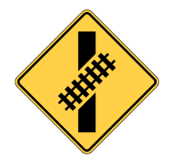

Section 8E.03 Pathway and Sidewalk Grade Crossing Signs and Markings
Adds Guidance: 10-ft overhead clearance for pathways used by equestrians
Adds Standard: 7-ft overhead clearance for sidewalks
Adds Options:
  Skewed Crossing (W10-12) sign
  LOOK (R15-8) sign
W10-12
R15-8
Notes:
Guidance is added recommending that if overhead traffic control devices are placed above pathways that are used by equestrians, the clearance from the bottom of the device to the pathway surface directly under the sign or device should be at least 10 feet.
A new Standard requires that overhead traffic control devices above sidewalks shall have at least 7 feet of clearance.
New Options allow that the Skewed Crossing sign may be used at a skewed pathway or sidewalk grade crossing to warn pathway or sidewalk users that the tracks are not perpendicular to the pathway or sidewalk. The LOOK sign may be used at a pathway or sidewalk grade crossing to inform pathway or sidewalk users to look in both directions prior to crossing the track(s).
New Guidance recommends that if a LOOK sign is used at a pathway or sidewalk grade crossing, it should be mounted on a separate post that is farther from the pathway or sidewalk than the Crossbuck sign or Crossbuck Assembly.

Slide 51
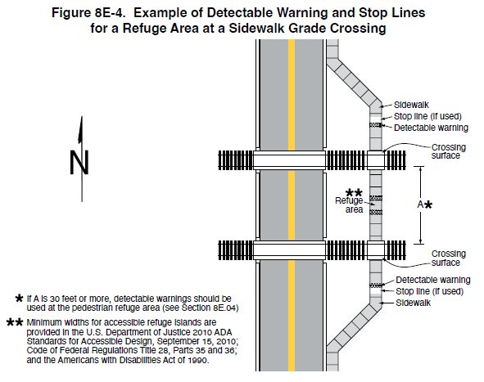
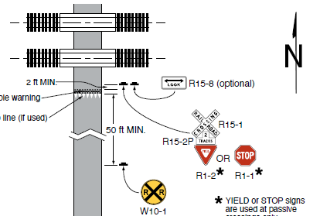
Section 8E.04 Stop Lines, Edge Lines, and Detectable Warnings
Recommends Stop Line if surface capable of retaining marking
Requires detectable warnings
Figure 8E-4. Example of Detectable Warning and Stop Lines for a Refuge Area at a Sidewalk Grade Crossing
Sidewalk
Stop line (if used)
Figure 8E-3. Example of Signing and Markings at a Pathway Grade Crossing
Detectable warning
Crossing surface
Refuge area
A
2 ft MIN.
R15-8 (optional)
Detectable warning
Crossing surface
Yield line or stop line (if used)
R15-1
Detectable warning
50 ft MIN.
If A is 30 feet or more, detectable warning should be used at the pedestrian refuge area (See Section 8E.04)
Stop line (if used)
R15-2P
Sidewalk
Minimum widths for accessible refuge islands are provided in the U.S. Department of Justice 2010 ADA Standards for Accessible Design, September 15, 2010; Code of Federal Regulations Title 28, Parts 35 and 36; and the American with Disability Act of 1990.
R1-2
R1-1
W10-1
YIELD or STOP signs are used at passive crossing only
Notes:
New Guidance recommends that a stop line should be provided at a pathway grade crossing if the surface where the marking is to be applied is capable of retaining the application of the marking.
A new Option allows that a stop line may be provided at a sidewalk grade crossing if the surface where the marking is to be applied is capable of retaining the application of the marking.
A new Standard requires that detectable warnings be used at pathway grade crossings where pedestrian travel is permitted and at sidewalk grade crossings and shall extend across the full width of the pathway or sidewalk. These Standards are restated from previously existing requirements in Part 3.

Slide 52
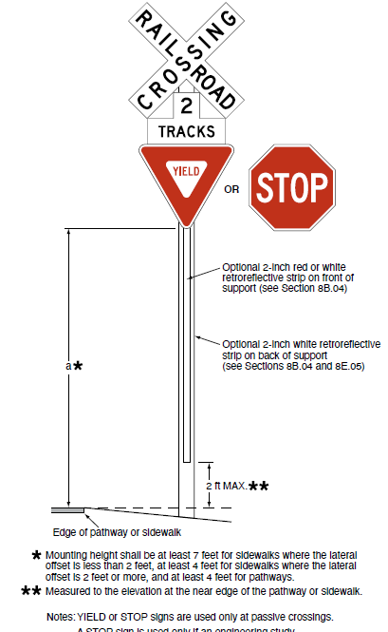
Section 8E.05 Passive Traffic Control Devices – Crossbuck Assemblies
Figure 8E.5. Example of a Crossbuck Assembly at a Pathway or Sidewalk Grade Crossing
Revises Standard: Crossbuck Assembly for pathway or sidewalk required when more than 25 ft from grade crossing traffic control warning device
Revises Option: Retroreflective strip not required on back of support at pathway or sidewalk grade crossing
Adds Standard: Minimum height and lateral offsets
OR
Optional 2-inch red or white retroreflective strip on front of support (see Section 8B.04)
Optional 2-inch white retroreflective strip on back of support (see Sections 8B.04 and 8E.05)
a
2 ft MAX.
Mounting height shall be at least 7 feet for sidewalks where the lateral offset is less than 2 feet, at least 4 feet for sidewalks where the lateral offset is 2 feet or more, and at least 4 feet for pathways.
Measured to the elevation at the near edge of the pathway or sidewalk.
Notes: YIELD or STOP signs are used only at passive crossings.
A STOP sign is used only if an engineering study
determines that it is appropriate for that particular approach.
Notes:
A revised Standard requires that where the nearest edge of a passive pathway or sidewalk grade crossing is located more than 25 feet from the center of the nearest traffic control warning device at the grade crossing, a Crossbuck Assembly shall be installed on each approach to the pathway or sidewalk grade crossing.
An Option is revised to state that the retroreflective strip on the back of the support may be omitted on the Crossbuck support at a pathway or sidewalk grade crossing.
A new Standard requires the minimum height, measured vertically from the bottom of the YIELD or STOP sign to the elevation of the near edge of the pathway or sidewalk, of Crossbuck Assemblies installed on pathways or sidewalks to be 4 feet where the lateral offset to the nearest edge of the sign is 2 feet or more and 7 feet where the lateral offset to the nearest edge of the sign is less than 2 feet. The minimum lateral offset, measured horizontally from the nearest edge of the pathway or sidewalk to the nearest edge of the Crossbuck Assembly signs, shall be 0 feet for sidewalks and 2 feet for pathways.

Slide 53
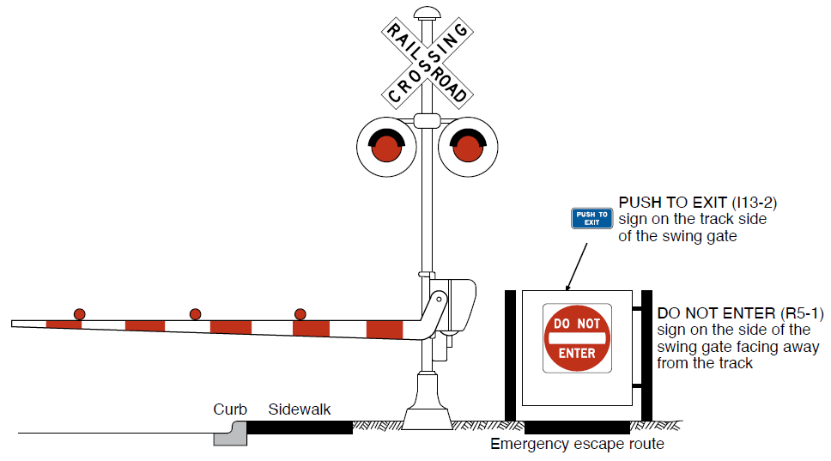
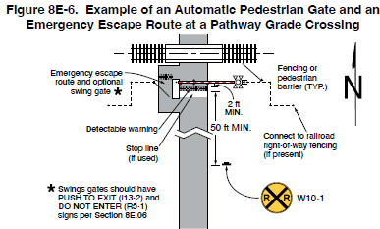

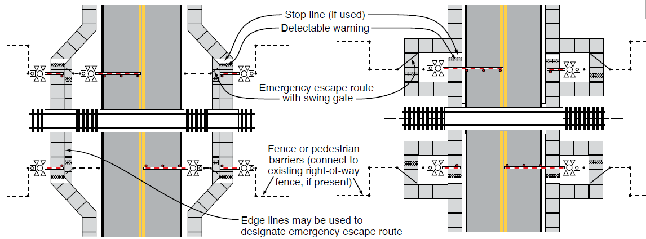
Section 8E.06 Channelizing Devices Used with Sidewalk and Pathway Traffic Control Devices
Figure 8E-10. Example of Traffic Control Devices
for an Optional Swing Gate
Traffic control devices associated with pedestrian channelizing devices
Swing gates, fencing, and pedestrian barriers
Figure 8E-6. Example of an Automatic Pedestrian Gate and an Emergency Escape Route at a Pathway Grade Crossing
Figure 8E-9. Example of Active Traffic Control Systems with Automatic Pedestrian Gates and Swing Gates at a Sidewalk Grade Crossing
Emergency escape route and optional swing gate
A – Sidewalks on outside of vehicular gates
B – Sidewalks on inside of vehicular gates
2 ft. MIN.
Detectable warning
50 ft. MIN.
Stop line (if used)
Connect to railroad right-of-way fencing (if present)
Swing gates should have PUSH TO EXIT (I13-2) and DO NOT ENTER (R5-1) signs per Section 8E.06
W10-1
Notes:
This revised Section includes provisions for pedestrian channelizing devices used with sidewalk and pathway traffic control devices. These changes were made to provide agencies with more information for the consistent and safe applications of these measures. Provisions are included for the traffic control devices associated with pedestrian channelizing features such as swing gates, fencing, and pedestrian barriers. Support statements and figures are intended to illustrate how safety can be enhanced by guiding pedestrian movements.

Slide 54
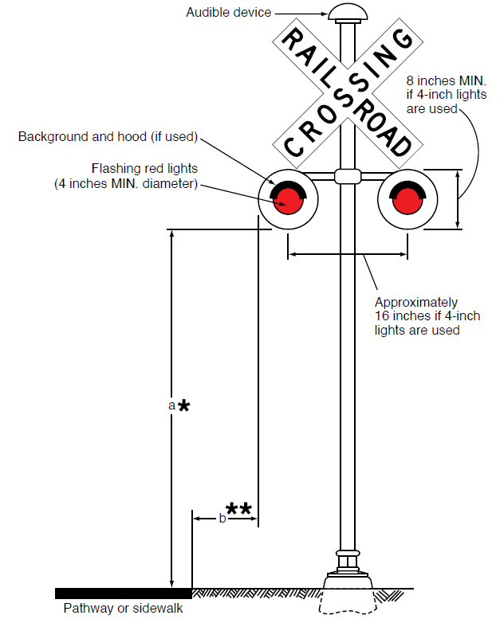
Section 8E.07 Active Traffic Control Systems
Active traffic control system required at LRT pathway/sidewalk grade crossings where LRT operating speeds exceed 25 mph
Active traffic control system, including automatic gates, required where LRT operating speeds on a semi-exclusive alignment exceed 40 mph
May omit audible warning within 25 ft of another already equipped device
Pedestrian refuge area or island
Figure 8E-7. Example of a Flashing-Light Signal Assembly at a Pathway or Sidewalk Grade Crossing
Minimum mounting height adjacent to sidewalks and pathways should be 4 feet. Minimum mounting height above a sidewalk shall be 7 feet. Minimum mounting height above a pathway should be 8 feet.
Minimum lateral offset for pathways should be 2 feet. Sidewalks do not have a minimum lateral offset.
Notes:
A new Standard requires that at pathway-LRT and sidewalk-LRT grade crossings where LRT operating speeds on a semi-exclusive alignment exceed 25 mph, active traffic control systems shall be used. At pathway-LRT and sidewalk-LRT grade crossings where LRT operating speeds on a semi-exclusive alignment exceed 40 mph, active traffic control systems, including automatic gates, shall be used.
If used at a pathway or sidewalk grade crossing, an active traffic control system shall include flashing-light signals on each approach to the crossing.
An Option is added that flashing-light signals, bells, and other audible warning devices may be omitted at pathway or sidewalk grade crossings that are located within 25 feet of an active warning device at a grade crossing that is equipped with those devices.
New Guidance recommends that if there is space, a pedestrian refuge area or island should be provided between the tracks and the roadway to permit pedestrians to stand clear of the tracks while waiting to cross the roadway and to stand clear of the roadway while waiting to cross the tracks.

Slide 55
New Section 8E.08 Active Traffic Control Devices – Signals
Figure 8E-7. Example of a Flashing-Light Signal Assembly at a Pathway or Sidewalk Grade Crossing
Adds Standard prohibiting pedestrian signal heads at pathway and sidewalk grade crossings
  Option allows use of pedestrian signal heads at pathway and sidewalk grade crossings where movement of LRT vehicles is controlled by a traffic control signal
Adds Standards for flashing-light signals to provide uniformity
Adds Guidance for use of automatic pedestrian gates
Minimum mounting height adjacent to sidewalks and pathways should be 4 feet. Minimum mounting height above a sidewalk shall be 7 feet. Minimum mounting height above a pathway should be 8 feet.
Minimum lateral offset for pathways should be 2 feet. Sidewalks do not have a minimum lateral offset.
Notes:
A new Standard prohibits the use of pedestrian signal heads at pathway and sidewalk grade crossings. This change is made to improve pedestrian safety and prevent user confusion at grade crossings through the uniform active traffic control device of horizontally-aligned, alternately-flashing red lights for all grade crossings where rail traffic does not stop.
A new Option allows the use of pedestrian signal heads at pathway and sidewalk grade crossings with LRT controlled by a traffic control signal.
New Standards are added for flashing-light signals at pathway and sidewalk grade crossings. This change is made to provide uniformity in the design and operation of flashing-light signals.
New Guidance recommends that if a Diagnostic Team finds that a flashing-light signal with a Crossbuck sign and an audible device is still not resulting in appropriate pedestrian behavior, consideration should be given to also installing an automatic pedestrian gate.

Slide 56
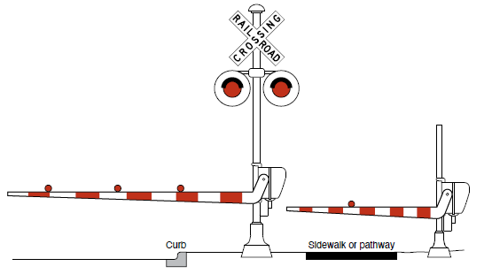
Section 8E.09 Active Traffic Control Devices – Automatic Pedestrian Gates (1 of 2)
Adds Standard requiring a system of automatic pedestrian gates, swing gates, and fencing for pathway and sidewalk grade crossings where trains are permitted to travel 80 mph and higher
Adds Guidance recommending emergency escape route
At least one red light required
Figure 8E-11. Example of a Separate Automatic Pedestrian Gate
Curb
Sidewalk or pathway
Notes:
A new Standard requires a system of automatic pedestrian gates, swing gates and fencing for pathway and sidewalk grade crossings where trains are permitted to travel 80 miles per hour and higher. This change is made for pedestrian safety at grade crossings where higher speed trains operate.
New Guidance recommends that an emergency escape route should be provided when automatic pedestrian gates are used.
A new Standard requires at least one continuously-illuminated red light on the automatic pedestrian gate arm. If there is more than one red light, they shall be installed in pairs and must be flashed in an alternating pattern.

Slide 57
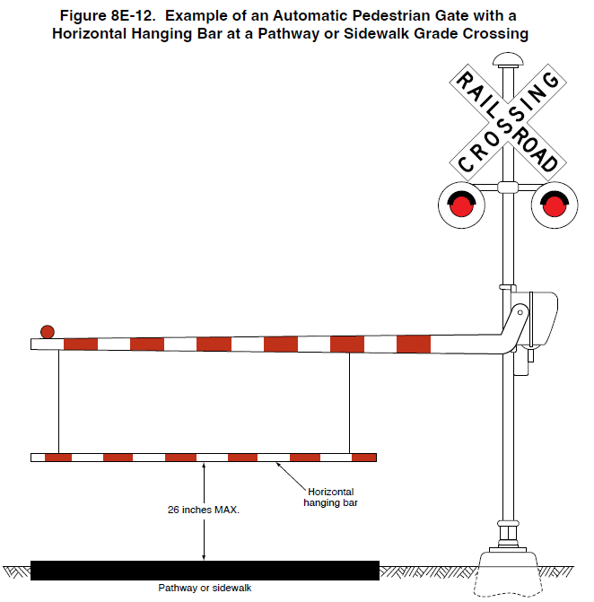
Section 8E.09 Active Traffic Control Devices – Automatic Pedestrian Gates (2 of 2)
Adds Option allowing horizontal hanging bar mounted below automatic pedestrian gate arm
  Recommends horizontal hanging bar be maximum height of 26 inches above the pathway or sidewalk when gate is in the down position
Figure 8E-12. Example of an Automatic Pedestrian Gate with a Horizontal Hanging Bar at a Pathway or Sidewalk Grade Crossing
26 inches MAX.
Horizontal hanging bar
Pathway or sidewalk
Notes:
A new Option allows a horizontal hanging bar to be mounted below the automatic pedestrian gate arm to inform pedestrians with vision disabilities that the automatic pedestrian gate is in the down position and to reduce the likelihood that pedestrians will violate a lowered crossing gate.
New Guidance recommends a maximum height of 26 inches between the horizontal hanging bar and the surface of the pathway or sidewalk when the gate is in the down position.

Slide 58

FHWA’s National
Traffic Control Devices Program
for more information:
mutcd.fhwa.dot.gov
e–Subscribe Service
Official Rulings Database
Standard Highway Signs
Frequently Asked Questions
MUTCD News Feed
Notes:
This concludes this module. Additional modules on the MUTCD 11th Edition are available at the MUTCD Web Site at http://mutcd.fhwa.dot.gov/.
Almost anything related to the MUTCD that you need is at the official MUTCD Web site.
If you haven’t yet signed up for our e-Subscribe service, please take a moment to do so. We’ll send out a bulletin whenever new information is available so you can keep up-to-date. As subscribers, you’ll also hear about future Webinar and other opportunities first.

