Slide 1


Manual on Uniform Traffic Control Devices for Streets and Highways
An Overview of Changes in the 11th Edition
As published in the December 2023
Notice of Final Rule
Prepared by the
Federal Highway Administration’s
Office of Operations
Traffic Control Devices Program
Notes:
Welcome to the Manual on Uniform Traffic Control Devices for Streets and Highways—the MUTCD 11th Edition.
This series provides an overview of the significant changes in the MUTCD and was prepared by the FHWA’s Office of Operations Traffic Control Devices team. Each module address the changes in a specific area of the MUTCD.
Additional modules on the MUTCD 11th Edition are available at the MUTCD Web Site at http://mutcd.fhwa.dot.gov/. The series includes the following modules:
Part 1
Part 2:
Chapter 2A
Chapter 2B
Chapter 2C
Chapter 2D
Chapter 2E
Chapter 2F
Chapter 2G
Chapters 2H and 2I
Chapters 2J and 2K
Chapter 2L
Chapters 2M and 2N
Part 3
Part 4
Part 5
Part 6
Part 7
Part 8
Part 9

Slide 2
Disclaimers
Except for the statutes and regulations cited, the contents of this presentation do not have the force and effect of law and are not meant to bind the States or the public in any way. This presentation is intended only to provide information regarding existing requirements under the law or agency policies.
The Federal Highway Administration (FHWA) is the source of all images in this presentation unless otherwise indicated.
Notes:
(Disclaimer) Except for the statutes and regulations cited, the contents of this presentation do not have the force and effect of law and are not meant to bind the States or the public in any way. This presentation is intended only to provide information regarding existing requirements under the law or agency policies.
FHWA is the source of all images in this presentation unless otherwise indicated.

Slide 3
Overview of Changes in Part 9
Manual on
Uniform Traffic Control Devices
9
for Streets and Highways
An Overview of Changes in Part 9
As published in the December 2023
Notice of Final Rule
Notes:
The remainder of this presentation will focus on the significant changes to Part 9 of the MUTCD.

Slide 4
Chapter 9A
General

Slide 5
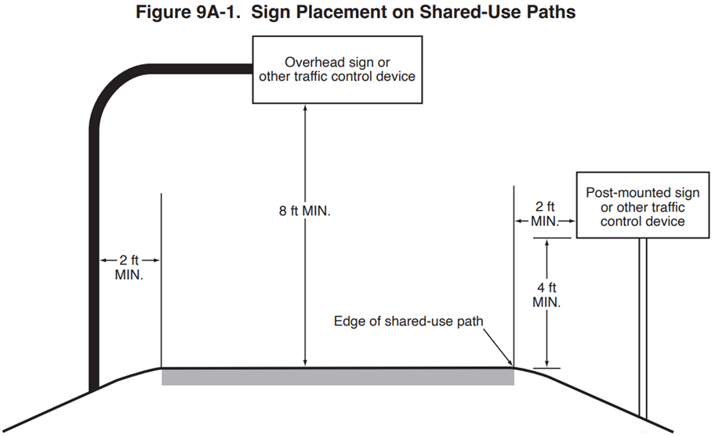
Section 9A.02 Standardization of Application for Signing
Changes Standard to Guidance for placement of sign supports to accommodate field conditions
Adds Option allowing 18 in. × 18 in. warning signs that are only applicable to bicyclists and pedestrians
Figure 9A-1. Sign Placement on Shared-Use Paths
Notes:
Section 9A.02 includes Standard, Guidance, and Option statements from previously existing Sections.
A Standard is changed to Guidance to provide agencies the discretion in placement of sign supports to accommodate field conditions that may require modifications during design or sign installation.
An Option is also added allowing 18″ x 18″ warning signs that are only applicable to bicyclists and pedestrians. This change allows agencies to use smaller signs where appropriate.

Slide 6
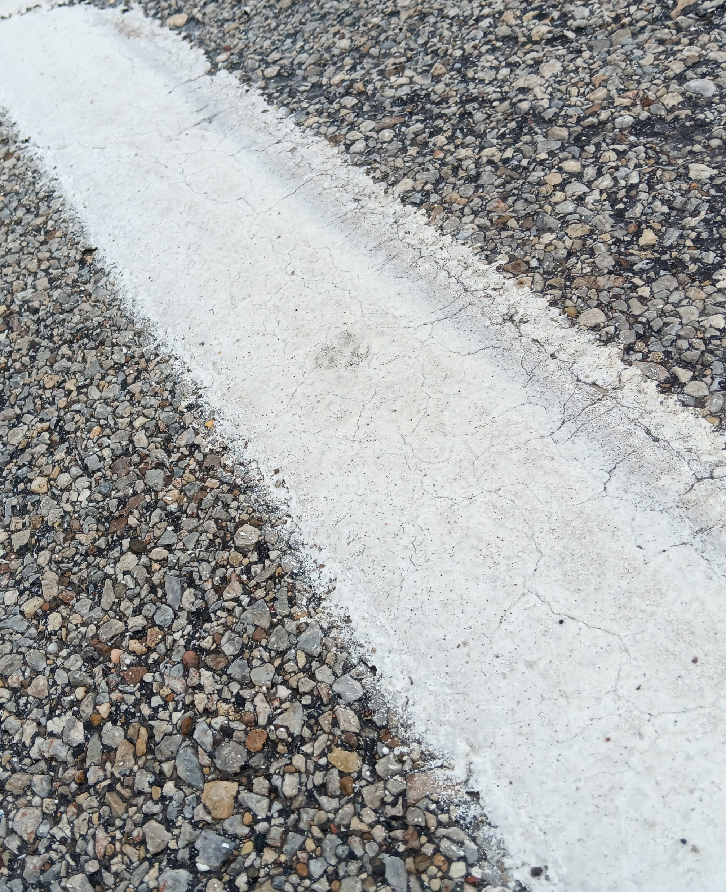
Section 9A.03 Standardization of Application for Markings (1 of 2)
Requires pavement markings on bicycle facilities to be retroreflective or adequately visible at night or in low-light conditions under provided lighting
Discourages use of raised pavement markers with bicycle lanes or shared-use paths
Notes:
Previously existing Sections are relocated and consolidated into Section 9A.03.
A Standard is revised to require that pavement markings on bicycle facilities that must be visible at night, or in low-light conditions, be retroreflective unless the pavement markings are adequately visible under provided lighting. This change clarifies when retroreflectivity is required. Retroreflectivity is generally required for white markings and optional for green pavement color (3H.02).
New Guidance paragraphs are added to discourage the use of raised pavement markers with bicycle lanes or shared-use paths. It also recommends that if raised pavement markers are used around bicycle facilities that they are not immediately adjacent to the travel path of bicycles. This Guidance is added because raised pavement markers create collision potential for bicyclists by placing fixed objects immediately adjacent to the travel path of the bicyclist.

Slide 7
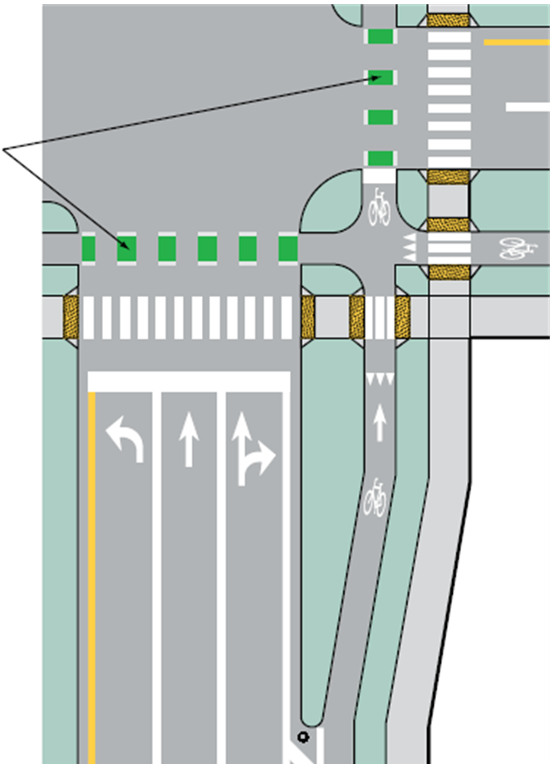

Section 9A.03 Standardization of Application for Markings (2 of 2)
Includes green-colored pavement as an Option to enhance conspicuity:
  Allowed as an Option in Section 3H.06 (Support in 9A.03)
Supplements other markings for bicycle facilities
Includes Option that they may be retroreflective
Green-colored
pavement (optional)
Notes:
Green-colored pavement is included in the MUTCD 11TH Edition. It is allowed as an Option, and Section 3H.06 contains information on green-colored pavement for bicycle facilities.
Green-colored pavement, if used, is only allowed for bicycle lanes, bicycle lane extensions, two-stage bicycle turn boxes, intersection bicycle boxes, and as a background for the bicycle detector symbol.
Green-colored pavement shall not be used as a background for shared-lane markings or used instead of required markings for bicycle facilities. It shall also not be used with electric-vehicle parking areas or pedestrian crosswalks.
Green-colored pavement supplements white and yellow bicycle facility markings, and green-colored pavement may be either retroreflective or non-retroreflective.

Slide 8
Signs

Slide 9
Chapter 9B
Regulatory Signs

Slide 10
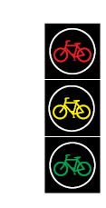
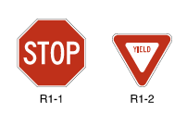
Section 9B.01 STOP and YIELD Signs (R1-1 and R1-2)
Adds Standard prohibiting a STOP or a YIELD sign from being installed in conjunction with a bicycle signal face
X
X
R
Y
G
R1-1
R1-2
G = green; R = red; Y = yellow.
Notes:
In Section 9B.01, a Standard is added that prohibits a STOP sign or a YIELD sign from being installed in conjunction with a bicycle signal face. This restriction will provide uniformity in the application of signals and to avoid conflicts between bicycle signal indications and signs.

Slide 11
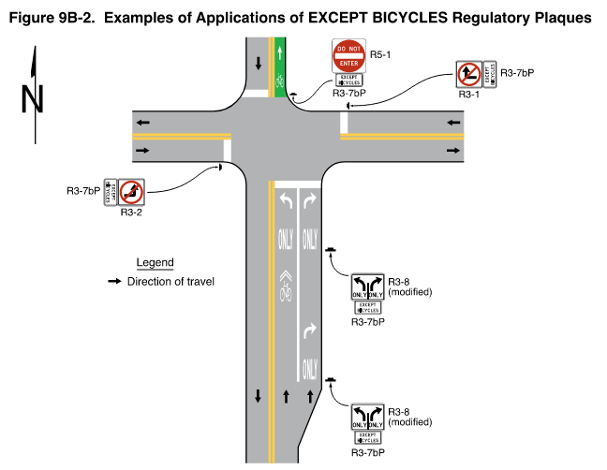
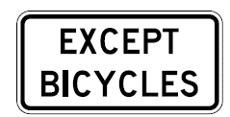
Section 9B.02 EXCEPT BICYCLES Regulatory Plaque (R3-7bP)
Prohibits R3-7bP regulatory plaque from being used to exempt bicyclists from the legal requirements of STOP, YIELD, or traffic signal indications
Requires regulatory plaque to be placed below the regulatory sign that it supplements
Adds Figure 9B-2
Figure 9B-2. Examples of Applications of EXCEPT BICYCLES Regulatory Plaques
R3-7bP
Notes:
Section 9B.02 is a new section that describes the use of the EXCEPT BICYCLES plaque for circumstances where bicycles are exempt from regulatory restrictions that apply to other traffic.
New Standard paragraphs are added to prevent EXCEPT BICYCLES plaques from conflicting with STOP signs or YIELD signs and requires the plaques to be placed below the regulatory sign that it supplements. These plaques shall not be used to exempt bicyclists from the legal requirements of a STOP or YIELD sign, YIELD HERE FOR PEDS or STOP HERE FOR PEDS signs, or a traffic signal indication.
A new Figure is also added to show examples of how the EXCEPT BICYCLES plaque can be applied.

Slide 12
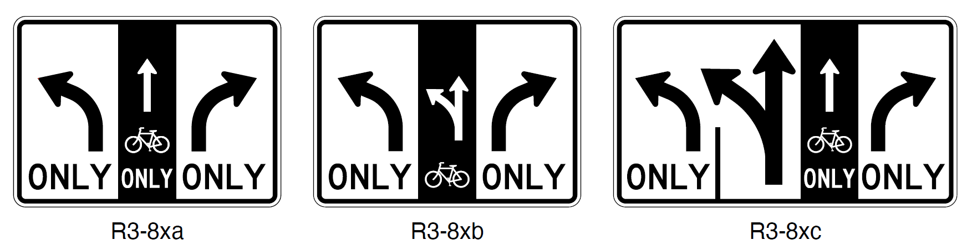
Section 9B.03 Advance Intersection Lane Control Signs (R3-8 Series) for Bicycle Lanes
Adds new Section with Standard, Guidance, Option, and Support for accommodating bicycle lanes on the R3-8 series signs
R3-8xa
R3-8xb
R3-8xc
Notes:
A new section 9B.03 is added to provide Standard, Guidance, Option, and Support statements for accommodating bicycle lanes on the R3–8 series of signing where determined to be appropriate.

Slide 13

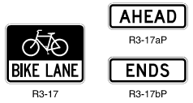
Section 9B.04 Bicycle Lane Signs and Plaques
(R3-17, R3-5hP, R3-17aP, and R3-17bP)
Signs and plaques are optional
If used, signs and plaques shall only be used with marked bicycle lanes
If used, signs and plaques should be at beginning and end of the bicycle lane and may be used periodically in between
Plaques may be used to supplement Mandatory Movement Lane Control and Optional Movement Lane Control signs
R3-17aP
R3-5hP
R3-17
R3-17bP
Notes:
In Section 9B.04, a Guidance statement is changed to an Option regarding the placement of Bike Lane signs and plaques periodically along the bicycle lane in order to give agencies the discretion of sign placement when developing a policy for the use of Bike Lane signs.
A new Option allows the use of a BIKE LANE plaque to supplement Mandatory Movement Lane Control signs in places where only a single bicycle movement is permitted from the bicycle lane and to supplement Optional Movement Lane Control signs where two or more movements from a bicycle lane are permitted in order to prevent operational problems.

Slide 14
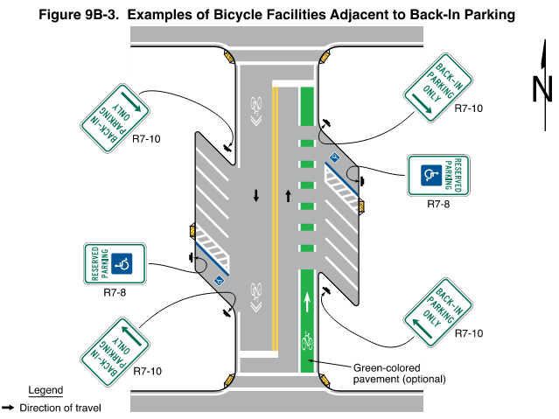
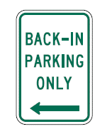
Section 9B.10 Back-In Parking Sign (R7-10)
Provisions for new R7-10 sign
Figure 9B-3. Examples of Bicycle Facilities Adjacent to Back-In Parking
R7-10
Green-colored pavement (optional)
Notes:
Section 9B.10 is a new section that provides Option and Support statements, along with a figure, to address the application of the new Back-In Parking sign. These provisions may be used where back-in angle parking is required for motor vehicles due to the presence of a bicycle lane.

Slide 15
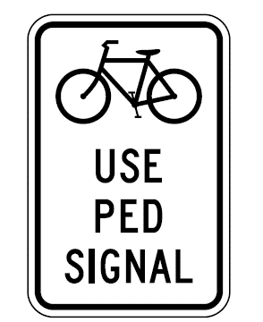
Section 9B.11 Bicycles Use Ped Signal Sign (R9-5)
(1 of 2)
Revises Guidance that if used, this sign should be installed in the vicinity of where bicyclists will be crossing the street
Adds Option to use R10-12b, R10-15, and R10-15a signs for drivers making turns
R9-5
Notes:
New Guidance is added in Section 9B.11 to address situations where bicyclists cross the street under the control of pedestrian signal indications. The new Guidance is intended to increase uniformity in placement location for the Bicycles Use Ped Signal sign.

Slide 16
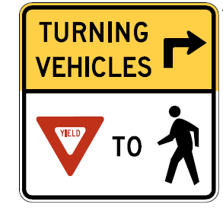
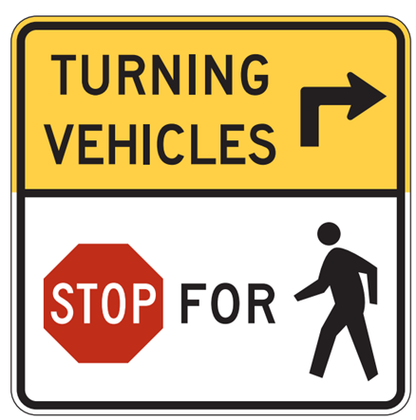
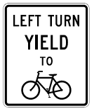
Section 9B.11 Bicycles Use Ped Signal Sign (R9-5)
(2 of 2)
Adds Option to use a Turning Vehicles Yield to Pedestrians
(R10-15), Turning Vehicles Stop for Pedestrians (R10-15a),
or Left Turn Yield to Bicycles (R10-12b) sign
References Section 2B.59
Does not include a R10-15 sign variant with bicycle symbol
R10-15
R10-15a
R10-12b
Notes:
A new Option is added to Section 9B.11 allowing a Turning Vehicles Yield to Pedestrians (R10–15), Turning Vehicles Stop for Pedestrians (R10-15a), or Left Turns Yield to Bicycles (R10–12b) sign to be used to remind drivers making turns to yield to or stop for pedestrians or bicyclists.
The R10-12b LEFT TURN YIELD TO BICYCLES sign is an important addition because road users approaching a signalized intersection with an opposing counter-flow bicycle lane may not expect to yield to oncoming bicycles.
Note that there is currently no R10-15 sign variant with a bicycle symbol in the MUTCD and one should not be used.

Slide 17
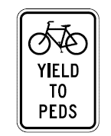
Section 9B.12 Bicycles Yield to Peds Sign (R9-6)
May be used at specific locations where bicyclists must yield to pedestrians
Shall not be used in bicycle corridors to establish programmatic regulation where no specific yielding point exists
Shall not be used with STOP or YIELD signs
R9-6
Notes:
Additional Standard paragraphs are added in Section 9B.12 regarding the application and use of the Bicycles Yield to Peds sign where a bicyclist is required to cross or share a facility used by pedestrians and is required to yield to the pedestrians. The new provisions are intended to give practitioners additional information and promote uniformity in the use of this sign.

Slide 18
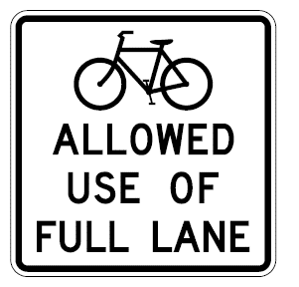
Section 9B.14 Bicycles Allowed Use of Full Lane Sign (R9-20)
Changes the legend of the previous Bicycles May Use Full Lane (R4-11) sign to “Bicycles Allowed Use of Full Lane”
Changes sign designation from R4-11 to R9-20
R9-20
Notes:
The legend of the previous R4–11 (Bicycles May Use Full Lane) sign is changed to ‘‘Bicycles Allowed Use of Full Lane.’’ The standardized sizes of the sign did not change, and the legend continues to be of commensurate size for its application, ensuring adequate levels of legibility and recognition. This change is in the 11th Edition, because the legend of the previous sign, which was introduced in the 2009 Edition of the MUTCD, conveys a warning message on a regulatory sign while the updated legend is consistent with regulatory signs that display notification of vehicle codes governing rules of the road.
In addition to this change, this sign is redesignated from R4–11 to R9–20 to group this sign with several other bicycle-related signs within the R9 series designations.

Slide 19
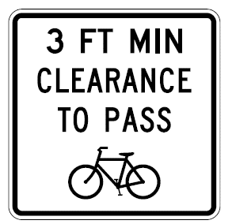
Section 9B.15 Bicycle Passing Clearance Sign
(R4-19)
Adds Section for the new R4-19 sign
Adds Standard that requires the R4-19 sign to only be used in jurisdictions that have a specific passing clearance defined in law or ordinance
Adds Option to adjust the specific
clearance displayed on the sign to
reflect the law or ordinance
R4-19
Notes:
A new Section 9B.15 is added to describe the use of the new Bicycle Passing Clearance sign. This sign shall only be used in jurisdictions that have passed a law or ordinance specifying a specific passing clearance to be provided by motor vehicles when they pass a bicycle. The specific clearance displayed on the sign may be adjusted to reflect the distance specified in the applicable law or ordinance.

Slide 20

Section 9B.16 Bicycles Use Shoulder Only Sign
(R9-21)
Adds Section for new R9-21 sign
Recommends limiting R9-21 sign use on freeways and expressways where bicycles are allowed, but the sign must remain on an available and useable shoulder
R9-21
Notes:
A new Section 9B.16 is added to describe the use of the new Bicycles Use Shoulder Only sign that is an option to designate locations
on a freeway or expressway where bicycles are allowed but must remain on an available and usable shoulder.
The Guidance provided in this section recommends that the Bicycles Use Shoulder Only sign only be placed adjacent to the on-ramp or entrance to the freeway, at or near the location where the full-width shoulder resumes beyond the entrance ramp taper. This sign is added because there are places where bicycles are permitted on a freeway but are required to travel on an available and usable shoulder.

Slide 21
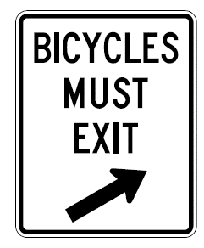
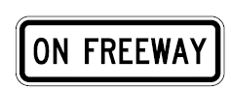
Section 9B.17 Signing for Bicycles on Freeways and Expressways (1 of 2)
Adds Bicycles Must Exit (R9-22) sign—shall be used on freeways or expressways where bicycles become prohibited and shall be placed before last exit for bicycles
Adds Standard that if a Bicycles Must Exit (R9-22)
sign is used, a No Bicycles (R5-6) sign past exit is
also required
Adds ON FREEWAY plaque R5-10dP that is an
option to use on freeways to prohibit bicycles on
ramps leading to an adjacent or parallel freeway
R9-22
R5-10dP
Notes:
New Section 9B.17 is added to provide Standard, Option, and Support paragraphs for bicycle signing on freeways and expressways.
A new Bicycles Must Exit sign is added that is required in advance of a location where a freeway or expressway becomes prohibited to bicycle travel.
Also, a new ON FREEWAY plaque is added that is an option to use on freeways with an appropriate Selective Exclusion sign to prohibit bicycles on ramps leading to an adjacent or parallel freeway.

Slide 22
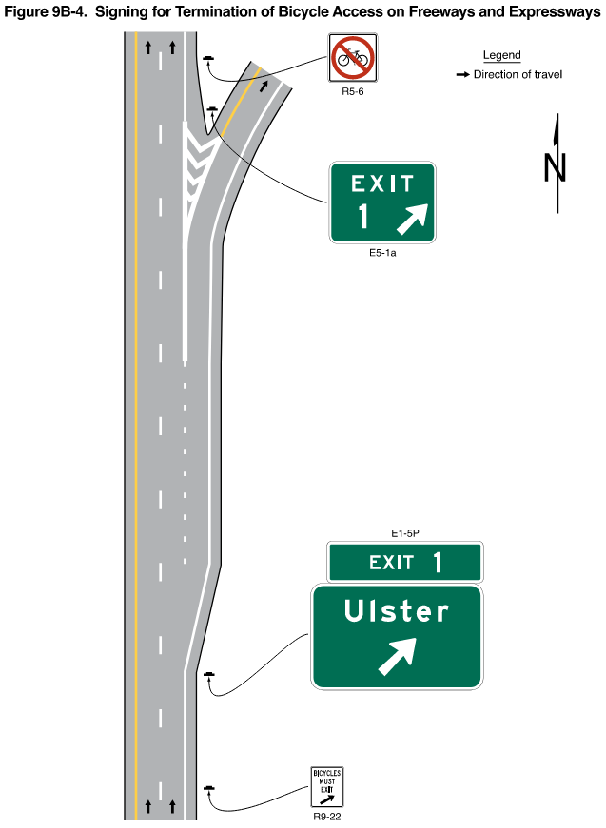
Section 9B.17 Signing for Bicycles on Freeways and Expressways (2 of 2)
Figure 9B-4. Signing for Termination of Bicycle Access on Freeways and Expressways
Adds Standard requiring the No Bicycles (R5-6) sign to be placed downstream from the intersection or the exit ramp departure point where the prohibited segment begins
Adds Figure 9B-4
Notes:
A new Standard is added requiring the No Bicycling Sign be placed downstream from the intersection or exit ramp departure point where the prohibited segment of freeway or expressway begins. This new section provides uniformity in signing for bicycles on freeways and expressways.
A new Figure 9B-4 illustrates the new provisions.

Slide 23
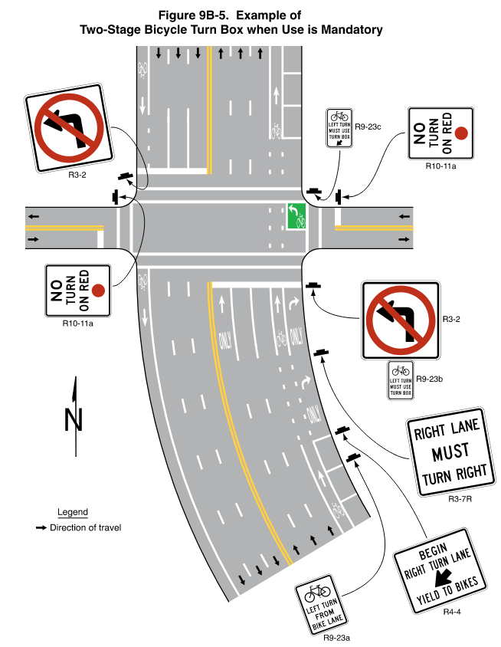
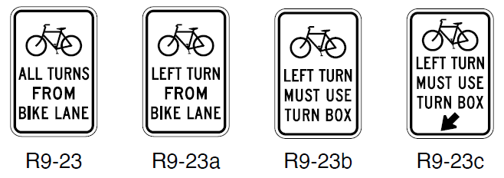
Section 9B.18 Two-Stage Bicycle Turn Box Regulatory Signing (R9-23 series)
Shall use when two-stage turn box is mandatory for bicycles
Shall use at least one advance sign (R9-23 or R9-23a) and at least one sign at intersection (R9-23b or R9-23c)
Figure 9B-5. Example of Two-Stage Bicycle Turn Box when Use is Mandatory
R9-23
R9-23a
R9-23b
R9-23c
Notes:
A new Section 9B.18 is added for Two-Stage Bicycle Turn Box signing. Use of two-stage bicycle turn boxes for turns may be either mandatory or optional for bicyclists. This slide shows the signing that is required when two-stage turn boxes are mandatory for turning bicyclists. We will cover the guide signs that can be used when two-stage turn boxes are optional for bicyclist later in the presentation.
A new section is added with provisions for Two-Stage Bicycle Turn Box Regulatory Signing.
Standard, Option, and Support statements are added for the new R9-23 series signs as well as a new Figure that illustrates required signing for two-stage turn boxes that are used to simplify the turning task for bicyclists at certain intersections.

Slide 24
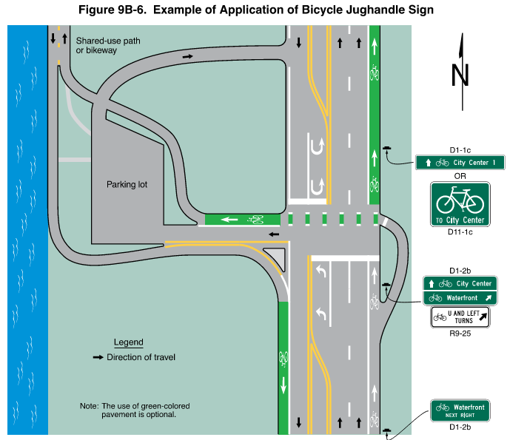
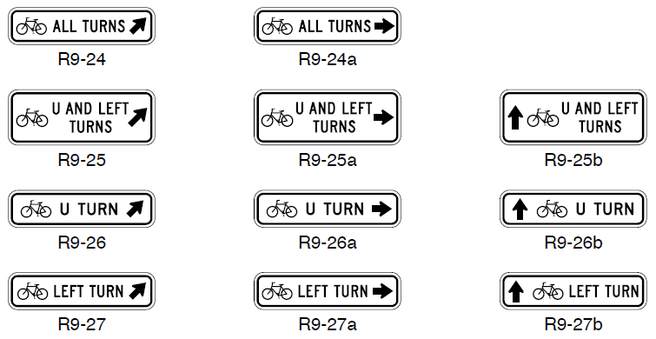
Section 9B.19 Bicycle Jughandle Signs (R9-24,
R9-25, R9-26, and R9-27 Series)
Adds signs, adds Figure 9B-6
Adds Option to use R9-23 All Turns From
Bike Lane sign in advance of jughandle
Figure 9B-6. Example of Application of Bicycle Jughandle Sign
R9-24
R9-24a
R9-25b
R9-25
R9-25a
R9-26
R9-26a
R9-26b
R9-27
R9-27a
R9-27b
Notes:
A new Section 9B.19 is added to define a bicycle jughandle turn and provide Guidance, Option, and Support, as well as a new Figure, that illustrates signing for such locations.
An Option is added to allow the use of a Bicycle All Turns from Bike Lane sign in advance of where bicycles are required to use the bicycle jughandle to turn in order to facilitate all turns.

Slide 25
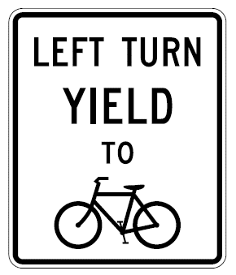
Section 9B.21 Left Turn Yield to Bicycles Sign
(R10-12b)
Adds sign for optional use
Emphasizes the requirement for motorists to yield
in situations where bicycle movement may be
unexpected in direction or location
Road users approaching a signalized intersection with
an opposing counter-flow bicycle lane may not expect to yield
Also refers to Section 2B.59, Traffic Signal Signs and Plaques (R10-5 through R10-30)
R10-12b
Notes:
Section 9B.21 is a new section that is added to provide information regarding the new Left Turn Yield to Bicycles sign and refers the user to Section 2B.59. This sign is added because road users approaching a signalized intersection with opposing counter-flow bicycle lanes may not expect to yield to oncoming bicycles.

Slide 26
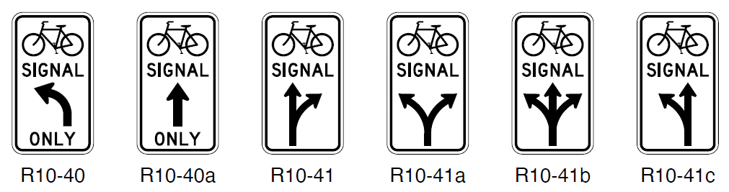

Section 9B.22 Bicycle Signal Signs (R10-40,
R10-40a, R10-41, R10-41a, R10-41b, and R10-41c)
Incorporates new signs, as required by a new Standard in Section 4H.03, for use adjacent to every bicycle signal face:
  Informs road users that bicycle signal is intended only for bicyclists
  Informs bicyclists of specific movements controlled by bicycle signal
R10-40
R10-40a
R10-41
R10-41a
R10-41b
R10-41c
Notes:
This new Section 9B.22 on Bicycle Signal Signs is added in concert with the addition of bicycle signal faces to the MUTCD.
A new Standard in Section 4H.03 requires that a Bicycle Signal sign be installed immediately adjacent to every bicycle signal face to inform road users that the specialized signal control face is intended only for bicyclists, and to inform bicyclists which specific movements are controlled by the bicycle signal face.
The Bicycle Signal sign that was allowed in Interim Approval 16 under the 2009 MUTCD is no longer permitted for use.

Slide 27
Chapter 9C
Warning Signs and Object Markers

Slide 28
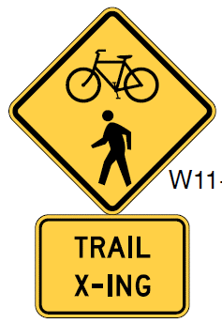

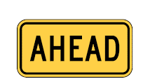
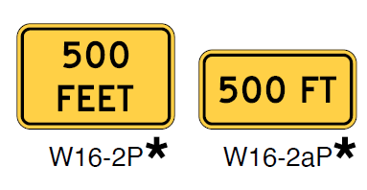
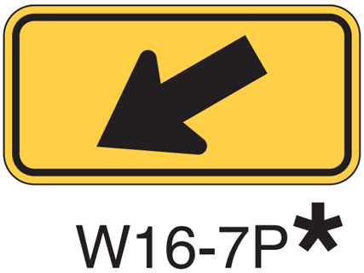
Section 9C.04 Bicycle Warning and Trail Crossing Signs (W11-1 and W11-15)
Changes Option to Guidance recommending use of an AHEAD (W16-9P) or XX FEET (W16-2P, W16-2aP) plaque to supplement a W11-1, W11-15, or W11-15P sign in advance of a crossing point
Requires a W16-7P plaque when Bicycle Warning or Trail Crossing sign is used at location of the crossing
W11-15*
W16-7P*
W16-9P*
W16-2P*
W16-2aP*
W11-1*
W11-15P*
A fluorescent yellow-green background color may be used for this sign or plaque.
The background color of the plaque should match the color of the warning sign that it supplements.
Notes:
In Section 9C.04, the title and text referencing the W11-5 sign are revised to reflect the change of the sign name from combined Bicycle/Pedestrian sign to Trail Crossing sign.
An Option is changed to Guidance regarding the use of supplemental plaques with the legend AHEAD or XX FEET to indicate that when used in advance of a trail crossing, a W11-15 or W11-15a sign should be supplemented with an AHEAD or XX FEET plaque. This is intended to inform road users that they are approaching a point where crossing activity might occur. This change is also consistent with Guidance in Chapter 2C.
When Bicycle Warning or Trail Crossing signs are used at the location of a crossing point, a diagonal downward pointing arrow plaque W16-7P is required.

Slide 29
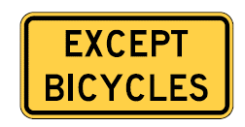
Section 9C.05 EXCEPT BICYCLES Warning Plaque (W16-20P)
Adds Option allowing use of W16-20P plaque to notify bicyclists that the conditions or hazards depicted by a warning sign are not applicable to bicyclists
W16-20P
Notes:
A new Section 9C.05 is added to provide information regarding a new EXCEPT BICYCLES warning plaque that can be used to notify bicyclists that a warning sign is not applicable to them.
Examples of signs this plaque could supplement include DEAD END (W14-1) and NO OUTLET (W14-2), when the road or street ends for motor vehicles, but bicycles are permitted to continue using a bicycle facility.

Slide 30
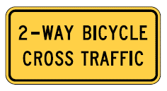
Section 9C.06 Two-Way Bicycle Cross Traffic Warning Plaque (W16-21P)
Adds Option for new plaque to alert road users to unexpected bicycle movements at crossroads and driveways
Adds Guidance statement recommending use of this plaque in combination with STOP or YIELD signs when a counter-flow or two-way bicycle facility has an approach that is counter to the customary scanning behavior of motorists
If used, a Standard requires the W16-12P plaque
to be installed only below a STOP or YIELD sign
W16-21P
Notes:
A new section 9C.06 is added to provide information regarding a new Two-Way Bicycle Cross Traffic plaque that may be used at crossroads and driveways to alert motor vehicles of unexpected bicycle traffic. This plaque is not to be used in conjunction with any other sign types. It is recommended specifically for use when a counter-flow or two-way bicycle facility has an approach that is counter to the customary scanning behavior of motorists. If used, it shall only be installed below a STOP or a YIELD sign.

Slide 31
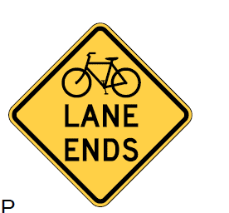
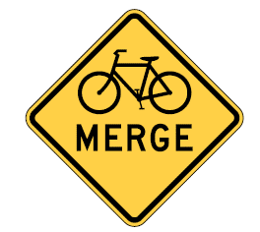
Section 9C.07 Bicycle Lane Ends Warning Sign
(W9-5) and Bicycles Merging Sign (W9-5a)
Adds signs:
  Bicycle Lane Ends (W9-5)
  Bicycles Merging (W9-5a)
W9-5
W9-5a
Notes:
A new section 9C.07 is added to provide Support, Option, and Guidance provisions for two new signs, the Bicycle Lane Ends warning sign and the Bicycles Merging sign. These can be used to alert road users when a bicycle lane is ending, or a bicycle merge is occurring.
The following two provisions provide additional important information when a bicycle lane ends, or a bicycle merge occurs:
Guidance:
“To avoid excessive use of signs, the Bicycle Lane Ends warning sign should not be used where a bicycle lane is dropped on the approach to an intersection and resumes immediately after the intersection.”
Option:
“A Bicycles Allowed Use of Full Lane (R9-20) sign (see Section 9B.14) and/or shared-lane markings (see Section 9E.09) may be installed downstream of the merge area.”

Slide 32





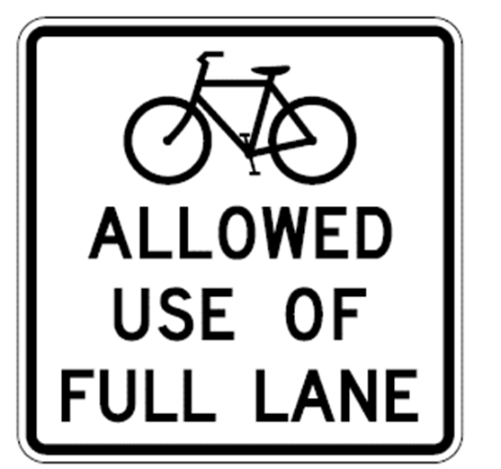

Section 9C.08 Other Bicycle Warning Signs
Adds Option to use a plaque displaying the legend IN ROAD (W16-1P) or IN STREET (W16-1aP) with the Bicycle Warning (W11-1) sign to warn road users to watch for bicyclists traveling along the highway
Removes the SHARE THE ROAD plaque from the MUTCD
Consider R9-20 Bicycles Allowed Use of Full Lane sign and shared-lane markings
W16-1P
W16-1aP
W11-1
W16-1P
R9-20
A fluorescent yellow-green background color may be used for this sign or plaque. The background
color of the plaque should match the color of the warning sign that it supplements.
Notes:
An Option is added to use a plaque displaying the legend IN ROAD or IN STREET with the Bicycle Warning Sign to communicate to bicycles and motor vehicles that bicycles are in the road.
The SHARE THE ROAD plaque is removed from the MUTCD based on research indicating that road users do not understand the intended message.
The R9-20 BICYCLES ALLOWED USE OF FULL LANE sign that was addressed in earlier slides may be used in locations where it is important to inform road users that bicyclists might occupy the travel lane. The shared-lane marking, which will be discussed in an upcoming slide, is also an option to convey this message with pavement markings.

Slide 33
Chapter 9D
Guide and Service Signs

Slide 34


Section 9D.01 Bicycle Destination Signs (1 of 2)
Changes Guidance to Standard prohibiting the substitution of Bicycle Destination signs for vehicular destination signs when message is also intended for motorists
Allows Destination signs and Street Name signs to be installed instead of, or in addition to, Bicycle Destination signs
Allows Distance signs to be installed instead of, or in addition to, Bicycle Distance signs
Adds Guidance and Option for displaying distances less than
½ mile to destinations
D1-1b
D1-1c
Notes:
In Section 9D.01, Guidance is changed to a Standard to prohibit the use of smaller size Bicycle Destination signs when the message is also intended to be applicable to motorists.
Two new Option statements are added to permit Destination signs, Street Name signs, or Distance signs to be installed instead of, or in addition to, comparable Bicycle signs if the sign applies to motorists and bicyclists.
A new Guidance statement and an Option statement are added to provide more clarification about displaying distance information when distances are less than ½ mile to destinations.

Slide 35
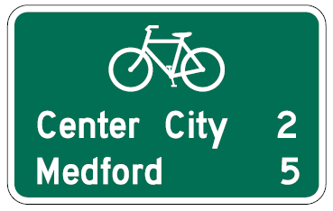
Section 9D.01 Bicycle Destination Signs (2 of 2)
Adds Option allowing the use of an oversized bicycle symbol as the top line of a Bicycle Destination sign
Adds Guidance discouraging displaying travel times on Bicycle Destination signs
D2-2a
Notes:
In addition, an Option is added to Section 9D.01 to permit the use of an oversized bicycle symbol as the top line of a Bicycle Destination sign instead of individual bicycle symbols for each of the destination/distance lines. This option facilitates legibility on these signs and is based on an FHWA Official Interpretation under the 2009 MUTCD.
Finally, New Guidance and Support statements discourage displaying travel times on Bicycle Destination signs. This recommendation is added because travel times can vary greatly based on an individual bicyclist’s speed and experience.

Slide 36
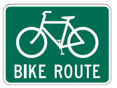
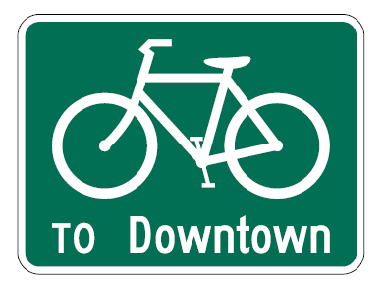


Section 9D.02 Bike Route Guide Signs (D11-1 and D11-1c)
Explains that D11-1 and D11-1c signs are used where no unique designation of bike routes is desired
Adds Option allowing BEGIN and END plaques with Bike Route Guide signs
Adds Guidance discouraging displaying travel times on Bike Route Guide signs or Alternative Bike Route Guide signs
M4-14P
M4-6P
D11-1
D11-1c
Notes:
In Section 9D.02, a new Option statement clarifies that the BEGIN plaque and END plaque may be used with BIKE ROUTE guide signs.
A new Guidance statement discourages displaying travel times on BIKE ROUTE guide signs or Alternative BIKE ROUTE guide signs.

Slide 37

Section 9D.03 BIKE ROUTE Plaque (D11-1bP) (1 of 2)
Adds Option allowing plaque to supplement:
  Alternative Bike Route Guide (D11-1c) sign
  Bicycle Directional (D11-11) sign
  Street Name (D3-1) sign
Adds Standards and Options regarding use of the plaque
Prohibits the bicycle symbol from being used on a Street Name sign
D11-1bP
Notes:
In Section 9D.03, new Options allow for the installation of the BIKE ROUTE plaque to supplement the Alternative Bike Route Guide sign, the Bicycle Directional sign, or a Street Name sign.
Three new Standards are also added regarding the use of the new sign.

Slide 38
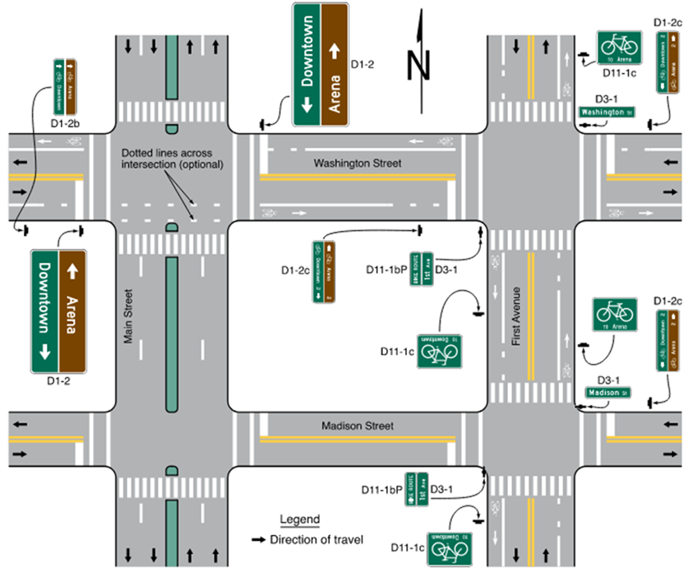
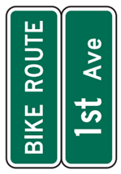


Section 9D.03 BIKE ROUTE Plaque (D11-1bP) (2 of 2)
Figure 9D-3 example:
Figure 9D-3. Example of Bicycle Route Guide Signing
Note: The D1-2 signs are larger than the other guide signs on this figure
because the legends on the D1-2 signs need to be legible to motorists.
Notes:
Figure 9D-3 illustrates the use of a D11-1bP BIKE ROUTE plaque with a Street Name Sign.

Slide 39
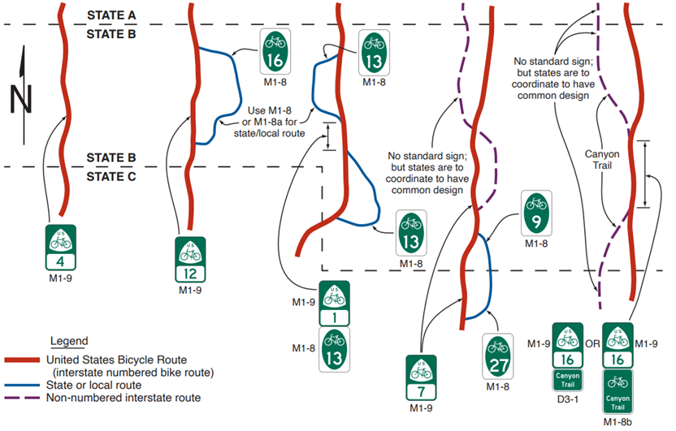
Section 9D.04 Numbered Bikeway Systems
Describes proper signing for numbered bicycle routes
Adds Figure 9D-4
Figure 9D-4. Examples of Route Signing for Numbered or Named Bicycle Routes
A – United States
Bicycle Route
(USBR) only
(interstate numbered
bike route)
B – State or local
numbered bicycle
route with no
route concurrency
with USBR
C – State or local
numbered bicycle
route with route
concurrency
with USBR
D – Non-numbered
interstate bicycle
route with no
route concurrency
with USBR
E – Non-numbered
interstate bicycle
route with route
concurrency
with USBR
Notes:
A new Section 9D.04 is added to provide Support, Guidance, Standard, and Option statements, as well as a new Figure, describing the proper signing for numbered bicycle routes. This new section provides uniformity in the numbering and signing of bicycle route systems. New Figure 9D-4 illustrates how to address multiple numbered bike routes with and without concurrency.

Slide 40
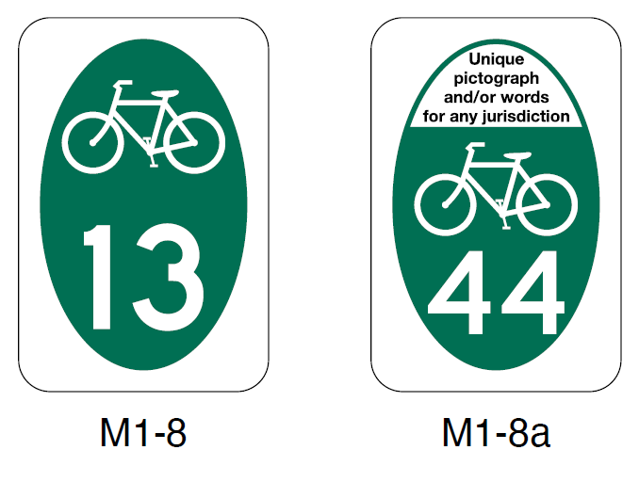
Section 9D.05 Numbered Bicycle Route Signs
(M1-8 and M1-8a)
Adds Standard requiring a bicycle symbol when the Numbered Bicycle Route (M1-8, M1-8a) sign is used on a roadway
Adds Guidance clarifying the dimensions and placement for use of a pictograph and bicycle symbol on M1-8a sign
M1-8
M1-8a
Notes:
In Section 9D.05, a new Standard is added to require a bicycle symbol when the Numbered Bicycle Route sign is used on a roadway so that the bicycle route can be distinguished from other numbered route systems.
New Guidance is added to clarify the dimensions and placement of a pictograph, if used, on these signs.
Lastly, a new Guidance statement is added for the M1-8a sign to recommend a minimum height for the bicycle symbol of one quarter of the sign panel height.

Slide 41
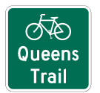

Section 9D.06 Non-Numbered Bicycle Route Sign
(M1-8b and M1-8c)
Adds new signs for establishing a bicycle route that is named instead of numbered
Provides Support, Option, Standard, and Guidance statements on the use and design of the Non-Numbered Bicycle Route
(M1-8b, M1-8c) sign
M1-8b
M1-8c
Notes:
A new Section 9D.06 is added to provide Support, Option, Standard, and Guidance statements on the use and design of the Non-Numbered Bicycle Route sign.
This new section provides information for signing bicycle routes that are designated specifically by name or established using a distinctive route identity but are not part of a numbered route system.

Slide 42

Section 9D.07 U.S. Bicycle Route Sign (M1-9)
Changes the U.S. Bicycle Route (M1-9) sign layout
M1-9
Notes:
In Section 9D.07, the U.S. Bicycle Route sign layout is changed in accordance with FHWA Interim Approval IA–15, which was issued under the 2009 MUTCD.
The previous sign layout used a black legend and border on a white background.

Slide 43
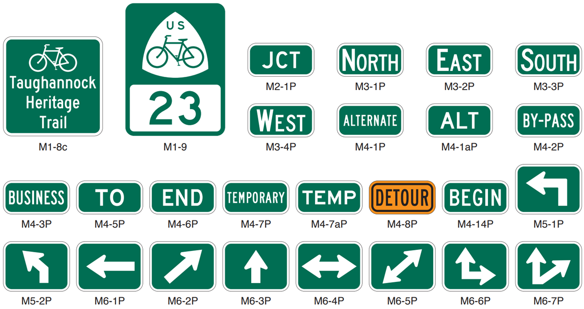
Section 9D.08 Bicycle Route Sign and Auxiliary Plaques
M2-1P
M3-1P
M3-2P
M3-3P
M1-8c
M1-9
M3-4P
M4-1P
M4-1aP
M4-2P
M4-3P
M4-5P
M4-6P
M4-7P
M4-7aP
M4-8P
M4-14P
M5-1P
M5-2P
M6-1P
M6-2P
M6-3P
M6-4P
M6-5P
M6-6P
M6-7P
Notes:
Section 9D.08 contains Standards, Guidance, Options, and Support for the use of bicycle route sign and auxiliary plaques.
------
Some of the specific provisions include the following:
New Guidance is added that the route sign and auxiliary plaques for bikeways may be installed on independent assemblies if a designated or numbered bicycle route is concurrent with a numbered highway. This change is intended to minimize road user confusion in route signing.
A new Standard prohibits installing route signs for bikeways on guide signs or overhead because these signs are typically intended for motorists and bicyclists may not expect or be able to view the legends.
An Option is added permitting route assemblies for a designated or numbered bicycle route to be installed at locations and distances other than those prescribed in Chapter 2B based on an FHWA Official Interpretation under the 2009 MUTCD.
Also, clarification is added that except for the M4-8P plaque, all route sign auxiliary plaques should match the color combination of
the route sign that they supplement.
A new Guidance statement recommends minimum route sign sizes to improve visibility.
Also, new Guidance clarifies that Bicycle Route Sign assemblies should be installed on all approaches where bicycle routes meet other bicycle routes. This Guidance is intended to improve bicycle network wayfinding.

Slide 44


Section 9D.09 Bicycle Parking Area, Sharing Station, and Lockers Guide Signs (D4-3, D4-4, D4-4a)
Adds Bicycle-Sharing Station (D4-4) guide sign
Adds Bicycle Lockers (D4-4a) guide sign
Allows reversal of arrow
Prohibits inclusion of promotional advertising, business logos, or other information conveying public-private partnership involvement not allowed in accordance with Section 1D.07
D4-4
D4-4a
Notes:
An Option is added in Section 9D.09 permitting a new Bicycle-Sharing Station sign to be installed to provide directional information to a designated bicycle sharing system. This sign may be modified with two lines to accommodate installation in constrained areas.
There is also a new Bicycle Lockers guide sign that may be installed where it is desirable to show the direction to designated bicycle lockers. The arrow may be reversed as appropriate.

Slide 45
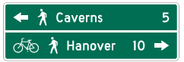
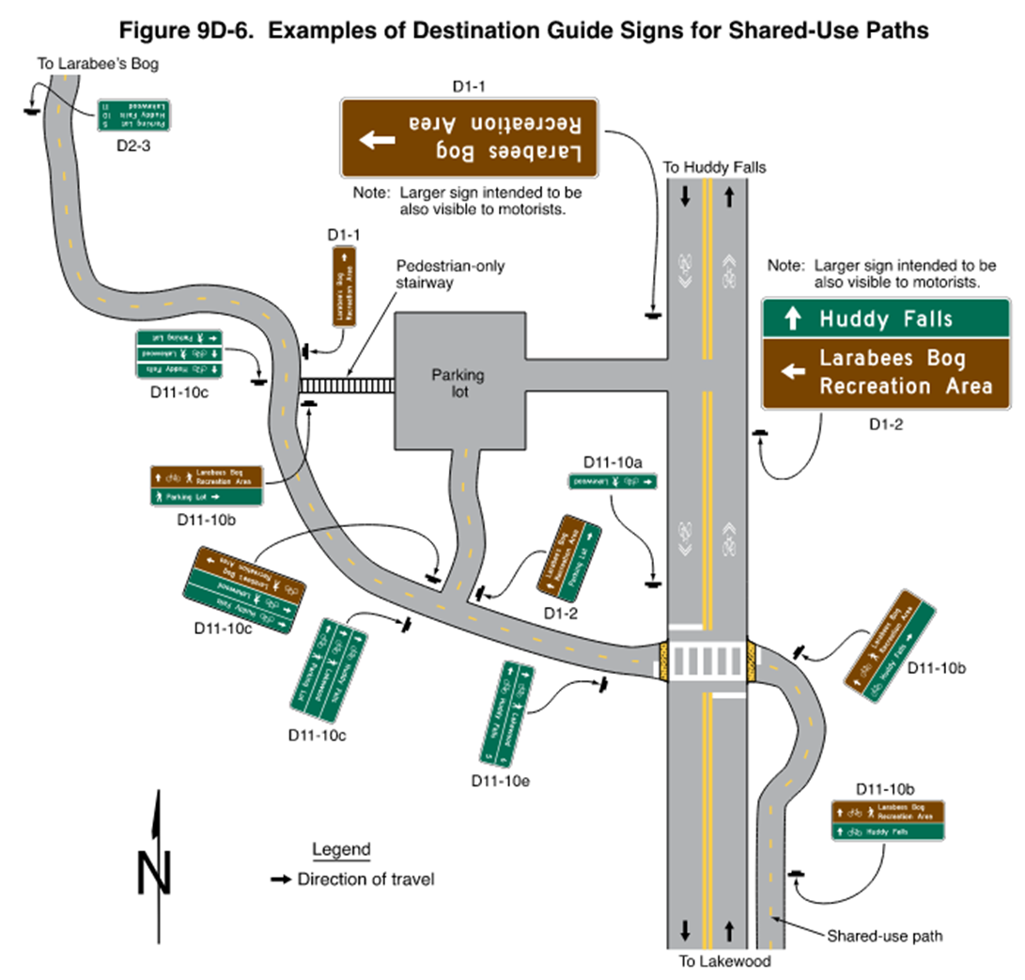
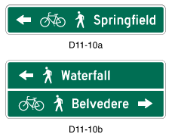
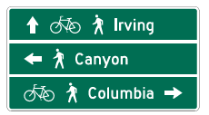
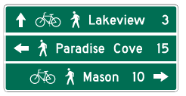

Section 9D.12 Destination Guide Signs for
Shared-Use Paths (D11-10a, D11-10b, D11-10c, D11-10d, D11-10e, and D11-10f)
Adds Section with Support, Standard, Guidance, and Option regarding the application of Destination Guide signs for
shared-use paths
Figure 9D-6. Examples of Destination Guide Signs for Shared-Use Paths
D11-10a
D11-10e
D11-10c
D11-10b
D11-10d
D11-10f
Notes:
A new section is added to provide Support, Standard, Guidance, and Option statements regarding the application of Destination Guide signs for shared-use paths.

Slide 46

Section 9D.13 Two-Stage Bicycle Turn Box Guide Signs (D11-20 series)
Figure 9D-7. Example of Two-Stage Bicycle Turn Box when Use is Optional
Guide signs are for use when
two-stage turn box is optional and not required for turning bicyclists
Figure 9D-7 shows an example
The use of the R10-11 Series signs
required (see Section 9E.11)
Notes:
Use of two-stage bicycle turn boxes for turns may be either mandatory or optional for bicyclists. This slide shows the signing that is required when two-stage turn boxes are optional for turning bicyclists. We covered the regulatory signs that are required when two-stage turn boxes are mandatory for bicyclist use earlier in this presentation.
A new section is added with Standard, Option, and Support statements related to the use of guide signs for two-stage bicycle turn boxes. New Figure 9D–7 illustrates the guide signing for two-stage turn boxes that are used to simplify the turning task for bicyclists at certain intersections.

Slide 47
Chapter 9E
Markings

Slide 48

Section 9E.01 Bicycle Lanes (1 of 2)
Requires longitudinal pavement markings AND bicycle lane symbol or word markings to define bicycle lanes
Clarifies that the first symbol or word marking should be placed at beginning of the bicycle lane
Allows optional use of arrow markings
Figure 9E-1. Word, Symbol, and Arrow Pavement Markings for Bicycle Lanes
A – Bike Symbol
B – Word legends
Notes:
In Section 9E.01, the Standard is revised to require the use of bicycle lane symbol or word markings, in addition to longitudinal pavement markings, to define bicycle lanes. Both are required. These changes are designed to inform road users of the bicycle lane and to reduce wrong-way bicycling.
Guidance is revised to clarify that the first symbol or word denoting a bicycle lane should be placed at the beginning of the bicycle lane. This change makes the bicycle markings consistent with preferential lane word and symbol markings.
In conjunction with the bicycle lane symbol or word markings, a new Option is added that permits the use of arrow markings to indicate the direction of travel allowed.
Where the bicycle lane symbols or word markings are used, Bicycle Lane signs may also be used, but not necessarily adjacent to every set of pavement markings in order to avoid overuse of the signs.

Slide 49

Section 9E.01 Bicycle Lanes (2 of 2)
Allows only one bicycle symbol marking for consistency (discontinues helmeted bicycle symbol)
Prohibits a portion of the travel way from being both a shoulder and a bicycle lane
Figure 9E-1. Word, Symbol, and Arrow Pavement Markings for Bicycle Lanes
A – Bike symbol
B – Word legends
Notes:
Figure 9E-1 is revised to allow only one bicycle symbol for pavement marking. This is intended to enhance uniformity and improve recognition of bicycle symbols.
A new Standard prohibits the bicycle symbol or BIKE LANE pavement word marking and the pavement marking arrow in a shoulder.
Also, a new Standard requires that a portion of the travel way cannot be established as both a shoulder and a bicycle lane because each serves a different use and has differing regulations that apply. The uniform marking of each type minimizes any confusion and accommodates the expectancy of the road user.

Slide 50

Section 9E.09 Shared-Lane Marking (1 of 3)
Assists bicyclists with lateral positioning and alerts road users to bicycle presence and likely lateral location
May be used with, or instead of, the R9-20 Bicycles Allowed Use of Full Lane sign
R9-20
Notes:
We are going to skip ahead and cover Shared-Lane Markings now – both to contrast them with bicycle lane markings and to set the stage for discussing markings at intersection approaches.
In Section 9E.09, Shared-lane markings indicate a shared space between bicyclists and motorists. They assist bicyclists with lateral positioning and alert road users that bicycles are likely to occupy the traveled way, and the location on the roadway bicyclists are likely to be located, for example, out of the “door zone.”
Shared-lane markings should not be used on roadways that have a speed limit of 40 miles per hour or greater. This is not an actual change in application with the 11th Edition, but it is an editorial change using “40 MPH or greater” instead of “above 35 MPH”.
They may be used with, or instead of, the BICYCLES ALLOWED USE OF FULL LANE R9-20 sign.

Slide 51



Section 9E.09 Shared-Lane Marking (2 of 3)
Prohibits use in:
  Shoulders
  Bicycle lanes or bicycle lane extensions
  Travel lanes with light-rail transit
  Transition areas where motor vehicles must
  weave across bicycle lanes
  Two-stage turn boxes
  Bicycle boxes
  Shared-use paths or shared-use path crossings
  Physically-separated bikeways (in roadway or on an independent right-of-way)
Notes:
A Standard in Section 9E.09 is revised to expand the listing of locations where shared-lane markings are prohibited. The revisions are based on field experience with this marking since it was adopted in the 2009 Edition of the MUTCD.
Shared-lane markings shall not be used in:
A. Shoulders;
B. Bicycle lanes or in designated extensions of bicycle lanes through intersections or driveways
C. A travel lane in which light-rail transit vehicles also travel;
D. The transition area where a motor vehicle entering a mandatory turn lane must weave across bicyclists in bicycle lanes;
E. Two-stage turn boxes;
F. Bicycle boxes;
G. Shared-use paths or shared-use path crossings; or
H. Physically-separated bikeways, either in the roadway or on an independent right-of-way.

Slide 52


Section 9E.09 Shared-Lane Marking (3 of 3)
Prohibits use with green-colored pavement as a background
Allows use of black background markings for contrast
Notes:
A new Standard is added that green-colored pavement shall not be applied as a background to shared-lane markings.
As an option, black background markings may be used in combination with shared-lane markings to enhance contrast.

Slide 53

Section 9E.02 Bicycle Lanes at Intersection Approaches (1 of 2)
Figure 9E-3. Examples of Bicycle Lane Markings on an Approach to an Intersection
(Sheet 3 of 3)
Prohibits a through bicycle lane from being positioned to the right of a right turn only lane or left of a left turn only lane unless controlled by a bicycle signal indication that eliminates turning vehicle conflicts
Prohibits marking with dotted or other line markings within a general-purpose turn lane
Notes:
In Section 9E.02, a new Option allows a bicycle lane to be located on the outside of a turn lane if a bicycle signal face is used and the signal phasing and signing eliminates potential conflicts with turning vehicles.
A new Standard requires bicycle lanes located at an intersection approach between contiguous lanes for motor vehicle movements be marked with a bicycle symbol and arrow pavement markings.
A new Standard prohibits bicycle lanes from being marked within a general-purpose turn lane, either with dotted or any other line markings. These additions are intended to alert motor vehicles of the presence of bicyclists and prevent potential conflicts.

Slide 54

Section 9E.02 Bicycle Lanes at Intersection Approaches (2 of 2)
Figure 9E-5. Examples of Pavement Markings for Mixing Zones
C – Reestablishment of bike lane after crossing paths with
right-turning motor vehicles
A – Mixing zone without
yielding area
B – Mixing zone with
yielding area
Allows use of shared-lane markings to accommodate bicycle travel within a turn lane
Adds new provisions for mixing zones
Notes:
Where there is insufficient width in the roadway to include both a bicycle lane and a general-purpose turn lane, bicycle travel may be accommodated within the turn lane or general-purpose lane using shared-lane markings.
A new Standard requires that through bicycle movements shall not be accommodated in a general-purpose turn lane controlled by a traffic signal unless the turning movement is always permitted to proceed simultaneously with the adjacent through movement.
Option and Support statements are added for shifting over of buffer separated or separated bicycle lanes at intersections to improve visibility for motor vehicles and bicycles. These revisions are made to address new developments in bicycle facility design since the 2009 Edition of the MUTCD. We will look at examples of these situations in upcoming slides.
Finally, there are new provisions, along with a figure, regarding mixing zones, which occur when general purpose and bicycle lanes must share the same space through an intersection.

Slide 55

Section 9E.03 Extensions of Bicycle Lanes through Intersections (1 of 2)
Figure 9E-2. Example of Pavement Markings for Bicycle Lanes on a Two-Way Street
Bicycle lane extensions are:
  Recommended for buffer-separated and separated bike lanes
  Optional for other types of bicycle lanes
Shared-lane markings and chevron markings shall not be used through intersections
Notes:
A new Section 9E.03 provides Support, Standard, Guidance, and Option statements on the application of bicycle lane extensions.
Bike lane extensions through intersections are recommended (Guidance) for buffer-separated and separated bicycle lanes and are Optional for other types of bicycle lanes.
This section clarifies that shared-lane markings and chevron markings shall not be used through intersections. This is not a new Standard, rather a clarification of a previously existing Standard.

Slide 56

Section 9E.03 Extensions of Bicycle Lanes through Intersections (2 of 2)
New Standard requires dotted lane
line patterns for bicycle lane extensions
through intersections
Section 3H.06 allows the optional
use of green color within the dotted
lane line pattern
Lateral limits of bicycle lane extensions
through intersections shall be marked when
the bicycle lane is contiguous to a crosswalk
Notes:
A new Standard requires extensions of bicycle lanes through intersections to use dotted lane line patterns. Section 3H.06 allows the optional use of green colored pavement between the dotted lane line pattern.
A new Standard requires the lateral limits of bicycle lane extensions through intersections to be marked when the bicycle lane is contiguous to a crosswalk.

Slide 57

Section 9E.04 Bicycle Lanes at Driveways
Adds Options for bicycle lanes at or through driveways to allow:
  Solid or dotted lines
  Bicycle symbol, arrow marking, word marking, or a combination thereof
  Green-colored pavement
C – Intersection and driveway with no on-street parking
D – Contiguous buffer on both sides of the bicycle lane
Notes:
A new Section 9E.04 provides Options for bicycle lanes at or through driveways. It includes options for solid or dotted lines, bicycle symbols, arrow markings, word markings, or a combination thereof, and green colored pavement. This new section provides practitioners with options for marking bicycle lanes in the vicinity of driveways and is intended to promote the uniform application of these treatments.

Slide 58


Section 9E.06 Buffer-Separated Bicycle Lanes
Provides lateral separation between a bicycle lane and a
general-purpose lane using pavement markings
Helps reduce crashes with vehicle doors opening adjacent to
on-street parking
Does not include vertical elements (separated bike lanes use vertical elements)
A – Buffer-separated bicycle lanes on a two-way street with no parking
B – Buffer-separated bicycle lanes on a two-way street with on-street parking
Notes:
A new Section 9E.06 adds provisions on the application of buffer separated bicycle lanes, along with a new figure.
Buffer-separated bicycle lanes provide additional lateral separation between a bicycle lane and a general-purpose lane by a pattern of pavement markings without the presence of vertical elements.
Providing a buffer space between a bicycle lane and a general-purpose lane creates more separation between motor vehicles and bicycles, can reduce vehicle encroachment into the bicycle lane, and can increase the comfort of bicyclists.
Providing a buffer space between a bicycle lane and a parking lane can reduce crashes involving bicycles and the opening of vehicle doors from the parking lane.
New Standards in the 11th Edition provide requirements on the buffer-separated bicycle lines, including line types, markings in the buffer, width, location, and color.
New Guidance recommends the use of chevron or diagonal markings in a buffer space that is two to three feet wide.

Slide 59

Section 9E.07 Separated Bicycle Lanes (1 of 3)
Provides a physical separation between a general-purpose lane and a bicycle lane using vertical objects or vertical separation between the general-purpose lane and bicycle lane
A – One-way bicycle lanes on a two-way street
B – One-way bicycle lanes on a one-way street behind on-street parking
C – Two-way bicycle lane on a one-way street
Note: Diagonal or chevron markings shall be
used if buffer width is 2 feet or greater
for separated bicycle lanes
Note: Parking provides the
vertical element of this
separated bicycle lanes
Note: Diagonal or chevron marking shall
be used if buffer width is 2 feet or
greater for separated bicycle lanes
Notes:
A new Section 9E.07 provides Support, Standard, Option, and Guidance statements, along with a new figure 9E-7, for the application of separated bicycle lanes.
Separated bicycle lanes provide a physical separation between a general-purpose lane and a bicycle lane through the use of vertical objects or vertical separation between the general-purpose lane and bicycle lane. Providing a physical separation between a bicycle lane and a general-purpose lane can reduce vehicle encroachment into the bicycle lane beyond a marked buffer alone and can in some cases prevent that encroachment altogether.

Slide 60


Section 9E.07 Separated Bicycle Lanes (2 of 3)
Allows lanes to be shifted toward or away from traffic at intersections
E – Separated bicycle lane shifted away from traffic
D – Separated bicycle lane shifted toward the adjacent general-purpose lane
Notes:
Physical separation between general-purpose lanes and bicycle lanes introduces additional design considerations over buffer-separated bicycle lanes, including the awareness of a potentially unexpected conflict point for turning motor vehicles and the provision of adequate sight distance for all users at intersections and driveway crossings.

Slide 61


Section 9E.07 Separated Bicycle Lanes (3 of 3)
Adequate sight distance and other design considerations
F – Separated bicycle lane at an intersection
G – Separated two-way bicycle lane at an intersection
Notes:
Again, be aware of potentially unexpected conflict points for turning motor vehicles and the provision of adequate sight distance for all users at intersections and driveway crossings.

Slide 62

Section 9E.08 Counter-Flow Bicycle Lanes (1 of 3)
Adds new Support, Standard, and Guidance statements for location and application of counter-flow bicycle lanes
Adds new Figure 9E-8
Figure 9E-8. Example of Counter-Flow Bicycle Lanes at an Intersection
Notes:
A new section 9E.08 provides Support, Standard, and Guidance statements, along with a new figure, for the application of counter-flow bicycle lanes, which is when one-directional bicycle lanes travel the opposite direction of the general traffic that is also traveling in one direction.

Slide 63
Section 9E.08 Counter-Flow Bicycle Lanes (2 of 3)
Requires double yellow center line markings, a painted median island, a raised median island, or some form of physical separation to define the counter-flow bicycle lane where the speed limit is 30 mph or less
Requires a buffer, a painted median, a raised median island, or another form of physical separation to ensure safe operation through adequate separation between opposing flows of bicycles and motor vehicles where the speed limit is 35 mph or greater
Notes:
The key provisions for separating the counter-flow bicycle lane and the opposing flow of motor vehicles are based on the speed limit of the street or roadway. Where the speed limit is 30 MPH or less, a double yellow center line marking is the minimum acceptable form of separation. Additional measures are required where the speed limit is 35 MPH or greater to ensure safe operation through adequate separation between opposing flows of bicycles and motor vehicles.
.

Slide 64
Section 9E.08 Counter-Flow Bicycle Lanes (3 of 3)
ONE WAY, DO NOT ENTER, and Movement Prohibition signs that do not apply to bicycles shall have EXCEPT BICYCLES plaques
Intersection traffic controls shall be provided and oriented toward bicyclists in the counter-flow lane
At signalized intersections, bicycle signalization and a method for counter-flow bicycle actuation shall be provided
A Two-Way Bicycle Cross Traffic (W16-21P) warning plaque should be used below crossroad STOP signs at intersections where a counter-flow bicycle lane is provided on the primary street
Notes:
Additional provisions for counter-flow bicycle lanes are added to address signing and signalization. All of these new provisions are intended to provide practitioners important information for uniformity in application.

Slide 65
Section 9E.10 Shared-Lane Markings for Circular Intersections
Allows shared-lane markings in the circulatory roadway of
multi-lane circular intersections
Recommends that shared-lane markings be located within the center of the lane when used in circular intersections
Notes:
A new Section 9E.10 provides that shared-lane markings may be used in the circulatory roadway of multi-lane circular intersections. This new section will assist practitioners with providing uniform treatments of shared-use paths in the vicinity of circular intersections based on an NCHRP study.
New Guidance recommends that, if used, the shared-lane markings should be located within the center of the lane when used in circular intersections.

Slide 66



Section 9E.11 Two-Stage Bicycle Turn Boxes (1 of 2)
Allows bicyclists to make easier left turns in urban areas
Explains that bicyclists cross the intersection to designated area, then completes their turn when cross traffic gets green signal (two stages)
Provides flexibility for mandatory bicycle turns (regulatory signs) or optional bicycle turns (guide signs)
Notes:
A new Section 9E.11 provides Support, Standard, Option, and Guidance statements and two new Figures to describe the application of two-stage bicycle turn boxes.

Slide 67

Section 9E.11 Two-Stage Bicycle Turn Boxes (2 of 2)
Adds Standards on location, markings, arrows, and passive detection
Requires full-time
turns-on-red prohibition where the path of vehicles lawfully turning right on red would pass through the bicycle turn box
Provides multiple examples in Figures 9E-10 and 9E-11
C – On the inside of the through bicycle lane
Notes:
Standards are added to provide requirements on location, pavement markings, arrows, and passive detection of bicycles at traffic signals. As two stage bicycle turn boxes are intended to be positioned within an intersection for bicyclists to queue safely, these Standards define what is required to make those spaces both safe and operationally effective for bicyclists at traffic signals.
In addition, new Guidance recommends consideration of the peak hour bicycle demand and adjacent land uses for the size of the bicycle turn box.
An Option is added to use green-colored pavement. If used, the entire turn box must be green-colored pavement.
A Standard requires a full-time turns-on-red prohibition where the path of vehicles lawfully turning right on red would pass through the bicycle turn box.

Slide 68

Section 9E.12 Bicycle Box
Adds new Section and new Figure 9E-12
Requires locations, markings, signal yellow change and red clearance intervals, and countdown pedestrian signals when the bicycle box extends across more than one approach lane of motor vehicles
Provides Option to use green-colored pavement
Figure 9E-12. Examples of Intersection Bicycle Boxes (Sheet 1 of 2)
A – Bicycle box across one lane
Notes:
A new Section 9E.12 provides Option, Standard, Guidance, and Support statements and a new Figure 9E-12, to describe the application of a bicycle box.
Bicycle boxes may be used to increase the visibility of stopped bicycles on the approach to a signalized intersection during the portion of the traffic control signal cycle when a red signal indication is being displayed to motor vehicles in the approach lanes behind the box.
In addition, Standards are added requiring locations, markings, signal yellow change and red clearance intervals, and countdown pedestrian signals when the bicycle box extends across more than one approach lane of motor vehicles. These changes are intended to mitigate the potential conflict between bicyclists and motorists by informing bicyclists whether there is adequate time remaining to move to an adjacent lane before the onset of the green signal phase for that approach.
An Option is added to use green-colored pavement. If used, the entire turn box must be green-colored pavement.
Turns on red shall be prohibited from the lane where a bicycle box is placed.

Slide 69

Section 9E.13 Shared-Use Paths
Adds Standard requiring crosswalk markings to be used where a shared-use-path crosses a roadway
Adds Figure 9E-14 showing example of pavement markings
Figure 9E-14. Example of Pavement Markings for a Shared-Use Path with Mode Separation
Notes:
In Section 9E.13, a new Option, Guidance, and Standard are added along with accompanying new Figure 9E-14, to provide additional design options for pavement markings at shared-use path crossings.

Slide 70

Section 9E.14 Bicycle Route Pavement Markings
Allows marking to supplement guide signs
Limits usage to shared-use paths, separated bicycle lanes, and
buffer-separated bicycle lanes
Prohibits markings in standard bicycle lanes or shared lanes
Recommends systematic methodology of locating signs and bicycle route pavement markings
Figure 9E-15. Example of Placement Route Markers for a Shared-Use Path
Note: Right-of-way assignment
and associated traffic
control is not shown.
Notes:
A new Section 9E.14 provides Option, Standard, and Guidance statements, as well as a new Figure 9E-15, for the application of pavement markings to simulate route auxiliary plaques and Bicycle Route Guide signs to provide navigational guidance for bicyclists and pedestrians on shared-use paths, separated bikeways on independent alignment, and on improved trails.
A Standard is added to limit the use of route markers to shared-use paths, separated bicycle lanes, and buffer-separated bicycle lanes. They are prohibited in standard bicycle lanes and shared lanes.
A new Guidance statement recommends a systematic methodology of locating signs and bicycle route pavement markings.

Slide 71

Section 9E.15 Bicycle Detector Symbol
Provides Option for WAIT HERE FOR GREEN word markings that may be placed on the pavement immediately below the bicycle detector symbol
Reiterates that green-colored pavement may be used as a background for the bicycle detector symbol to improve conspicuity (Option in Section 3H.06)
Figure 9E-16. Bicycle Detector Pavement Marking
Note: The word pavement markings are optional.
Notes:
In Section 9E.15, an Option is added that allows FOR GREEN WAIT HERE word markings to be placed on the pavement immediately below the bicycle detector symbol to help bicyclists know to stop on the bicycle detector symbol.

Slide 72
Section 9E.17 Raised Devices
If used, channelizing devices should be tubular markers
If used in separated bicycle lanes, channelizing devices should be placed in the buffer space and at least 1 ft from the longitudinal bicycle lane pavement marking
Channelizing devices shall not incorporate the color green into the device or its retroreflective element to supplement the presence of green-colored pavement
Notes:
A new section provides Support, Option, Standard, and Guidance statements for the application of raised devices in coordination with bicycle facilities.
Guidance statements recommend that the channelizing devices should be tubular markers, and that the selection of a raised device should consider the collision potential of both the post and the base.
New Guidance is added to recommend that if used in separated bicycle lanes, channelizing devices should be placed in the buffer space and at least one foot from the longitudinal bicycle lane pavement marking.
Channelizing devices shall not incorporate the color green into the device or its retroreflective element to supplement the presence of green-colored pavement.

Slide 73

FHWA’s National
Traffic Control Devices Program
for more information:
mutcd.fhwa.dot.gov
e–Subscribe Service
Official Rulings Database
Standard Highway Signs
Frequently Asked Questions
MUTCD News Feed
Notes:
This concludes this module. Additional modules on the MUTCD 11th Edition are available at the MUTCD Web Site at http://mutcd.fhwa.dot.gov/.
Almost anything related to the MUTCD that you need is at the official MUTCD Web site.
If you haven’t yet signed up for our e-Subscribe service, please take a moment to do so. We’ll send out a bulletin whenever new information is available so you can keep up-to-date. As subscribers, you’ll also hear about future Webinar and other opportunities first.

